Slide 1
Stock Valuation
Lecture 14

Slide 2
Saving for college and retirement
8% compounded annually. How much to die broke?
Deposit $10,000 each year
1st deposit on 31st b-day, last on 65th 35 deposits.
Withdraw $40,000 for college
1st withdrawal on 47th b-day, last on 50th 4 withdrawals
Retirement withdrawals
1st on 66th birthday, last on 85th 20 withdrawals
Notes:
Standing at year 30:
PV for the first 35 deposits=116,546
PV for the withdrawals at the end of 46th birthday (evaluate using Annuity formula)= 132,485
Discounting it back to 30th birthday = 132,485/(1+8%)^16 = 38,671
Difference in PV = 116,546-38,671=77,875
The retirement withdrawals:
FV of the surplus at year 65 = 77,875 * (1+8%)^35=1,151,407
We get each withdrawal is 117,273

Slide 3
Determinants of Yields
The real rate of interest
Expected future inflation
Interest rate risk
Default risk premium
Taxability premium
Liquidity premium

Slide 4
Inflation
Fisher Effect
or
where R is the nominal rate of return
r is the real rate of return
i is the rate of inflation
Approximation

Slide 5
Term Structure of Interest Rates
The relationship between nominal interest rates on default-free pure discount securities (zero coupon bonds) and time to maturity.
Usually upward sloping
Sometimes hump-shaped

Slide 6
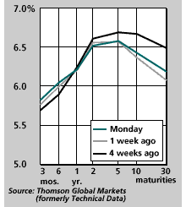
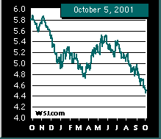
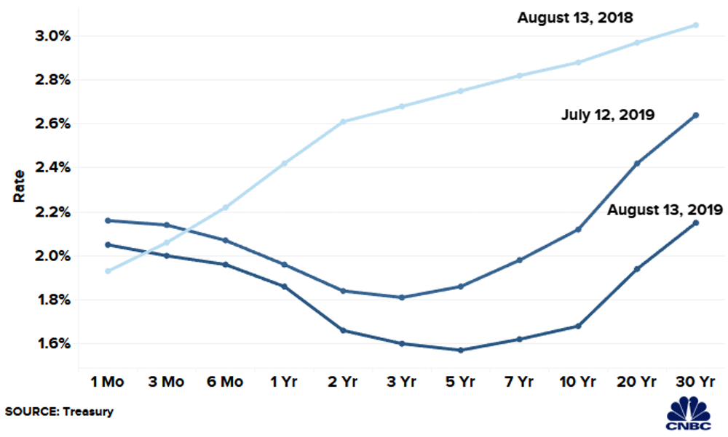
Term Structure of Interest Rates
Quiz: fiviz.page/quiz
Which of the graphs does not represent a yield curve?
Which of the graphs contains the yield curve that signals a recession?
B
C
A

Slide 7
Valuing Stocks
Preferred Stocks
Pay constant dividend indefinitely
Use perpetuity formula
What about common stocks?

Slide 8
Decomposing Returns
The return from holding common stock consists of two parts.
Dividend + The capital gain (or loss)
Let
P₀ be the price when the share was bought;
P₁ be the price of the share at the end of the year;
Div_{l} be the dividend paid at the end of the first year

Slide 9
Example 1
You buy a share of United Technologies (UTX) for $40.00 and you receive a $2.00 dividend at the end of your one year holding period. What is your annual return, given that you sell your share at the end of the year holding period for $46.00?
Notes:
Annual return = [2+(46-40)]/40 = 20%

Slide 10
Finding the Price
If we know the return (or expected return), we can determine the price of an asset given its cash flows:

Slide 11
Constant dividend
If the stock pays a constant dividend, we can value a share using the present value of a perpetuity:
Notes:
We also use a constant expected returns

Slide 12
Example 2: Preferred Share
GM pays a dividend of $3.00. What is the price for a GM share given that the dividend will remain constant forever, and that the market required rate of return for a similar share is 11%?
What would the price be if the stock didn’t start paying a dividend until three years from now?
Notes:
P= 3 / 11% = 27.27
Paying dividend 3 yrs from now: 27.27 / 1.11^2=22.13

Slide 13
Constant Growth Dividend Valuation Model
If we expect dividends to grow over time, we can use the growing perpetuity formula:
g = growth rate r = (required) rate of return
Div₀ = recently paid dividend (just missed it).
Div₁ = dividend paid one period from today
g can’t be bigger than r (forever)
Visualization:
https://fiviz.page/cfs

Slide 14
Example 3: Common Stock
Now assume a growth rate of 4.5% for the dividends of the GM share. The dividend of $3.00 was the last dividend paid by GM. IF the required rate of return is 11%, price the stock.
Notes:
Next dividend = 3 * (1+4.5%) = 3.135
P = 3.135/(11%-4.5%) = 48.23

Slide 15
Example 4: Implied Return
Philip Morris' shares are trading at $60.00. The last annual dividend paid was $1.00 per share, and Philip Morris's growth rate is assumed to be 10%. What is the required rate of return for the Philip Morris stock?
Notes:
60 = 1*(1+10%)/(r-10%)
r-10%=0.01833
r=11.83%

Slide 16
Estimating the growth rate
Historical estimate
Based on past growth in dividends
Bloomberg
Thomson One
FactSet
Implied growth
Based on observed price, previous dividend, and required rate of returns.

Slide 17
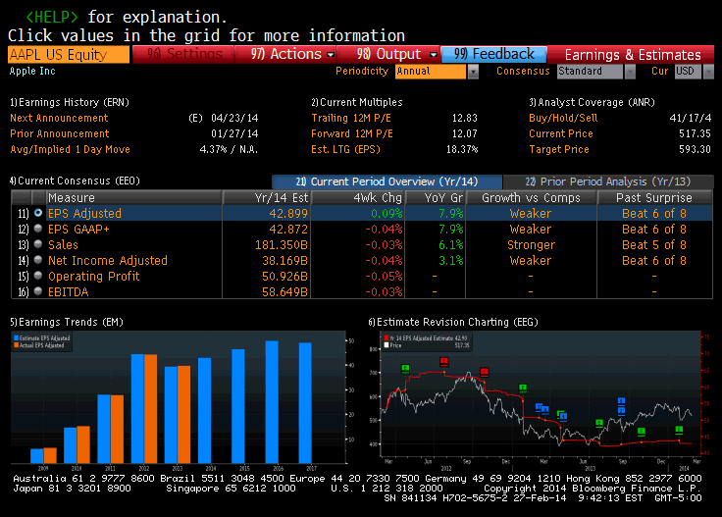

Slide 18
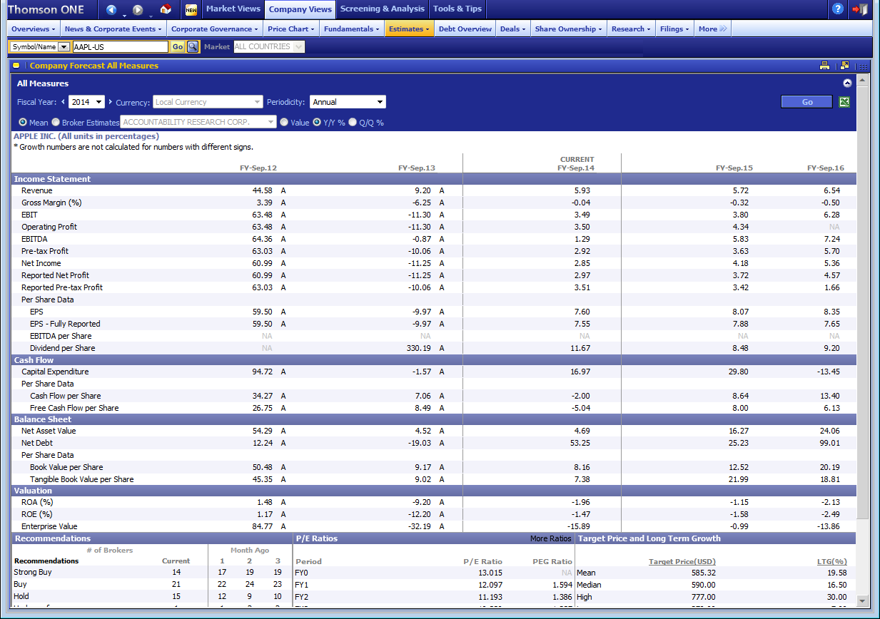

Slide 19
Implied Growth
IBM shares are trading at $100.00. The last annual dividend paid was $1.20 per share, and IBM’s required rate of return is 10%. What is the implicit growth rate in the observed price?
Notes:
P = 100 =1.2(1+g) / (10%-g)
100(10%-g) = 1.2(1+g)
10-100g = 1.2 +1.2g
8.8 = 101.2g
g = 8.8/101.2 = 8.7%

Slide 20
Multi-stage Growth
Companies may grow at rate g1 in the first t years and the growth rate may change (normally decreases) to g2 from t+1 year onward. The price of stocks is evaluated based on a growing annuity + a growing perpetuity.
Trick: Split the CFs into to components:
Growing Annuity with growth rate g1
Growing Perpetuity with growth rate g2
Alternatively: find the prices iteratively.
First find out the stock price one year before the growth rate become g2.
Treat that value as a terminal dividend and then apply the PVGP formula to calculate all previous dividends.
Visualization:
https://fiviz.page/stock

Slide 21
Example 5
A start-up will not pay any dividends for the first two years. At the end of the third year, it is expected to pay a dividend of $0.30. This dividend should then grow at a rate of 12% for 6 years, and at a reduced rate of 6% thereafter. The market required rate of return for similar high growth start-up companies is 16%. Estimate the price of the company's shares today.
Notes:
This is the alternative way to cut the time line – in class, we cut the time line after year 9
Price of this stock at the end of year 8 = 0.3 * (1+12%)^6 / (16%-6%)=5.92
Price of the Dividends from year 3 to year 8 at the end of year 2
= 0.3 * (1-(1+12%)^6/(1+16%)^6)/(16%-12%)=1.42
Discount them back to year 0= 5.92/ (1+16%)^8+1.42/(1+16%)^2=2.86

Slide 22
Example 6
A high growth software company will pay its first dividend at the end of its 5th year. This dividend of $4 will grow at a rate of 16% for 4 years. After that, the growth will slow down to 10% forever. The required rate of return is 17%. Find the price of the stock.
Notes:
At the end of year 9 we have 4*(1+16%)^4
Standing at the end of year 9, we evaluate the rest of the dividends,
4*(1+16%)^4*(1+10%) / (17%-10%)=113.81
Dividends from year 5-year 9:
Standing at the end of year 4:
4*(1-(1+16%)^5/(1+17%)^5)/(17%-16%)=16.80
Price at year 0 = 113.81/(1+17%)^9+16.80/(1+17%)^4=36.66

Slide 23
Next Class:
More on stock valuation (review).

