Slide 1
Federated Learning Security

Slide 2
Motivation
No control over the training data in FL environment thus easier to attack and harder to defend.
FL consists of diverse training data and resources which raises new set challenges compare to traditional machine learning.
The focus of existing works is on finding efficient attack strategies and defending against them.
Existing works mainly is limited to fixed set of system parameters without considering the FL data and resource heterogeneity.
In this work our objective is to extensively study the impact of various attack mechanism in different FL settings and propose a mechanism to mitigate or minimize the impact of attacks.

Slide 3
Related works
How to backdoor federated learning -
Model poisoning on FL, scales up weights to replace global model during aggregation.
Bagdasaryan, Eugene, et al. "How to backdoor federated learning." arXiv preprint arXiv:1807.00459 (2018).
Mitigating Sybils in Federated Learning Poisoning -
Uses Sybil attacks to increase attack effectiveness, introduces a novel defense strategy.
Fung, Clement, Chris JM Yoon, and Ivan Beschastnikh. "Mitigating sybils in federated learning poisoning." arXiv preprint arXiv:1808.04866 (2018).
Analyzing Federated Learning through an Adversarial Lens -
Also boosts model weights.
Bhagoji, Arjun Nitin, et al. "Analyzing federated learning through an adversarial lens." arXiv preprint arXiv:1811.12470 (2018).
Robust Aggregation for Federated Learning -
Uses geometric median instead of FedAvg to mitigate effect of weight outliers.
Pillutla, Krishna, Sham M. Kakade, and Zaid Harchaoui. "Robust Aggregation for Federated Learning." (2019).
DBA: Distributed Backdoor Attacks Against Federated Learning -
Focuses on developing effective distributed backdoor attacks in FL systems
Under review

Slide 4
Limits of Related Works
Do not evaluate against diverse systems settings such as varying non-IIDness, data quantities and resource heterogeneity
Uses synthetic datasets, not comparable to real world scenarios
Small Scale

Slide 5
Objective
Analyze impact of poisoning and backdooring on large scale FL from a systems perspective.
How attack efficiency is affected by resource heterogeneity in a FL environment for example attack using faster data parties vs slower ones (async FL).
How the number of malicious data parties affect the attack efficiency.
How training hyper-parameters impact the overall attack efficiency for example batch size and learning rate.
How the FL system design affects attack efficiency for example number of clients selected per round.
Data distribution (non-IID ness) impacts the attack.
Data quantity impacts the overall attack efficiency.
Impact of the attack timing.
Impact of attack efficiency with a combination of above factors.
Based on the observations propose a mitigating method to prevent attacks.

Slide 6
Resource Heterogeneity
FL is composed of wide range heterogeneous resources.
In async setting faster resources have higher impact on the global model.
Overall faster clients contribute more to global model.
Label poisoning or backdooring using the faster data parties may result in better overall attack efficiency.

Slide 7
Impact of Number of Malicious data parties
Impact of attack efficiency is also correlated with the number of malicious data parties.
The higher the number of malicious data parties the more impactful is the attack efficiency.

Slide 8
Impact of Training Hyperparameters
As training hyper-parameters are critical for a machine learning model performance.
The impact of hyperparameters (batch size and learning rate) may result in different attack efficiency.
For example: Smaller batch size and smaller learning rate may have higher impact of attack.

Slide 9
Impact of System Design
System parameters:
Client selection policy may also impact the overall attack efficiency.
For example: synchronous FL, unbounded asynchronous and bounded asynchronous may have a different impacts on overall attack efficiency.
Number of clients selected per round.
Percentage of classes being poisoned.

Slide 10
Impact of Data quantity and Quality
Impact of different level of non-IID ness.
Impact of training points per data party.
Impact of number of poisoned classes per data party
Impact of overall poisoned classes.

Slide 11
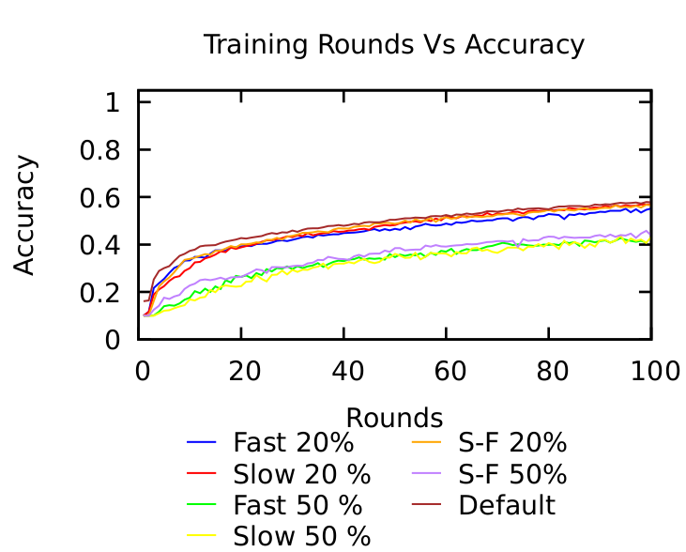
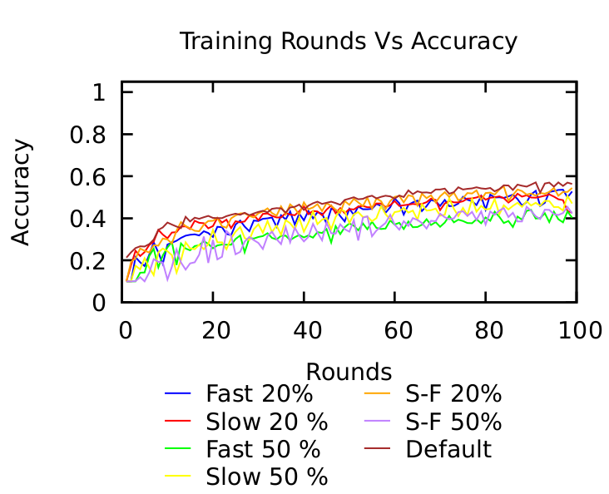
Label Poisoning - Cifar10 - # of Clients Poisoned
Async-Bounded
Async-Unbounded

Slide 12
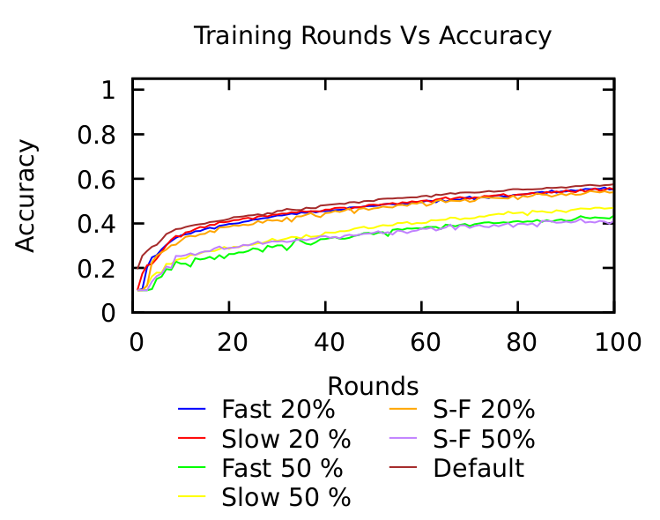
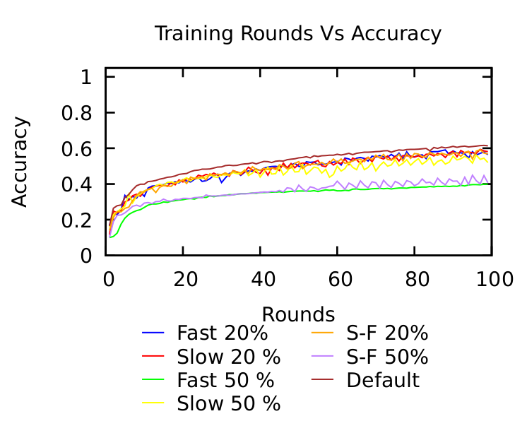
Label Poisoning - Cifar10 - # of Clients Poisoned
nonIID-async
IID-async

Slide 13
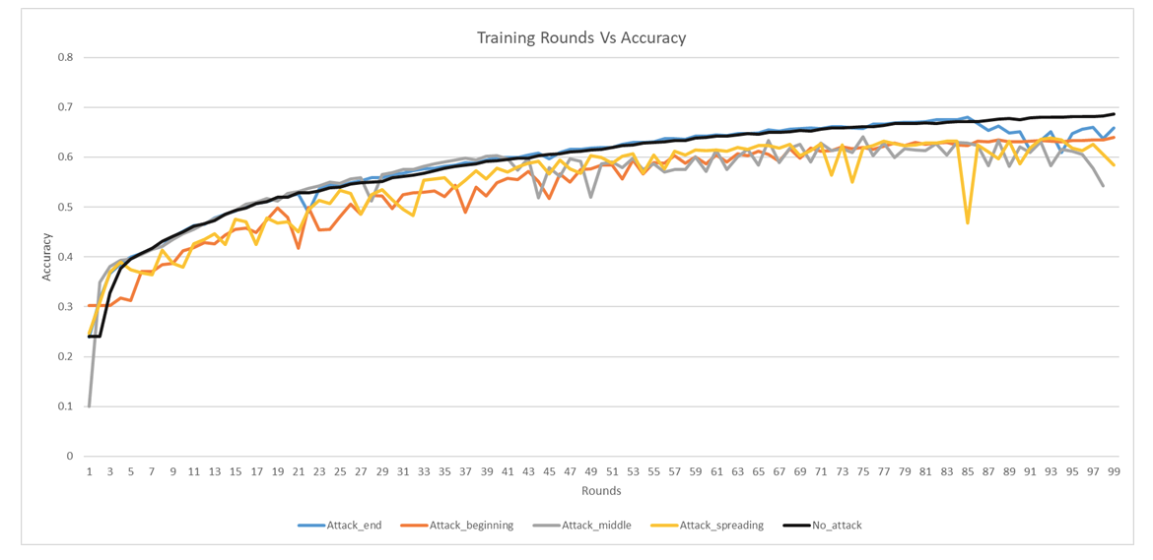
Attack timing

Slide 14
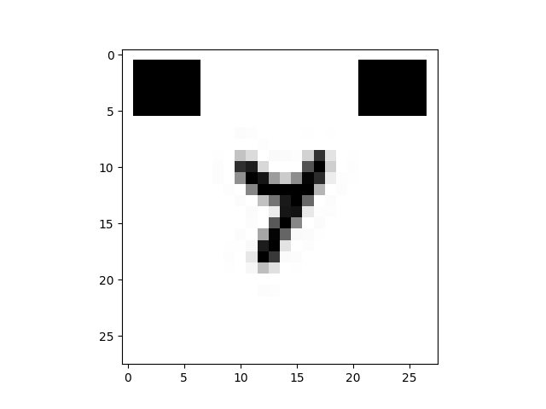
Backdooring

Slide 15
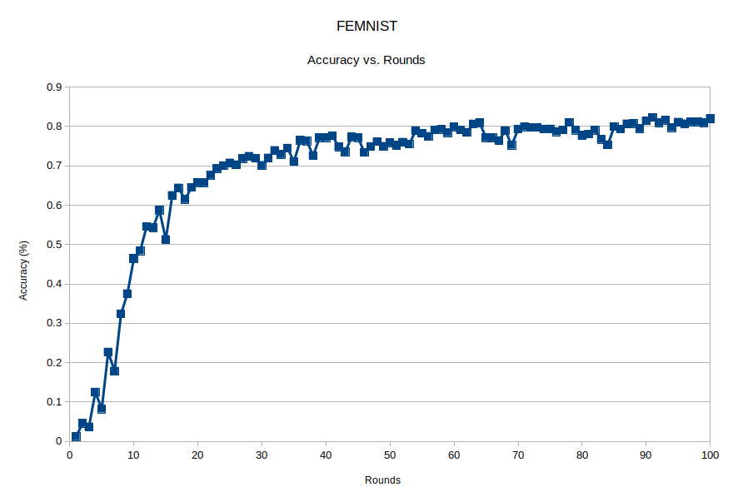
Accuracy Over Rounds (distributed LEAF)

Slide 16
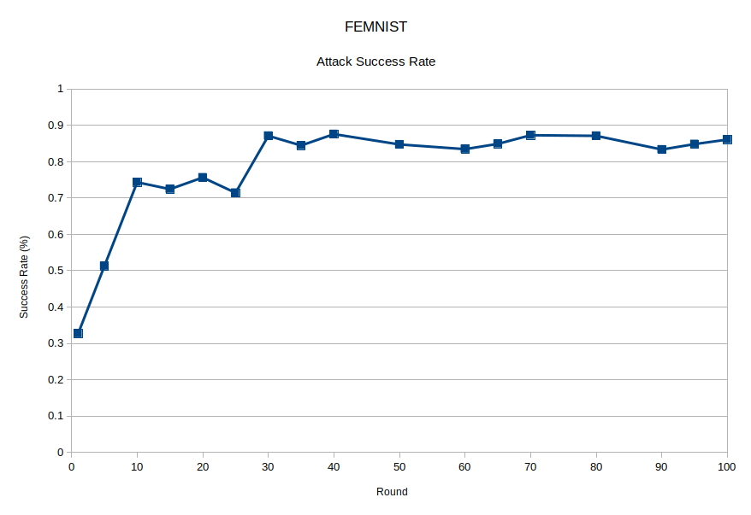
Attack Success Rate (distributed LEAF)

Slide 17
Features of the developed tool
Purely distributed FL system
Controllable resource heterogeneity
Controllable non-IIDness (Feature heterogeneity)
Controllable number of clients and data points
Attack
Label poisoning
Backdooring
Overtime, Over rounds, number of poisoned clients, number of poisoned classes
Synchronous, asynchronous and bounded asynchronous FL

Slide 18
Key Observations from Related Works
Related Works mention -
More poisoned clients/data mean worse accuracy/backdooring
[2] - Mitigating Sybils in Federated Learning Poisoning
Section 1 - “the larger the proportion of poisoning data, the higher the attack effectiveness”
Attacks are most effective after convergence
[5] - DBA: Distributed Backdoor Attacks Against Federated Learning -
Appendix A.2 - Better to Attack Late
[1] - How to backdoor federated learning
Section 5.5
Label Poisoning is trivially detectable
[3] - Analyzing Federated Learning through an Adversarial Lens
Section 2.3 - “First, the server can verify whether the update, in isolation, would improve or worsen the global model’s performance on a validation set. Second, the server can check if that update is very different statistically from other updates.”
Reference for Federated Learning in asynchronous
No papers using async FL found. Would that raise questions?
Detecting backdoors is still an open question

Slide 19
Corresponding To Do List (Prioritized)
Get Counter Results -
More poisoned data/clients leading to more effective attacks
Change Class distribution/quantity and see if this still holds
Training Parameters
Attacks after convergence will be most effective
Training parameters changes convergence
Attack Frequency earlier vs. later
Analyze effect of heterogeneity on Label Poisoning on LEAF
Impact of Attack Time
Impact of System Design
Impact of Training Hyperparameters

