Slide 1
github.com://dzh-a-v
PROBLEM 1
Mobile Data Plan
EASY • REAL-LIFE
A phone provider charges customers as follows:
FIND
$10 flat fee for the first 5 GB of data
$2 for every additional GB beyond 5 GB
(a) Cost for 3 GB
(b) Cost for 5 GB
(c) Cost for 8 GB
(d) Cost for 12 GB
Cost function:
C(x) = 10
C(x) = 10 + 2(x − 5)
if 0 ≤ x ≤ 5
if x > 5
Piecewise Functions • Problem 1

Slide 2
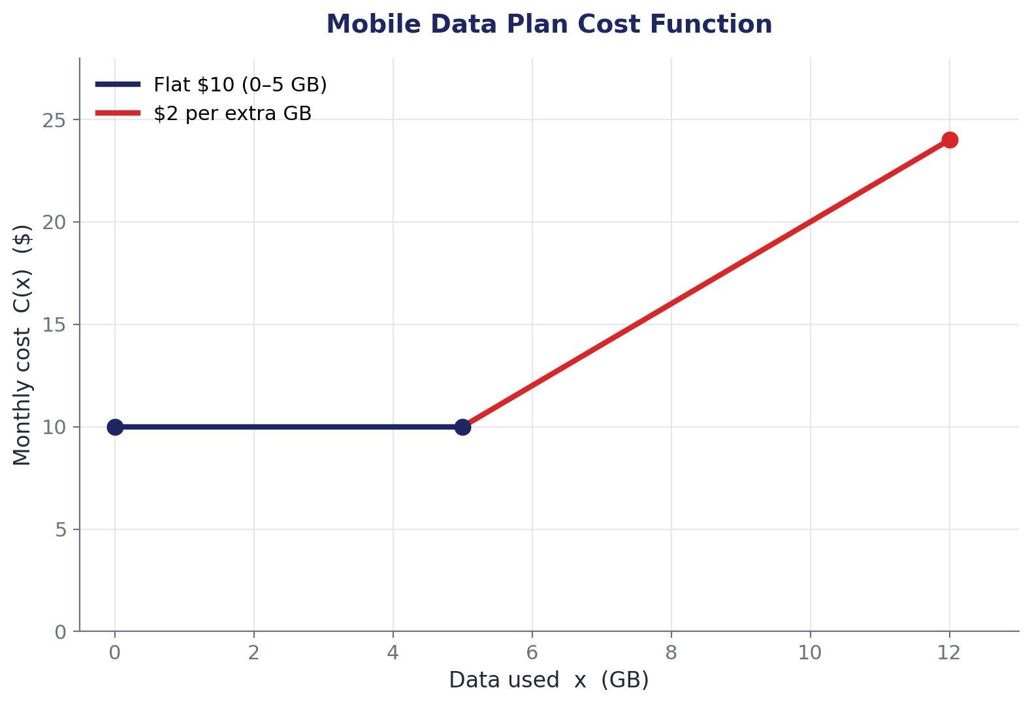
github.com://dzh-a-v
SOLUTION 1
Mobile Data Plan
Substitute each value of x into the correct piece:
(a) x = 3 → 3 ≤ 5, use top piece
C(3) = $10
(b) x = 5 → boundary, top piece
C(5) = $10
(c) x = 8 → 8 > 5, use bottom piece
C(8) = 10 + 2(8 − 5) = $16
(d) x = 12 → 12 > 5, bottom piece
C(12) = 10 + 2(12 − 5) = $24
Key idea Always check which interval x lies in before substituting.
Piecewise Functions • Solution 1

Slide 3
github.com://dzh-a-v
PROBLEM 2
Two-Bracket Income Tax
MEDIUM • REAL-LIFE
A simplified income tax system uses two brackets:
Tax T owed on income I (in dollars):
T(I) = 0.10 · I
T(I) = 2,000 + 0.20 · (I − 20,000)
if 0 ≤ I ≤ 20,000
if I > 20,000
(a)
(b)
(c)
How much tax does someone earning $15,000 pay?
How much tax does someone earning $35,000 pay?
What income produces a tax bill of exactly $5,000?
Piecewise Functions • Problem 2

Slide 4
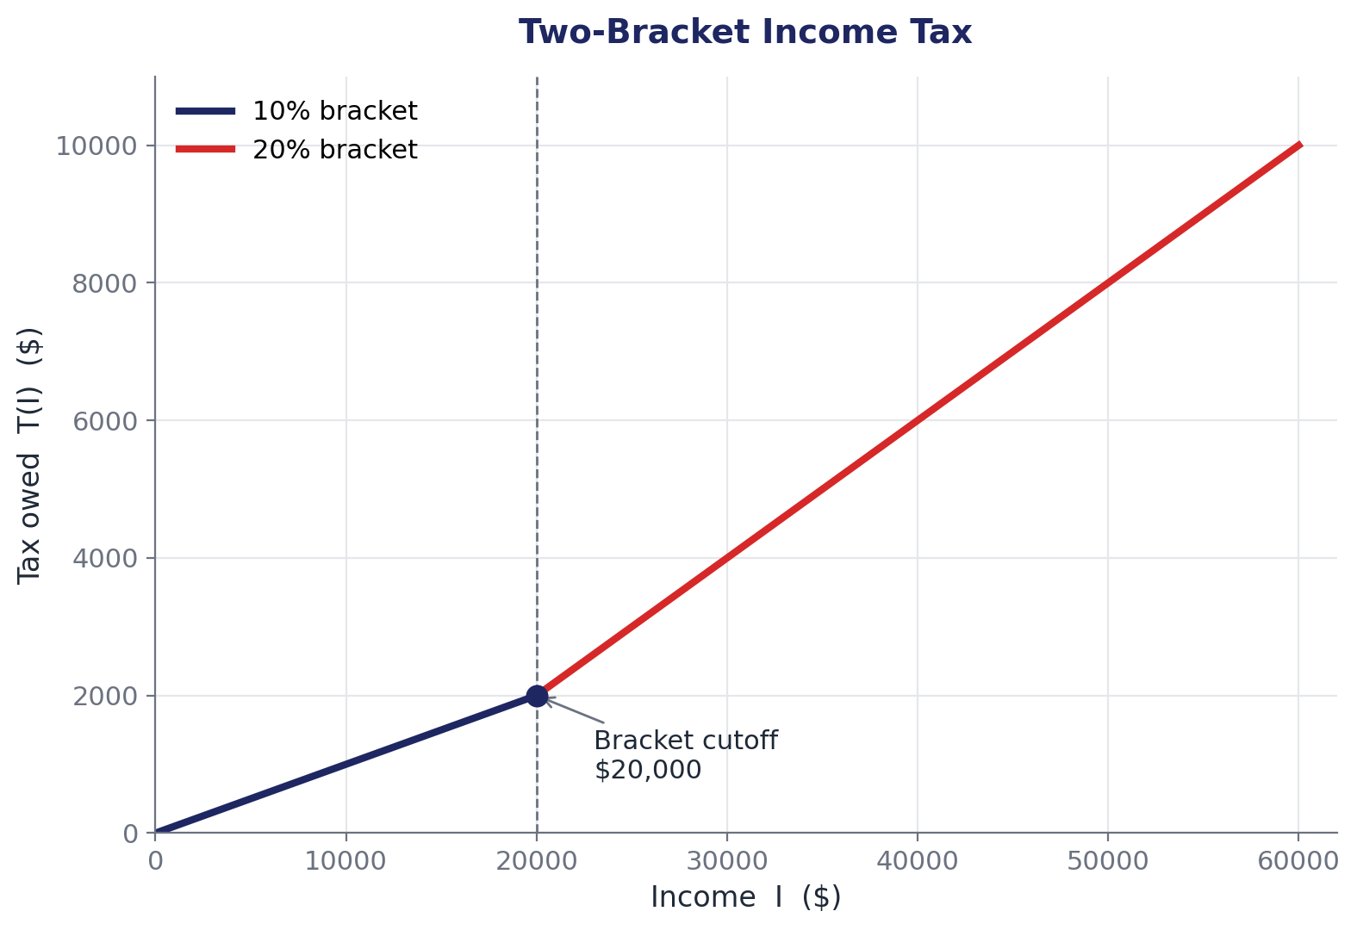
github.com://dzh-a-v
SOLUTION 2
Two-Bracket Income Tax
(a) I = $15,000 ≤ $20,000 → first piece
T = 0.10 × 15,000 = $1,500
(b) I = $35,000 > $20,000 → second piece
T = 2,000 + 0.20 × (35,000 − 20,000)
T = 2,000 + 0.20 × 15,000 = 2,000 + 3,000
T = $5,000
(c) Tax of $5,000 > $2,000 (cutoff tax) → use second piece
5,000 = 2,000 + 0.20(I − 20,000)
3,000 = 0.20(I − 20,000) ⇒ I − 20,000 = 15,000
I = $35,000
Notice The graph bends at I = $20,000 — only the slope changes; the function stays continuous.
Piecewise Functions • Solution 2

Slide 5
github.com://dzh-a-v
PROBLEM 3
Parking Garage Pricing
HARD • REAL-LIFE
A parking garage in the city centre charges:
$3 for the first hour (or any part of it)
An additional $2 for each extra hour started, for the next 3 hours
After 4 hours total, a daily maximum of $9 applies
YOUR TASK
(a) Write the piecewise function P(t) for parking t hours.
(b) Find P(0.5), P(2.5), P(7).
(c) Sketch the graph for 0 < t ≤ 8 hours.
Hint: “For each extra hour started” means we round up — this is a step function.
Piecewise Functions • Problem 3

Slide 6
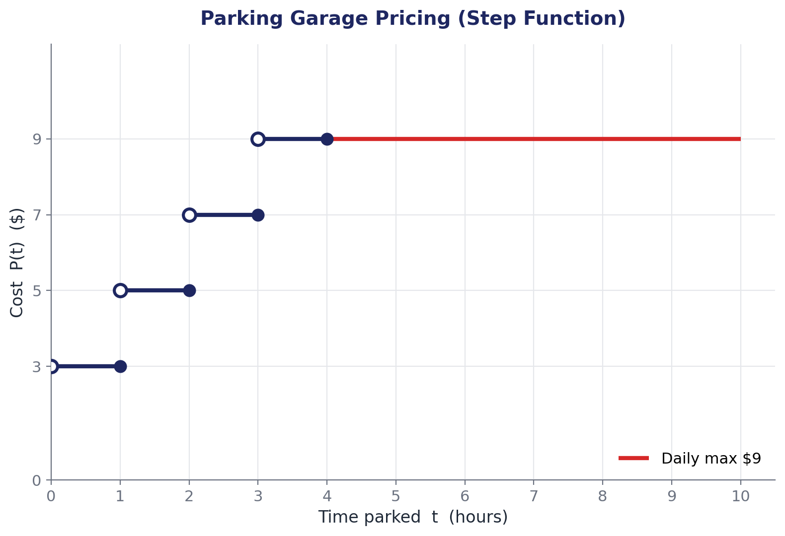
github.com://dzh-a-v
SOLUTION 3
Parking Garage Pricing
(a) Piecewise definition
P(t) = 3
P(t) = 5
P(t) = 7
P(t) = 9
P(t) = 9
if 0 < t ≤ 1
if 1 < t ≤ 2
if 2 < t ≤ 3
if 3 < t ≤ 4
if 4 < t ≤ 24 (daily max)
(b) Evaluations
P(0.5) = $3
half an hour falls in the first interval (0, 1]
P(2.5) = $7
2.5 lies in (2, 3], so P = 7
P(7) = $9
7 > 4, daily-max rate kicks in
(c) Step graph open ○ = excluded endpoint, filled ● = included.
Piecewise Functions • Solution 3

Slide 7
github.com://dzh-a-v
PROBLEM 4
Continuity Conditions
VERY HARD • THEORY
Consider the piecewise function:
x² + 1
a x + b
2x + 4
if x < 1
if 1 ≤ x ≤ 3
if x > 3
f(x) =
TASK Find values of a and b that make f continuous everywhere on the real line.
Piecewise Functions • Problem 4

Slide 8
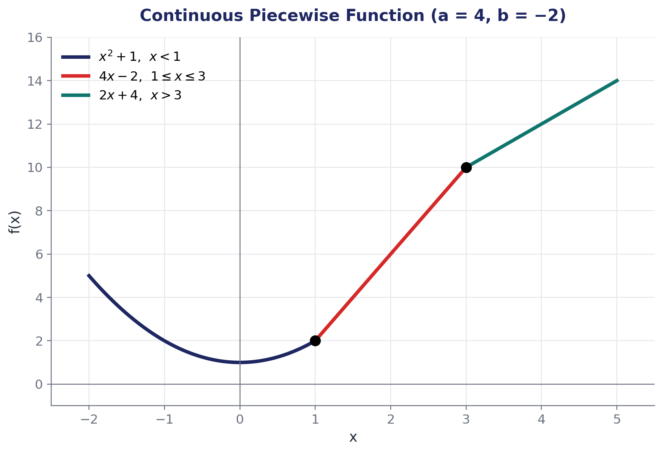
github.com://dzh-a-v
SOLUTION 4
Continuity Conditions
Continuity at the joining points
At x = 1 , left and right values must agree:
(1)² + 1 = a(1) + b
a + b = 2 …(1)
At x = 3 :
a(3) + b = 2(3) + 4
3a + b = 10 …(2)
Subtract (1) from (2): (3a + b) − (a + b) = 10 − 2
2a = 8 ⇒ a = 4
Substitute back into (1): b = 2 − 4 = −2
ANSWER
a = 4, b = −2
Piecewise Functions • Solution 4

