Slide 1

Data Models
Motus Data
January 3, 2019
Dongming Zhang

Slide 2
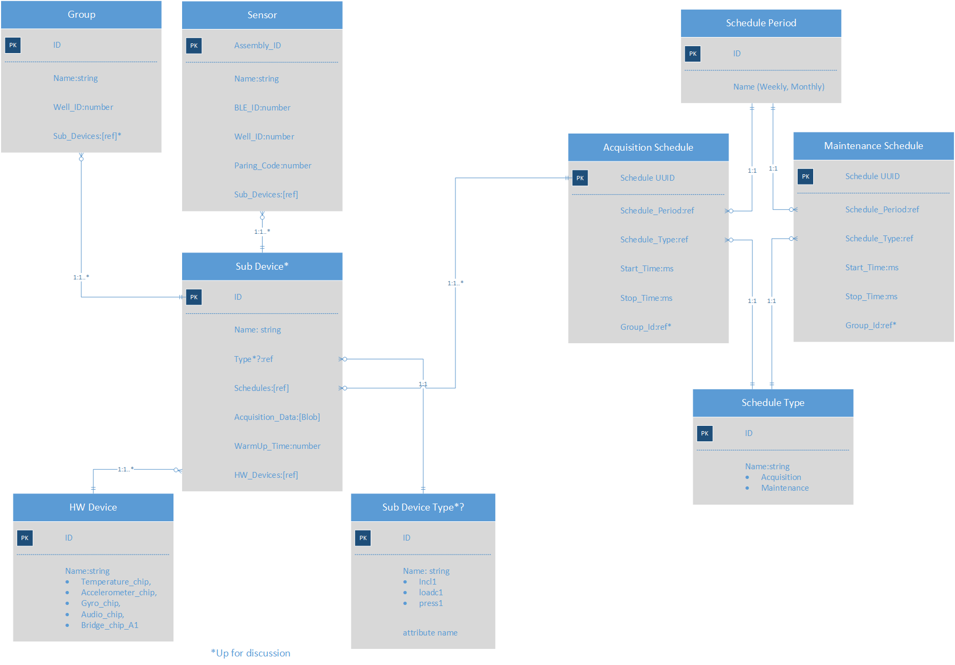
Data Model Overview

Slide 3
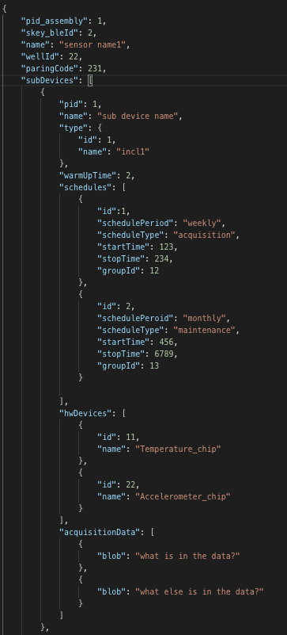
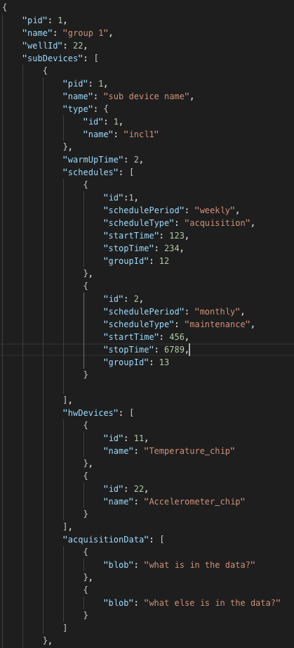
Data Model Design*
Group | Sensor
* In DynamoDB

Slide 4
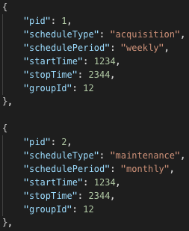
Data Model Design
Schedule

Slide 5
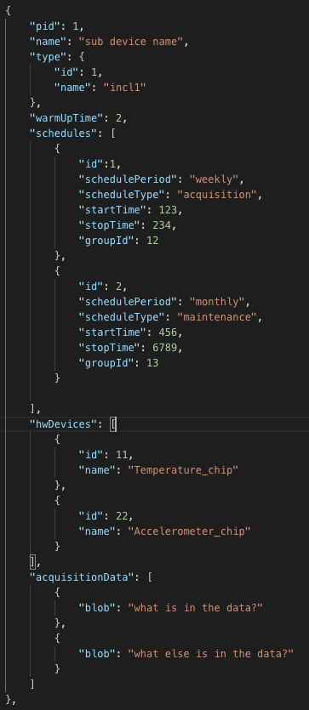
Data Model Design
Sub Device

Slide 6
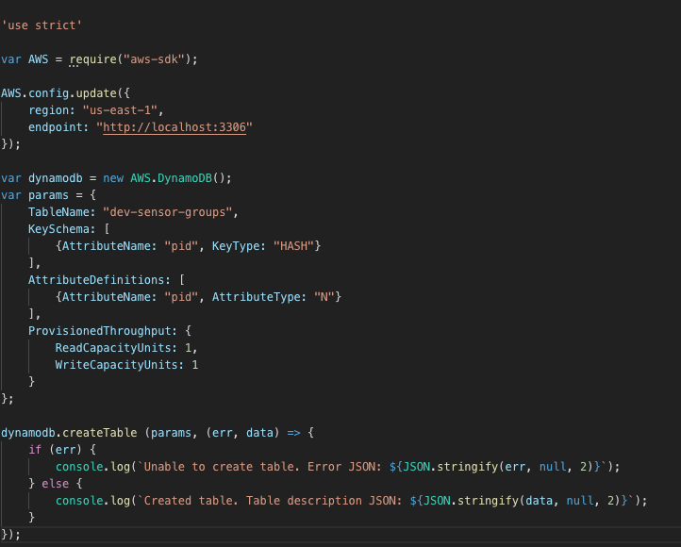
Data Model Implementation
Group

Slide 7
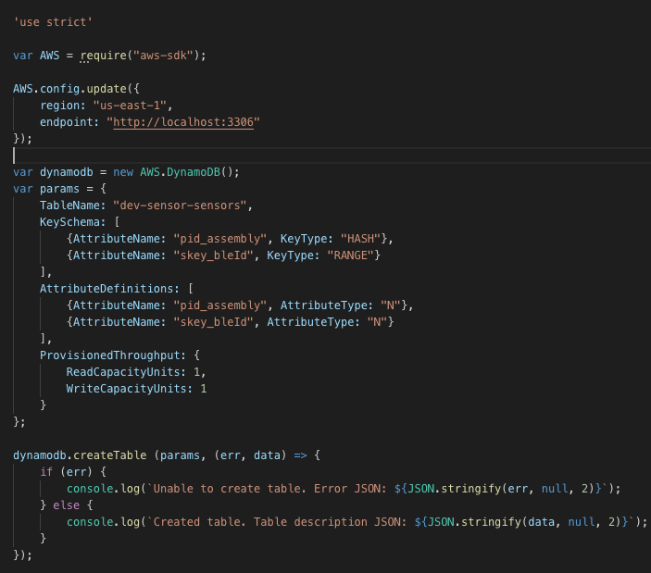
Data Model Implementation
Sensor

Slide 8
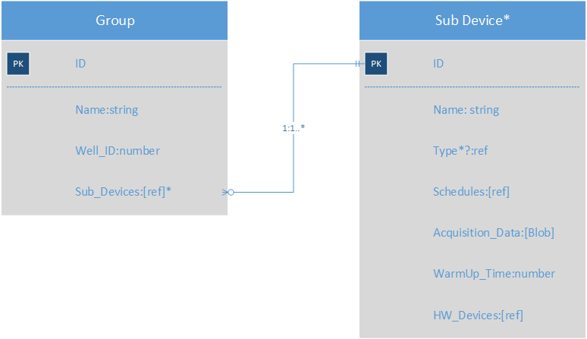
Group Definition
Group is a collection of sensing data collected from various sub-devices from one or more physical sensors.
Group “contains”
Group ID
Group Name
Well ID
Sub-Devices

Slide 9
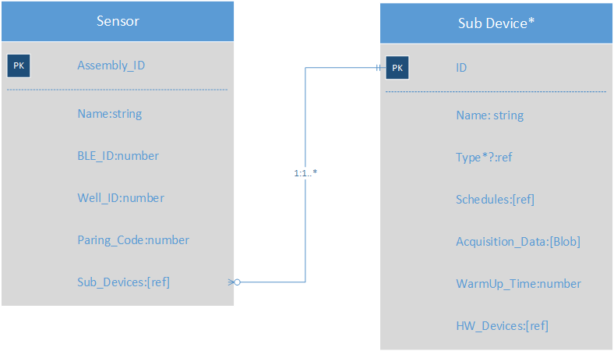
Sensor Definition
Sensor is a physical unit/assembly that may have more than one sensing component, called sub-device, each of which is used for collecting different type of data. | Sensor “contains” Assembly ID Sensor Name BLE ID Well ID Paring Code Sub-Devices

Slide 10
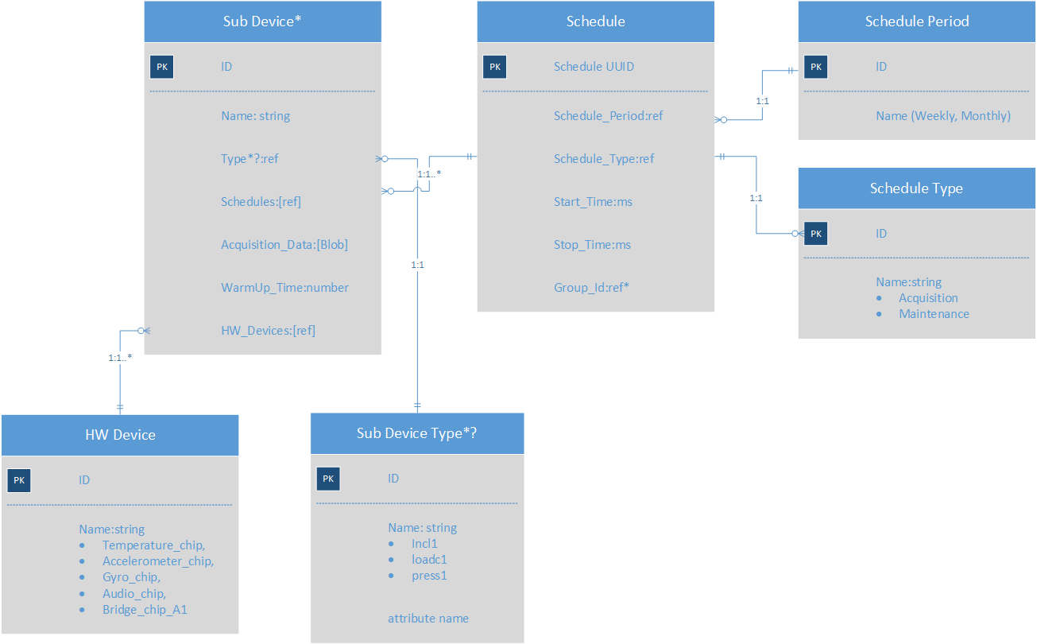
Sub-Device Definition
Sensor Sub-Device is the physical component attached on the sensor board. Each sensor may have more than one sub-devices. Each sub-device serves for different purpose.
Sub-Device “contains”
ID
Name
Type*? (TBD)
Schedules
Acquisition Data[]
Warm-up time
HW Devices

Slide 11
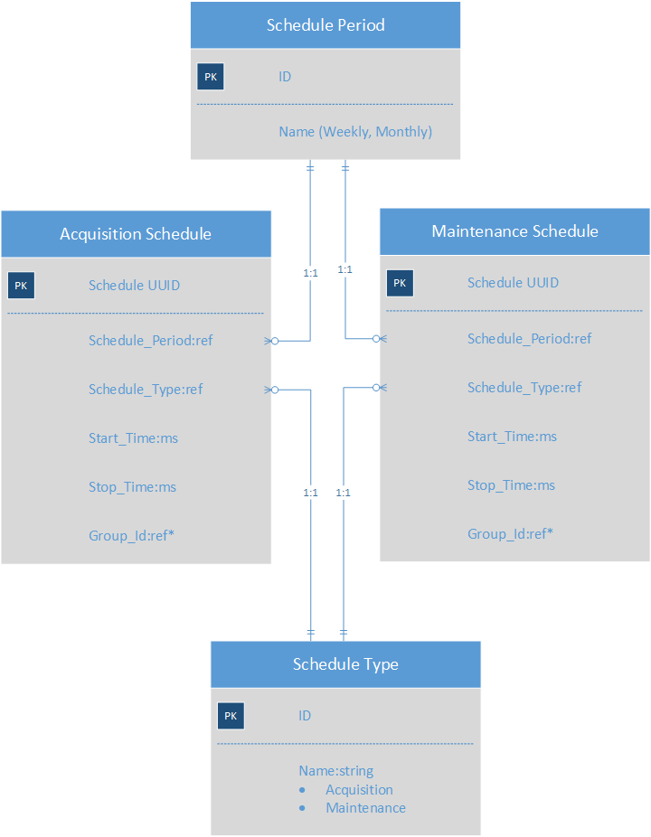
Schedule Definition
Schedule ”contains”
ID
Schedule_Period: weekly or Monthly
Schedule_Type: Acquisition or Maintenance
Start_Time
Stop_Time
Group_ID

Slide 12
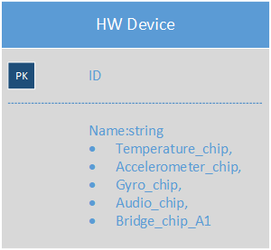
Hardware Device Definition
HW Device “contains”
ID
Name
Temperature_chip
Accelerometer_chip
Gyro_chip
Audio_chip
Video_chip

Slide 13
Well -- missing

Slide 14
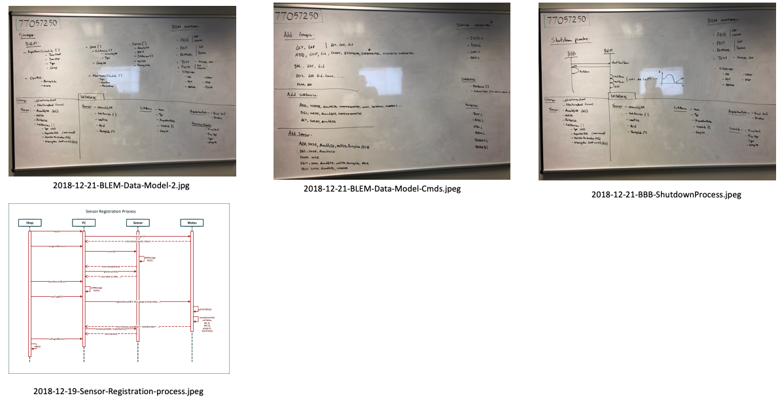
References from Whiteboard Pictures

