Slide 1
Astana Apartment Price Prediction
• Endterm Project — Machine Learning Algorithms
• Nurkhan Kuanyshov and Bakytzhan Jangazy
• Group SE-2431
Speaker: Both
SE-2431 | Slide 1

Slide 2
Problem and research objective
• Estimate apartment asking prices from listing characteristics.
• Question: Can area, location, rooms, floor, building characteristics and amenities predict price?
• Regression target: price; models learn log1p(price).
• Use case: decision support, not an official valuation.
Speaker: Nurkhan
SE-2431 | Slide 2

Slide 3
Dataset and responsible scope
• Astana Real Estate Dataset by turarr (Kaggle); advertisements from Krisha.kz.
• Asking prices, not verified final transaction prices.
• Potential duplicates, missing fields and seller-entry errors are documented limitations.
• Dataset size and feature inventory are reported dynamically by the notebook.
Replace this note with the executed notebook's dataset-size table.
Speaker: Nurkhan
SE-2431 | Slide 3

Slide 4
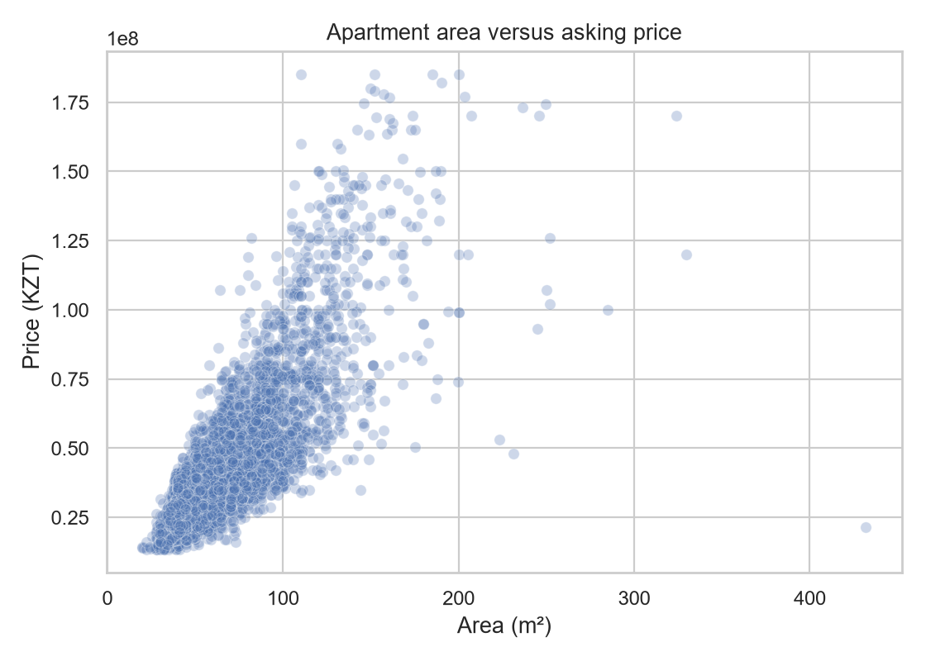
Preparation, EDA and feature engineering
• Numeric conversion, floor extraction, duplicate removal, range checks and leakage-field removal.
• EDA: raw/log price, area-price, district distributions, correlations and missingness.
• Engineered: house age, first/top floor, floor ratio, area per room.
• Distance to centre is added only when actual coordinates exist.
Speaker: Nurkhan
SE-2431 | Slide 4

Slide 5
Evaluation design and leakage control
• Fixed 70/15/15 train, validation and test split with log-price quantile bins.
• Imputation, scaling and one-hot encoding are fitted inside pipelines only on training data.
• Five-fold CV and tuning use training data; validation selects; test is final once.
• Metrics: log RMSE, log MAE, R², KZT MAE and MedAPE.
Speaker: Bakytzhan
SE-2431 | Slide 5

Slide 6
Regression models and tuning
• Midterm retained: median baseline, Linear Regression, Decision Tree and KNN.
• Endterm adds Random Forest and Gradient Boosting.
• Bounded randomized five-fold hyperparameter searches keep CPU execution practical.
• Feature importance is interpreted as association—not causation.
Speaker: Bakytzhan
SE-2431 | Slide 6

Slide 7
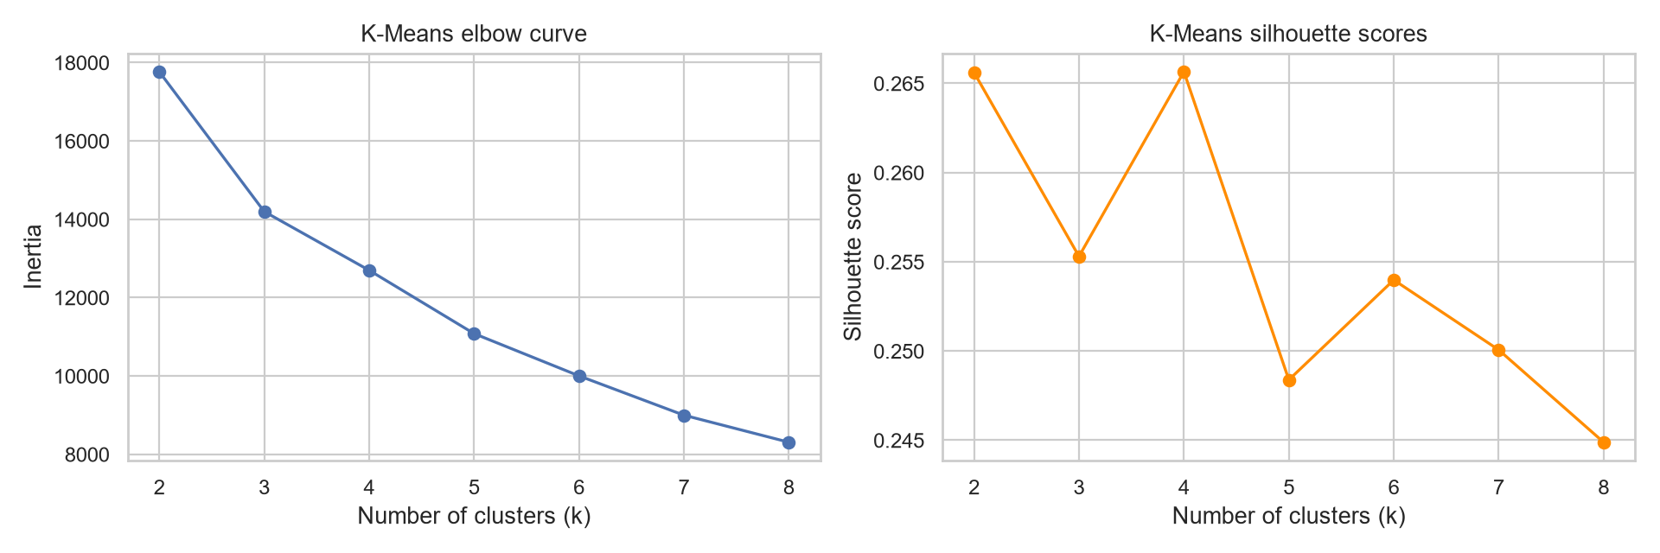
K-Means market segmentation
• Exploratory clustering uses meaningful scaled numeric listing characteristics.
• Price is allowed here for segmentation, but never used as a supervised feature.
• Elbow inertia and silhouette scores guide k selection.
• Cluster summaries compare listing count, price, area, rooms and age.
Speaker: Nurkhan
SE-2431 | Slide 7

Slide 8
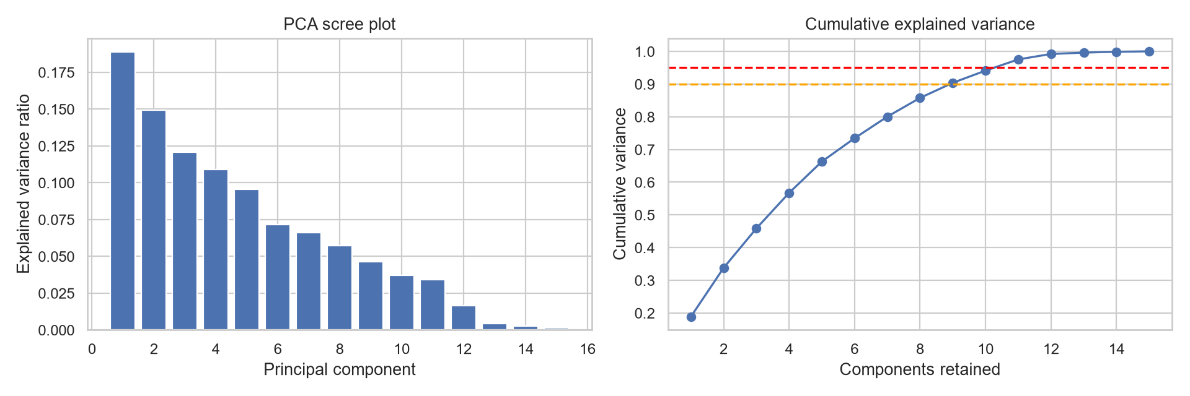
PCA: dimensionality reduction
• PCA is fitted to standardized numerical training features.
• Scree and cumulative-variance plots show information retention.
• The first two components visualize listings and K-Means labels.
• PCA improves exploration, but components are less interpretable than original features.
Speaker: Nurkhan
SE-2431 | Slide 8

Slide 9
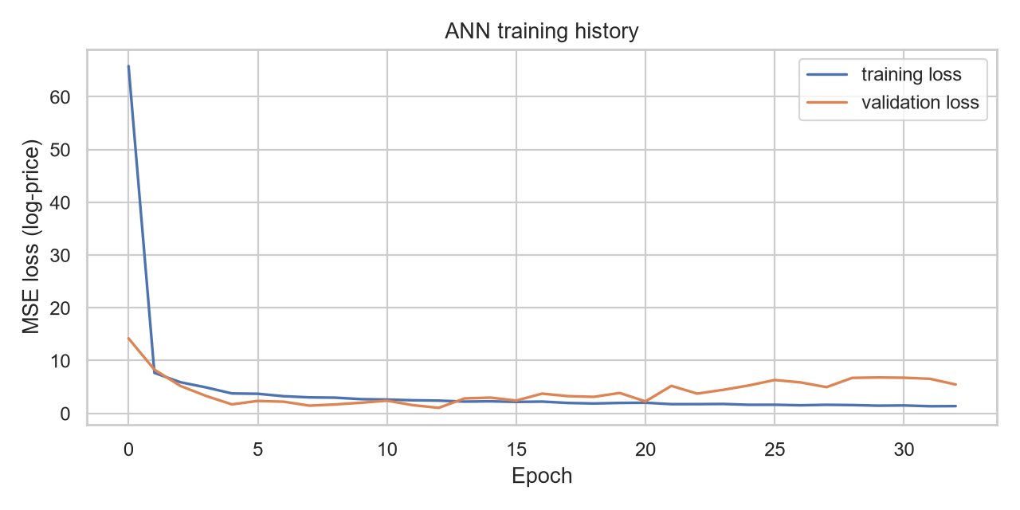
ANN for tabular regression
• Appropriate deep learning choice: feedforward ANN, not unrelated CNN/NLP.
• Architecture: 128 → 64 → 32 ReLU; dropout 0.2; linear output.
• Adam optimizer, MSE loss, EarlyStopping and ReduceLROnPlateau.
• Validation loss history checks convergence and potential overfitting.
Speaker: Bakytzhan
SE-2431 | Slide 9

Slide 10
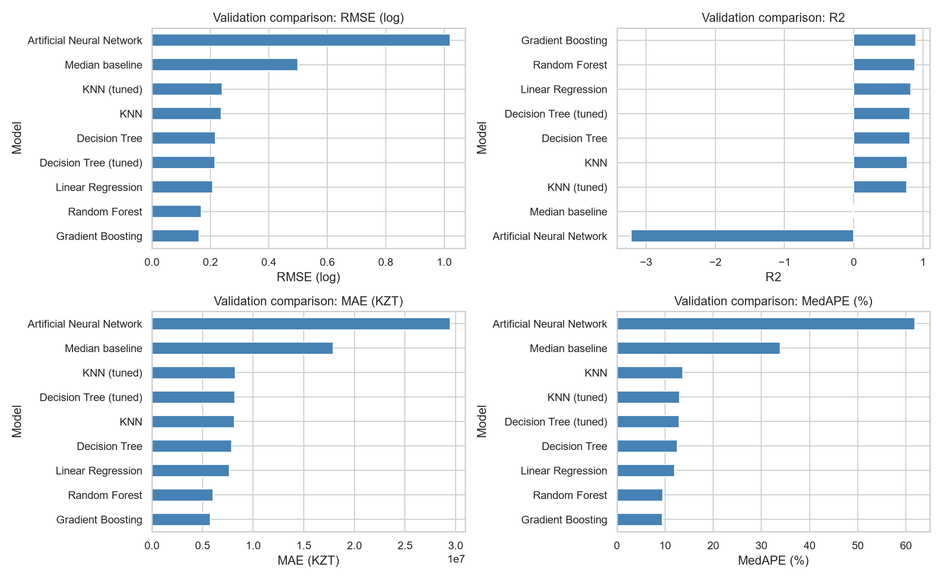
Unified model comparison
• All models use the same split and metric definitions.
• Validation log-RMSE selects the model family.
• The selected approach is refit on train + validation, then evaluated once on test.
• Gradient Boosting was best on validation; the ANN did not improve traditional results.
Speaker: Bakytzhan
SE-2431 | Slide 10

Slide 11
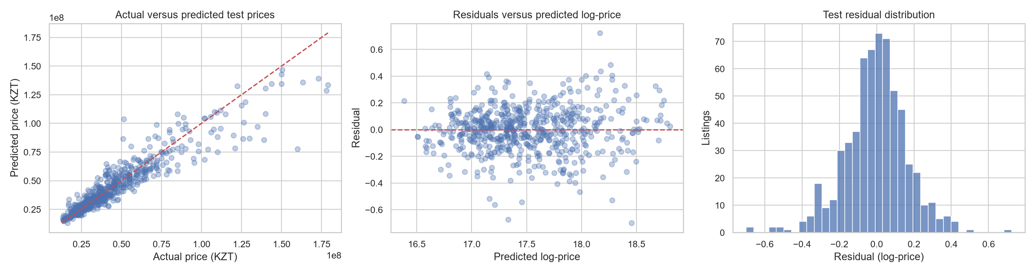
Final model and error analysis
• Final Gradient Boosting: RMSE(log) 0.167; R2 0.892; MedAPE 9.27%.
• Inspect actual versus predicted prices and residual distribution.
• Report errors by price segment, district and largest listing errors.
• Treat renovation/view/building-reputation explanations as hypotheses when unrecorded.
Speaker: Bakytzhan
SE-2431 | Slide 11

Slide 12
Limitations and ethics
• Listings can differ from transaction prices and represent a particular market period.
• Missing and inaccurate seller details limit predictions, especially premium homes.
• Accuracy may be uneven across districts and price segments.
• Predictions should support—not replace—professional appraisal and human judgement.
Speaker: Nurkhan
SE-2431 | Slide 12

Slide 13
Conclusions and practical value
• State whether the original objective was met using the final test evidence.
• Name the selected model and whether ANN justified its added complexity.
• Summarize the market patterns from clusters and PCA.
• Future work: verified sales, richer property quality data, temporal validation.
Complete only after results exist; every conclusion must cite the executed notebook output.
Speaker: Both
SE-2431 | Slide 13

Slide 14
Contributions and Q&A
• Nurkhan: preparation, EDA, features, clustering, PCA and documentation.
• Bakytzhan: supervised modelling, tuning, ANN, evaluation and error analysis.
• Defense preparation: reports/defense_questions.md
• Questions
Speaker: Both
SE-2431 | Slide 14

