Slide 1
MACHINE LEARNING ALGORITHMS · ENDTERM
≈ 0.89
Predicting Apartment Asking Prices in Astana
R² on the test set, Gradient Boosting
≈ 9%
median error, against 34% for the baseline
Log-price regression, K-Means, PCA and a neural network on real Krisha.kz listings
5
market segments tested best by K-Means
Nurkhan Kuanyshov · Bakytzhan Jangazy
Group SE-2431

Slide 2
01 · PROBLEM
Can we predict an Astana asking price?
Predict the asking price of an apartment from its area, location, rooms, floor, building and amenities.
01
02
03
Task
Target
Success metrics
Supervised regression on tabular listing data
Price in KZT; models learn log1p(price) because prices are right-skewed
Log RMSE, log MAE and R²; KZT MAE and median absolute percentage error (MedAPE)
A decision-support estimate, not an official valuation · test set used once
Nurkhan · 2

Slide 3
02 · DATASET AND PREPARATION
Real Krisha.kz listings, cleaned without leakage
5,003
23
Kaggle
listings in the raw CSV
columns, plus engineered features
turarr, scraped from Krisha.kz
Cleaning
Engineered features
Numeric conversion; floor pairs like “5 of 9” split
Drop IDs, free text and leakage fields
Remove duplicates; range checks on area, rooms, year and floors
Trim the outer 1% of prices
Impute only inside the pipeline, on train data
house_age
is_first_floor
is_last_floor
floor_ratio
area_per_room
distance_to_centre_km
Built from listing attributes only: no feature uses the target. Distance to centre is added only when real coordinates exist.
Limits: asking prices, duplicates, seller-entered fields, one collection period.
kaggle.com/datasets/turarr/astana-real-estate-dataset · CSV loaded with pandas
Nurkhan · 3

Slide 4
03 · EXPLORATORY ANALYSIS
Prices are right-skewed: models learn log-price
14M–185M
25–30M
KZT price range kept after trimming
KZT: the most common asking price
Long upper tail
log1p fixes the shape
Evaluate in KZT too
Most listings are below 75M KZT; a few luxury flats reach 150M and above.
The log scale is close to symmetric, which suits regression and keeps luxury listings from dominating.
Predictions are converted back, so MAE and MedAPE are reported on the real price scale.
Outer 1% of prices trimmed; the log distribution still has a mild right tail
Nurkhan · 4

Slide 5
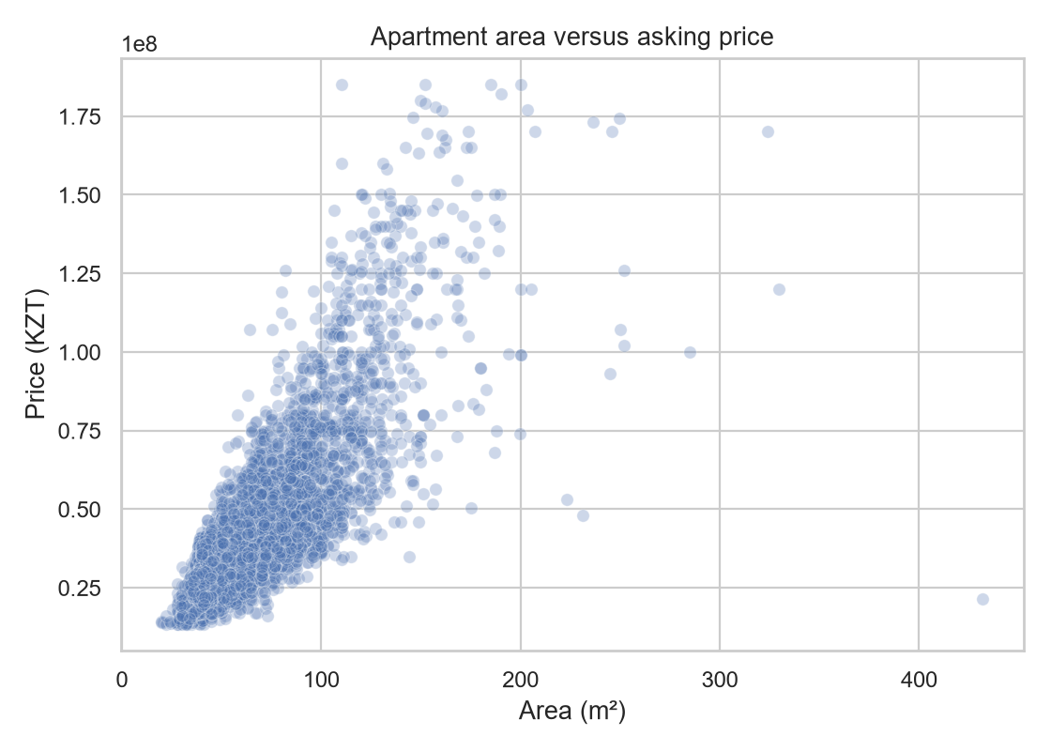
04 · EXPLORATORY ANALYSIS
Area and district drive asking prices
≈ 47M
≈ 30M
Esil: highest median, widest range
Saryarkin: the cheapest median
District matters
Location moves the price even at similar sizes. Esil asks the most and varies the most; Saryarkin is the cheapest. Area and rooms carry overlapping information, so read these as associations, not causes.
Area is the main driver: correlation ≈ 0.8 with price, and the spread widens above 100 m².
Correlations are associations, not causes · area and rooms are strongly collinear
Nurkhan · 5

Slide 6
05 · EVALUATION DESIGN
70 / 15 / 15 split with no leakage
Train 70%
Val 15%
Test 15%
fit preprocessing, tune with 5-fold CV
pick model
used once
1
2
3
Stratified by price
Pipeline-only fitting
One clean final test
Ten quantile bins of log-price keep cheap, middle and expensive listings in every split.
Imputer, scaler and one-hot encoder are fitted on training data, and on training folds inside CV.
The chosen model is refit on train plus validation and scored on test a single time.
Random seed 42 everywhere · rare categories grouped (minimum frequency 10) · metrics: log RMSE, log MAE, R², KZT MAE, MedAPE
Bakytzhan · 6

Slide 7
06 · SUPERVISED MODELS
Midterm baselines, tuned and extended
Model | Tuning (5-fold CV, train)
Median baseline | None: reference
Linear Regression | None: benchmark
Decision Tree | Grid: depth, leaf
KNN | Grid: k, weights
Random Forest | Random search ×12
Gradient Boosting | Random search ×12
Midterm set + endterm
Median baseline, Linear Regression, Decision Tree and KNN come from the midterm. The endterm adds Random Forest and Gradient Boosting.
area_m2 carries ≈ 71% of Gradient Boosting importance; ceiling height ≈ 9%.
Grid / randomized search with five-fold CV uses train data only · importance describes predictive use, not causes
Bakytzhan · 7

Slide 8
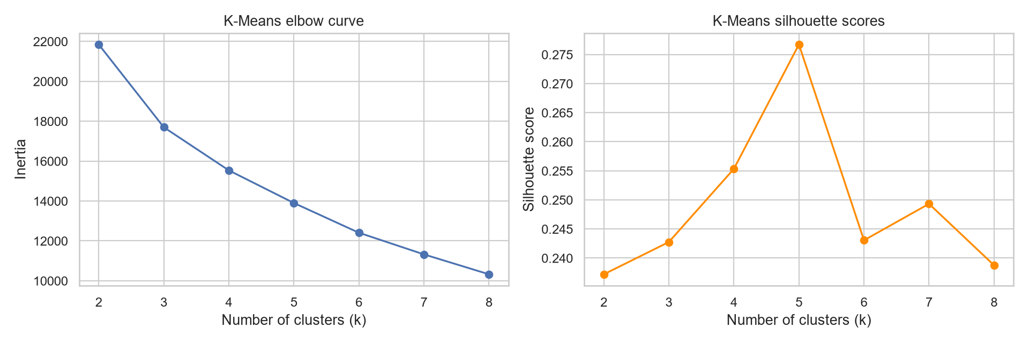
07 · UNSUPERVISED LEARNING
K-Means: limited market structure
Choice of k: k = 5 has the highest tested silhouette score; elbow and silhouette evidence are shown on the left.
Takeaway: the segments overlap, so K-Means finds limited structure.
Price is allowed for segmentation but never used as a supervised predictor.
Setup and choice of k
Features: area, rooms, price, house age, floor ratio, coordinates
Median imputation, then standardization (distance-based method)
k = 2–8, k-means++ start, 20 restarts
Cluster summaries compare count, price, area, rooms and age
Exploratory only: clusters are not used as inputs to the regression models
Nurkhan · 8

Slide 9
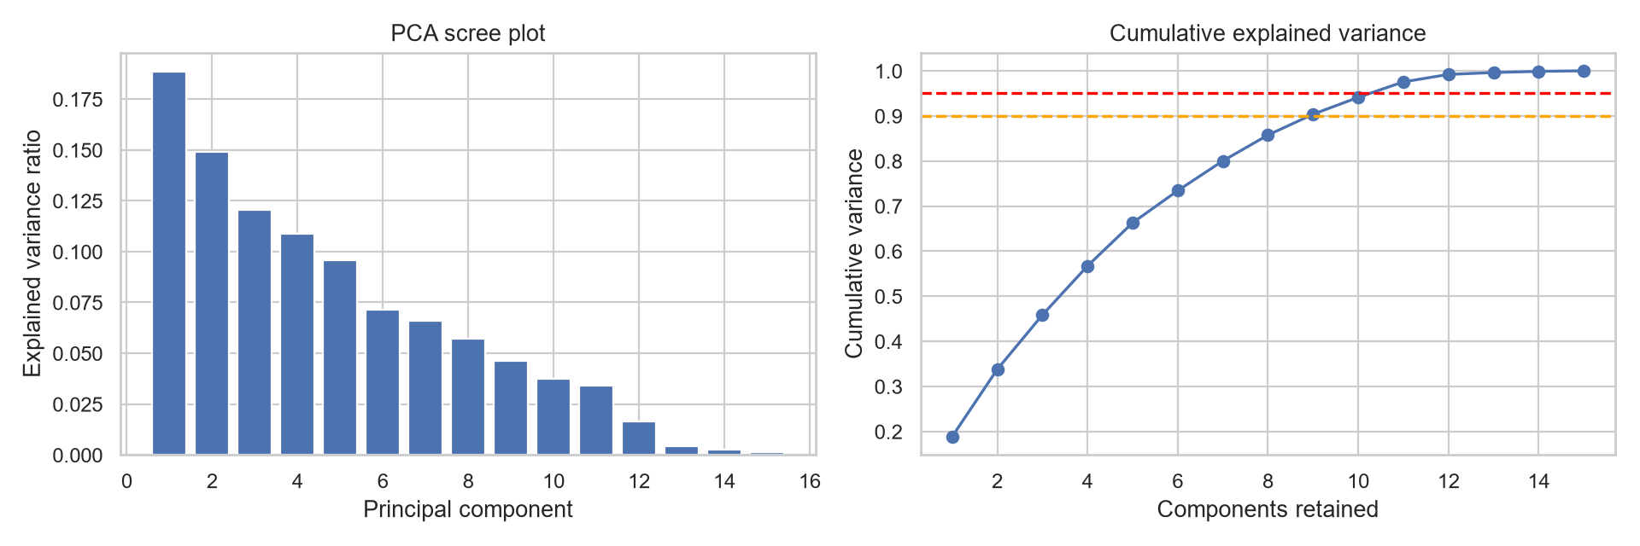
08 · DIMENSIONALITY REDUCTION
PCA: variance is spread across many components
Fitted on standardized numeric training features only.
No dominant axis: the features carry mostly independent information, so PCA compresses little.
It helps visualization but is less interpretable than the original features.
33.8%
9
11
variance in 2 components
components for 90%
components for 95%
PCA is used for visualization and structure, not as model input
Nurkhan · 9

Slide 10
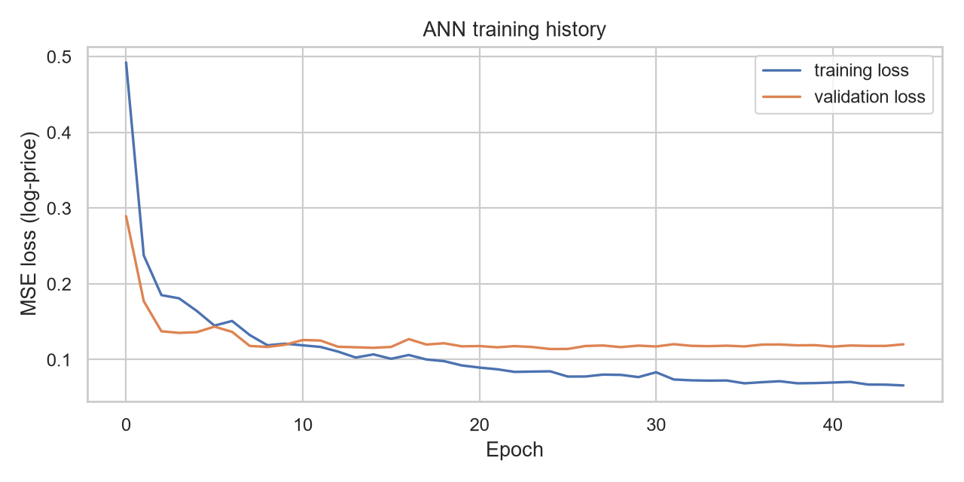
09 · NEURAL NETWORK
Feedforward ANN: competitive once the target is scaled
Input
→
Dense 128
→
Dense 64
→
Dense 32
→
Output 1
preprocessed
ReLU · drop 0.2
ReLU · drop 0.2
ReLU
linear
Setup
MSE loss, Adam at 0.001, batch 32, early stopping and learning-rate halving on plateau
What changed
Input and log-price target scaling are fit on training data only, so training starts at the right scale.
Result
Validation RMSE(log) = 0.171: competitive, but above Gradient Boosting (0.162).
Tabular data, so an ANN is the right deep-learning model; a CNN or NLP model would not apply
Bakytzhan · 10

Slide 11
10 · MODEL COMPARISON
Gradient Boosting leads, the ANN is close behind
Model, validation set
RMSE (log)
R²
MAE (KZT)
MedAPE
Gradient Boosting
0.16
0.89
5.8 M
9.4%
Random Forest
0.17
0.88
6.0 M
9.7%
Neural network (ANN)
0.17
0.88
6.2 M
9.6%
Linear Regression
0.21
0.82
7.7 M
11.9%
Decision Tree (tuned)
0.22
0.80
8.3 M
13.3%
KNN (tuned)
0.24
0.77
8.3 M
13.1%
Median baseline
0.50
0.00
17.9 M
34%
Same split and metrics for all models · values read from the validation charts (±0.01)
Bakytzhan · 11

Slide 12
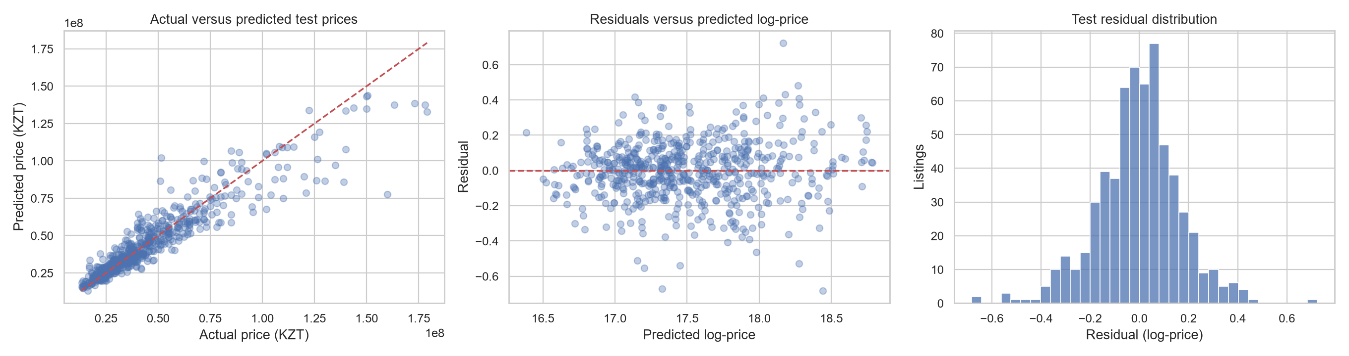
11 · FINAL TEST AND ERROR ANALYSIS
Where the best model errs on the test set
Unbiased on average
Premium flats underpredicted
Even spread
Residuals centre on 0; most fall within ±0.2 log-price (about ±20%).
Above ≈ 100M KZT, predictions fall below the diagonal.
Error does not grow with predicted price; a few outliers reach ±0.7.
Final test metrics: RMSE (log) 0.167 · R² 0.892 · MedAPE 9.18%
Best model refit on train plus validation, scored once on the test set
Bakytzhan · 12

Slide 13
12 · LIMITATIONS AND ETHICS
What the model cannot tell you
Data limitations
Responsible use
Asking prices differ from negotiated sale prices
Duplicates, missing fields and seller-entry errors
One market period, so no time-aware validation
Renovation, view and building details are missing, which hurts premium flats
A decision-support estimate, not an official appraisal
Feature importance shows predictive use, not causes
Accuracy varies by price segment and district
Predictions support, not replace, professional appraisal and human judgment
Seen in our own results: premium listings are underpredicted, and the ANN’s extra complexity did not beat Gradient Boosting. Next: verified sales, quality data, time-aware validation.
Ethical angle: an automated price anchor can mislead buyers and sellers if over-trusted
Nurkhan · 13

Slide 14
13 · CONCLUSIONS
Four findings from the evidence
R² ≈ 0.89
≈ 71%
Gradient Boosting is the best model
Area dominates the price
Test median error ≈ 9.2% against 34% for the baseline; Random Forest is within 0.01 RMSE.
Then ceiling height ≈ 9%, latitude, rooms and build year; importance is not causality.
5 clusters
RMSE 0.171
Weak market structure
The ANN works, but does not win
K-Means finds limited structure; PCA needs 9 components for 90% variance.
With a scaled target it is competitive, yet its complexity is not justified against Gradient Boosting (0.162).
Answer: yes, asking prices are predictable to about 9% median error, least accurately for premium listings.
Final test metrics on slide 12
Both · 14

Slide 15
14 · TEAM CONTRIBUTIONS
Who did what
Nurkhan Kuanyshov
Bakytzhan Jangazy
Data preparation, cleaning, feature engineering, EDA
Leakage-safe split and preprocessing pipeline
Midterm baselines, K-Means, PCA, documentation
Supervised modelling and tuning: Decision Tree, KNN, Random Forest, Gradient Boosting
Neural network: architecture, training, diagnosis
Final comparison, test evaluation, error analysis
Presents slides: 2–5, 8–9, 13
Presents slides: 6–7, 10–12
Thank you. Questions?
Code, README and the contribution record are in the project repository
Both · 15

