Slide 1
SWD Page Recorder

Slide 2
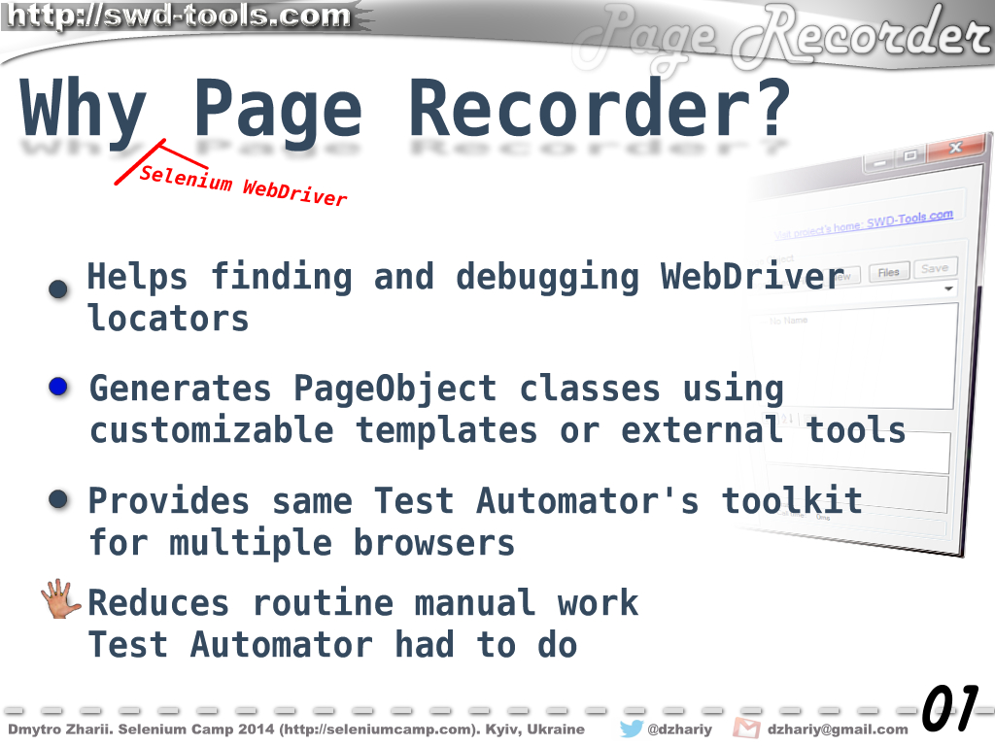

Slide 3


