Slide 1

Record your Page Objects fast like a ninja!
Kyiv
Selenium
Camp 2014

Slide 2


Slide 3
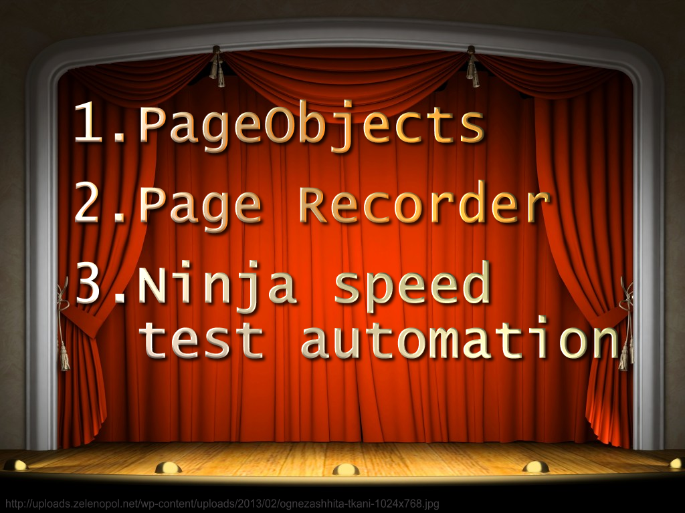

Slide 4
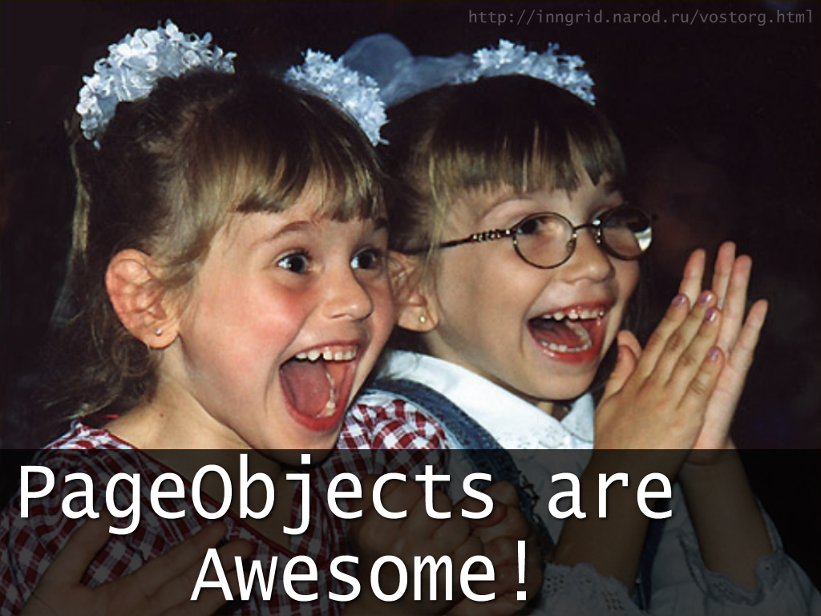

Slide 5
Empty
1 Page Object
2 Page Objects
3. PageObjects
= Framework
= Code Reusability

