Slide 1
Skip List and
Probabilistic Analysis of Algorithm
Дмитрий Желонкин
Соколов Артём

Slide 2
Quick info
probabilistic data structure
same asymptotic expected time bounds as balanced trees
simpler, faster and use less space than trees

Slide 3

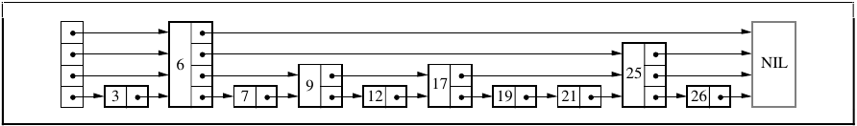
Structure intro (I)

Slide 4
Structure intro (II)
Level, max level, forvard pointer

Slide 5
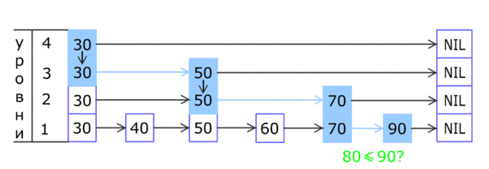
Search algorithm
Search(list, searchKey)
x := list→header
//loop invariant: x→key < searchKey
for i := list→level downto 1 do
while x→forward[i]→key < searchKey do
x := x→forward[i]
//x→key < searchKey ≤ x→forward[1]→key
x := x→forward[1]
if x→key = searchKey then
return x→value
else
return failure

Slide 6
Insertion and Deletion algorithms
Insert(list, searchKey, newValue)
local update[1..MaxLevel]
x := list→header
for i := list→level downto 1 do
while x→forward[i]→key < searchKey do
x := x→forward[i]
update[i] := x
x := x→forward[1]
if x→key = searchKey then
x→value := newValue
else
newLevel := randomLevel()
if newLevel > list→level then
for i := list→level + 1 to newLevel do
update[i] := list→header
list→level := newLevel
x := makeNode(newLevel , searchKey, value)
for i := 1 to newLevel do
x→forward[i] := update[i]→forward[i]
update[i]→forward[i] := x

Slide 7
Insertion and Deletion algorithms

