Slide 1


Building message-driven solutions with MassTransit
Denis Zhivtsov
Lead Software Engineer
EPAM Systems, Inc.

Slide 2
Agenda
Why messaging?
What is MassTransit?
Publish-Subscribe
Key features (Error handling, Scheduling, Audit, …)
Request-Response
Saga
Courier

Slide 3
Applications Integration
Files
Shared database
RPC/REST
Messaging

Slide 4
RPC/Rest
Explicit contract
Synchronous flow (request/response)
Deeply nested web service call stack
Services must be available at invocation
Load-balancer – separate software
Service 1
Service 2
Service 3

Slide 5
Messaging
Explicit contract
Asynchronous flow (pub/sub)
Minimized coupling
Fault tolerance
No temporal coupling
Naturally load-balanced
Service 1
Service 2
Service 3
Bus

Slide 6
RabbitMQ
Producer
Consumer
Ack
RabbitMQ
Binding
Exchange
Queue
Notes:
At least once delivery

Slide 7
RabbitMQ Exchanges
Exchanges
direct
fanout
topic
header
Bindings
reports.*
format=pdf
Queues
queue1
queue2
queue3
queue4
queue5

Slide 8
RabbitMQ setup
Install Erlang (http://www.erlang.org/downloads)
Install RabbitMQ (https://www.rabbitmq.com/download.html)
Enable management plugin (https://www.rabbitmq.com/management.html)

Slide 9
What is MassTransit?
“MassTransit is a free, open source, lightweight message bus for creating distributed applications using the .NET framework.”
Abstraction layer over transport
Connection management
Error handling
Messages correlation
Patterns (Request/Response, Saga, Routing Slip)
Developer friendly API
Serialization (JSON, XML, BSON, String, Binary, …)

Slide 10
Supported Transports
RabbitMQ
ActiveMQ
Azure ServiceBus
Azure EventHub
Amazon SQS
Http
…

Slide 11
History and statistics
Is continuously developed since 2007
Fully rebuilt in 2014 (v3)
Chris Patterson (@phatboyg) – Microsoft MVP, creator of Topshelf
Nuget: 2.7M downloads, 926 avg per day (as of 7/24/2019)
Latest version: 5.5.4 (released 7/24/2019) (as of 7/24/2019)

Slide 12
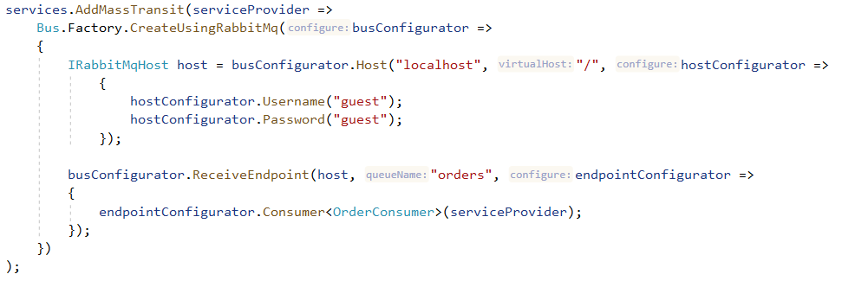
Quick Start
Add Nuget packages MassTransit, MassTransit.RabbitMQ, MassTransit.AspNetCore
Configure

Slide 13
Key concepts
Commands – send to specific queue exchange
Events – publish to event exchange so that anybody can subscribe
SendEndpoint/PublishEndpoint – exchange to send messages to
Consumer – message handler class (similar to Controller in MVC)
Consume – method of the Consumer (similar to Action of Controller)
ReceiveEndpoint – queue the app is listening to
Bus/BusControl – the composition root for all the endpoints and configuration

Slide 14
Produce a message
To publish an event - IPublishEndpoint
To send a command ISendEndpointProvider (or EndpointConvention + ISendEndpoint)
Always use Publish/Send method of the context (if available)
Queue1 Exchange
Queue1
Event Exchange
Queue2 Exchange
Queue2
Notes:
IBus as a façade
Events inheritance

Slide 15
Envelope
string SourceAddress
string DestinationAddress
string ResponseAddress
string FaultAddress
string[] MessageType
object Message
DateTime? ExpirationTime
DateTime? SentTime
IDictionary<string, object> Headers
HostInfo Host
string MessageId
string RequestId
string CorrelationId
string ConversationId
string InitiatorId

Slide 16
DEMO

Slide 17
Scheduling
MassTransit.Quartz – reference NuGet package
UseInMemoryScheduler() – non durable
ScheduleSend()/SchedulePublish() – to schedule a message
ScheduleRecurringSend() – to schedule recurring message (CRON)
CancelScheduledSend()/CancelScheduledRecurringSend() – to cancel
Redeliver() – to redeliver current message
Notes:
Brokers can also support (e.g. RabbitMQ via plugin, Azure Service Bus out of the box)

Slide 18
Scheduling
.UseMessageScheduler(Uri) - durable
Service
Scheduler (Quartz.NET)
Bus

Slide 19
Error Handling
At Consumer, Endpoint or Bus level
UseInMemoryOutbox
UseTransaction
UseMessageRetry (first-level retry)
UseScheduledRedelivery (second-level retry)
Handle and Ignore filters
Consume Fault<T> messages

Slide 20
Circuit Breaker
.UseCircuitBreaker(...)
Closed
Failure threshold exceeded
Success
Delay
Open
Half Open
Error

Slide 21
Demo

Slide 22
Large payloads (Message Data)
public class YourMessage
{
public string YourName { get; set; }
public MessageData<byte[]> TheLargeMessage { get; set; }
}

Slide 23
Large payloads (MessageData)
public interface IMessageDataRepository
{
Task<Stream> Get(Uri address, CancellationToken cancellationToken = default(CancellationToken));
Task<Uri> Put(Stream stream, TimeSpan? timeToLive = default(TimeSpan?), CancellationToken cancellationToken = default(CancellationToken));
}
Notes:
Out-of-the box: InMemory, FileSystem, MongoDB/GridFS integration with Enchilada

Slide 24
Large payloads (MessageData)
e.UseMessageData<YourMessage>( provider.GetService<IMessageDataRepository>());
var message = new YourMessage
{
YourName = "Test",
TheLargeMessage = repository.PutBytes(yourByteArray)
};

Slide 25
Observers
IReceiveObserver
IConsumeObserver
IConsumeMessageObserver<T>
ISendObserver
IPublishObserver
IBusObserver

Slide 26
Observers - ConsumeObserver
public interface IConsumeObserver
{
Task PreConsume<T>(ConsumeContext<T> context);
Task PostConsume<T>(ConsumeContext<T> context);
Task ConsumeFault<T>(ConsumeContext<T> context, Exception exception);
}

Slide 27
Audit
interface IMessageAuditStore
{
Task StoreMessage<T>(<T> message, MessageAuditMetadata metadata);
}
bus.ConnectSendAuditObservers(auditStore)
bus.ConnectConsumeAuditObserver(auditStore)

Slide 28
Middleware
Built-in:
UseConcurrentMessageLimit
UseRateLimit
UseCircuitBreaker
UseInMemoryOutbox
UseTransaction
….
Custom:
Implement IPipeSpecification<T>

Slide 29
Request - Response
Consumer - Requester
Request
Consumer - Responder
Response

Slide 30
Request - Response
Consume(ConsumeContext<IOrderSubmitted> context) {
{ IRequestClient<CheckOrderStatus> client = context.CreateRequestClient<CheckOrderStatus>(bus);
Response<OrderStatusResult> response = await client.GetResponse<OrderStatusResult>(new {OrderId = id});
}
Respond to request in CheckOrderStatusConsumer:
context.RespondAsync<OrderStatusResult>(new {…})

Slide 31
Saga
Create cart
Add items
Check out
Process payment
Distributed process with coordinator
Described as state machine
Consists of state, events and activities
State is saved in repository
Service 1
Coordinator
Service 2
Bus

Slide 32
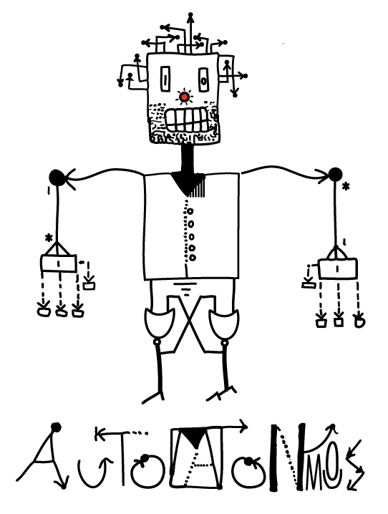
Saga
Nuget packages:
Automatonymous
MassTransit.Automatonymous
Components
TSaga : SagaStateMachineInstance
MassTransitStateMachine<TSaga>
ISagaRepository<TSaga>
Notes:
Repositories out of the box: Entity Framework, MongoDB, Dapper, NHibernate, Redis, Marten, CosmosDb, Azure Service Bus – Session!

Slide 33
Demo

Slide 34
Courier / Routing slip
Bus
Routing Slip Message
Book flight
Book hotel
Rent a car
Cancel
Cancel
Cancel
Dynamic list of Activities
Itinerary is sent together with message
Each Activity has two methods (Execute and Compensate)

Slide 35
Courier / Routing slip
A tracking number, which should be unique for each routing slip
An itinerary, which is an ordered list of activities
An activity log, containing an ordered list of previously executed activities
A compensation log, containing an order list of previous executed activities which may be compensated if the routing slip faults
A collection of variables, which can be mapped to activity arguments
A collection of subscriptions, which can be added to notify consumers of routing slip events
A collection of exceptions which may have occurred during routing slip execution

Slide 36
Courier / Routing slip
Build routing slip
Execute
Subscribe to events
RoutingSlipCompleted
RoutingSlipFaulted
RoutingSlipCompensationFailed
RoutingSlipActivityCompleted
RoutingSlipActivityFaulted
RoutingSlipActivityCompensated
RoutingSlipActivityCompensationFailed

Slide 37
Demo

Slide 38
Testing
Consumers – easy to unit test
Bus.Factory.CreateUsingInMemory – in-process message bus, good for integration testing
MassTransit.TestFramework – test harness for NUnit

Slide 39
What else?
Batches
Integration with SignalR
Integration with Reactive Extensions (Rx.NET)
Turnout (for long running tasks)
Conductor

Slide 40
Resources
Enterprise Integration Patterns (Gregor Hohpe, Bobby Woolf), 2003
https://masstransit-project.com/MassTransit/ - docs
https://github.com/MassTransit – sources and samples
https://gitter.im/MassTransit/MassTransit - chat
https://groups.google.com/forum/#!forum/masstransit-discuss – forum
.NET Rocks! podcasts with Chris Patterson (798, 1228)
https://github.com/dzhivtsov/DotNetMeetupMassTransit

Slide 41
Q&A
Thank you!

