Slide 1
E-COMMERCE API
PREPARED:
DZHENGIZ TURHAN FERAD

Slide 2
Login
Authentication/Login API
The authentication or login API is the access authorization that you need to access the resources of a shipping provider's site. This login API helps the channel owner validate that you are a valid user. If you need to authenticate via bearer auth (e.g., for a cross-origin request), use -H "Authorization: Bearer ‘token’ …

Slide 3
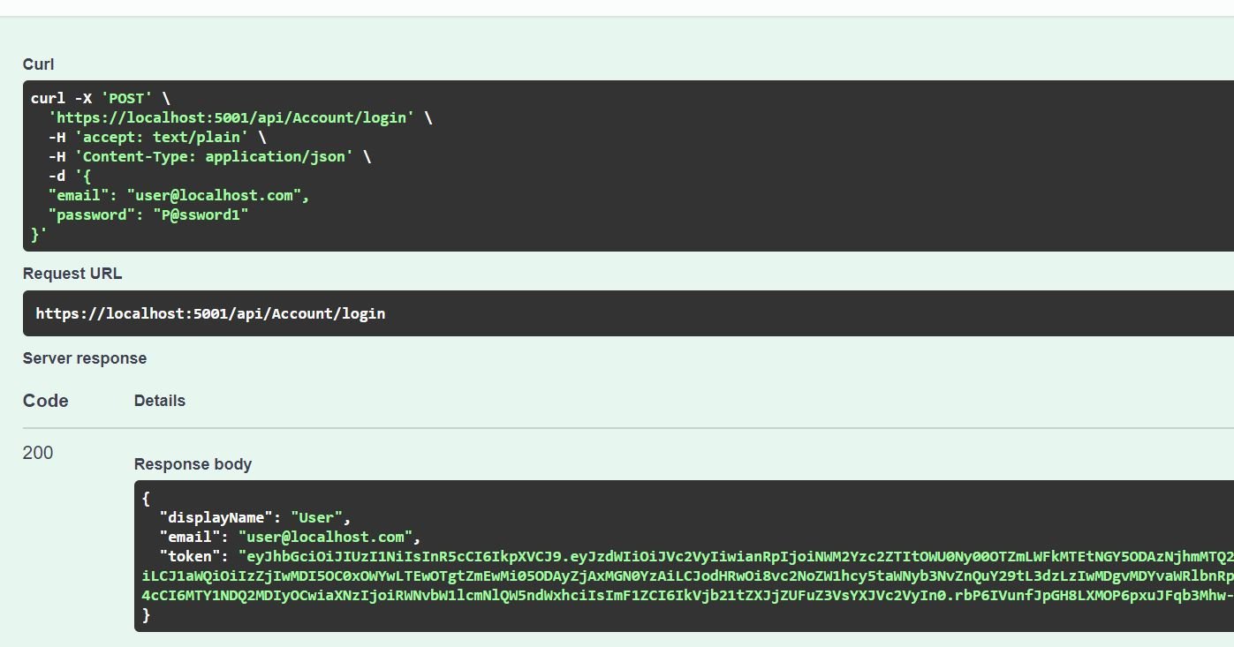
Login

Slide 4
Add Product
Product information API
A product information API allows you to extract product details from a database of products that includes information about product descriptions, product ID, product specs, product images, pricing, the number of products, and more.
A user can sort and filter the product data according to the pricing of cheapest and most expensive products.
Also can search by Type, Brand or Name.

Slide 5
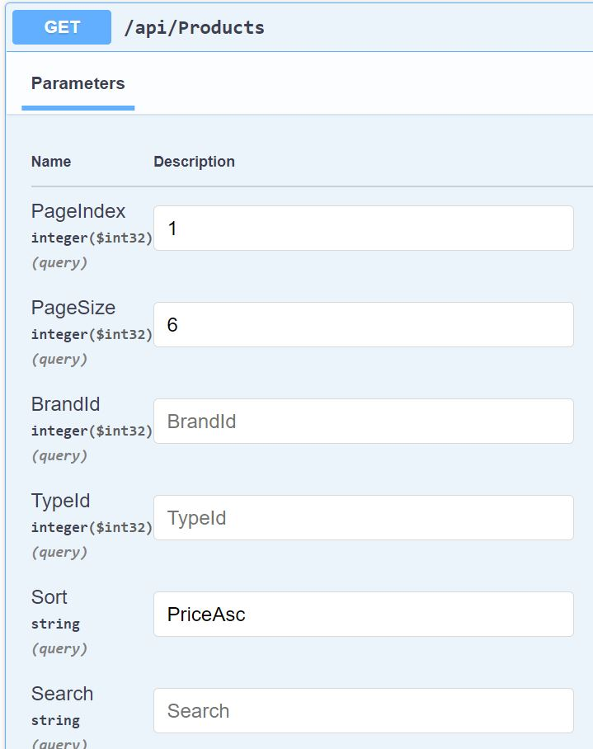
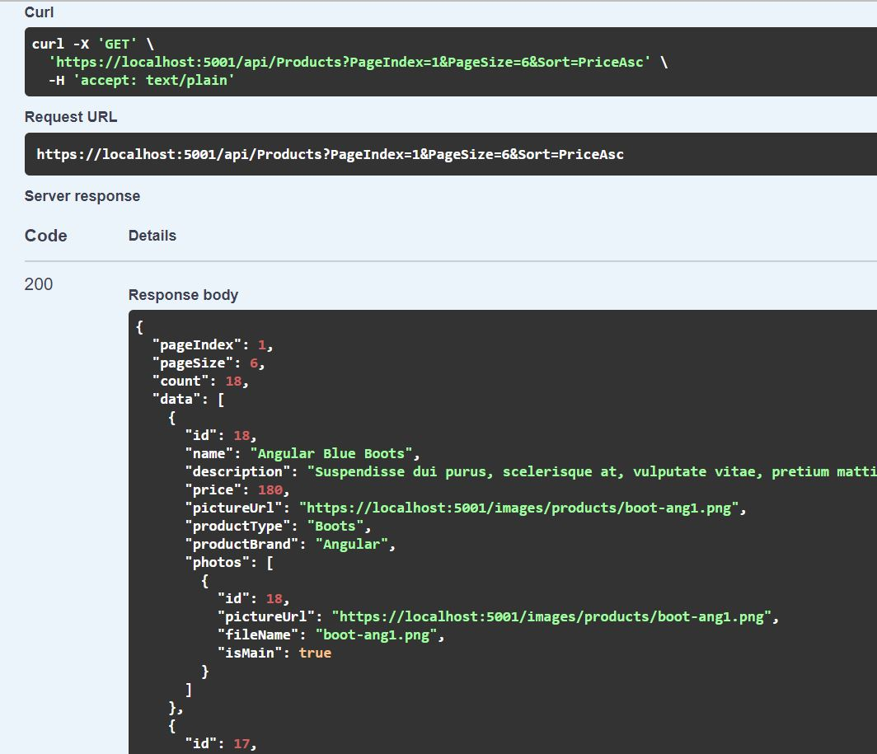
Get Products

Slide 6
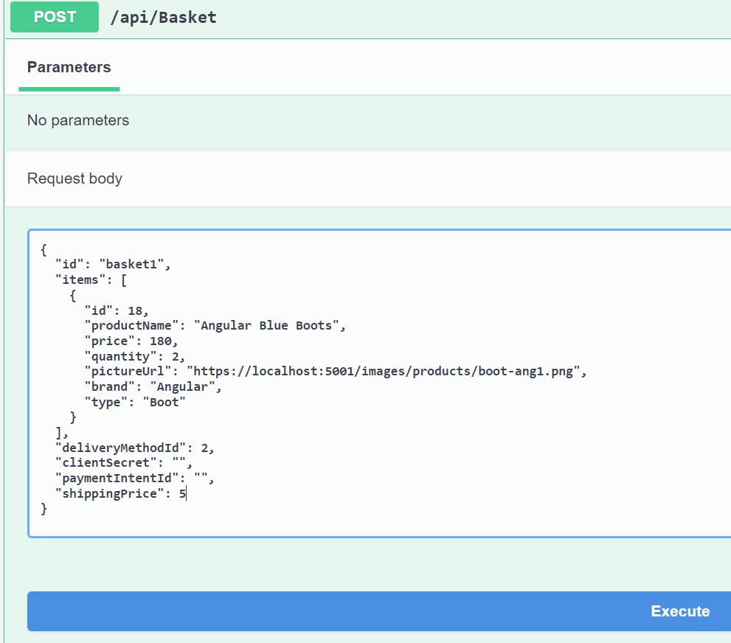
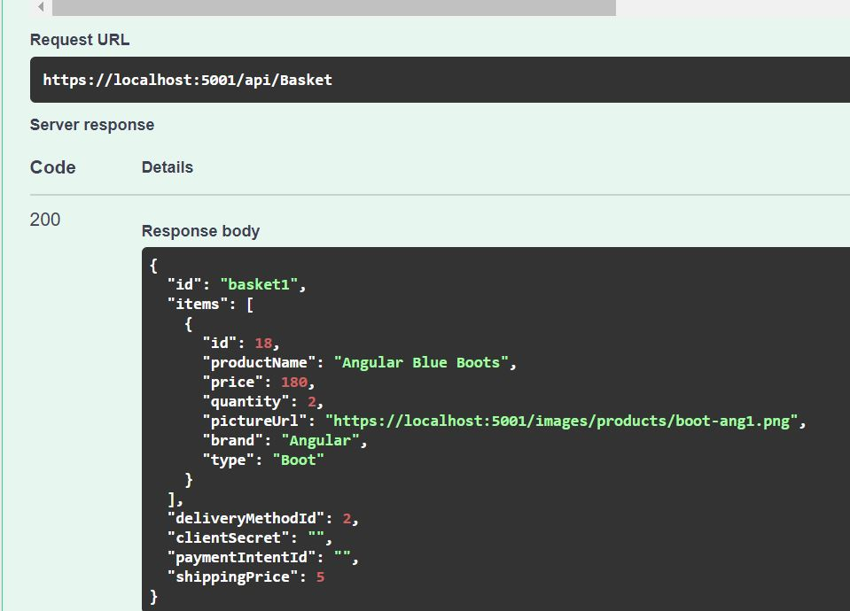
Add to basket

Slide 7
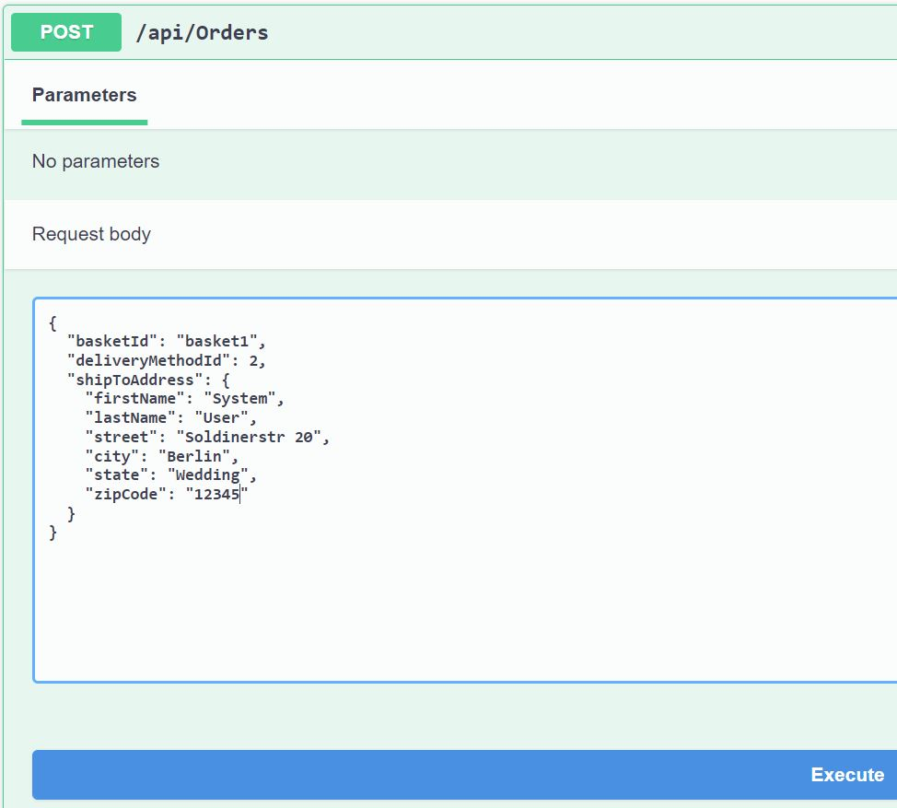
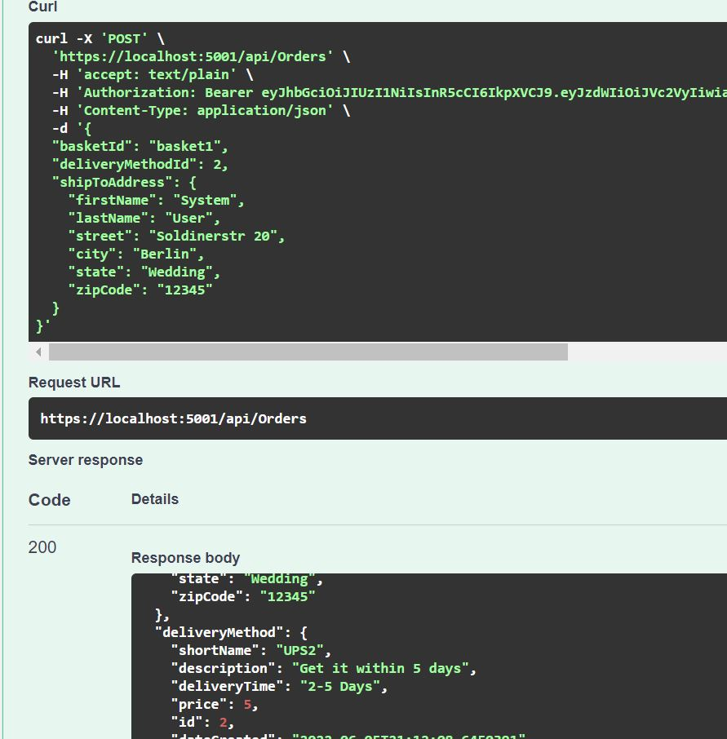
Add Order

Slide 8
Add Payment
Payment API
With the payment API you can create an application for the checkout process that accepts payment through TEST credit card or debit card test data in Stripe.
If you are authenticated the Payment API can be programmed according to your existing payment gateway.
The Stripe API uses API keys to authenticate requests. You can view and manage your API keys in the Stripe Dashboard.
Test mode secret keys have the prefix sk_test_ and live mode secret keys have the prefix sk_live_. Alternatively, you can use restricted API keys for granular permissions.

Slide 9
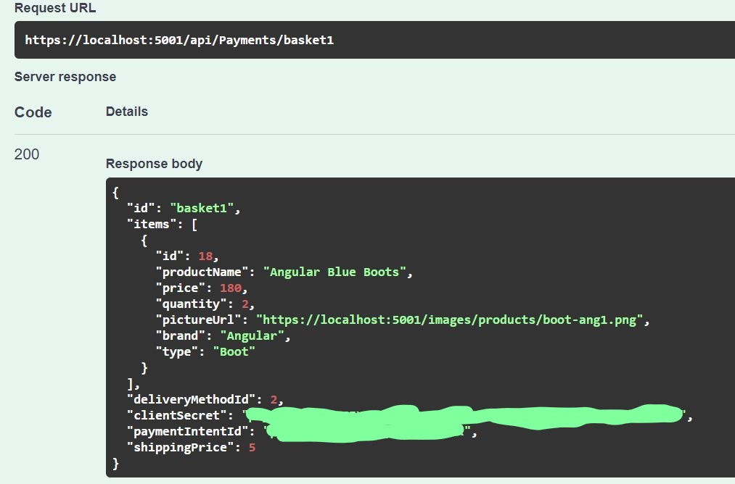
Add Payment

Slide 10
You can try more examples in Swagger. ☺

