Slide 1
User Guide of PSRFM Program (C++ Version)
Detang Zhong
detang.zhong@canada.ca

Slide 2
Requirements
2 pairs of fine (Landsat / Sentinrel-2) and MODIS images on the Start and End dates;
one or a series of MODIS image acquired on the prediction date(s) between the Start and End dates;
Windows 7 or 10.

Slide 3
3 Steps to run the program
Copy the compiled executable PSRFM_Main.exe to a local folder, e. g. C:\PSRFM;
Prepare or edit the parameter input file: PSRFM_Input.txt with your input data files and processing options;
In a dos command window, change the current folder to the folder where PSRFM.exe sits. For example: type the command: cd C:\PSRFM;
Run the program: PSRFM_Main.exe PSRFM_Input.txt

Slide 4
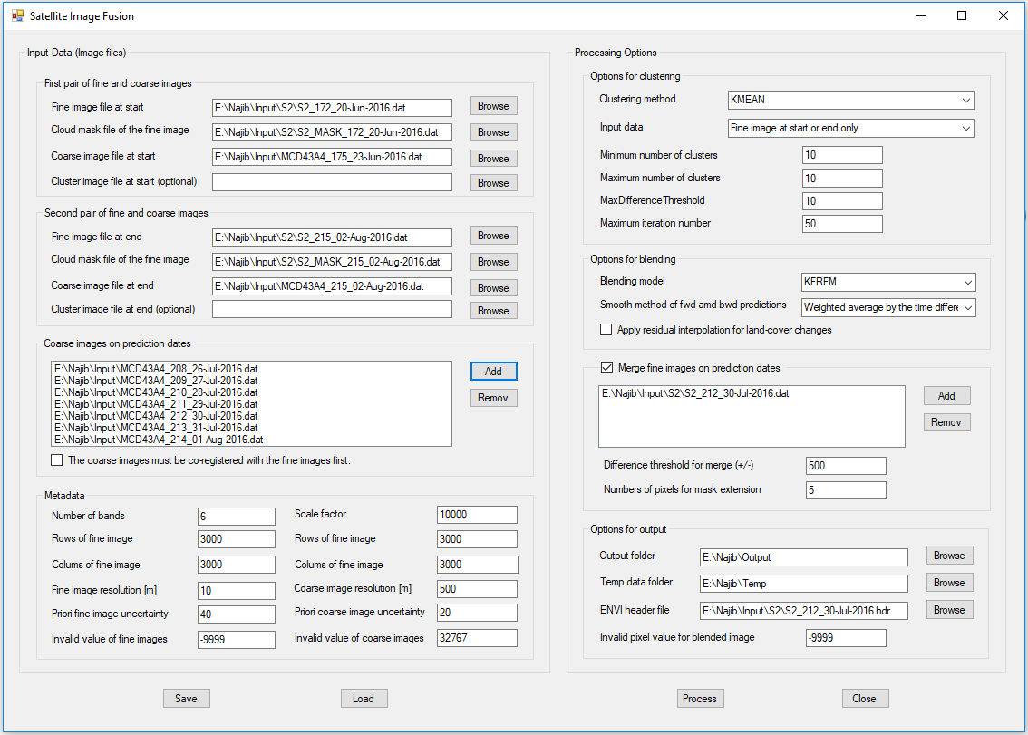
User interface of PSRFM program
Users can also use the compiled user graphic interface SatImgFusion.exe to run PSRFM program.
Just copy the exe file SatImgFusion.exe to the same folder as the exe file PSRFM_Main.exe and then double click on it to start.

Slide 5
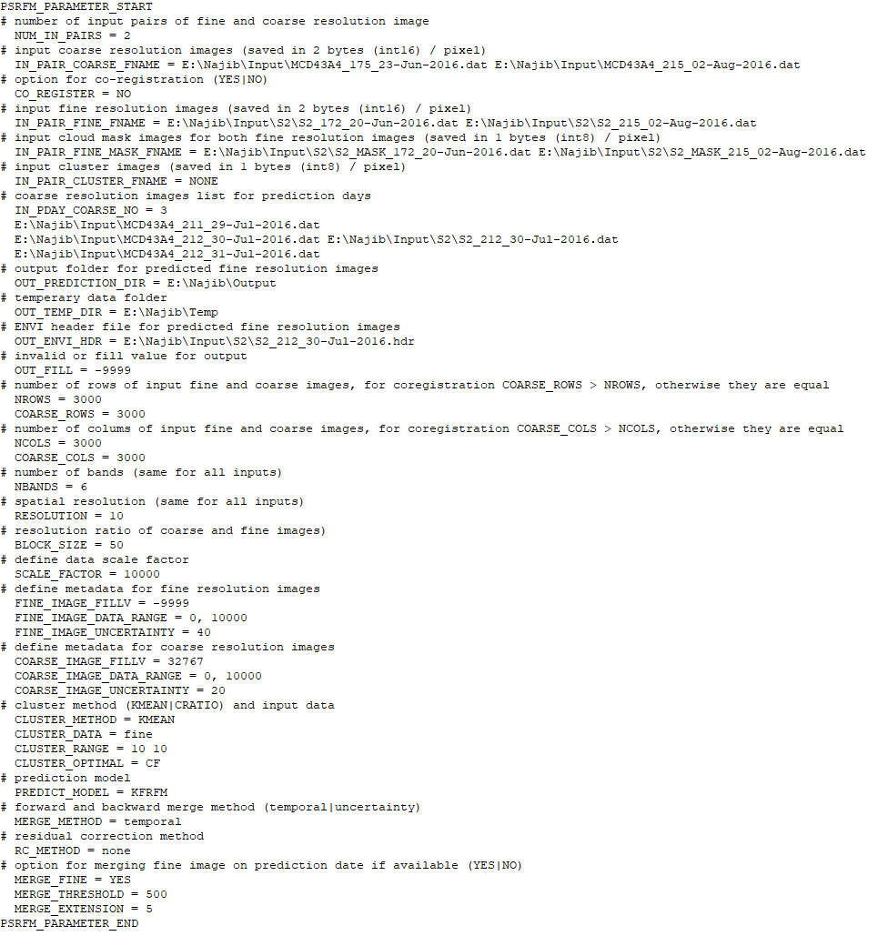
The PSRFM_Input.txt File
The PSRFM_Input.txt file controls the image blending processing

Slide 6
The Required Input Files
two coarse resolution (MODIS) images at the start and end dates saved in 2 bytes (int16) / pixel binary format;
two fine resolution (Landsat or Sentinel-2) images at the start and end dates saved in 2 bytes (int16) / pixel binary format;
two cloud mask files for the fine resolution images at the start and end dates saved in 1 byte (int8) / pixel binary format (The pixel value 1 and 0 mean cloudy and normal respectively);
a coarse resolution image list for prediction days, use a space to separate file names;
an ENVI header file for the final predicted images (same as ENVI header file for the fine resolution images if available).

Slide 7
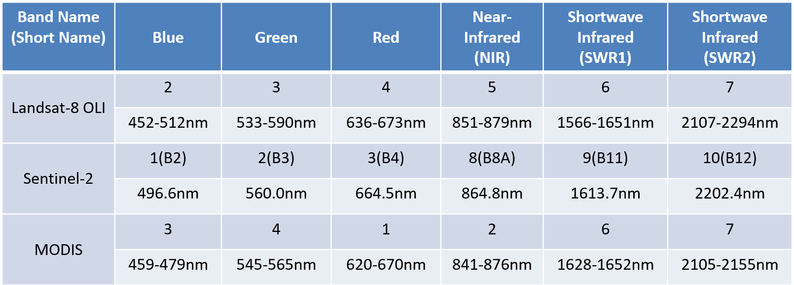
Requirements on the input files
Re-projected to a same mapping projection system (e.g. UTM);
Named with their acquisition dates in the format *_ddd_dd-mmm-yyyy.dat at the end of their file names, for example: E:\\PSRFMTest\\Input\\L2A_T13UCT_143_23-May-2018.dat (the 143 (ddd) is the number of days of year);
Saved in the 2 bytes Int16 binary format for all input images;
Single band data files must be merged into a multiple band data file;
The band/channel data with different sensors must be matched in the same order;
The coarse resolution images must cover the same or larger area than the fine resolution images. If the coverage is larger, the co-registration option must be selected.
The cloud mask files saved in 1 byte (Int8) binary format for the fine resolution images are required. If no cloudy pixels exist, create an all zero pixels image.

Slide 8
Options for Prediction Model
# prediction model (PSRFM, KFRFM)
# use the prediction smooth model
PREDICT_MODEL = PSRFM
# or use the Kalman Filter prediction model
PREDICT_MODEL = KFRFM

Slide 9
Options for co-registration
# option for co-registration (YES|NO)
CO_REGISTER = YES
# number of rows of input fine and coarse images,
# for co-registration COARSE_ROWS > NROWS, otherwise they are equal
NROWS = 1400
COARSE_ROWS = 1600
# number of columns of input fine and coarse images,
# for co-registration COARSE_COLS > NCOLS, otherwise they are equal
NCOLS = 2000
COARSE_COLS = 2200
Note: 1 to 2 km coverage extension of the coarse images is recommendable for the co-registration.

Slide 10
Metadata of the input images
# number of bands (same for all inputs)
NBANDS = 6
# spatial resolution (same for all inputs)
RESOLUTION = 20
# resolution ratio of coarse and fine images (BLOCK_SIZE = coarse resolution / fine resolution)
# important: the NROWS and NCOLS must be divisible by the BLOCK_SIZE
BLOCK_SIZE = 25
# pixel value scale factor
SCALE_FACTOR = 10000
# metadata for fine resolution image
FINE_IMAGE_FILLV = -9999
FINE_IMAGE_DATA_RANGE = 0, 10000
FINE_IMAGE_UNCERTAINTY = 40
# metadata for coarse resolution image
COARSE_IMAGE_FILLV = 32767
COARSE_IMAGE_DATA_RANGE = 0, 10000
COARSE_IMAGE_UNCERTAINTY = 20

Slide 11
Option for Input Cluster Data Files
# use known input cluster data (saved in 1 bytes (int8) / pixel)
CLUSTER_METHOD = DONE
IN_PAIR_CLUSTER_FNAME = C:\\PSRFM\\psrfm\\TestData\\Input\\start_cluster_image.dat C:\\PSRFM\\psrfm\\TestData\\Input\\end_cluster_image.dat
# Note: The cluster numbers should be 1, 2, 3, …, K. The K class is used for a
# background value or invalid pixels. This is different from PCI Geomatica’s
# output of clustering methods that uses 0 to represent the background value
# or invalid pixels.
# or let the program conduct clustering
CLUSTER_METHOD = KMEAN
IN_PAIR_CLUSTER_FNAME = NONE

Slide 12
Options for clustering
# cluster method (DONE|KMEAN|CRATIO) and input data.
# CLUSTER_METHOD = DONE use the known input cluster data files
# CLUSTER_METHOD = KMEAN use the kmean method for clustering
# CLUSTER_METHOD = CRATIO use the simple grouping method,
# only valid when CLUSTER_DATA = ratio
CLUSTER_METHOD = KMEAN
# cluster method input data (fine|fine+coarse|ratio)
# CLUSTER_DATA = fine use the fine resolution image at the start or end date only
# CLUSTER_DATA = fine+coarse use the fine resolution image at the start or
# end date + the coarse resolution image
# CLUSTER_DATA = ratio use the coarse resolution reflectance change ratios
CLUSTER_DATA = fine
# cluster range used for optimizing clusters
CLUSTER_RANGE = 8 20
# cluster optimization method (CC|CF)
CLUSTER_OPTIMAL = CF

Slide 13
Options for residual adjustment
# residual correction or adjustment method for abrupt land
# surface changes(none|bilinear)
# RC_METHOD = none don't apply the residual adjustment
# RC_METHOD = bilinear apply the residual adjustment
# based on a bilinear interpolation method
RC_METHOD = none

Slide 14
Options for smooth
# forward and backward merge method (temporal|uncertainty)
# MERGE_METHOD = temporal use elapsed time for weighting
# MERGE_METHOD = uncertainty use estimated uncertainty for # weighting
MERGE_METHOD = temporal

Slide 15
Options for merging clear-sky fine image pixels
# option for merging fine image on prediction dates if available (YES|NO)
MERGE_FINE = YES
MERGE_THRESHOLD = 500
MERGE_EXTENSION = 5
# MERGE_THRESHOLD is used to detect clouds and cloud shadows
# MERGE_EXTENSION is used to normalize the blended pixels to fine image pixels

Slide 16
Question & Support
If you have questions, please contact Detang Zhong (detang.zhong@canada.ca) and Fuqun Zhou (Fuqun.Zhou@canada.ca) at Canada Centre for Remote Sensing, Canada Centre for Mapping and Earth Observation, Natural Resources Canada.
If the software is helpful for your research and application developments, please cite the following papers:
Zhong, D.; Zhou, F. Improvement of Clustering Methods for Modelling Abrupt Land Surface Changes in Satellite Image Fusions, Remote Sens. 2019, 11, 1759; doi:10.3390/rs11151759.
Zhong, D.; Zhou, F. A Prediction Smooth Method for Blending Landsat and Moderate Resolution Imagine Spectroradiometer Images, Remote Sens. 2018, 10 (9), 1371; doi:10.3390/rs10091371

