Slide 1
GRACE TWS Downscaling Program (Matlab)
Detang Zhong
detang.zhong@canada.ca

Slide 2
Objective and Method
Objective: Downscaling GRACE terrestrial water storage anomaly (GRACE TWSA) from its original coarse monthly resolution (monthly ~300km) to a high spatiotemporal resolution (daily 5km)
Method: Two-step downscaling with high spatiotemporal resolution terrestrial water storage anomaly simulated by a Land Surface Model (LSM TWSA)
Step 1: Using the iterative adjustment method based on the self-calibration variance-component model (SCVCM) to downscale the monthly GRACE TWSA spatially to the high resolution grid of the monthly LSM TWSA
Step 2: Downscale the spatially downscaled monthly GRACE TWSA temporally to the high resolution grid of the daily LSM TWSA
References:
Paper 1: A Self-Calibration Variance-Component Model for Spatial Downscaling of GRACE Observations Using Land Surface Model Outputs
Paper2: Spatiotemporal Downscaling of GRACE Terrestrial Water Storage Using Land Surface Model Outputs

Slide 3
Input Data
The Monthly Mass Grids – JPL Global Mascons Solution (https://grace.jpl.nasa.gov/data/get-data/jpl_global_mascons/)
Daily Absolute Terrestrial Water Storage Grids simulated by NRCan EALCO Model

Slide 4
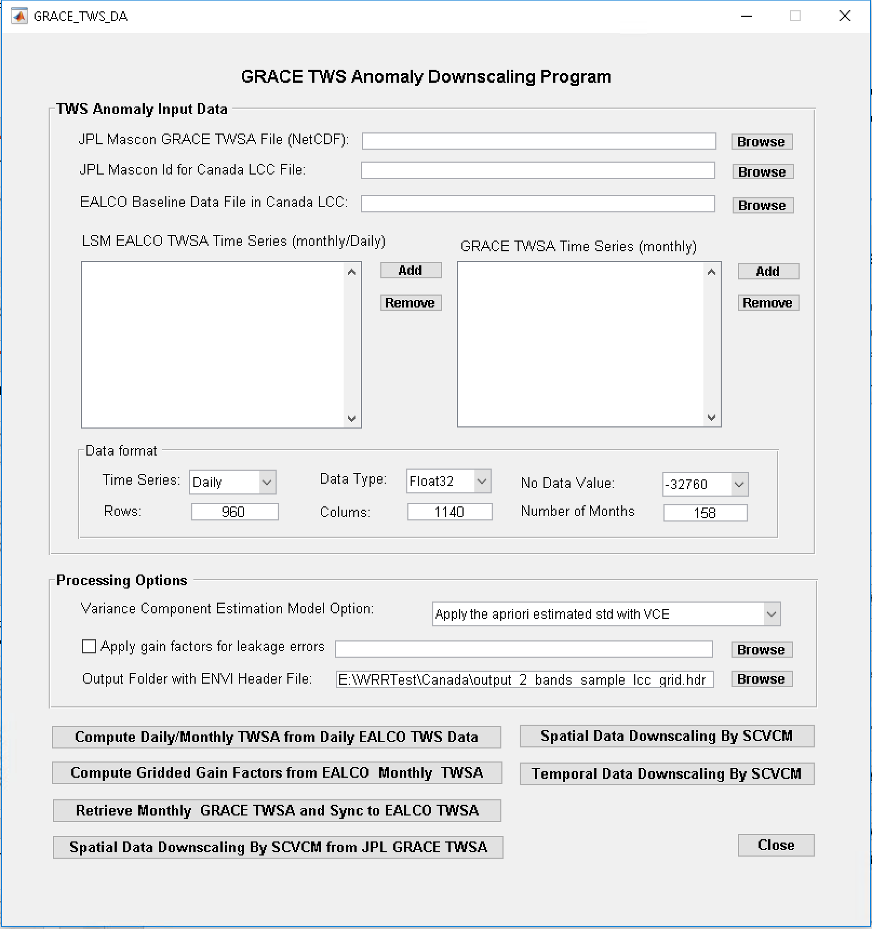
Step 1 - Start the program interface
Unzip the TWSModel.zip to a local folder, e. g. C:\TWSModel;
Open Matlab Software;
Change Matlab current path to the TWSModel program folder;
Load the GRACE_TWS_DA.m and run it.

Slide 5
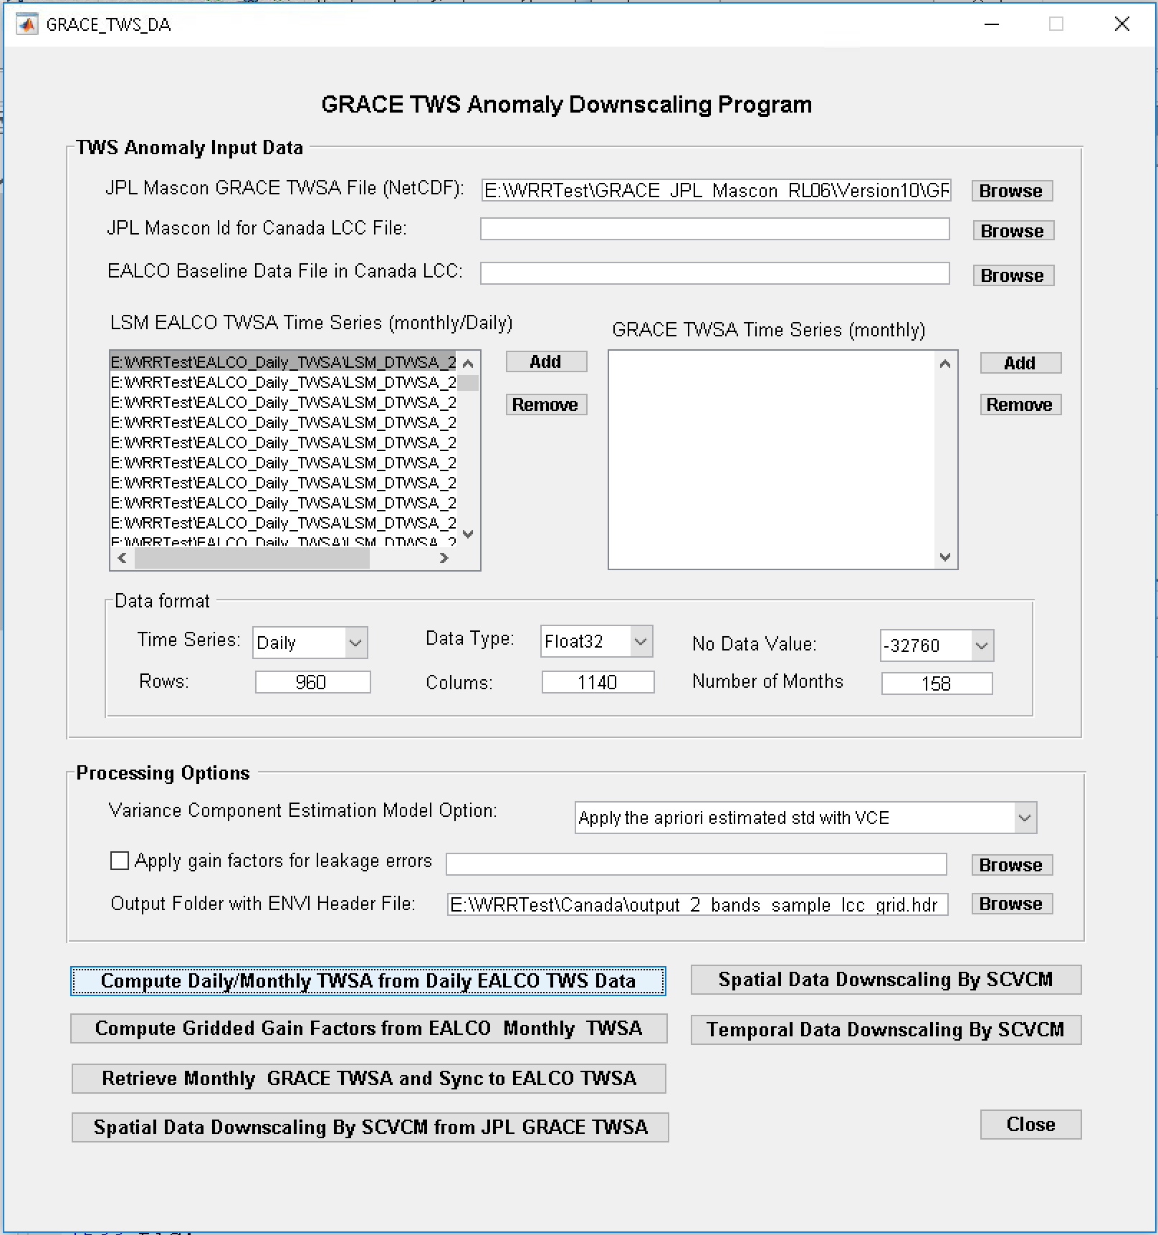
Step 2 - Compute Daily/Monthly TWSA from Daily EALCO TWS Data
Specify the JPL Mascon GRACE TWS data file in NetCDF format (downloaded from JPL GRACE data product website)
Specify EALCO daily absolute TWS time series and their metadata
Specify the output data folder by a 2-band ENVI header file
Click on the button “Compute Monthly EALCO TWSA from Daily EALCO TWS Data”
Output: A binary float32 data file with two bands per day. The first band is the daily EALCO TWSA. The second band is the estimated std. A binary float32 data file with two bands per month. The first band is the monthly EALCO TWSA. The second band is the estimated std.

Slide 6
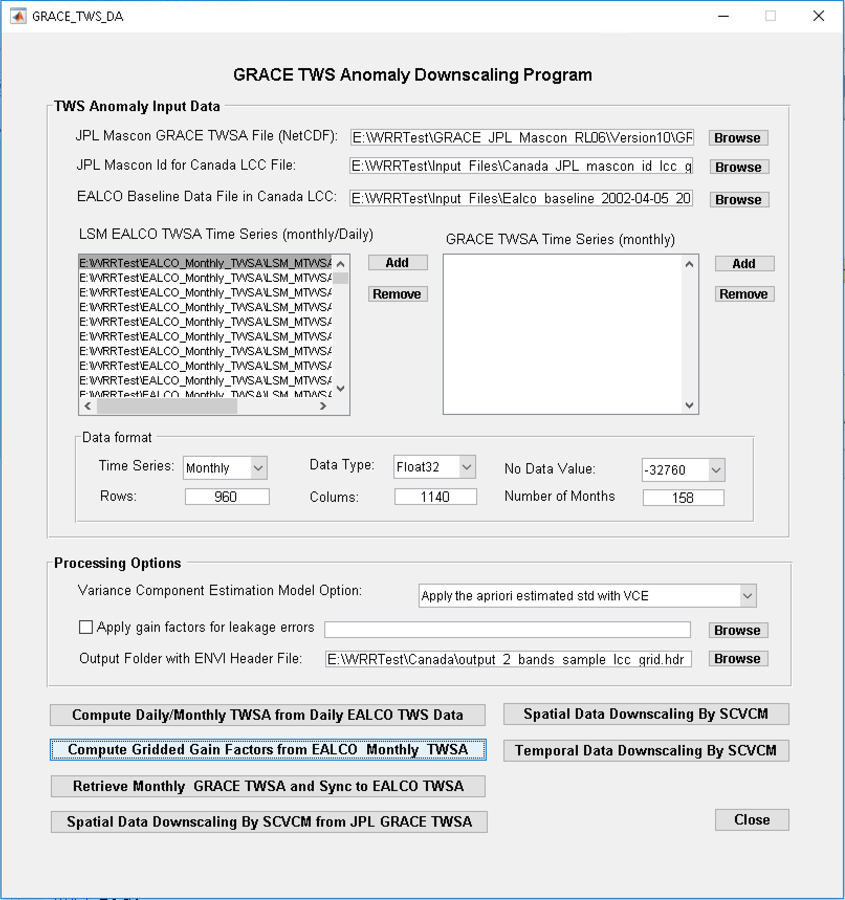
Step 3 - Compute Gridded Scale Gain Factors from EALCO TWSA Monthly Data
Specify the JPL Mascon GRACE TWS data file in NetCDF format (downloaded from JPL GRACE data product website)
Specify EALCO monthly TWSA time series and their metadata (from step 1)
Specify EALCO Baseline data file (from step 1)
Specify the output data folder by browsing a 2-band ENVI header file
Click on the button “Compute Gridded Gain Factors from EALCO Monthly TWSA”
Output: A binary float32 data file with two bands. The first band is the scale factors. The second band is the estimated std.

Slide 7
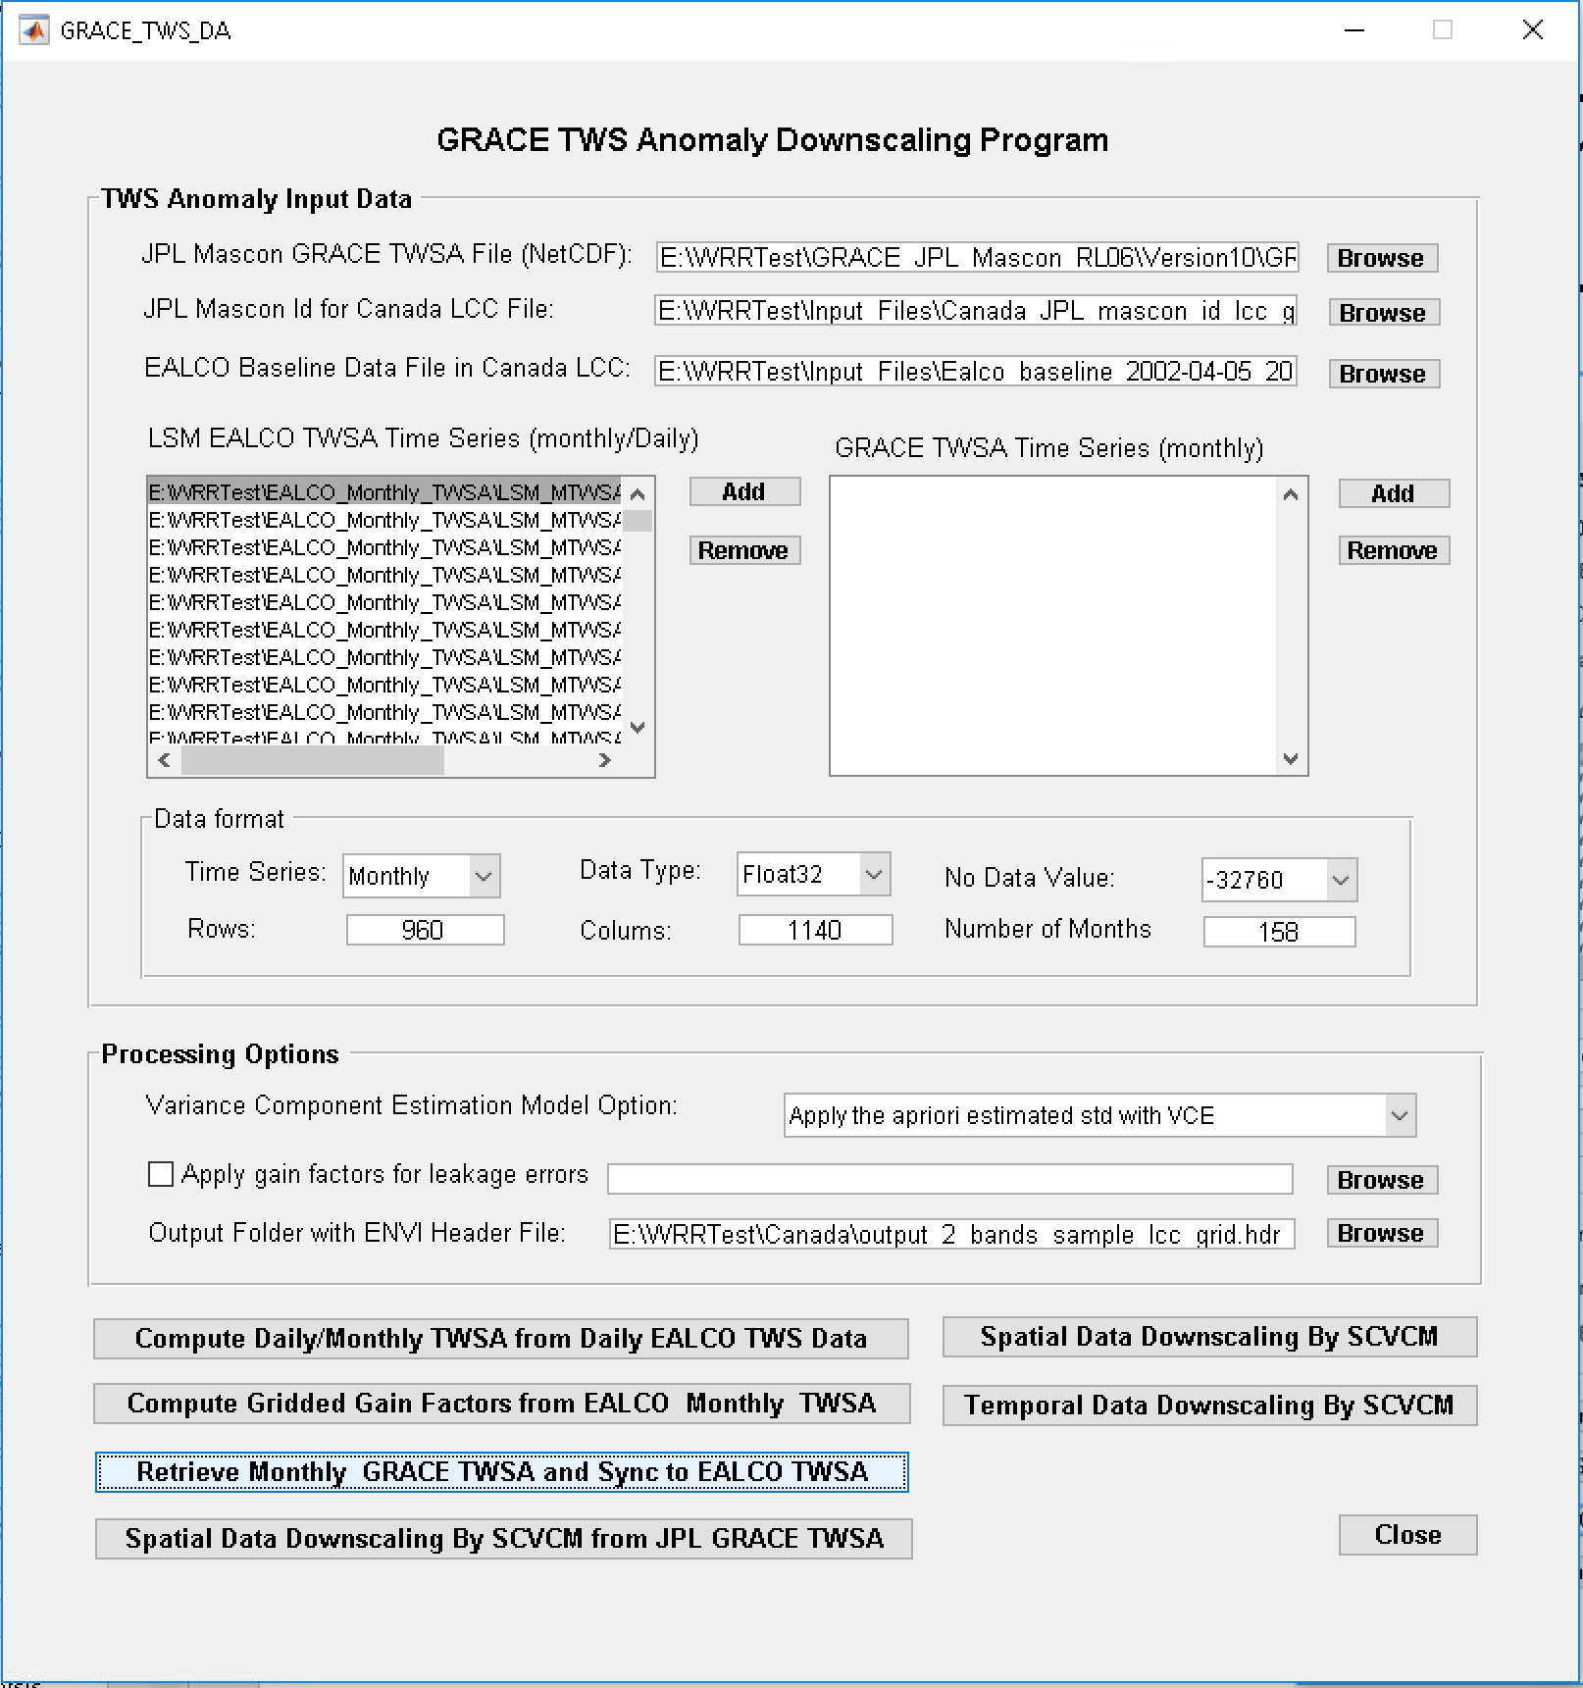
Step 4 - Retrieve Monthly GRACE TWSA and Sync to EALCO TWSA
Specify the JPL Mascon GRACE TWS data file in NetCDF format (downloaded from JPL GRACE data product website)
Specify EALCO monthly TWSA time series and their metadata (from step 1)
Specify the output data folder by browsing a 2- band ENVI header file
Click on the button “Retrieve Monthly GRACE TWSA and Sync to EALCO TWSA”
Output: A binary float32 data file with two bands per month. The first band is GRACE TWSA. The second band is the estimated std by the JPL mascon solution. All 5kmx5km grid cells within a mascon are set to the same GRACE TWSA and the std from the JPL mascon solution.

Slide 8
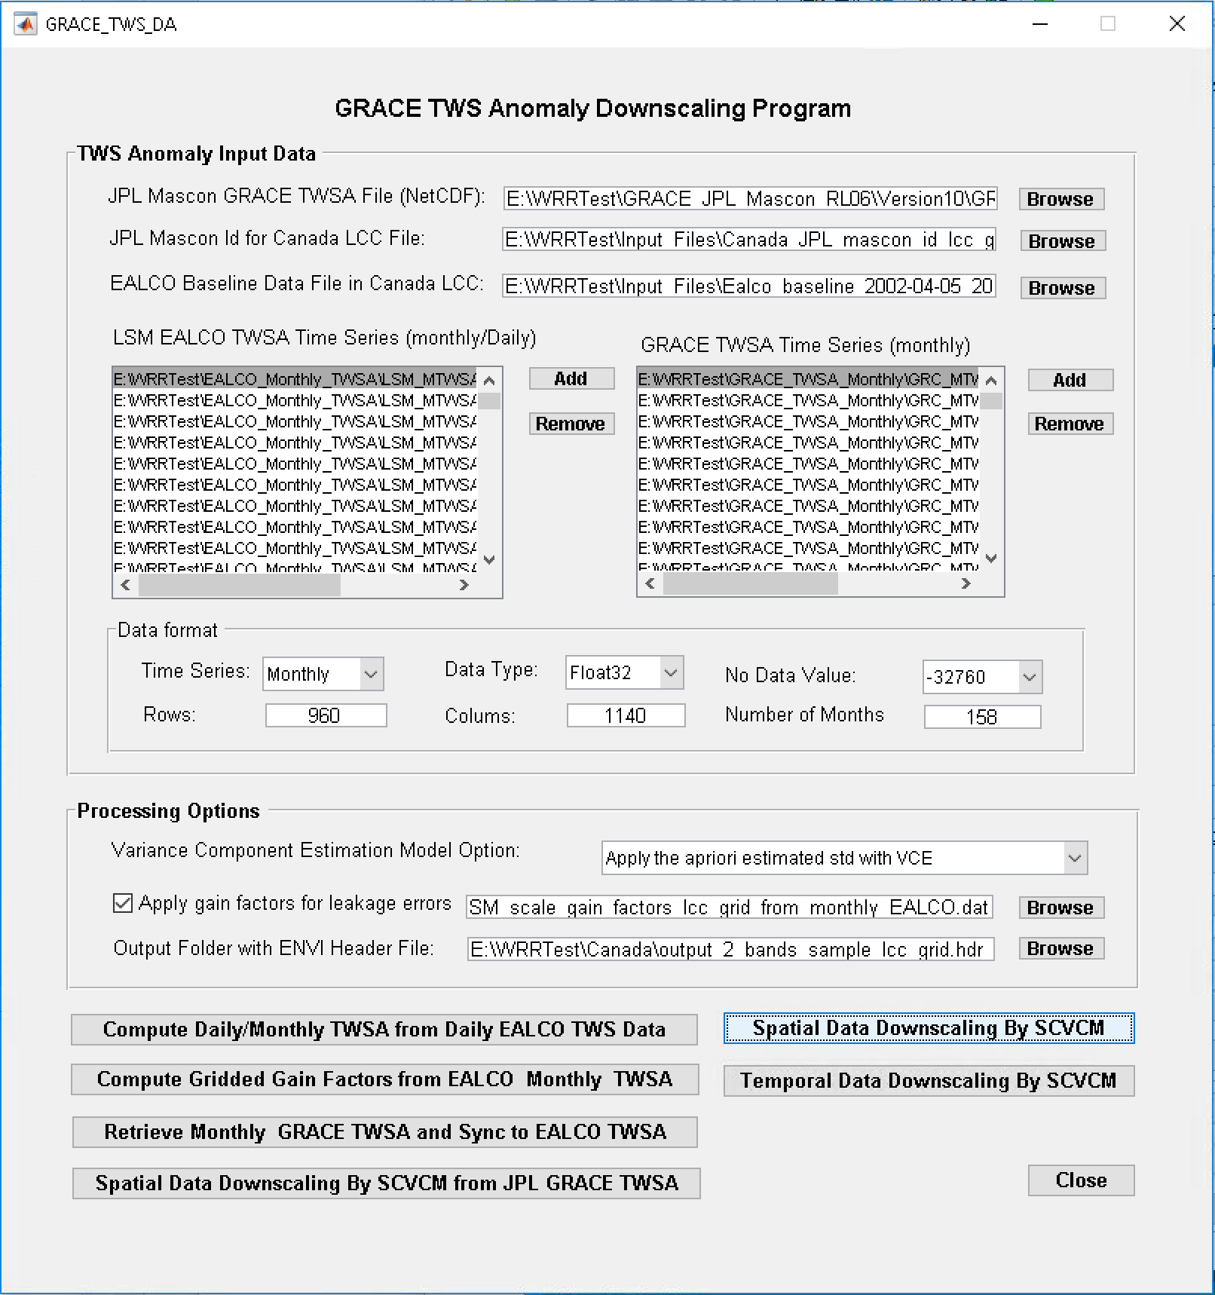
Step 5 - Spatial Downscaling by SCVCM
Specify the JPL Mascon GRACE TWS data file in NetCDF format (downloaded from JPL GRACE data product website)
Specify the JPL Mascon Id in the Canada LCC grid
Specify monthly EALCO TWSA time series and their metadata (from step 1)
Specify the EALCO Baseline data file (from step 1)
Specify the matched monthly GRACE TWSA time series (from step 4)
Specify the Variance Component Estimation Model Option
Check the “Apply gain factors for leakage errors” and specify the scale gain factors file (from step 3)
Specify the output data folder by browsing a 2-band ENVI header file
Click on the button “Spatial Data assimilation By SCVCM”
Output (A binary float32 data file with two bands per month. The first band is the assimilated GRACE TWSA. The second band is the estimated std by the SCVCM ):
Downscaled monthly TWSA files in output folder SD_TWSA
Estimated monthly GSWSA files in output folder SD_GSWSA
In addition, following files contain all monthly data of different components.
EA_All_TWSA.dat – all monthly EALCO TWSA
GR_All_TWSA.dat – all monthly GRACE TWSA
SD_All_TWSA.dat – all monthly downscaled TWSA
SD_All_GWSA.dat – all estimated monthly GSWSA
SD_All_STWSA.dat – all simply scaled monthly GRACE TWSA

Slide 9
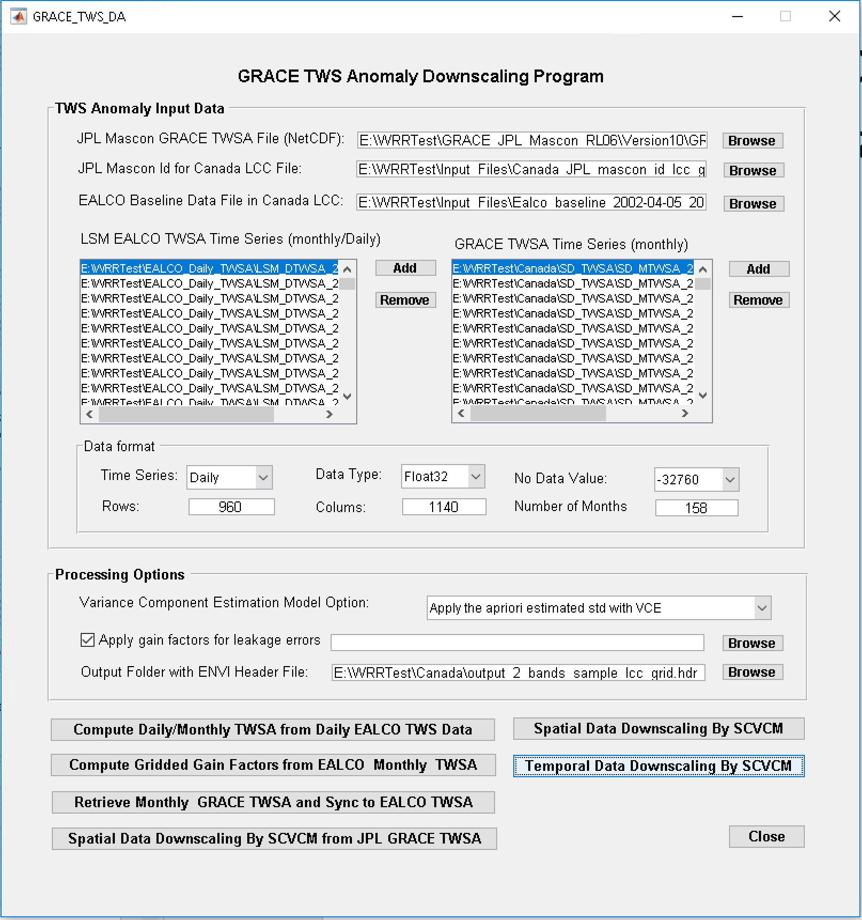
Step 6 - Temporal Downscaling and Assimilation by SCVCM
Specify the JPL Mascon GRACE TWS data file in NetCDF format (downloaded from JPL GRACE data product website)
Specify the JPL Mascon ID in the Canada LCC grid
Specify daily EALCO TWSA time series and their metadata (from step 1)
Specify the EALCO Baseline data file (from step 1)
Specify the spatially downscaled monthly GRACE TWSA time series (from step 5)
Specify the Variance Component Estimation Model Option
Check the “Apply gain factors for leakage errors”
Specify the output data folder by browsing a 2-band ENVI header file
Click on the button “Temporal Data Downscaling By SCVCM”
Output:
Downscaled daily TWSA files in output folder STD_TWSA
Estimated daily GSWSA files in output folder STD_GSWSA

Slide 10
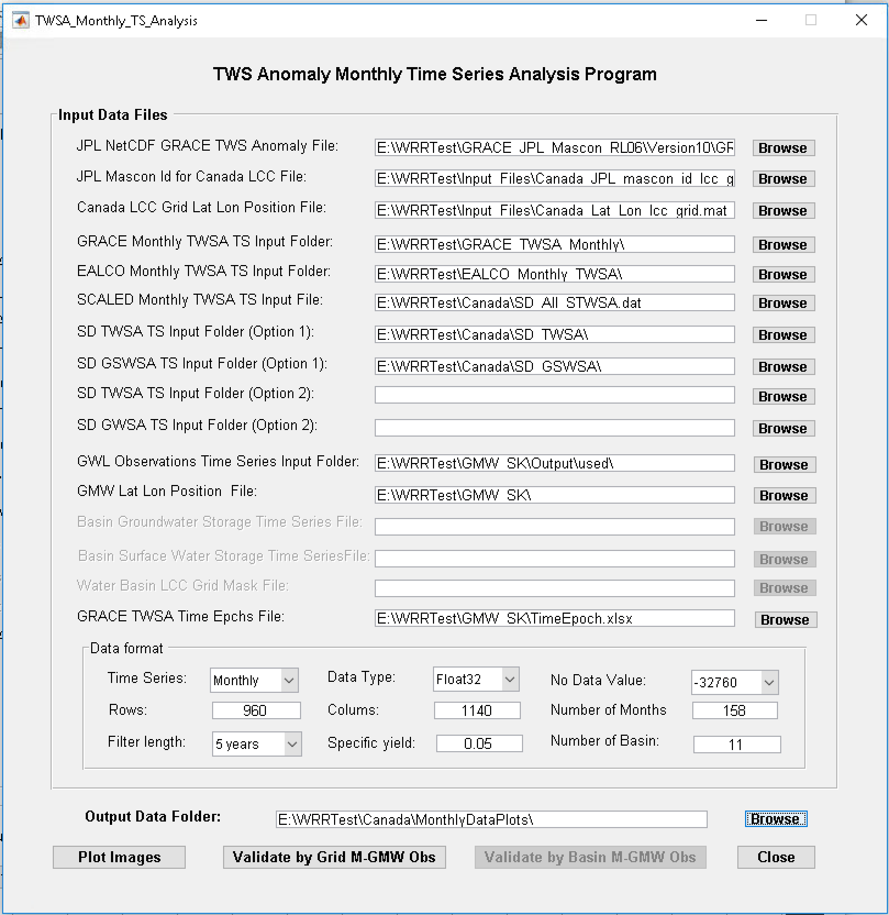
TWSA Monthly Time Series Analysis

Slide 11
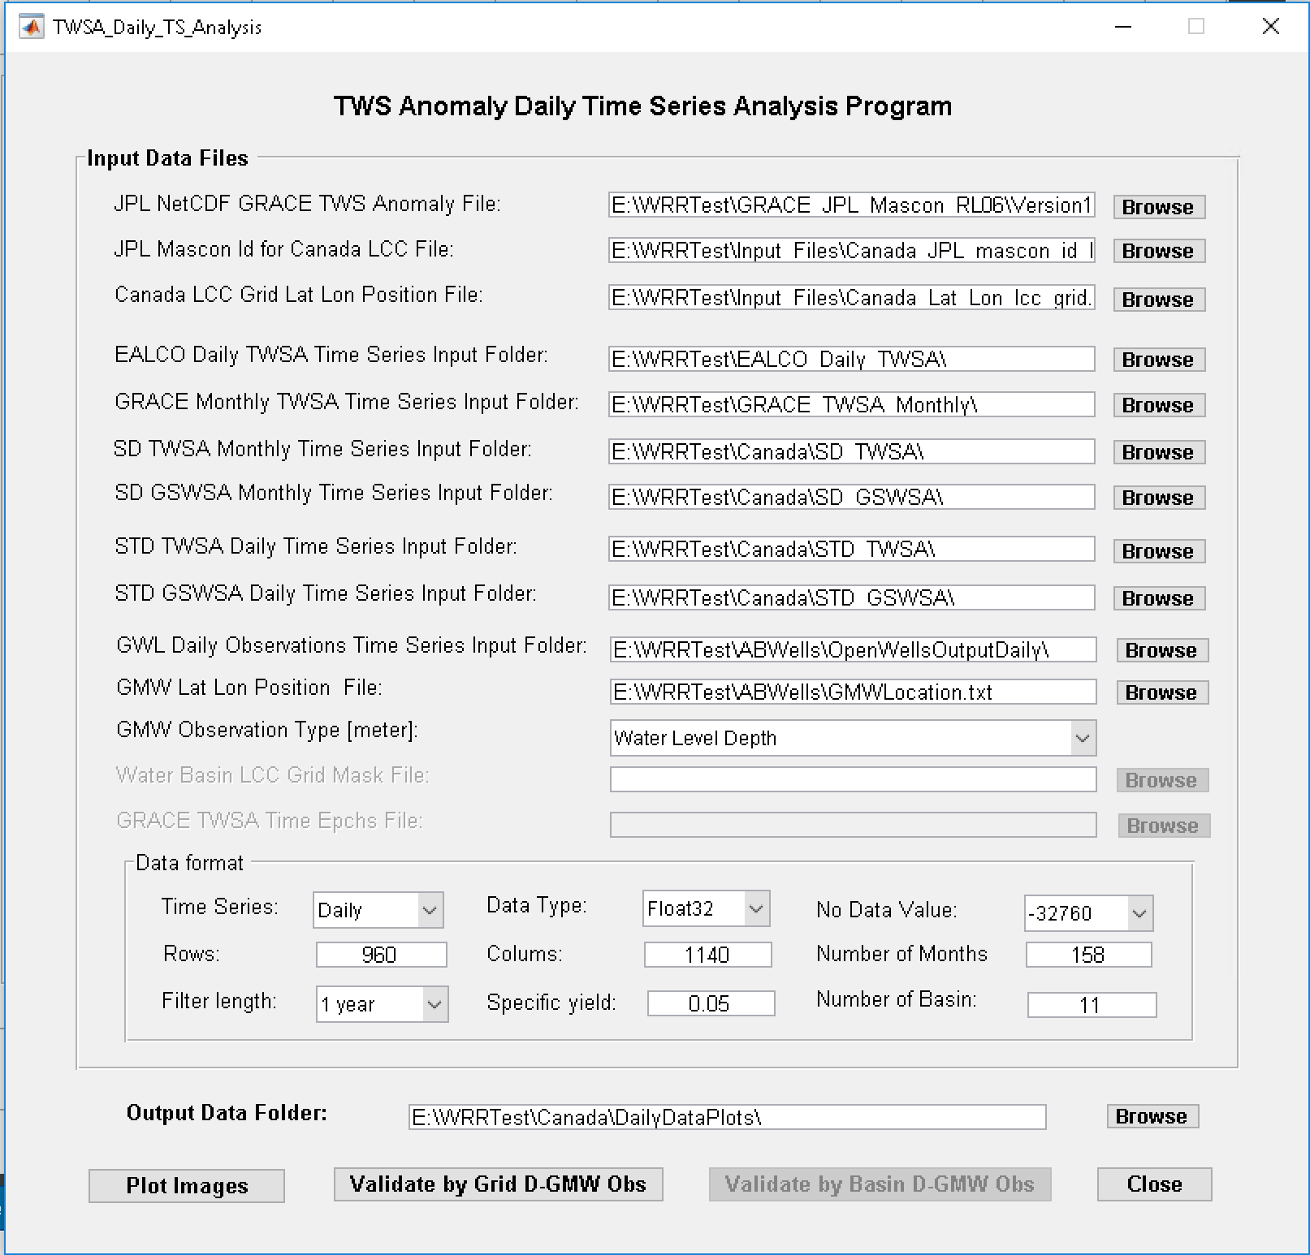
TWSA Daily Time Series Analysis

