Slide 1
Sentinel-2 Image Downscaling & Vegetation Biophysical Parameter Retrieval Program (Matlab)
Detang Zhong
detang.zhong@canada.ca

Slide 2
Objective and Method
Objective: Unify Sentinel-2 image resolutions from 20m to 10m for Vegetation Biophysical Parameter Retrieval (VBPR). The downscaled images can be used for other applications.
Methods: Downscaling the 20m resolution bands to 10m using the well-developed super-resolution algorithms:
Bicubic – bicubic spline interpolation (used for a comparison)
ATPRK-MS – Area-To-Point Regression Kriging using all 10m bands for the synthesized scheme (Wang et al., 2016)
ATPRK-PAN – Area-To-Point Regression Kriging selecting a 10m band with the largest correlation coefficient (CC) for each 20m band for the synthesized scheme (Wang et al., 2016)
SupReME – A Super-Resolution Method based on inverting an explicit imaging model (Lanaras et al., 2017)
DSen2 – A Super-Resolution Method based on a deep machine learning approach (Lanaras et al., 2018)

Slide 3
Requirements
MATLAB Version 2019b with following toolboxes:
Deep Learning Toolbox
Statistics and Machine Learning Toolbox
Optimization Toolbox
Image Processing Toolbox
Mapping Toolbox (optional)
GDAL 2.3.2 Apps and Python 3.5
Sen2cor version 2.5.5

Slide 4
Workflow Chart
S2 MSI L1C Data
Atmosphere Correction (Sen2Cor)
S2 MSI L2A Data
Subset Data
Crop for a Subset
Resample to 20m (NNP)
Resample to 10m (Bicubic)
Downscale to 10m
(ATPRK-MS, ATPRK-PAN, SupReME, DSen2)
R1-20
R2-10
D1-10
D2-10
D3-10
D4-10
Bio Variable Estimation (ALR SL2P)
Bio Variable Estimation (SL2P)
Different Bio Datasets
(ALR SL2P)
Bio Variable Assessment (In-Situ data)
Different Bio Datasets
(SL2P)
Validation Results

Slide 5
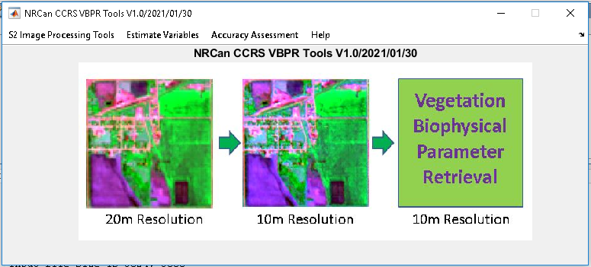
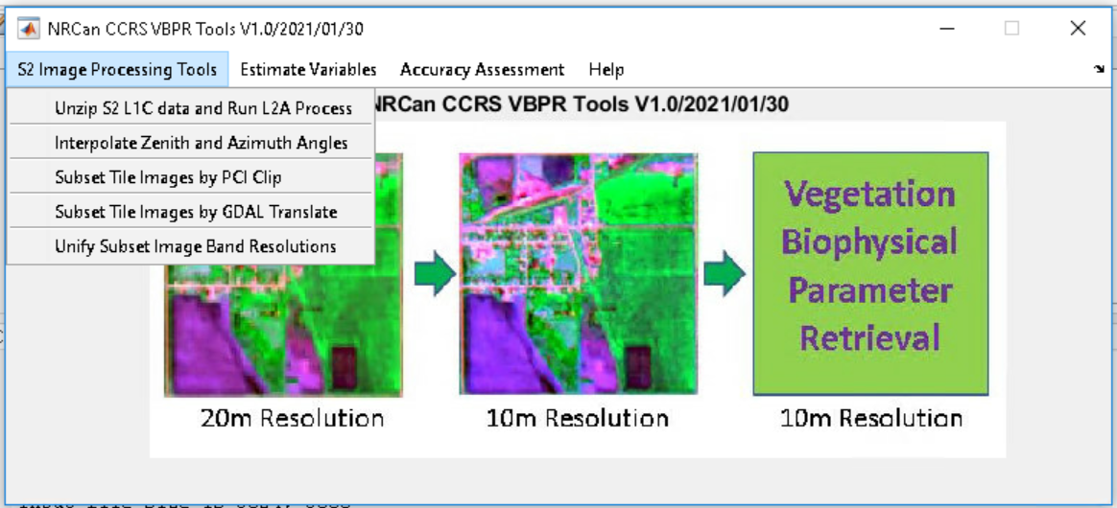
Step 1 - Start the program interface
Unzip the S2RS.zip to a local folder, e. g. C:\VBPRPro;
Open Matlab Software;
Change Matlab current path to the VBPRPro program folder;
Load the VBPRPro.m and run it.
Three main menus:
S2 Image processing tools
L1C to L2A process
Interpolate view angles
Crop a subset
Unify resolutions
BIO variable estimation
SL2P
ALR + SL2P
Accuracy assessment
Compare to In-Situ Data

Slide 6
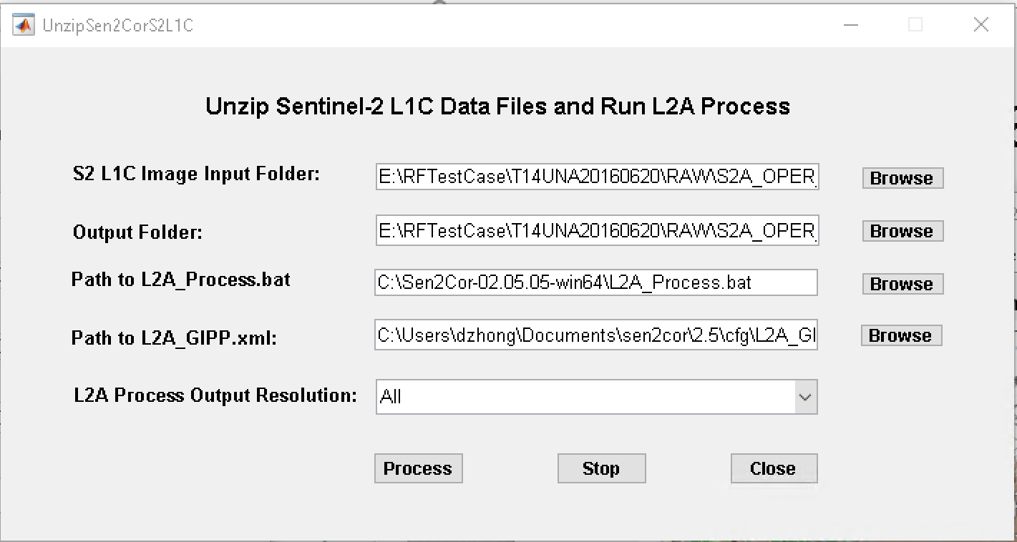
Step 2 – Unzip Sentinel-2 L1C data Files and Run L2A Process
Download S2 LIC zip file to a local disk drive
Start the “Unzip… “ program interface
Specify the L1C zip file folder
Specify the output data folder
Specify the path to Sen2cor L2A Process.bat and L2A_GIPP.xml files
Click button “Process” to start
Output: L2A images files of resolutions 10m, 20m and 60m in the folder S2A...\GRANULE\...\IMG_DATA

Slide 7
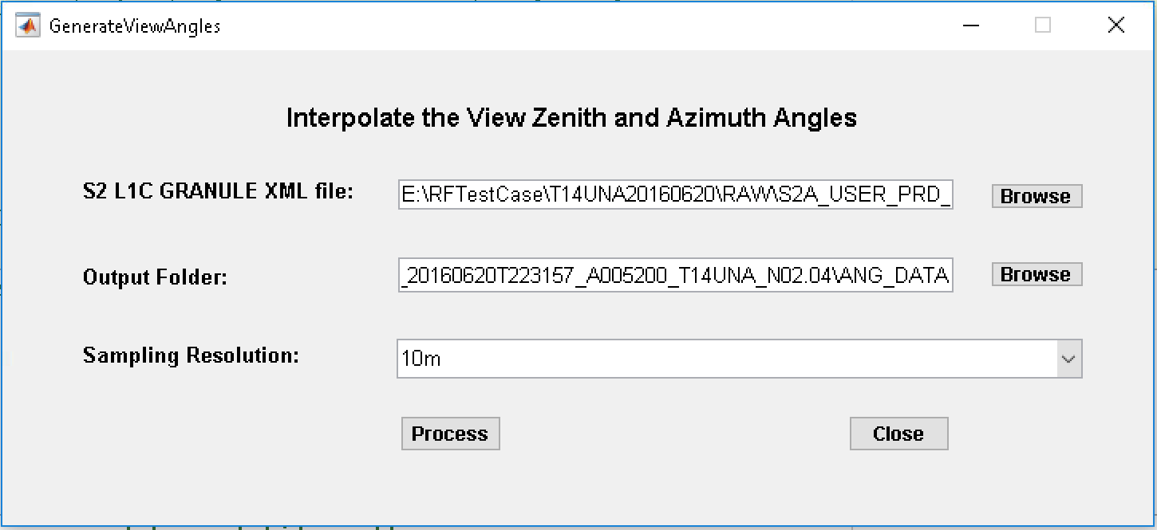
Step 3 – Interpolate Sentinel-2 View Angles
Specify S2 L1C GRANULE XML file
Specify the output data folder
Select a sampling resolution 10m or 20m
Click on the button “Process”
Output: Interpolated S2 view angles data files
Important: Before you can run this module, GDAL 2.3.2 and Python 3.5 must be installed and configured properly.

Slide 8
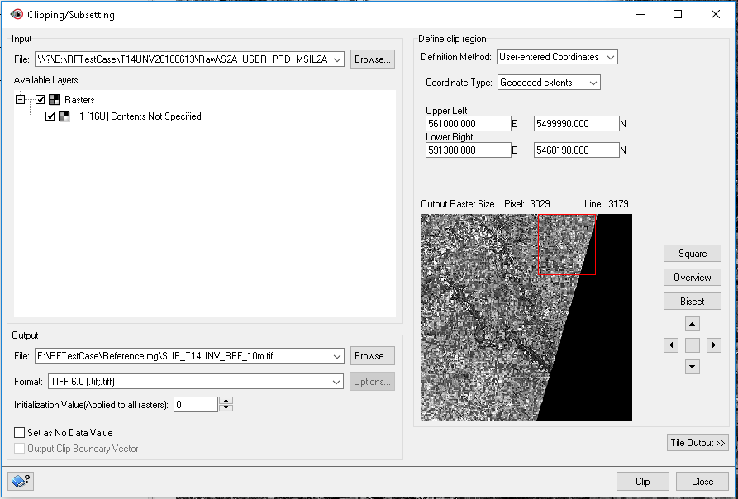
Step 4 – Create Subset Reference Image Files using PCI Geomatica
Open PCI Geomatica “Clipping/Subsetting” tool program
Browse to a S2 L2A image file
Specify Geocoded extends for the subset area
Specify a output geotiff file
Click on the button “Clip”
Output: the specified reference image file
Important: Create a reference image file for each resolution, i.e. 10m, 20, and 60m respectively and make their dimensions match each other exactly in an integer times, i.e. 10m dim = 2*(20m dim) = 6*(60m dim).

Slide 9
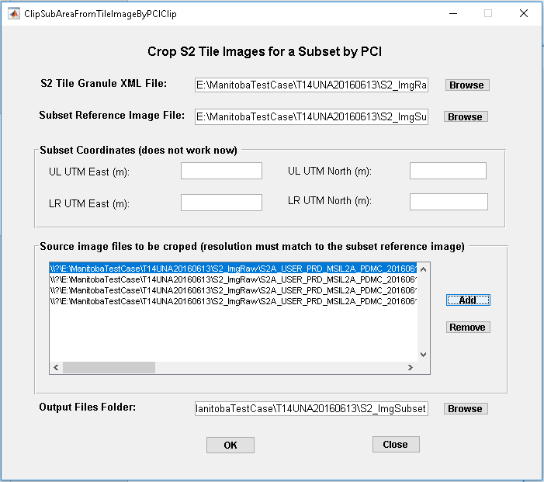
Step 5 – Crop Tile Images for a Subset by PCI Clip Module
Specify S2 Granule XML file
Specify a reference image file
Specify the image files to be cropped. Important: the image resolution must match the resolution of the reference image.
Specify an output folder
Click on the button “OK”
Repeat steps above for 10m, 20m and 60m resolution images respectively including the view angles images.
Output: Cropped subset image files in the output folder including the tile images in geotiff format.

Slide 10
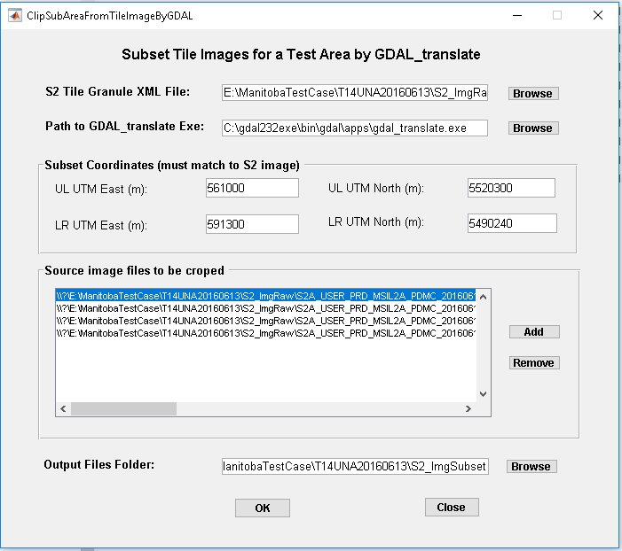
Step 5 – Crop Tile Images for a Subset by GDAL Translate Module
Specify S2 Granule XML file
Specify the path to GDAL translate.exe
Specify the UTM coordinates of the up left and lower right corners. Important: the coordinates should match the grid of S2 images exactly.
Specify the image files to be cropped.
Specify an output folder
Click on the button “OK”
Output: Cropped subset image files in the output folder including the tile images in geotiff format.

Slide 11
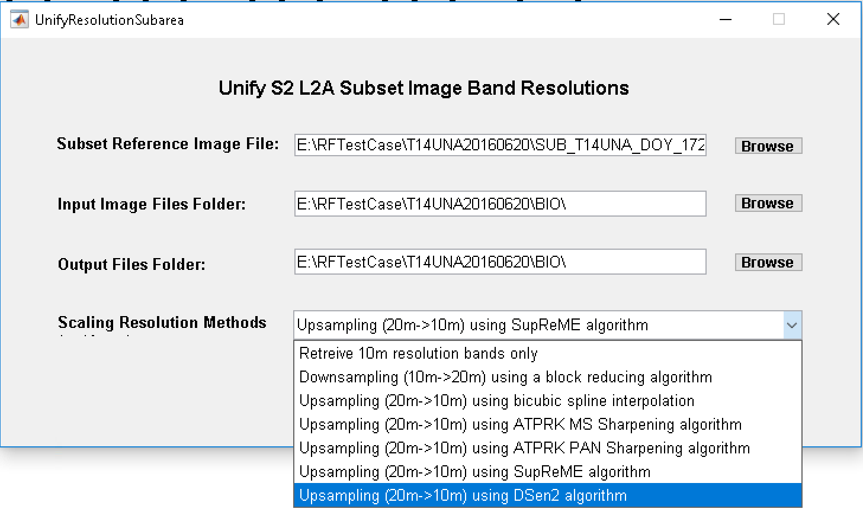
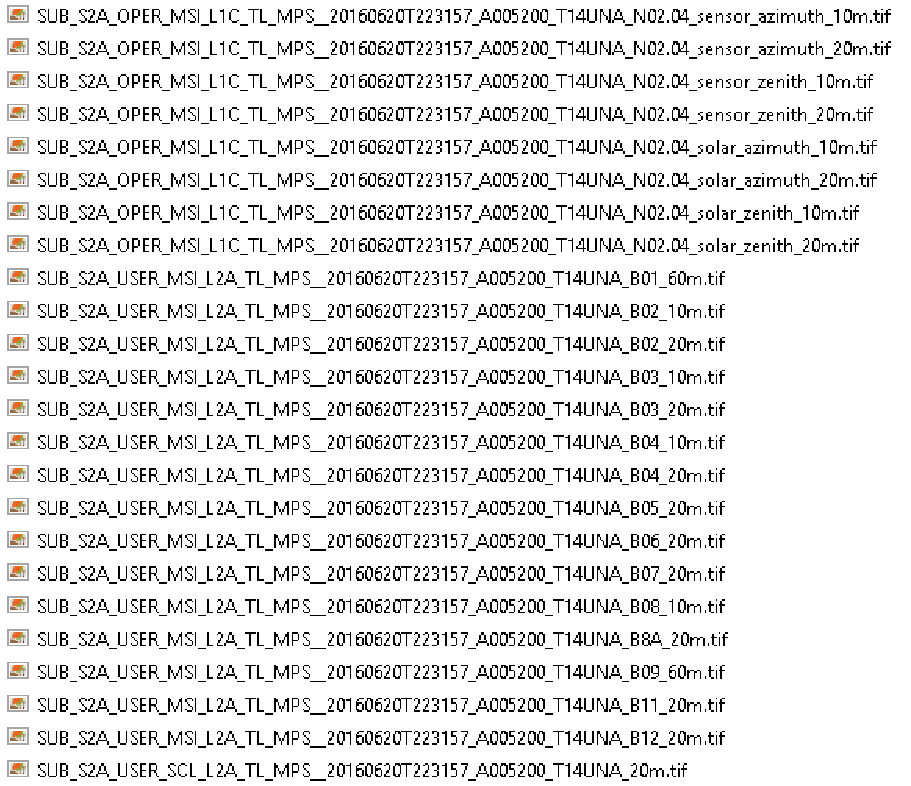
Step 6 – Downscale/Unify Resolutions for All Bands
Specify the 10m resolution reference image file
Specify input image files folder
Specify output image files folder
Select one of the scaling resolution methods
Click on the button “Process”
Output: Up/Down sampled 10m or 20m resolution images for all bands. (Note: 20m resolution images are just copied from source files)
Important: The input folder should have all images files listed on the right:

Slide 12
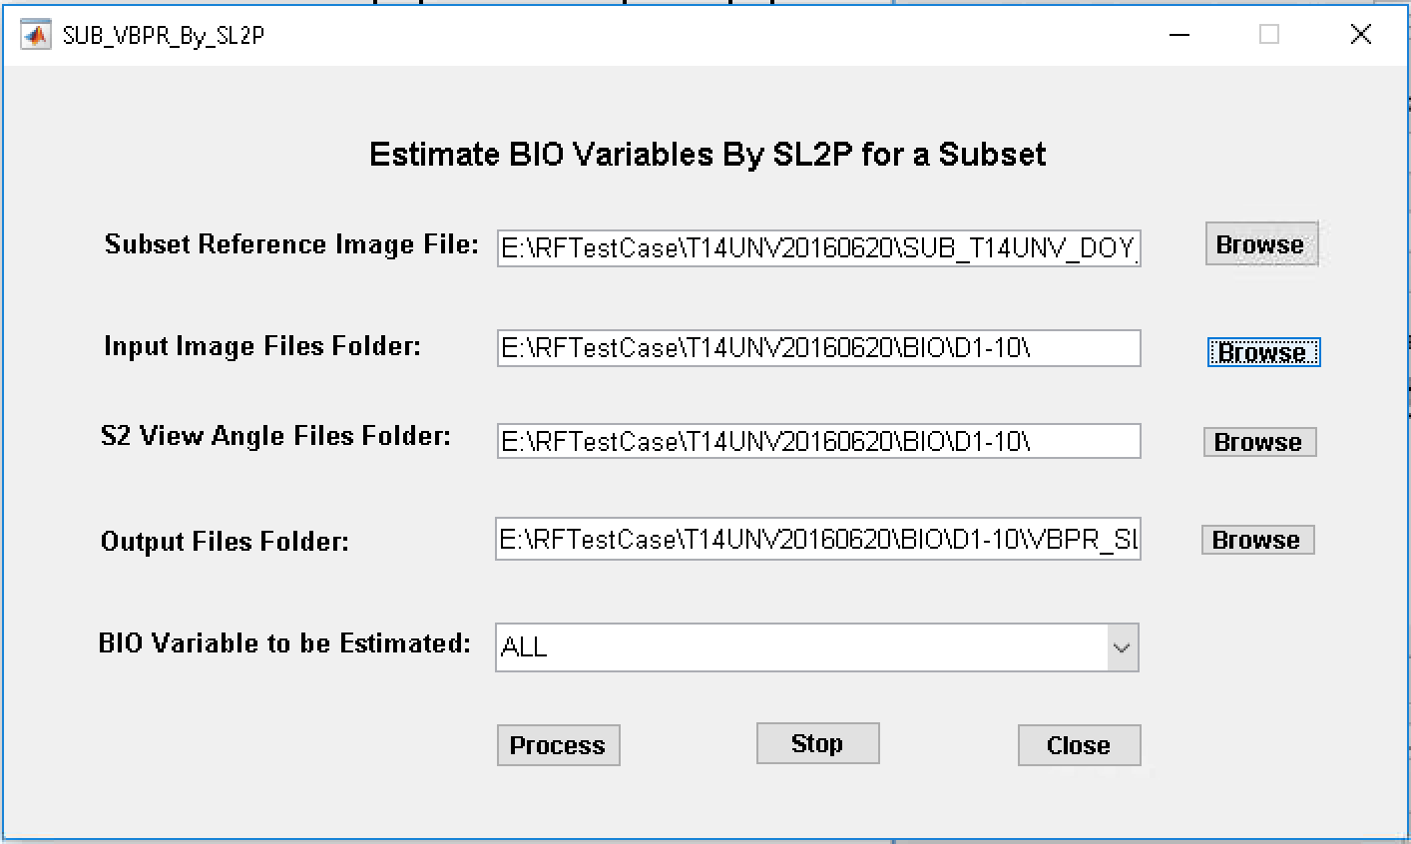
Step 7 – VBPR (Estimate Bio Variables) by SL2P
Specify a reference image file (10m or 20m resolution)
Specify input image files folder
Specify input view angle files folder
Specify an output folder
Click on the button “Process”
Output: Estimated BIO Variable files in the output folder (geotiff format).

Slide 13
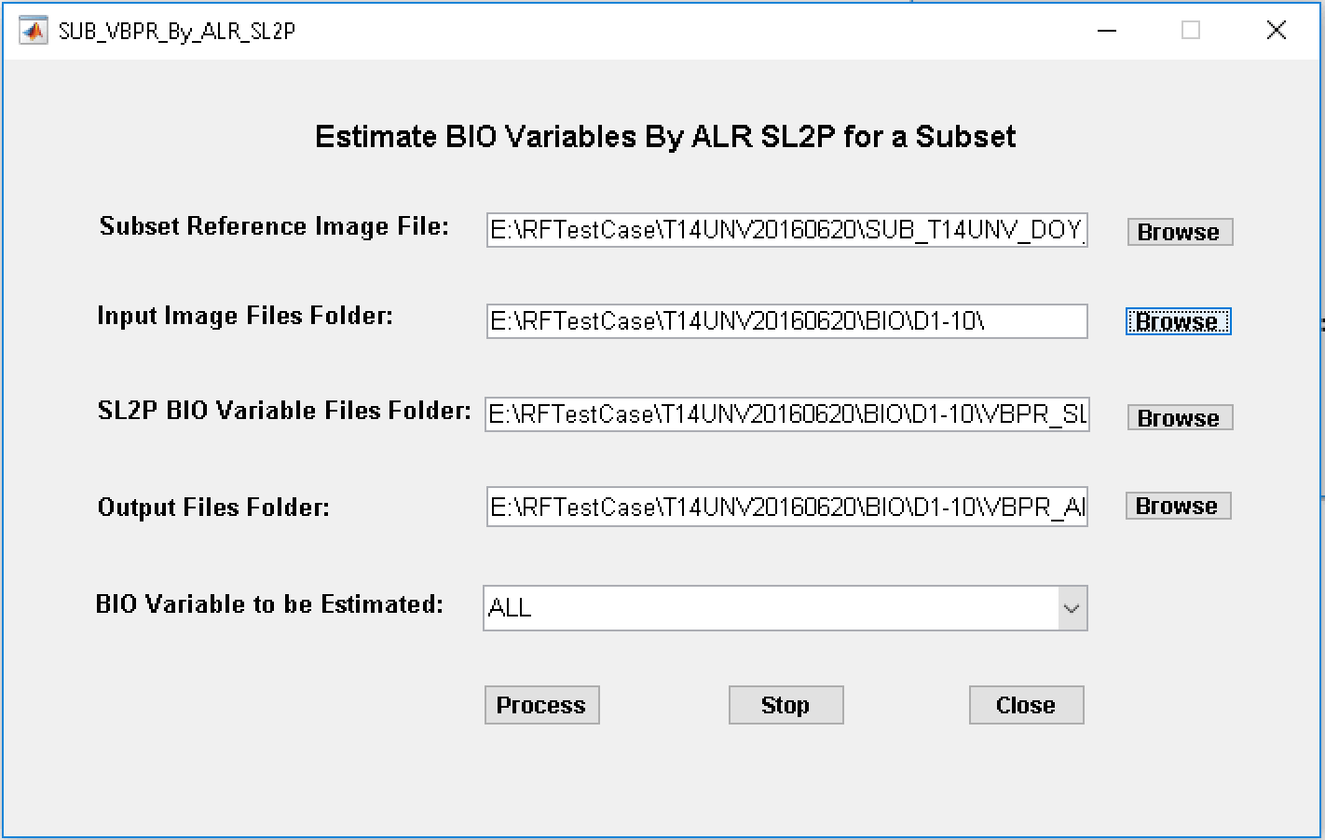
Step 8 – VBPR (Estimate Bio Variables) by ALR-SL2P
Specify a reference image file (10m or 20m resolution)
Specify input image files folder
Specify SL2P result input files folder
Specify an output folder
Click on the button “Process”
Output: Estimated BIO Variable files in the output folder.

Slide 14
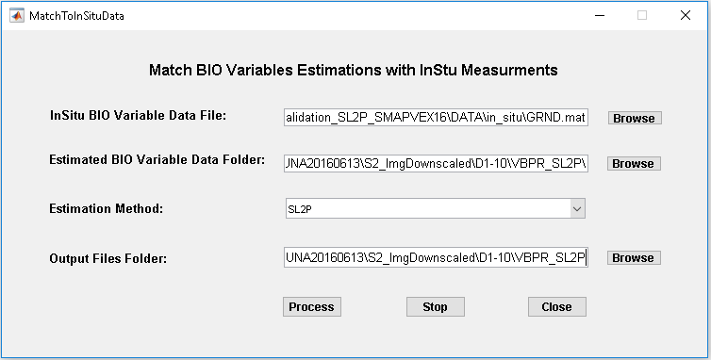
Step 9 – Pair Estimated Bio Variables with In-Situ Measurements
Specify input InSitu BIO variable data file
Specify an estimated BIO variable data folder
Specify the estimation method
Specify an output folder
Click on the button “Process”
Output: Evaluation results in the output folder.

Slide 15
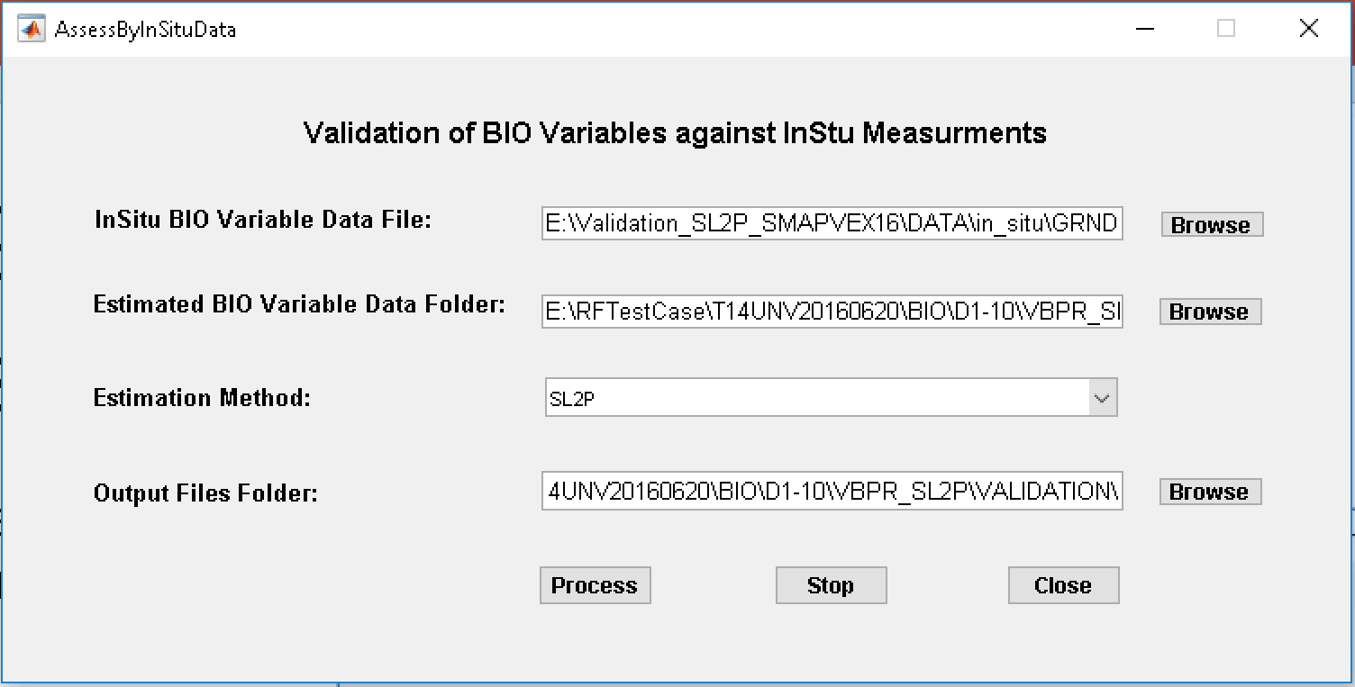
Step 10 – Evaluation of Bio Variables Using In-Situ Measurements
Specify input InSitu BIO variable data file
Specify the matched BIO variable data folder
Specify the estimation method
Specify an output folder
Click on the button “Process”
Output: Evaluation results in the output folder.

Slide 16
Test Results
Visual comparison of 10m resolution images downscaled by 5 different methods
SL2P BIO variables vs. the in-situ field measurements
ALR-SL2P BIO variables vs. the in-situ field measurements
Comparison statistics of SL2P and ALR-SL2P BIO variables vs. the in-situ measurements

Slide 17
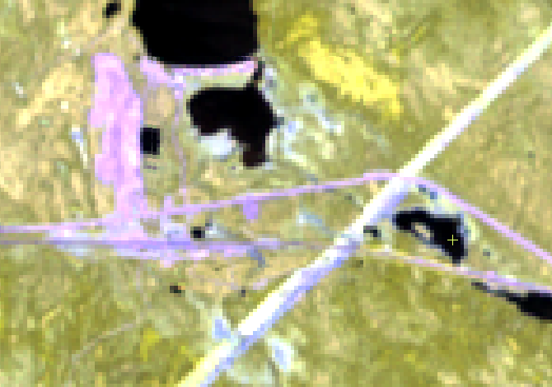
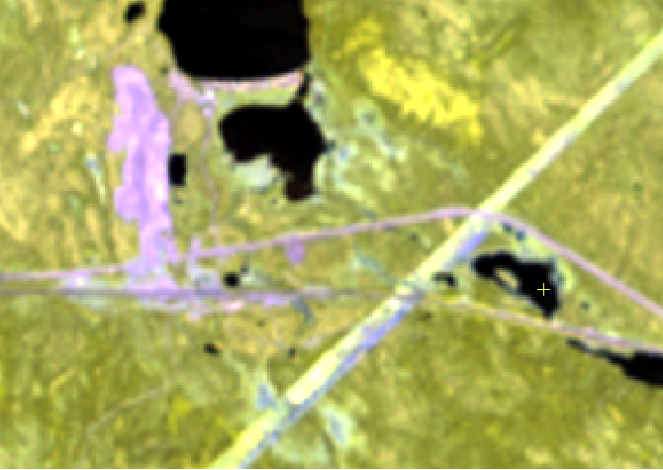
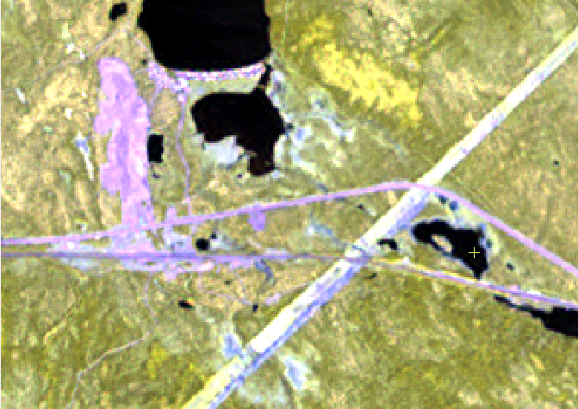
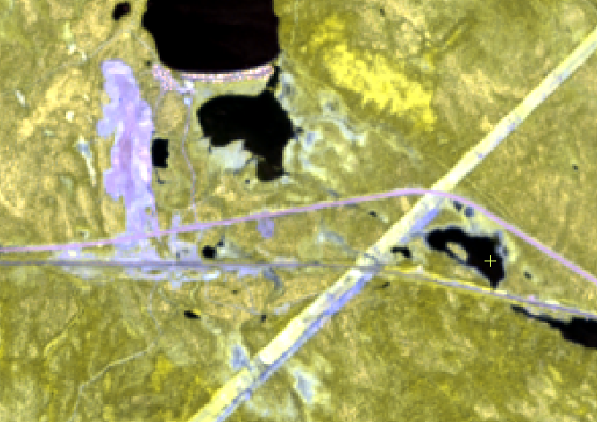
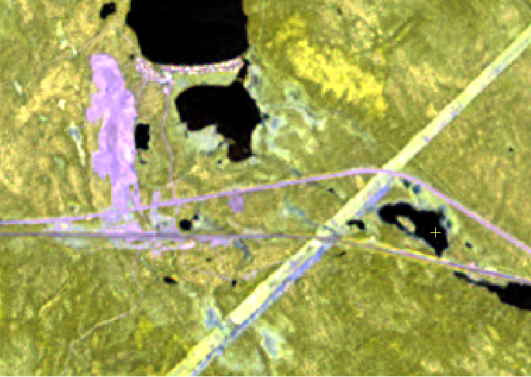

Band 06-8A-12 false color image comparisons (Wabush test area)
R-20m
Original
R-10m
Bicubic
D1-10m
ATPRK_MS
D3-10m
SupReME
D2-10m
ATPRK-PAN
D4-10m
DSen2

Slide 18
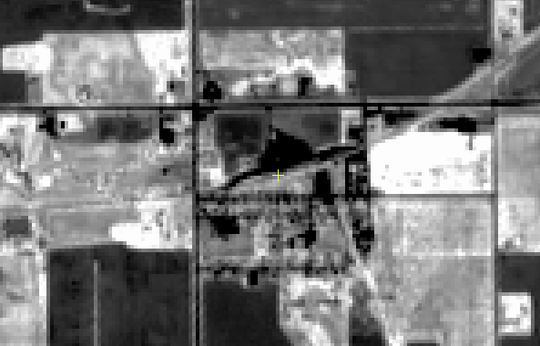
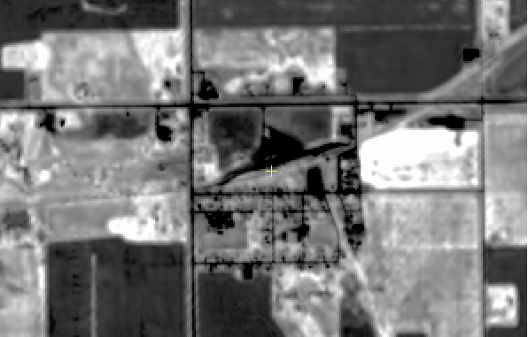

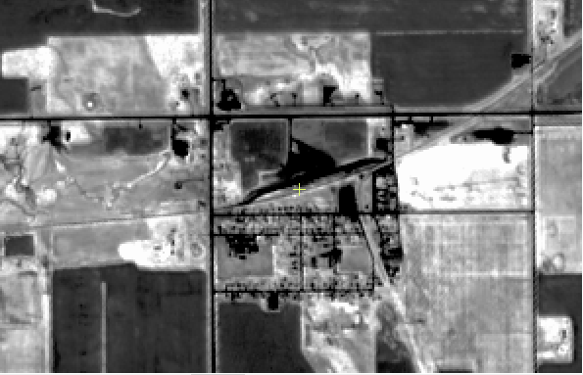
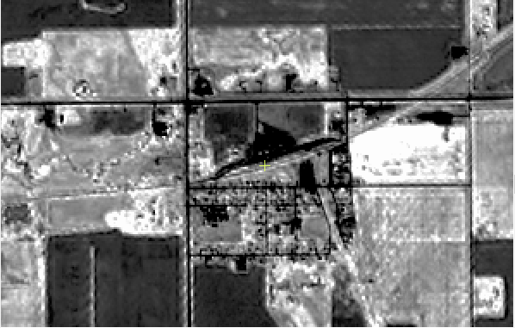
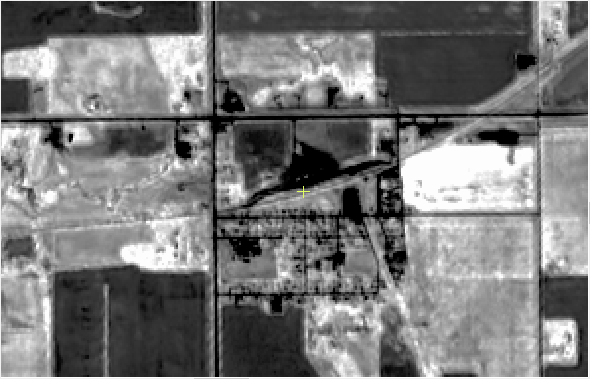
BIO Variable LAI image comparisons (Manitoba test area)
R-20m
Original
R-10m
Bicubic
D3-10m
SupReME
D1-10m
ATPRK_MS
D2-10m
ATPRK-PAN
D4-10m
DSen2

Slide 19
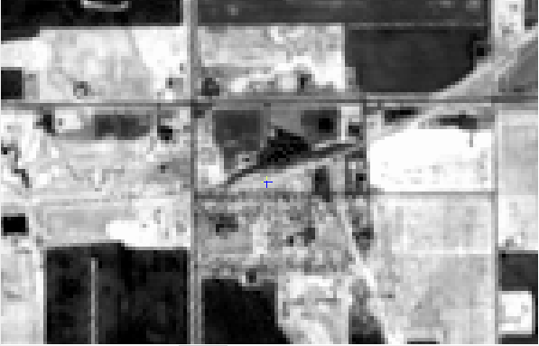
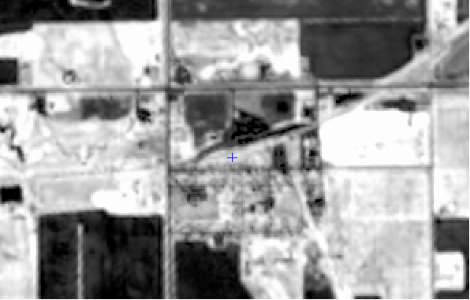
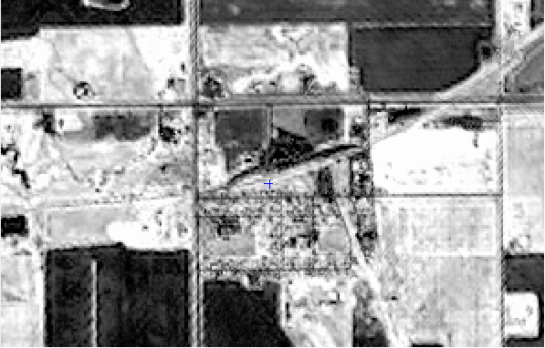
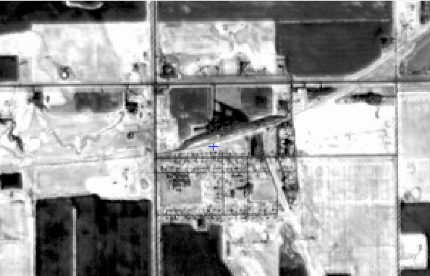

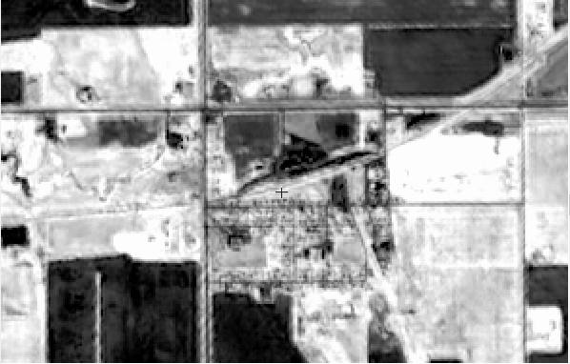
BIO Variable FAPAR image comparisons (Manitoba test area)
R-20m
Original
R-10m
Bicubic
D3-10m
SupReME
D1-10m
ATPRK_MS
D2-10m
ATPRK-PAN
D4-10m
DSen2

Slide 20
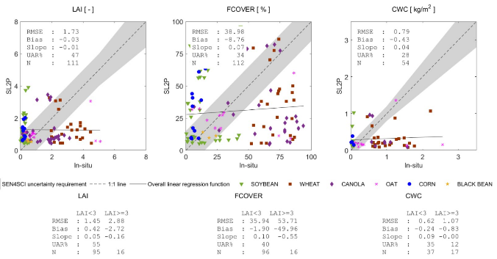
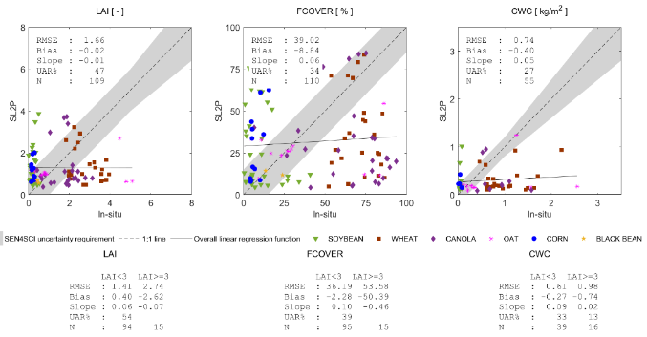
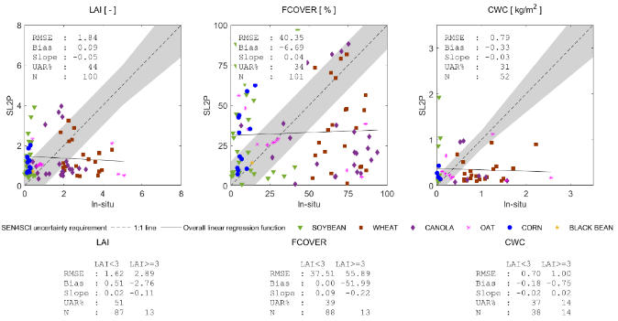
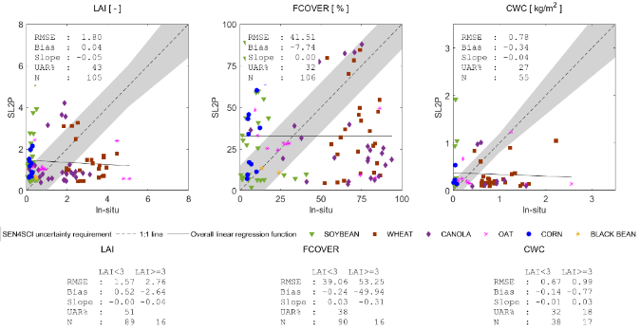
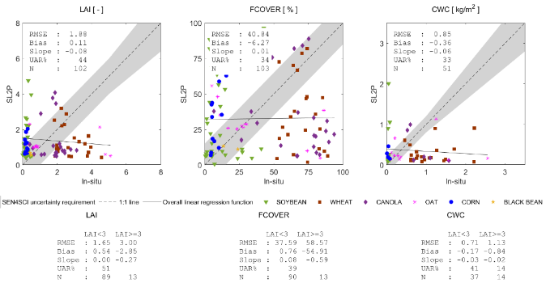

SL2P BIO variables vs. the in-situ field measurements (Manitoba test area)
R-20
R-10
D1-10
D3-10
D2-10
D4-10

Slide 21
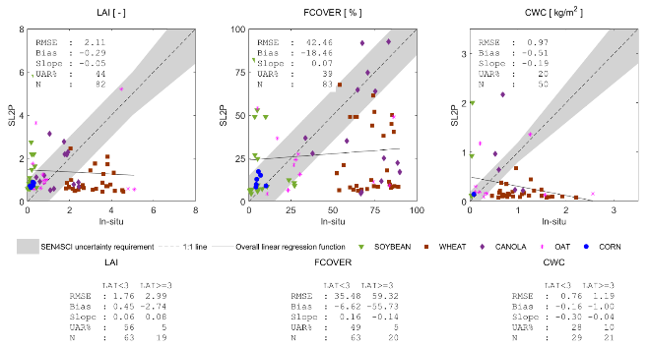
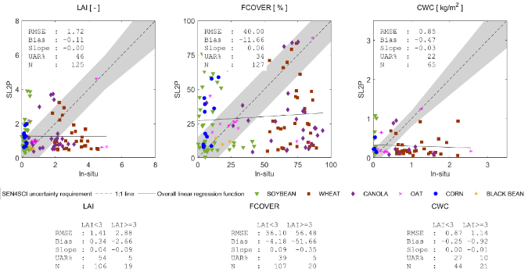
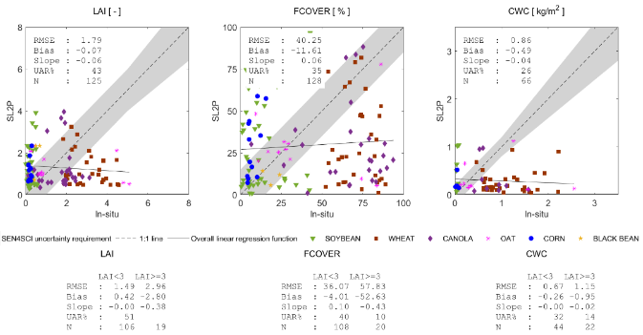

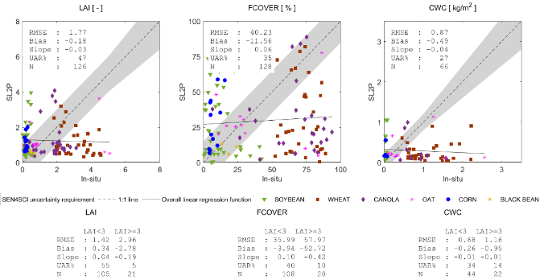
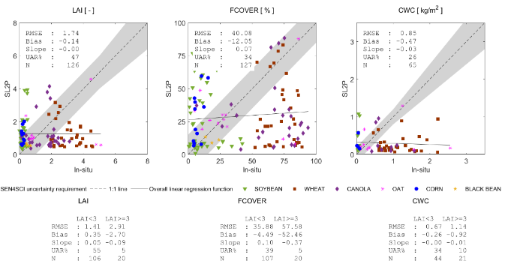
ALR-SL2P BIO variables vs. the in-situ field measurements (Manitoba test area)
R-20
R-10
D1-10
D3-10
D2-10
D4-10

Slide 22
LAI Validation Statistics via In-Situ Measurements
Method |  | RMSE | Bias | Slope | UAR% | N
SL2P | R1-20 Original | 1.73 | -0.03 | -0.01 | 47 | 111
 | R2-10 Cubic | 1.66 | -0.02 | -0.01 | 47 | 109
 | D1-10 ATPRK MS | 1.84 | 0.09 | -0.05 | 44 | 100
 | D2-10 ATPRK-PAN | 1.88 | 0.11 | -0.08 | 44 | 102
 | D3-10 SupReME | 1.80 | 0.04 | -0.05 | 43 | 105
 | D4-10 DSen2 | 1.66 | -0.01 | 0.00 | 48 | 107
ALR-SL2P | R1-20 Original | 2.11 | -0.29 | -0.05 | 44 | 82
 | R2-10 Cubic | 1.72 | -0.11 | 0.00 | 46 | 125
 | D1-10 ATPRK MS | 1.79 | -0.07 | -0.06 | 43 | 125
 | D2-10 ATPRK-PAN | 1.77 | -0.18 | -0.03 | 47 | 126
 | D3-10 SupReME | 1.72 | -0.14 | -0.02 | 45 | 126
 | D4-10 DSen2 | 1.74 | -0.14 | 0.00 | 47 | 126

Slide 23
FCOVER Validation Statistics via In-Situ Measurements
Method |  | RMSE | Bias | Slope | UAR% | N
SL2P | R1-20 Original | 38.98 | -8.76 | 0.07 | 34 | 112
 | R2-10 Cubic | 39.02 | -8.84 | 0.06 | 34 | 110
 | D1-10 ATPRK MS | 40.35 | -6.69 | 0.04 | 34 | 101
 | D2-10 ATPRK-PAN | 40.84 | -6.27 | 0.01 | 34 | 103
 | D3-10 SupReME | 41.51 | -7.74 | 0.00 | 32 | 106
 | D4-10 DSen2 | 38.56 | -8.71 | 0.07 | 33 | 108
ALR-SL2P | R1-20 Original | 42.46 | -18.46 | 0.07 | 39 | 83
 | R2-10 Cubic | 40.00 | -11.66 | 0.06 | 34 | 127
 | D1-10 ATPRK MS | 40.25 | -11.61 | 0.06 | 35 | 128
 | D2-10 ATPRK-PAN | 40.23 | -11.56 | 0.06 | 35 | 128
 | D3-10 SupReME | 40.47 | -11.76 | 0.05 | 34 | 127
 | D4-10 DSen2 | 40.08 | -12.05 | 0.07 | 34 | 127

Slide 24
CWC Validation Statistics via In-Situ Measurements
Method |  | RMSE | Bias | Slope | UAR% | N
SL2P | R1-20 Original | 0.79 | -0.43 | 0.04 | 28 | 54
 | R2-10 Cubic | 0.74 | -0.40 | 0.05 | 27 | 55
 | D1-10 ATPRK MS | 0.79 | -0.33 | -0.03 | 31 | 52
 | D2-10 ATPRK-PAN | 0.85 | -0.36 | -0.06 | 33 | 51
 | D3-10 SupReME | 0.78 | -0.34 | -0.04 | 27 | 55
 | D4-10 DSen2 | 0.72 | -0.38 | 0.05 | 31 | 55
ALR-SL2P | R1-20 Original | 0.97 | -0.51 | -0.19 | 20 | 50
 | R2-10 Cubic | 0.85 | -0.47 | -0.03 | 22 | 65
 | D1-10 ATPRK MS | 0.86 | -0.49 | -0.04 | 26 | 66
 | D2-10 ATPRK-PAN | 0.87 | -0.49 | -0.04 | 27 | 66
 | D3-10 SupReME | 0.81 | -0.44 | 0.02 | 23 | 66
 | D4-10 DSen2 | 0.85 | -0.47 | -0.03 | 26 | 65

Slide 25
Status & Conclusions
The integrated super-resolution methods (ATPRK-MS, ATPRK-PAN, SupReME and DSEn2) all work properly.
The preliminary results show that ATPRK-MS, ATPRK-PAN and DSEn2 are relatively better. DSen2 may give a better result by using local data to train the network.

