Slide 1
Crew’s Cup Case Analysis five-factor customer commitment study
MKT 512
IA2 – November 16, 2024
Maureen Dzifa Awumee Quist
icons: slidesgo

Slide 2

Background
Meet the new CEO of Crew’s Cup after undergoing changes from the Boekker’s estate
She and her team have the need to find and understand the optimal investment strategy to increase retention thus reducing the churn
Crew’s Cup is under new ownership – shifting from an old era
Having issues with reduction in customers due to change in ownership and restructuring of the company’s polices and values
Return of some popular instructors and positive media coverage reduced the churn rate from an average of 70% annually to 60%
A survey of 1,500 respondents was conducted to analyze the optimal investment strategy.
Tamika Guthrie

Slide 3
01
02
Investment Options
Monk’s Strategy
Addressing the normative commitment – restoring the values the firm stands for for the customers.
Proposed Subscription
Economic Commitment Flags – this improves overall retention and enables a stable revenue. This is a long-term benefit
03
Instructor’s New Product
Making the customers feel less trapped using a new class option. Provide a way for customers experience a new interest (to enjoy the brand)

Slide 4
—Someone Famous
Recommendation 01
Monk’s Strategy
From the Analysis -
Looking at the average of all commitment factors across the three (3) clusters, normative commitment is on the lower side, so a strategy to increase it is necessary.
A strong sense of normative commitment encourages customers to remain loyal to a brand, not just for personal benefit, but because they feel a moral or social obligation to do so.
This commitment is often driven by alignment with their values or a sense of responsibility, making them more likely to continue engaging with the brand over time.

Slide 5
—Someone Famous
Recommendation 02
Why the Monk’s Strategy?
Increasing customers' normative commitment enhances loyalty, making them less influenced by discounts or competitors. A strong brand campaign can further solidify this loyalty, boosting retention and reducing churn.
Since forced commitment is low and statistically not significant (p > 0.05), adding a new product from instructors is unnecessary. Additionally, a subscription model isn't needed, as economic commitment already strongly drives intent to stay.
A brand-focused strategy would benefit all segments, even bargain hunters, who recognize the exceptional value Crew’s Cup offers. As A.J. (bargain hunters) puts it, “It’s the best experience out there.” Judy from the faithful cluster felt betrayed by the changes in the brand and Maisey (The Fitness Buff) resonates with how the brand fits well with her routine.
Note: Even with a subscription model, customers may still churn if there is no genuine loyalty to the brand.

Slide 6
Analysis – Commitment Levels 01
01.1 Economic Commitment
Loyalty driven by the benefits gained from being a customer. A high economic commitment may mean a low to medium risk of churning as there is a derived benefits received by customers by being part of Crew’s Cup
01 The Necessity
A customer of Crew’s Cup based on necessity of economic, forced or habitual factors
The factors within this category demonstrate high reliability, with a Cronbach’s Alpha of approximately 97%
01.2 Forced Commitment
When customers feel compelled to stay due to external pressures or constraints, such as lack of alternatives. If there are alternatives, there is a high risk of customers churning
01.3 Habitual Commitment
A pattern or sense of loyalty based on regular habits and routines rather than active decision-making. A high habitual commitment means a lower risk of churning since routines are embedded into what the brand offers

Slide 7
Analysis – Commitment Levels 02
02 Obligatory Loyalty: Normative commitment
Normative commitment reflects a customer's loyalty driven by a sense of moral or social obligation rather than personal gain.
A low normative commitment score indicates a lack of loyalty to the brand, making customers more likely to churn. They don’t feel a strong sense of duty or attachment to the brand, which undermines long-term loyalty.
03 Emotional Attachment: Affective Commitment
Affective commitment reflects how emotionally connected customers feel to the brand, including their sense of belonging and how valued they feel as members. It also encompasses the mutual benefits they perceive from their investment in the brand.
Low emotional attachment increases the risk of customer churn. Poor treatment or negative experiences can leave lasting scars, making these customers highly likely to leave for alternative options.

Slide 8

Analysis – Insights on Segmentation 01
validating the Monk’s cluster personas
01 The Faithful
They row at least three times a week, with the highest average class attendance (379) among the three groups. Additionally, they have the largest average contribution ($3,913.90), making them highly profitable customers.
sample size = 594 out of 1500 respondents
AI generated
Commitment Level:
This group of customers exhibits high economic, habitual, affective, and forced commitment. However, their normative commitment is low, possibly stemming from a sense of betrayal following the brand's changes after the founders left and Boekker took over. Despite a temporary boycott, the lack of better alternatives reinforced their sense of forced commitment.

Slide 9

Analysis – Insights on Segmentation 02
validating the Monk’s cluster personas
02 Bargain Hunters
Fairly new to the brand. Has a minimum year they took their first class as 2018. They have the least contribution with an average of $350.82 and average class of 39. Their behavior suggests they are price-sensitive, often seeking discounts and utilizing aggregators like ClassPass
sample size = 424 out of 1500 respondents
AI generated
Commitment Level:
This group of customers demonstrates high affective commitment, appreciating the value they receive through discounted pricing. As A.J. noted, “It’s good that they finally made it available to more of us who like to work out but live on a budget.” Despite this, their economic commitment is low, as they remain budget-conscious and may not find it financially beneficial to maintain their relationship with the brand or suffer economically if it ends. They also exhibit low forced commitment, indicating they don’t feel compelled to stay, nor are they habitual customers. Additionally, their normative commitment is minimal, as they don’t feel a strong sense of obligation to remain loyal to the brand.

Slide 10

Analysis – Insights on Segmentation 03
validating the Monk’s cluster personas
03 Fitness Buffs
This group stands out from the other two. They engage in various fitness activities, with Crew’s Cup being just one part of their routine. They perceive it as more affordable compared to other gym memberships. Positioned between the loyal customers and bargain hunters, they attend an average of 110 classes, contributing an average of $1,202.41.
sample size = 482 out of 1500 respondents
AI generated
Commitment Level:
This group of customers values routine, with the brand seamlessly fitting into their established habits. While their other commitment factors are average compared to the other two groups, they particularly appreciate how Crew’s Cup aligns with their lifestyle. Additionally, they view the brand as a more economically favorable option compared to traditional gym memberships.

Slide 11
Analysis – Commitment on Intent 01
Economic Commitment has the strongest positive impact on intent (0.2081), indicating that customers who perceive financial value are highly motivated to remain loyal.
Habitual Commitment follows with the second strongest effect (0.1078), suggesting that consistent routines or habits also play a substantial role in driving customer intent.
Affective Commitment ranks third in influencing intent (0.1009), demonstrating that emotional attachment is still a meaningful, albeit slightly weaker, predictor of loyalty.
Normative Commitment comes in as the fourth strongest or second weakest (0.0469), implying that while a sense of duty or obligation affects intent, it has a relatively smaller impact compared to other factors.
Forced Commitment is the only factor that is not statistically significant and shows a minimal effect on intent (0.0065), indicating that customers do not feel compelled to stay and that this type of commitment does not meaningfully drive loyalty.

Slide 12
Analysis – Commitment on Intent 02
38% of variability is explained by the regression model using these commitment factors.
Conclusion
Given that Normative Commitment is low across clusters, it should be a priority to increase it. By aligning the brand with customers' values and emphasizing shared values, loyalty can be strengthened. This can help reinforce loyalty to the brand. This strategy encourages long-term engagement and customer retention.

Slide 13
Appendix 01
exhibit 01 - Exploratory Factor Analysis
- Factor 1: Necessity - High loadings on: e1(0.829), e2(0.850), e3(0.851), f1(0.795), f2(0.804), f3(0.766), h1(0.905), h2(0.909), h3(0.912)
- Factor 2: Obligation Loyalty - High loadings on: n1(0.863), n2(0.902), n3(0.919)
- Factor 4: Emotional Attachment
High loadings on: a1(0.883), a2(0.779), a3(0.826)
The other factors were not reliable hence.
Reliability of the 5 factors:
Economic Commitment: 0.97
Forced Commitment: 0.97
Habitual Commitment: 0.98
Normative Commitment: 0.94
Affective Commitment: 0.86
exhibit 01.01 - Factors
exhibit 01.02 - Reliability Factors

Slide 14
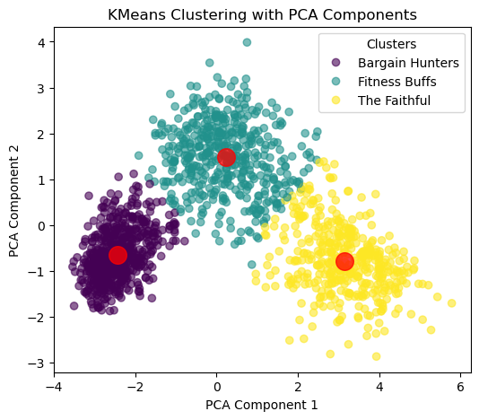
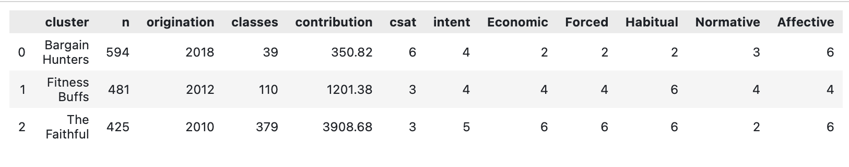
Appendix 02
exhibit 02 - Segmentation
exhibit 02.02 - summary of the 3 clusters, showing the size of the clusters, the minimum first year of when the customer took their first class, average classes taken, average contribution, average csat, average intent and average commitment levels.
exhibit 02.01 - PCA

Slide 15
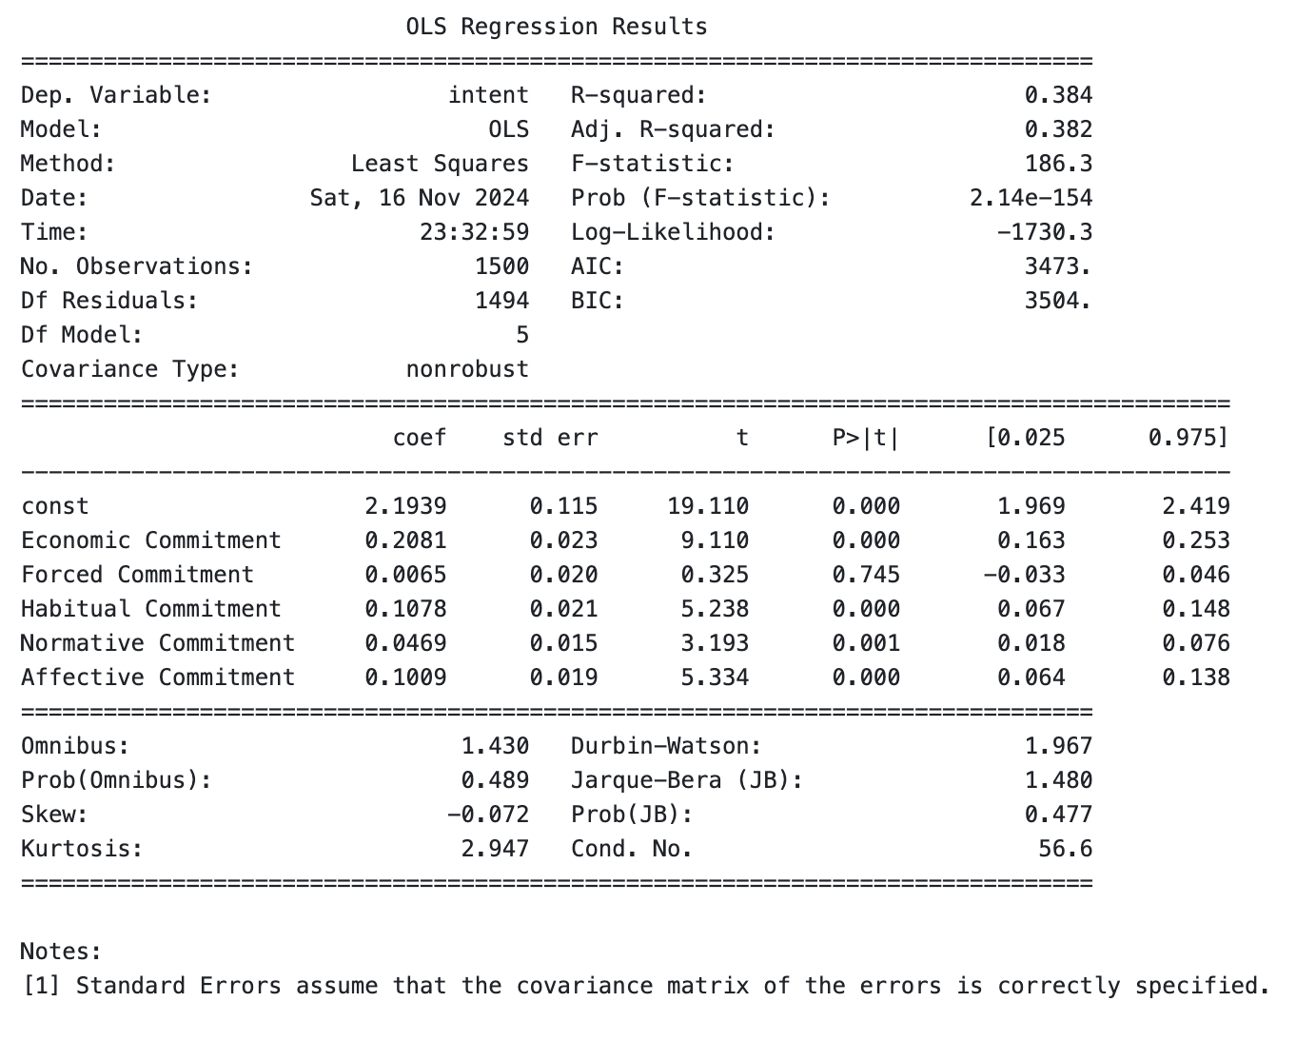
Appendix 03
exhibit 03 - Linear Regression
exhibit 03.01 - a regression model solely based on commitment levels. Although other analysis were made, this model was used to understand the role of each commitment factors in determining the level of intent

Slide 16

Thank You

