Slide 1
NEWS APP
Flutter news app + BLoC state management

Slide 2
Focus on our application:
MVVM concept
Directory settings on the application
Use of animation to support application interaction
Use of BLoC in calling data in the API
Use of Cubit in the use of local data

Slide 3
Supporting packages for the application:
BLoC and Flutter_bloc
Equatable
carousel_slider
flutter_staggered_animations
google_fonts
http
shared_preferences
Unicons
intl

Slide 4
DIRECTORY STRUCTURE :
LIB
COMPONENT
For widgets or other components that we will use repeatedly,
PAGES
Grouping application pages, there can be several more folders such as: view, service, bloc, models, and others.
ROUTE
Navigation settings for each page.
SERVICE
Basic functions in calling data methods from the API such as methods for get, post, put and delete.
STYLE
To put several styles in the application such as for Color or TextStyle

Slide 5
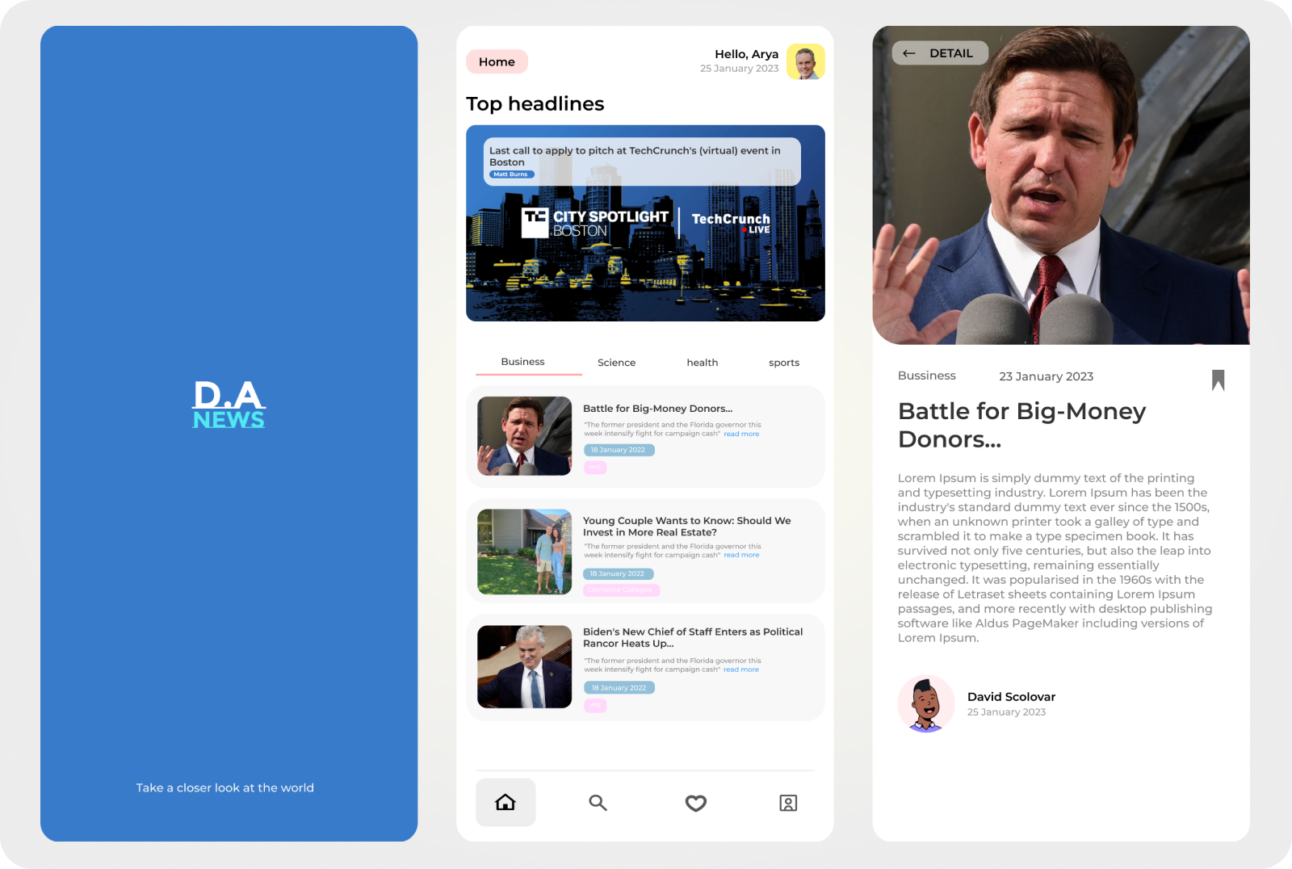
Our application design:
Application Concept : Simple and comfortable to read. not too many illustrations and looks elegant to linger using the application.

Slide 6
Thank you very much,
See you in the next video.

