Slide 1
Day 8 - Remote sensing and Earth observation
Satellite data for official statistics IFORD - Spatial R training

Slide 2
Questions on yesterday’s session?

Slide 3
Objectives for the day
Understand what remote sensing is and distinguish its four resolutions (spatial, temporal, spectral, radiometric).
Identify the main satellites, open data, classification methods, and change detection.
Identify the ethical issues raised by increasingly fine-grained satellite data.
Read a GHSL built-up indicator and its change over time.
Measure a teaching example of built-up growth, 2015-2025.
Cross several sources (AI-detected buildings, a modelled population raster, a crowdsourced road network) to estimate flood exposure.
Discuss validation and limitations.

Slide 4
Morning programme - 9:30 to 13:00
Time | Duration | Content
09:30-10:30 | 1h00 | Part 1 - Understanding remote sensing: sensors, electromagnetic spectrum, orbits & Part 2 - The four resolutions
10:30-11:00 | 30 min | Break
11:00-12:00 | 1h00 | Part 3 & 4: Satellites, spectral indices and classification & Derived products
12:00-12:15 | 15 min | Break
12:15-13:00 | 45 min | Part 5 - Analysis, change detection, ethics and applications & Introduction to the tutorial

Slide 5
Part 1 - Understanding remote sensing

Slide 6
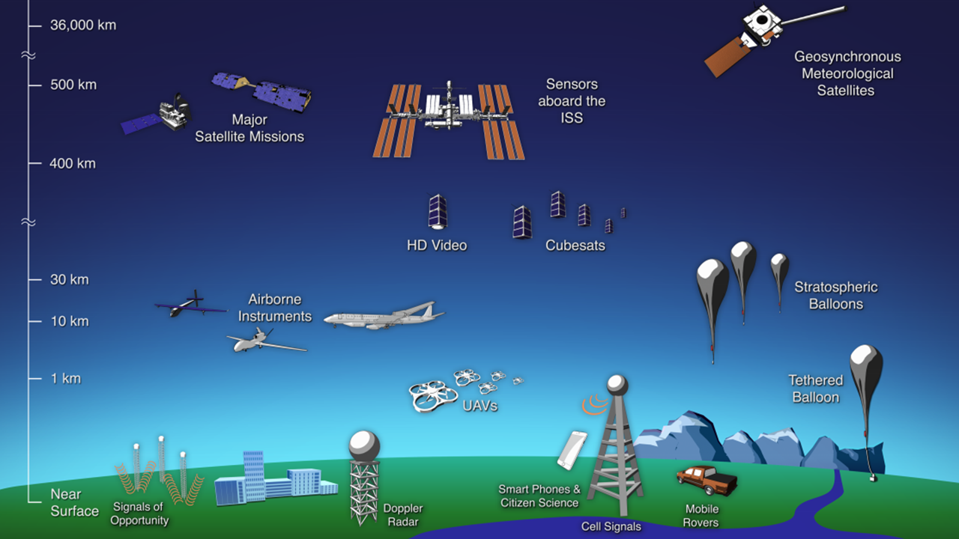
What is remote sensing?
Definition: obtaining information about an object or area without direct contact, from a distance.
A sensor (satellite, aircraft, drone) measures electromagnetic energy reflected or emitted by the Earth’s surface.
Enables repeated, consistent, large-scale monitoring where field surveys are costly or impossible.
Source: NASA Goddard Space Flight Center, Remotely Sensing Our Planet, 2017.

Slide 7
Earth observation, telecom, and navigation satellites
Everyone has heard of Starlink: about 7,000 satellites in low orbit, whose job is to deliver internet access, not to observe the Earth.
Everyone has heard of GPS too: a constellation of satellites (GPS, Galileo) that broadcast a timing signal so a receiver can compute its position; they don’t observe the Earth either.
An observation satellite (Landsat, Sentinel) carries sensors that measure energy reflected or emitted by the Earth’s surface: that is remote sensing.
A telecom satellite (Starlink, Inmarsat) relays signals between Earth and space; a navigation satellite (GPS, Galileo) broadcasts a positioning signal: neither “looks at” the surface or takes images.
In this course, “satellite” will always mean an observation satellite.

Slide 8
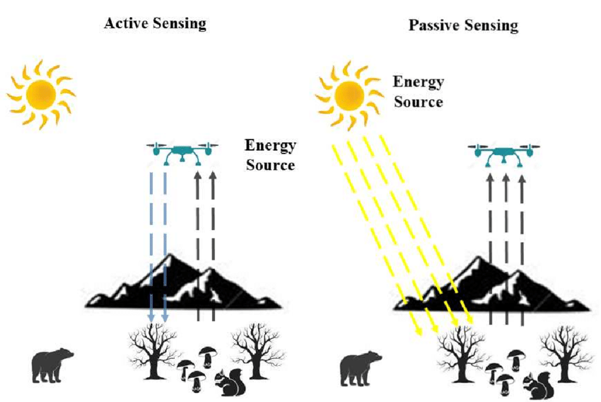
Sensor types
Passive sensors: measure reflected sunlight (e.g. Sentinel-2, Landsat).
Active sensors: emit their own signal and measure the return (e.g. radar, SRTM).
Source: Sawalmeh, A., Unmanned Aerial Vehicles (UAVs): A Survey on Civil Applications and Key Research Challenges, April 2018.

Slide 9
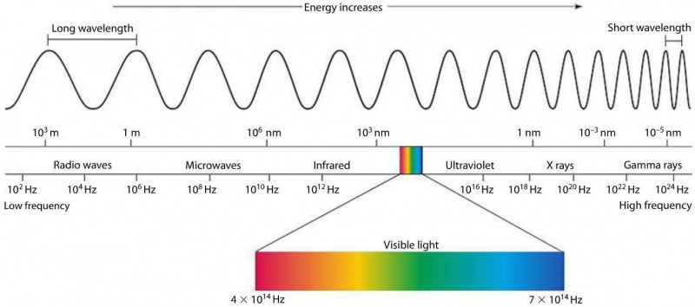
How it works: the electromagnetic spectrum
Each surface reflects, absorbs, or transmits energy differently depending on wavelength.
Snow reflects about 90% of visible light: it appears very bright.
The ocean reflects about 6% and absorbs the rest: it appears dark.
Absorbed energy is re-emitted as infrared, which allows surface temperature to be measured.
This “spectral signature”, specific to each surface type (water, vegetation, bare soil, built-up), makes it possible to tell them apart on an image.
Source: Imperial Encyclopedia Traveller, Marc Miller, July 2019.

Slide 10
Satellite orbits
An orbit is the path a satellite follows around the Earth, maintained by the balance between Earth’s gravity and the satellite’s speed.
Its altitude and inclination relative to the equator determine the area covered on the ground and how often it passes over the same location.
What is a swath? The width of the ground strip imaged on each pass, e.g. 290 km for Sentinel-2, 185 km for Landsat.
The orbital cycle (time to retrace the same ground track) and the swath together determine the actual revisit frequency; it is higher near the poles, where swaths overlap.

Slide 11
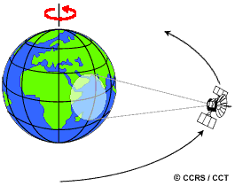
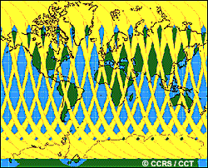
Satellite orbits — illustration

Slide 12
Zoom in: observation satellite orbits
Orbit type | Altitude | Characteristics | Examples
Low (LEO) | 160 - 2,000 km | Polar orbit, fast global coverage | Landsat, Sentinel, Terra/Aqua
Medium (MEO) | 2,000 - 35,500 km | Used for navigation | GPS, Galileo
Geostationary (GEO) | > 35,500 km | Fixed position above one point, continuous observation | Meteosat, GOES

Slide 13
Sun-synchronous orbits
Among low orbits (LEO), Landsat, Sentinel and MODIS use a near-polar orbit known as sun-synchronous. What is sun-synchronous? The satellite flies over each area at the same local solar time on every pass, which ensures comparable lighting from one image to the next.

Slide 14
Part 2 - Resolutions

Slide 15
Spatial resolution
Definition: the size of the ground area represented by a single pixel.
The smaller the pixel, the finer the detail, but the smaller the area covered.
Examples: Sentinel-2 (10-20 m), Landsat (30 m), MODIS (250 m to 1 km), GHSL (100 m).
A fine resolution suits analysis of a single city; a coarse resolution suits regional or global monitoring.

Slide 16
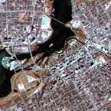
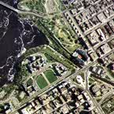
Spatial resolution — illustration

Slide 17
Temporal resolution
Definition: the time needed for a satellite to pass over the same location again (revisit frequency).
Polar satellites: MODIS revisits daily, Landsat every 16 days, Sentinel-2 every 5 days (two twin satellites).
Geostationary satellites: a new image every 10 to 15 minutes (Meteosat, GOES).
The choice depends on the phenomenon being tracked: a flood evolves over hours, urban expansion over years.

Slide 18
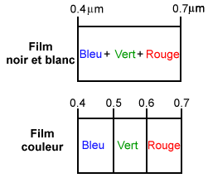
Spectral resolution
Definition: a sensor’s ability to distinguish narrow bands of wavelength.
Multispectral sensors: a handful of bands, typically 3 to 10 (Landsat, Sentinel-2, MODIS).
Hyperspectral sensors: hundreds of very narrow bands, specialised uses (e.g. AVIRIS, 224 bands).
The more bands available, the better similar surfaces can be told apart: crops, minerals, water quality.
Example use: combining the near-infrared band and the red band to calculate NDVI.

Slide 19
Radiometric resolution
Definition: the amount of information contained in each pixel, measured in bits.
An 8-bit image encodes 256 intensity levels per band (0 to 255).
A 12-bit image encodes 4,096 levels: more nuance between close intensities.
Better radiometric resolution helps distinguish, for example, two types of bare soil or two turbid water bodies that look similar.

Slide 20
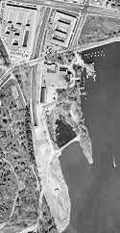
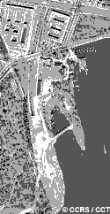
Radiometric resolution — illustration

Slide 21
Trade-offs between resolutions
It is impossible to optimise all four resolutions at once (spatial, temporal, spectral, radiometric).
A finer pixel requires a longer exposure time, hence a slower orbit to revisit the same location.
A common solution: constellations of twin satellites (e.g. the two Sentinel-2 satellites) that combine spatial detail with revisit frequency.
Choosing a sensor for a study is always a trade-off suited to the question at hand.

Slide 22
Part 3 - Satellites, indices and classification

Slide 23
Overview of satellites
Satellite | Agency | Orbit | Spatial resolution | Temporal resolution
Sentinel-2 (A/B/C) | ESA / Copernicus | Sun-synchronous, optical | 10-20 m | ~5 days
Sentinel-1 (A/B/C) | ESA / Copernicus | Sun-synchronous, radar | 5-20 m | ~6-12 days
Landsat (8/9) | NASA / USGS | Sun-synchronous, optical | 30 m | 16 days
Terra / Aqua (MODIS) | NASA | Sun-synchronous, optical | 250 m - 1 km | 1-2 days
Meteosat / GOES | EUMETSAT / NOAA | Geostationary | ~1-3 km | 10-15 min
Public satellites, open and free data:

Slide 24
Overview of commercial satellites
Satellite | Operator | Orbit | Spatial resolution | Temporal resolution
WorldView / GeoEye | Maxar (private) | Sun-synchronous, optical | 0.3-0.5 m | Up to daily depending on area
PlanetScope / SkySat | Planet Labs (private) | Sun-synchronous, optical | 3-5 m / 50 cm | Daily (constellation of ~130-200 satellites)
Pleiades / SPOT | Airbus Defence and Space (private) | Sun-synchronous, optical | 0.3-1.5 m | 1-2 days
Private satellites, very high resolution, usually paid data:

Slide 25
Commercial satellites: when and why?
They complement open data when very fine resolution or daily revisit is needed (e.g. construction monitoring, rapid crisis mapping).
Cost and usage licence must be considered from the design stage of a study; this ties in with the access asymmetry discussed under ethical issues.

Slide 26
Part 4 - Derived products

Slide 27
Spectral index: NDVI example
Formula:
NDVI = (NIR - Red) / (NIR + Red)
Interpretation:
Close to 1: dense vegetation.
Close to 0: bare soil, built-up areas, or sparse vegetation.
Negative: water, shadow, or particular surfaces.

Slide 28
Classifying satellite imagery
Goal: turn a raster of reflectance values into a map of interpretable classes (water, forest, built-up, cropland…).
Unsupervised classification: automatic grouping of pixels by spectral similarity (e.g. k-means), then a label is assigned to each group.
Supervised classification: the analyst supplies labelled training areas, and the algorithm learns to generalise (e.g. random forest, maximum likelihood).
The result is always imperfect: it is assessed with a confusion matrix and an overall accuracy score.

Slide 29
Overview of derived products
Product | Source / method | Resolution | Main use
GHSL Built-Up Surface | Supervised classification of Landsat/Sentinel time series | 100 m | Built-up area and population
SRTM | Radar, single space shuttle mission (2000) | 30 m | Elevation and slope
Copernicus EMS (floodDepth) | Rapid crisis mapping by image interpretation | Vector | Flooded areas, emergency management
Google Open Buildings | Deep learning detection on very high resolution imagery | Vector (footprints) | Buildings and estimated population
Spectral indices (NDVI…) | Calculated from a sensor’s bands | Same as the source sensor | Vegetation, water, soil

Slide 30
Part 5 - Analysis

Slide 31
Time series and change detection
A time series of images allows a phenomenon to be tracked over a period, beyond a single snapshot.
Change detection: comparing two dates (e.g. GHSL 2015 vs 2025) to reveal what has changed.
Common methods: simple difference between indices, independent classification followed by post-classification comparison, trajectory analysis over long series (e.g. Landsat since 1972).
Caution: a detected change may reflect a real change on the ground, or an artefact (cloud, viewing angle, different season).
Today’s workshop applies a simple change detection: built-up area 2015 vs 2025, at regional scale.

Slide 32
Fields of application for remote sensing
Cryosphere and water: snow cover monitoring, water availability.
Vegetation: crop health, droughts, wildfires (via NDVI).
Atmosphere: clouds, precipitation, extreme events.
Oceans: surface temperature, currents, cyclone forecasting.
Built environment and population: urbanisation, density, exposure to risk, the focus of today’s workshop.

Slide 33
Who uses this data?
Space and weather agencies: NASA, ESA/Copernicus, CNES, EUMETSAT, producing and distributing imagery.
National statistical institutes: updating sampling frames, mapping built-up areas and population.
Humanitarian organisations: Copernicus EMS for rapid crisis mapping (floods, earthquakes).
Private sector: Google Open Buildings, Maxar, Planet, very high resolution or large-scale data.
Researchers and NGOs: environmental monitoring, climate, food security.
This data is increasingly open and free, which is changing how countries in the Global South access satellite information.

Slide 34
Ethical and governance issues
Growing resolution: some commercial sensors can distinguish objects under one metre in size, raising privacy questions.
Consent, where possible and relevant, before observing people or dwellings.
De-identification: geomasking or blurring of sensitive data, aggregation to a level that protects individuals.
Watch for discrimination: a predictive model trained on satellite data can reproduce biases against certain regions or populations.
Access asymmetry: the finest and most recent data is often paid or reserved for certain actors (states, companies).

Slide 35
Applications and relevance for national statistics
Reduced cost over a large area, and measurement of spillover effects around an intervention.
Reduced sampling bias in hard-to-reach areas (conflict, remoteness).
Urban expansion and land take.
Agricultural mapping, flood risk, and exposure.
Physical accessibility of localities and updating of sampling frames.

Slide 36
Validation and limitations
Compare against high resolution imagery or a ground-truthed/photo-interpreted sample.
Avoid publishing a classification without an error matrix; document acquisition dates and cloud cover.
Built-up and bare-soil classes are sometimes confused; administrative boundary changes complicate comparisons.
Do not use remote sensing when the phenomenon has no geographic dimension, or to measure what it cannot see (gender, social capital, participation).
Remote sensing never fully replaces fieldwork; any trend must be tied to a precise statistical question.

Slide 37
Key messages
Choosing a sensor is always a trade-off between spatial, temporal, spectral, and radiometric resolution.
Image metadata matters as much as the map itself.
Indicators should be simple, repeatable, and explainable.

Slide 38
This afternoon

Slide 39
Time for hands-on practice in R: two workshops to work with satellite data.
First workshop: measuring built-up growth with GHSL in Cameroon (2015-2025).
Second workshop: combining Copernicus EMS flood data, Open Buildings, a WorldPop population raster, and the OpenStreetMap road network to estimate humanitarian exposure.

Slide 40
R Workshop Exercise 1: GHSL built-up area
The dataset used for the workshop is GHSL Built-Up Surface, available on the official European Commission portal:
https://human-settlement.emergency.copernicus.eu/dataDownload.php
Key points:
GHSL stands for Global Human Settlement Layer.
The Built-Up Surface product represents the built-up area on a 100 m grid.
The data is distributed as ZIP tiles that must be unzipped locally.
Several tiles may be needed to cover an entire country.
The rasters use a world equal-area projection, so administrative boundaries are reprojected before extraction.
Download steps for the workshop:
Open the GHSL download page.
Choose the Built-Up Surface product and the desired year.
Download the tiles covering Cameroon.
Unzip the archives into the data folder.
Run the R script to mosaic, crop, and compute the indicators.

Slide 41
R Workshop Exercise 1: key functions
unzip(): unzip the downloaded GHSL archives, then rast() to load each tile into memory.
mosaic(): assemble several raster tiles side by side into a single continuous layer (here, one per year: 2015 and 2025).
crop() then mask(): clip the mosaic to the outline of Cameroon (or a region), keeping only what falls inside.
exact_extract(..., "sum"): for each region or department, sum the built-up area (km²) contained within its boundaries.
left_join(): bring the 2015 and 2025 indicators together into a single table, region by region.
case_when(): build a typology from several conditions (e.g. “strong growth and dense fabric” vs “moderate growth”).

Slide 42
R Workshop Exercise 2: floods and buildings
Context:
Copernicus EMS activation EMSR772: floods in Yagoua (Far North Cameroon), 2024 — one of the most vulnerable regions of the country.
Goal: cross several imperfect sources (AI-detected buildings, a modelled population raster, a crowdsourced road network) to estimate humanitarian exposure, rather than trusting a single source.
To keep the maps responsive, the workshop works on a reduced 5 x 5 km window, centred on the most densely flooded sector of the official AOI01 (which actually covers ~6,870 km2).
Sources:
Copernicus EMS, activation EMSR772: action areas AOI01-03 and flood depth (floodDepth).
Google Open Buildings: AI-detected building footprints with a confidence score (recommended threshold >= 0.7). https://sites.research.google/gr/open-buildings/#open-buildings-download
The raw Open Buildings tiles (several GB, an area much larger than Yagoua) are pre-filtered once by scripts_formateurs/jour_08_formateur_prepare_open_buildings_en.R, which produces a lightweight GeoPackage restricted to the study area.
WorldPop (cmr_pop_2024_CN_100m_R2025A_v1.tif): a 100 m modelled population raster of Cameroon, used as an independent cross-check of the building count.

Slide 43
R Workshop Exercise 2: walkthrough
Load and explore the EMS layers (areaOfInterest, floodDepth) — understand the structure of a rapid mapping product.
Load and filter Open Buildings by confidence — limit false positives before any spatial join.
Count buildings and estimate population in AOI01 — an occupancy assumption to document (5 people/building).
Count buildings and population affected by flooding.
Compare this estimate against a direct extraction from the WorldPop population raster — an independent cross-check of the occupancy assumption.
Retrieve the OpenStreetMap road network and estimate flooded roads in AOI01 — an indicator of access to services (health, markets) during the crisis.
(Optional) Wrap the analysis in a function and reproduce it for AOI02 and AOI03 — generalise the code instead of copying it three times (DRY principle).

Slide 44
What is OpenStreetMap?
A free, collaborative geographic database: anyone can add or correct objects (roads, buildings, waterways, points of interest…).
Each object is a node (point), a line (way), or a relation, described by tags of the form key = value, for example highway = "primary" for a main road.
Distributed under the ODbL licence: free reuse, provided OpenStreetMap and its contributors are credited.
Freely accessible via the Overpass API, which returns objects within a geographic extent based on their tags; in R, the osmdata package queries this API and returns sf objects directly.

Slide 45
OpenStreetMap: strengths and limitations
Strength: worldwide coverage, continuously updated, free, and sometimes very detailed in areas mapped during humanitarian responses (e.g. Humanitarian OpenStreetMap Team).
Limitation: uneven coverage; quality and completeness depend on the number of locally active contributors.
Always visually check an OSM layer before using it in an analysis; do not assume uniform completeness between two areas.
The Overpass API is a public service for reasonable use: avoid repeated queries over large extents, and save the result locally if it needs to be reused.
A free service with limited capacity: in case of error (429, 504) or slowness, the workshop automatically falls back to an already-downloaded copy (data/OSM/routes_aoi01_yagoua.gpkg).

Slide 46
R Workshop Exercise 2: the data
Copernicus EMS EMSR772: an areaOfInterest shapefile per zone (the mapped perimeter) and a floodDepth shapefile (one polygon per depth range, value column, e.g. “0.50 - 1.00” metres).
Google Open Buildings: distributed as CSV.GZ tiles (latitude / longitude, area_in_meters, confidence, polygon footprint). The workshop loads open_buildings_yagoua.gpkg directly, the version already restricted to the study area, produced by jour_08_formateur_prepare_open_buildings_en.R.
OpenStreetMap: queried directly from R for the AOI01 extent, highway tag, one line per road segment, highway column giving the type (primary, secondary, tertiary, residential, track…). A fallback copy (data/OSM/routes_aoi01_yagoua.gpkg) produced by jour_08_formateur_prepare_osm_routes_en.R, used if the Overpass API is unavailable.
WorldPop: a population raster for Cameroon (100 m), used to extract an independent population figure for AOI01 and for the flooded area.

Slide 47
R Workshop Exercise 2: key functions
st_read(): read a shapefile (areaOfInterest, floodDepth) and load it as a spatial layer.
st_as_sf(coords = c("longitude", "latitude")): turn the Open Buildings table (two coordinate columns) into a point layer.
filter(confidence >= 0.7): keep only buildings whose confidence score exceeds a chosen threshold.
st_filter(): keep only objects located inside an area (e.g. the AOI, or the flooded polygons).
st_join(): attach the depth class of the water to each flooded building.
rast() + exact_extract(..., "sum") (terra/exactextractr packages, already seen in workshop 1): sum the WorldPop population contained in a polygon (AOI or flooded area), to validate the building count against an independent source.
crop() + mask() + tm_raster(): crop the WorldPop raster to AOI01 and map it by density class, to visualise where the estimated population is concentrated.
Writing your own function (e.g. analyse_flood(), optional): group the previous steps together so they can easily be repeated for AOI02 and AOI03, without copying the code three times.
opq() + add_osm_feature() + osmdata_sf() (osmdata package): query the Overpass API over an extent (bbox) and retrieve the objects matching a tag (e.g. highway).
st_intersection() + st_collection_extract("LINESTRING"): clip roads exactly to the boundaries of the flood polygons to get the length that is genuinely flooded.

