Slide 1
PHP Programming Hints and Techniques
<option value='5' <?= ($_POST['rows']==5)?'selected':'';?> >5</option>

Slide 2
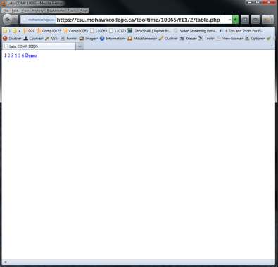
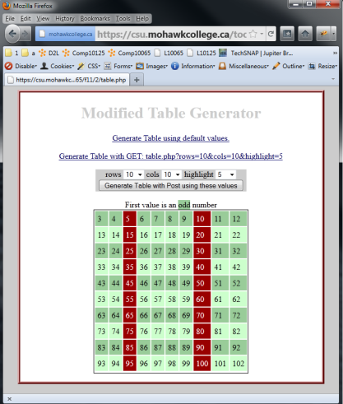
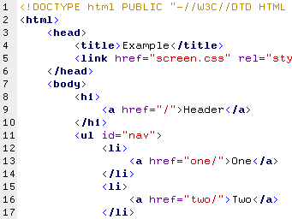
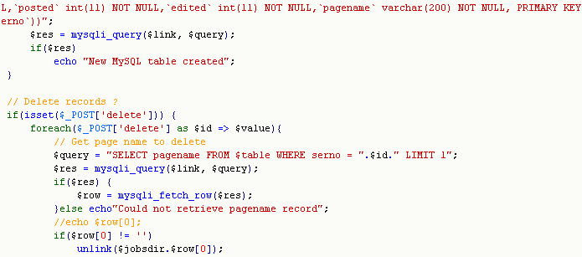
Client-Server Paradigm
HTTP Request for table.php
Web Server
PHP Interpreter
HTTP Reply and generated HTML
table.php

Slide 3
$_SERVER['PHP_SELF']
Always self-reference URL's with $_SERVER['PHP_SELF']
<form action="<?= $_SERVER['PHP_SELF'] ?>" name="getstuff" method="post" >
<a href="<?PHP echo $_SERVER["PHP_SELF"] ? >" >Refresh this page </a>
<a href="<?= $_SERVER['PHP_SELF'] ? >" >Refresh this page </a>
<a href="<?= $_SERVER['PHP_SELF'] ?>?act=sortby&col=size">sort</a>
double and single quotes both work in this example.

Slide 4
GET or POST ?
To determine if a web script was entered via a POST or a GET
if ($_SERVER['REQUEST_METHOD'] == 'GET') { echo "GET Method was used"; }
if ($_SERVER['REQUEST_METHOD'] == 'GET' && sizeof($_GET) == 0) { echo "GET Method was used and no URL parms were used. Welcome!"; }
if ($_SERVER['REQUEST_METHOD'] == 'POST') { echo "POST method was used"; }

Slide 5
Viewing POST and GET arrays
To visually see the array contents of the POST and GET array (or any array) use print_r()
print_r ($_POST);
echo print_r ($_GET, true);
$txt = print_r($myArray, true); //saves to a variable
echo '<pre>' . print_r ($_POST, true) . '</pre>';
<?= '<pre>' . print_r ($_POST, true) . '</pre>'; ?>
(
[act] => post
[email] => abc@abc.com
[province] => Array
(
[0] => PE
[1] => QC
[2] => SK
)
)

Slide 6
Accessing FORM and URL Variables
$_GET['act']
<html><body> <a href="<?= $_SERVER['PHP_SELF']?>?act=refresh">Refresh</a> <form action="<?= $_SERVER['PHP_SELF']?>" method='post'> <input type='text' name='username' value='' /> <input type=submit /> </form> </body></html>
$_POST['username']

Slide 7
Integrating PHP and HTML
Both of these methods work well.
Braces are for readability and not necessary in this sample code
Both methods NOT recommended in the long run, as this style does not work for templates since HTML is not preserved
echo "<div>{$varOne}</div>"; echo "<div class=\"class_one\">{$varTwo}</div>"; echo "<div class=\"class_two\">{$varThree} to {$varFour}</div>"; echo '<div>' . $varOne . '</div>'; echo '<div class="class_one">' . $varTwo . '</div>'; echo '<div class="class_two"> ' . $varThree . ' to ' . $varFour . '</div>';

Slide 8
Integrating PHP and HTML
<div> <?= $varOne; ?> </div> <div class="class_one"> <?= $varTwo; ?> </div> <div class="class_two"> <?= $varThree; ?> and <?= $varFour; ?> </div> <div> <?= $varOne; ?> </div> <div class="class_one"> <?= $varTwo; ?> </div> <div class="class_two"> <?= "{$varThree} and {$varFour}"; ?> </div>
preferred style
suitable for large blocks of code and templates
HTML is preserved

Slide 9
Integrating PHP and HTML
Preferred method for generating tables and ordered lists
<table> <? foreach ($TPL['filelist'] as $ROW): ?> <tr> <td><a href="<?= $ROW['fileNameDir'] ?>" ><?= $ROW['fileName'] ?></a></td> <td><?= $ROW['size'] ?></td> <td><?= $ROW['date'] ?></td> </tr> <? endforeach; ?> </table>
<table> <? foreach ($TPL['filelist'] as $ROW){ ?> <tr> <td><a href="<?= $ROW['fileNameDir'] ?>" ><?= $ROW['fileName'] ?></a></td> <td><?= $ROW['size'] ?></td> <td><?= $ROW['date'] ?></td> </tr> <? } ?> </table>

Slide 10
Array Walking
Each value in $_POST, $_GET or any array can be read with a foreach loop…
$PROVINCES = array(
"--" => "--- Please Select Provinces ---",
"NF"=>"Newfoundland",
"PE"=>"Prince Edward Island",
"NB"=>"New Brunswick",
"NS"=>"Nova Scotia",
"QC"=>"Quebec",
"ON"=>"Ontario",
"MB"=>"Manitoba",
"SK"=>"Saskatchewan",
"AB"=>"Alberta",
"BC"=>"British Columbia",
"NT"=>"Northwest Territories",
"YT"=>"Yukon Territory");
<?
foreach ($PROVINCES as $abbreviation => $provinceName) {
echo "<option value=\"$abbreviation\" >$provinceName</option>\n";
echo "<option value ='$abbreviation' >$provinceName</option>\n";
}
<?
<?
foreach ($_GET as $key => $val) { echo"$key = $val <br />";
}
?>

Slide 11
" Trim Whitespace "
Trim blank characters from the front and end of a string with trim()
//trim one POST variable $_POST['username'] = trim($_POST['username']); //trim all variables in $_POST foreach($_POST as $KEY => $VAL) $_POST[$KEY] = trim($VAL); //trim all variables in $_POST except arrays........ foreach($_POST as $KEY => $VAL){ if (is_array($VAL) == false) $_POST[$KEY]= trim($VAL); } //trim all variables in $_POST except arrays........ foreach($_POST as $KEY => $VAL) $_POST[$KEY] = (!is_array($VAL))?trim($VAL):$VAL;

Slide 12
Building URL's Dynamically
<? $ROWS = 5; $HIGHLIGHT = 9; $ROW['FILENAME'] = 'ascii.txt'; ?> <html><body> <a href="<?= $_SERVER['PHP_SELF']?>?act=refresh">Refresh</a> <br /> <a href=<?= $_SERVER['PHP_SELF'] ?>?act=del&file=<?= $ROW['FILENAME'] ?>>Delete</a> <br /> <a href="<?= "{$_SERVER['PHP_SELF']}?rows=$ROWS&highlight=$HIGHLIGHT" ?>">Generate</a> <br /> <a href="<?= "{$_SERVER['PHP_SELF']}?rows={$ROW['FILENAME']}&highlight=$HIGHLIGHT" ?>">Generate</a> </body></html>
PHP Source
<html><body> <a href="test.php?act=refresh">Refresh</a> <br /> <a href=test.php?act=del&file=ascii.txt>Delete</a> <br /> <a href="test.php?rows=5&highlight=9">Generate</a> <br /> <a href="test.php?rows=ascii.txt&highlight=9">Generate</a> </body></html>
HTML Source

Slide 13
Form Memory: Text Box
For Input Text boxes, print the value of the name given to the text box….
Country: < input type = "text" name = "country" value = "<?= $_POST['country'] ?>"/>

Slide 14
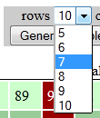
Form Memory: Select Box
HTML Source
(
[act] => post
[email] => abc@abc.com
[rows] => 7
)
<select name="rows">
<option value="5" >5</option>
<option value="6" >6</option>
<option value="7" selected>7</option>
<option value="8" >8</option>
<option value="9" >9</option>
<option value="10" >10</option>
</select>
$_POST
<select name='rows'> <option value='5' <?= ($_POST['rows']==5)?'selected':'';?> >5</option> <option value='6' <?= ($_POST['rows']==6)?'selected':'';?>>6</option> <option value='7' <?= ($_POST['rows']==7)?'selected':'';?>>7</option> <option value='8' <?= ($_POST['rows']==8)?'selected':'';?>>8</option> <option value='9' <?= ($_POST['rows']==9)?'selected':'';?>>9</option> <option value='10' <?= ($_POST['rows']==10)?'selected':'';?>>10</option> </select>
PHP Source

Slide 15
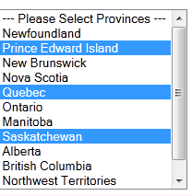
Form Memory: Multiple[] Select Box
HTML Source
(
[act] => post
[email] => abc@abc.com
[province] => Array
(
[0] => PE
[1] => QC
[2] => SK
)
)
<select name = "province[]" multiple size = "12" >
<option value="--" >--- Please Select Provinces ---</option>
<option value="NF" >Newfoundland</option>
<option value="PE" selected>Prince Edward Island</option>
<option value="NB" >New Brunswick</option>
<option value="NS" >Nova Scotia</option>
<option value="QC" selected>Quebec</option>
<option value="ON" >Ontario</option>
<option value="MB" >Manitoba</option>
<option value="SK" selected>Saskatchewan</option>
<option value="AB" >Alberta</option>
<option value="BC" >British Columbia</option>
<option value="NT" >Northwest Territories</option>
<option value="YT" >Yukon Territory</option>
</select>
$_POST
<select name = "province[]" multiple size = "12" >
....
<option.......
<option value="SK" <?= (in_array('SK', $_POST['province'] ) )?'selected':'';?>>Saskatchewan</option>
<option ........
.......
</select>
PHP Source

