Slide 1
Arrays, $_GET and $_POST

Slide 2
Associative Arrays
In associative arrays, we can associate a key with each value. The key may be an integer or string.
$daysWeek= array( "Mo" => "Monday",
"Tu" => "Tuesday",
"We" => "Wednesday",
"Th" => "Thursday",
"Fr" => "Friday",
"Sa" => "Saturday",
"Su" => "Sunday"
);
In this example, a sample associative array using days of the week.

Slide 3
Basic Associative Array Manipulation
<html><body>
<?
$daysWeek=array("Mo"=>"Monday",
"Tu"=>"Tuesday",
"We"=>"Wednesday",
"Th"=>"Thursday",
"Fr"=>"Friday",
"Sa"=>"Saturday",
"Su"=>"Sunday");
/* Print out one value */
echo "One Day --> {$daysWeek['We']} <br> ";
?>
</body></html>
A single value from the array is reference using the string key:
$daysWeek['We']
Output: One Day --> Wednesday

Slide 4
Basic Associative Array Manipulation
An associative array can be looped using the foreach() construct without regard to the array size.
<html><body>
<?
$daysWeek=array("Mo"=>"Monday",
"Tu"=>"Tuesday",
"We"=>"Wednesday",
"Th"=>"Thursday",
"Fr"=>"Friday",
"Sa"=>"Saturday",
"Su"=>"Sunday");
/* Loop through all values */
foreach ($daysWeek as $abbr => $dayOfWeek)
echo $abbr . ':' . $dayOfWeek . ' | ';
?>
</body></html>
Output: Mo:Monday | Tu:Tuesday | We:Wednesday | Th:Thursday | Fr:Friday | Sa:Saturday | Su:Sunday |

Slide 5
print_r() for debugging arrays
<html><body>
<?
$daysWeek=array("Mo"=>"Monday",
"Tu"=>"Tuesday",
"We"=>"Wednesday",
"Th"=>"Thursday",
"Fr"=>"Friday",
"Sa"=>"Saturday",
"Su"=>"Sunday");
/* Debug print array */
echo '<pre>';print_r($daysWeek);echo '</pre>';
?>
</body></html>
Array
(
[Mo] => Monday
[Tu] => Tuesday
[We] => Wednesday
[Th] => Thursday
[Fr] => Friday
[Sa] => Saturday
[Su] => Sunday
)
print_r output
print_r displays the contents of any sized array.

Slide 6
(also known as URL parameters or GET parameters)
$_GET Variables
<a href=get.php?fruit1=apple&fruit2=banana>Click Here</a>

Slide 7
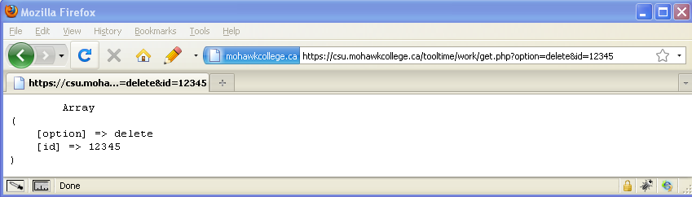
Displaying incoming $_GET parameters
<html><body>
<pre>
<?= print_r($_GET); ?>
</pre>
</body></html>
Key-Value pairs entered in an URL after a ? are entered by PHP into the GLOBAL array $_GET
get.php
get.php?option=delete&id=12345

Slide 8
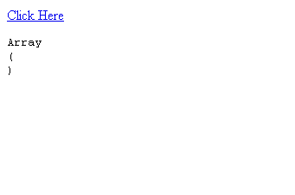
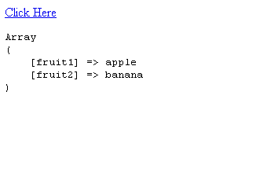
Displaying incoming $_GET parameters with print_r()
Before clicking link
GET
<html> <body>
<a href=get.php?fruit1=apple&fruit2=banana>
Click Here</a>
<?= '<pre>'.print_r($_GET,true).'</pre>'; ?>
</body> </html>
get.php
After clicking link

Slide 9

$_GET[ ]
All URL parameters are stored in the $_GET super global array
The $_GET array is used to collect values from a form with method="get"
Since $_GET is a super global, this array is available to all functions and classes as a GLOBAL variable.
clicked
Server
GET
PHP Script
echo $_GET['fruit'] prints 'apple';

Slide 10
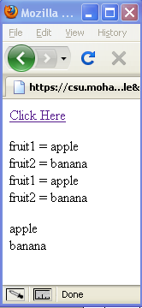
Methods of Accessing $_GET Variables
Different methods of accessing $_GET variables in PHP.
<html> <body>
<a href="get2.php?fruit1=apple&fruit2=banana">Click Here</a>
<p>
<?
foreach ($_GET as $key => $val) {
echo "$key = $val <br \>";
}
while (list($key,$val) = each($_GET)){
echo "$key = $val <br \>";
}
echo "<p>";
echo $_GET['fruit1'] . "<br \>" . $_GET['fruit2'];
?>
</body> </html>

Slide 11
{Complex (curly) syntax}
This works…...
echo $_GET["fruit1"] . "<br>" . $_GET["fruit2"];
This single string version doesn’t work……syntax error
echo " $_GET['fruit1'] <br> $_GET['fruit2'] ";
But it will work with the curly braces!
echo " {$_GET['fruit1']} <br> {$_GET['fruit2']}";
The curly braces are used to enclose complex expressions (like array references) within strings so that they may be expanded.
(A brace { followed by a $ with no space in between. )

Slide 12
POST Variables
$_POST
<form action='post.php' method='post'>
<input type='text' name='yourname'><br>
<input type='hidden' name='studentid' value='12345678'>
<input type='submit' >
</form>

Slide 13
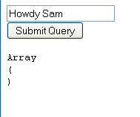
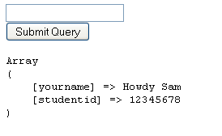
Displaying $_POST Variables
To server
$_POST
<html><body>
<form action="post.php" method="post">
<input type="text" name="yourname"><br>
<input type="hidden" name="studentid"
value="12345678">
<input type="submit" >
</form>
<?= "<pre>".print_r($_POST,TRUE)."</pre>" ?>
</body></html>
browser
From server
post.php
browser

Slide 14

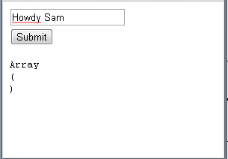
$_POST[ ]
The $_POST array is used to collect values from a form with method= "post"
Since it is a GLOBAL array, this array is available to all functions and classes also..
POST
Server
PHP Script
$_POST[“yourname”] = “GETANDPOST”;

Slide 15
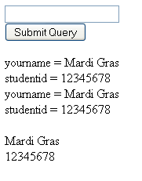
Accessing $_POST variables
<html><body>
<form action="post.php" method="post">
<input type="text" name="yourname"><br>
<input type="hidden" name="studentid"
value="12345678">
<input type="submit" >
</form>
<?
foreach ($_POST as $key => $val) {
echo "$key = $val <br \>";
}
while (list($key,$val) = each($_POST)){
echo "$key = $val <br \>";
}
echo "<br />". $_POST['yourname'] .
"<br \>" . $_POST['studentid'];
?>
</body></html>
Mardi Gras

