Slide 1
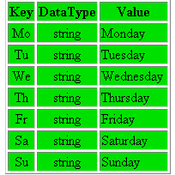
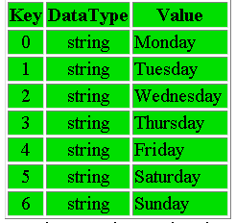
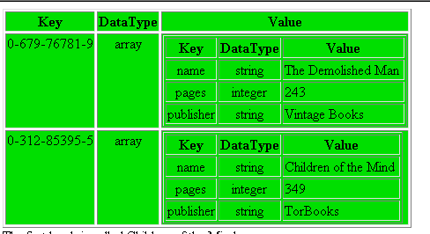
Associative Arrays

Slide 2
Arrays
arrays are defined with the [] operator
arrays consist of elements, each of which has a key - value pair (or index -value pair)
scalar arrays use numeric indices and are called “numerically indexed arrays”
associative arrays use string indices and are called “associative arrays” or “hashes”
by default, arrays are zero-based in that the first element has an index of zero
arrays can contain elements of a number of different data types (unlike C)

Slide 3
Initializing Arrays
arrays may be initialized by assigning values to empty brackets
      $fruit[] = "apple"
      $fruit[] = "banana"
      $fruit[] = "orange"
this creates an array with indices of 0,1,2
it could have been assigned with explicit indices
      $fruit[0] = "apple"
      $fruit[1] = "banana"
      $fruit[2] = "orange"

Slide 4
Initializing Arrays
integer indices can be assigned in any order
      $fruit[15] = "apple";
      $fruit[5] = "banana";
      $fruit[35] = "orange";
new values assigned without an index begin immediately after the highest-indexed element
count() returns the number of elements in an array
      $fruit[15] = "apple";
      $fruit[35] = "banana";
      $fruit[5] = "orange";
      $fruit[] = "plum"; //has index of 36
      echo (count($fruit)); //prints 4

Slide 5
Initializing Arrays
the array() function will initialize an array with the values passed as arguments
    $fruit = array("apple","banana","orange","plum");
    echo $fruit[2] ; //prints "orange"
indices can be set with the => operator
    $fruit = array(1 => "apple","banana",5 =>"orange");
    echo $fruit[1] ; //prints "apple"
    echo $fruit[2] ; //prints "banana"
    echo $fruit[5] ; //prints "orange"

Slide 6
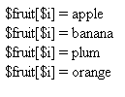
Looping Through Sequentially Indexed Arrays
count() function returns size
  count() should not be placed within for loop
for loop will access each key-value pair sequentially
<html><body>
<?
  $fruit = array ("apple","banana","plum","orange");
  $arrsize = count ($fruit);
  for ($i = 0; $i<$arrsize; $i++):
  echo"\$ fruit[\$ i]=$fruit[$i]< br>";
  endfor;
  ?>
</body></html>

Slide 7
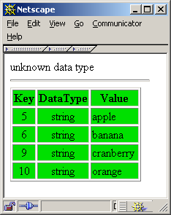
Viewing Arrays with greenarray.php
The greenarray.php is a versatile function for viewing variables and arrays
very useful for debugging and investigating
<?include ("greenarray.php");?>
<html><body>
<?
$fruit = array (5 => "apple",
"banana",
9 => "cranberry",
"orange");
dump_array ($fruit);
?>
</body></html>

Slide 8
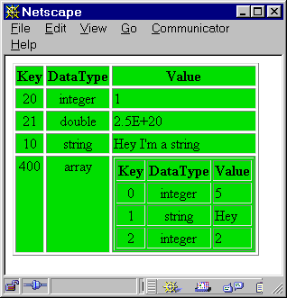
Non-sequentially Indexed Array
Keys can be in any order
Values can be any valid PHP data type
<html><body>
<?include(”greenarray.php");?>
<?
$my_array[20]= 1;
$my_array[]=2.5e20;
$my_array[10] = "Hey I'm a string";
$my_array[400] = array(5,"Hey",2);
dump_array($my_array);
?>
</body></html>
looping through non-sequential arrays require specialized array functions

Slide 9
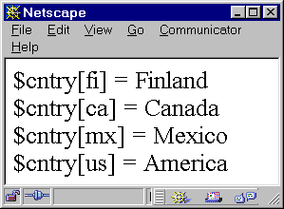
Associative Arrays
All PHP arrays are essentially associative arrays
  keys can be numerical or string values
  values can be any valid PHP data type
  internal pointer keeps track key value
<html><body>
<?
define ("NL","<br>");
$cntry = array ("ca" => "Canada",
"us" => "America",
"mx" => "Mexico");
$cntry["fi"] = "Finland";
//add one more
echo ("\$cntry[fi] = " . $cntry['fi'] . NL);
echo ("\$cntry[ca] = " . $cntry['ca'] . NL);
echo ("\$cntry[mx] = " . $cntry['mx'] . NL);
echo ("\$cntry[us] = " . $cntry["us"] . NL);
?>
</body></html>

Slide 10
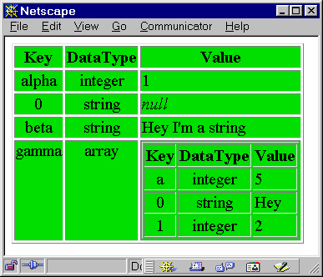
Associative Arrays
associative arrays can be quite complex when both key and values are different PHP data types
<html><body>
<?include(”greenarray.php");?>
<?
$my_array["alpha"] = 1;
$my_array[]="";
$my_array["beta"] = "Hey I'm a string";
$my_array["gamma"]=array("a"=>5,"Hey",2);
dump_array($my_array);
?>
</body></html>

Slide 11
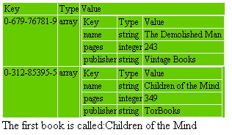
Multi-dimensional Arrays
<html><body>
<?
include"greenarray.php";
$books = array (
'0-679-76781-9' =>
array ( 'name' => 'The Demolished Man',
'pages' => 243,‘
publisher' => "Vintage Books"),
'0-312-85395-5' =>
array ( 'name' => "Children of the Mind",
'pages' => 349,
'publisher' => "TorBooks"));
echo dump_array ($books);
$nameofbook = $books["0-312-85395-5"]["name"];
echo ("The first book is called:" . $nameofbook);
?>
</body></html>

Slide 12
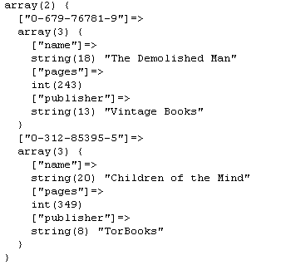
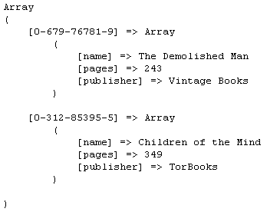
print_r() and var_dump()
print_r($books);
var_dump($books);
Useful for displaying complex arrays. An alternative to greenarray.php
Array is displayed as an array declaration. This can be saved to a file and included for use.

Slide 13
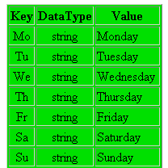
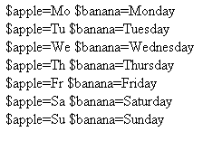
foreach() loops
<html><body>
<?
$daysweek = array("Mo"=>"Monday",
"Tu"=>"Tuesday",
"We"=>"Wednesday",
"Th"=>"Thursday",
"Fr"=>"Friday",
"Sa"=>"Saturday",
"Su"=>"Sunday");
foreach ($daysweek as $apple => $banana):
echo ("\$apple=".$apple." \$banana=".$banana."<br>");
endforeach;
?>
</body></html>

Slide 14

foreach() loops
<html><body>
<?
include"greenarray.php";
$books = array (
"0-679-76781-9" => array (
"name" => "The Demolished Man",
"pages" => 243,
"publisher" => "Vintage Books"),
"0-312-85395-5" => array (
"name" => "Children of the Mind",
"pages" => 349,
"publisher" => "TorBooks"));
foreach ($books as $ISBN => $ROW):
echo "<br>$ISBN: ";
foreach ($ROW as $KEY => $VAL):
echo "<b>$KEY</b> : $VAL ,";
endforeach;
endforeach;
?>
</body></html>

Slide 15
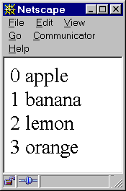
Functions for Sorting Arrays
sort() will sort an array by value in forward order
key-value association is lost
rsort() sorts in reverse order
<html><body>
<?
$fruits = array("d"=>"lemon",
"a"=>"orange",
"b"=>"banana",
"c"=>"apple");
sort($fruits);
foreach($fruits as $aa =>$bb)
echo("$aa $bb <br>\n");
?>
</body></html>

Slide 16

Functions for Sorting Arrays
asort() will sort an array by value in forward order and maintain key association
arsort() sorts in reverse order
<html><body>
<?
$fruits = array("d"=>"lemon",
"a"=>"orange",
"b"=>"banana",
"c"=>"apple");
asort($fruits);
foreach($fruits as $xx =>$bb)
echo("$xx $dd <br>\n");
?>
</body></html>

Slide 17
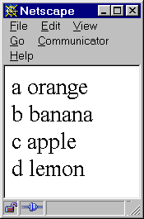
Functions for Sorting Arrays
ksort(array) -- Sort an array by key in forward order and maintain key association
krsort (array) sorts in reverse order
<html><body>
<?
$fruits = array("d"=>"lemon",
"a"=>"orange",
"b"=>"banana",
"c"=>"apple");
ksort($fruits);
foreach($fruits as $uu =>$yy)
echo("$uu $yy <br>\n");
?>
</body></html>

Slide 18
Functions for Sorting Arrays
uasort(array,function) sorts an array by value, maintains key-value association and permits the sorting order to be determined by a user specified function
function receives two array elements to compare
  return 0 if both arguments have same sorting priority
  return 1 if first argument has higher sorting priority
  return -1 if second argument has higher sorting priority
uksort(array,function) will sort by key
usort(array,function) sorts by value, but doesn’t maintain key-value association

Slide 19
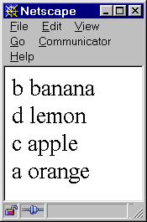
Functions for Sorting Arrays
<html><body>
<?
function second_char($a,$b)
{
//sort priority based only on second letter
if (substr($a,1,1) == substr($b,1,1)) return 0;
if (substr($a,1,1) < substr($b,1,1)) return -1;
else return 1;
}
$fruits = array("d"=>"lemon",
"a"=>"orange",
"b"=>"banana",
"c"=>"apple");
uasort($fruits,second_char);
foreach($fruits as $mm => $nn)
echo("$mm $nn <br>\n");
?>
</body></html>

Slide 20
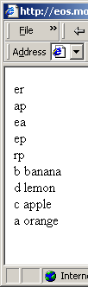
Functions for Sorting Arrays
<html><body>
<?
function second_char($a,$b)
{
echo substr($a,1,1) . substr($b,1,1)."<br>";
if (substr($a,1,1) == substr($b,1,1)) return 0;
if (substr($a,1,1) < substr($b,1,1)) return -1;
else return 1;
}
$fruits = array("d"=>"lemon",
"a"=>"orange",
"b"=>"banana",
"c"=>"apple");
uasort($fruits,second_char);
foreach($fruits as $key =>$value)
echo("$key $value <br>\n");
?>
</body></html>

Slide 21
in_array()
in_array() — Checks if a value exists in an array
<html><body>
<?
$fruits = array("d"=>"lemon",
"a"=>"orange",
"b"=>"banana",
"c"=>"apple");
if (in_array("banana", $fruits)) {
echo "The array has a value = banana . ";
?>
</body></html>

Slide 22
Associative Array Techniques
  Array Flip
  Word Finder Word Filter
  Multidimensional Array Sort

Slide 23
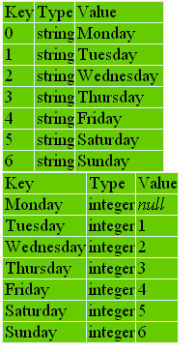
Converting Indexed Arrays to Associative Arrays
array_flip()
<html><body>
<?
include("greenarray.php");
$daysweek=array("Monday",
"Tuesday",
"Wednesday",
"Thursday",
"Friday",
"Saturday",
"Sunday");
dump_array($daysweek);
$newdaysweek = array_flip($daysweek);
dump_array($newdaysweek);
?>
</body></html>
Numerically
indexed array
!!!
$daysweek
Associative
array
$newdaysweek

Slide 24
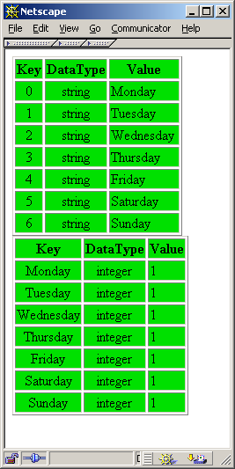
Converting Indexed Arrays to Associative Arrays
Flipping Key-Value with a loop
<html><body>
<?
include("greenarray.php");
$daysweek=array("Monday",
"Tuesday",
"Wednesday",
"Thursday",
"Friday",
"Saturday",
"Sunday");
dump_array($daysweek);
foreach ($daysweek as $key => $val)
$newdaysweek[$val] = 1;
dump_array($newdaysweek);
?>
</body></html>
Numerically
indexed array
$daysweek
Associative
array
$newdaysweek

Slide 25
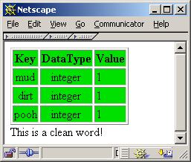
Word Finder
A string is checked against a list of known values using an array index.
<html><body>
<?
include ("greenarray.php");
$bad_words = array( "mud" => 1,
"dirt" => 1,
"pooh" => 1);
dump_array($bad_words);
$checkthisword = "sand";
if ($bad_words[$checkthisword] == 1)
echo "This is a bad word.";
else
echo "This is a clean word!";
?>
</body></html>

Slide 26
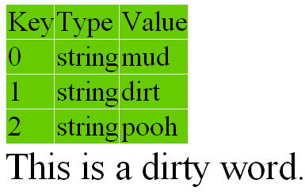
Word Finder with in_array()
A string is checked against a list of known values using in_array()
<html><body>
<?
  include ("greenarray.php");
  $illegalWords = array( "mud" , "dirt" , "pooh" ,);
  echo dump_array($illegalWords);
  $checkThisWord = "mud";
  if (in_array($checkThisWord, $illegalWords) )
  echo "This is a dirty word.";
  else
  echo "This is a clean word!";
?>
</body></html>

Slide 27
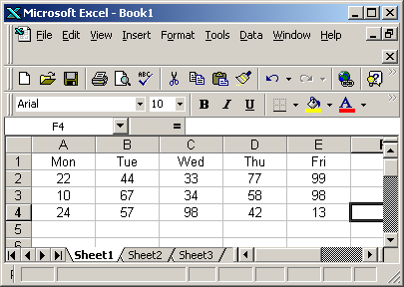
Relational Databases as Arrays
How do we represent table data from a relational database as an associative array?
How do we sort this array by any column?
Easy thing to do in a spreadsheet program.

Slide 28
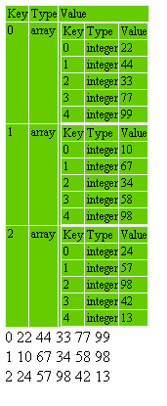
Relational Databases As Arrays
<html><body>
<?
include ("greenarray.php");
$weeks_arr = array(
0 => array(22,44,33,77,99),
1 => array(10,67,34,58,98),
2 => array(24,57,98,42,13));
echo dump_array($weeks_arr);
foreach($weeks_arr as $k =>$V) :
echo "$k $v[0] $v[1] $v[2] $v[3] $v[4] <br>";
endwhile;
?>
</body></body>
Spreadsheet data is represented as a multi-dimensional array.

Slide 29
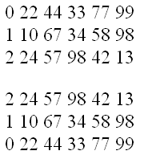
Sorting Relational Databases
<html><body>
<?
include ("greenarray.php");
function customSort($a,$b)
{
$col = 4;
if ($a[$col] == $b[$col]) return 0;
if ($a[$col] < $b[$col]) return -1;
else return 1;
}
$myScores = array(
0 => array(22,44,33,77,99),
1 => array(10,67,34,58,98),
2 => array(24,57,98,42,13));
foreach($myScores as $k => $v))
echo "$k $v[0] $v[1] $v[2] $v[3] $v[4] <br>";
uasort($myScores,customSort);
echo "<p>";
foreach ($myScores as $k => $v)
echo "$k $v[0] $v[1] $v[2] $v[3] $v[4] <br>";
?>
</body></body>
The array was sorted by column 5.

Slide 30
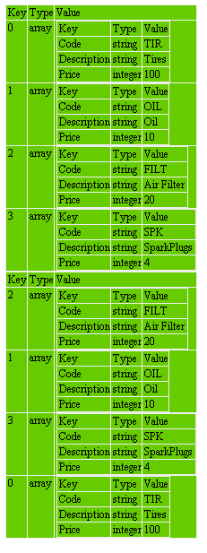
Sorting Multidimensional Arrays
<html><body>
<?
include ("greenarray.php");
function customSort($a,$b)
{
$col = "Code";
if ($a[$col] == $b[$col]) return 0;
if ($a[$col] < $b[$col]) return -1;
else return 1;
}
$products = array(
array( "Code" => 'TIR',"Description" => 'Tires',"Price" => 100 ),
array( "Code" => 'OIL',"Description" => 'Oil',"Price" => 10),
array( "Code" => 'FILT',"Description" => 'Air Filter',"Price" => 20),
array( "Code" => 'SPK',"Description" => 'SparkPlugs',"Price" => 4 ));
echo dump_array($products);
uasort($products,customSort);
echo dump_array($products);
?>
</body></body>
Multi-dimensional array is sorted by column with key value = “Code”.

