Slide 1
Variables,Constants and Data Types

Slide 2
Data Types
PHP supports three basic data types
  a weakly typed language (unlike C's strong typing)
  variables can contain any type of data
  type does not have to be declared
Integers
  ordinary, non-decimal numbers
  occupies 4 bytes of memory (range of +/- 2 billion)
Doubles or Floats
  numbers that contain decimal point or exponent
  Ex: 2.4 5.6e9
Strings
  represent non-numeric values
  Example: “hello"

Slide 3
Boolean Data Types
PHP does not support a specific Boolean data type
Expressions of the three basic data types are used for evaluation of TRUE and FALSE
  Integers
    0 = TRUE, non-zero = FALSE
  Floats
    0.0 or 0.0e0 = True, non-zero = FALSE
  Strings
    empty string evaluates to FALSE

Slide 4
Numeric Literals
Numeric data literal types supported by PHP
Decimal Integer:
  123 55 -55
Octal Integer:
  043 0777
Hex Integer:
  0xdeadbeef 0xffff2c97
Floating Point:
  100.5 100.234 3.4e5 -98e-3

Slide 5
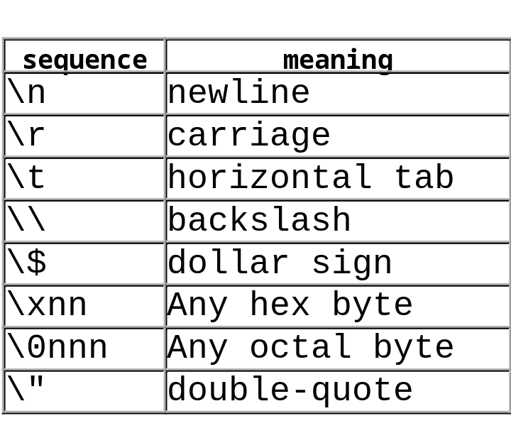
Escaping Characters in Strings
Strings contained in double quotes will be expanded using the backslash and C-style escape characters.
To print out the following sentence:
"©The value of $path is \home\user\public_html "
<html><body>
<?
$path = "\\home\\user\\public_html";
echo ("\"\xa9The value of \$path is $path \"");
?>
</body></html>

Slide 6
Single Quoted String Literals
strings encased in single quotes only understand two escape characters:
  \’ and \\
variable names are not recognized within the string
newline, carriage return and white space is preserved.
<html><body>
<?
$name = 'Johnny';
echo ("$name" . "<br>"); //prints: Johnny
echo ('$name' . '<br>'); //prints: $name
?>
</body></html>

Slide 7
HereDoc strings
Heredocs allow you to define your own delimiter in a string. (example uses EOT)
Useful for large blocks of text that may contain single, double quotes. (no escaping necessary)
Heredocs understand variable substitution.
Important that final EOT start on its own line and in the first column.
<?
$mystring = <<<EOT
This is some PHP text.
It understands "double quotes" and 'single quotes',
$variables and {$ARR[vars]}
EOT;
echo $mystring;
?>

Slide 8
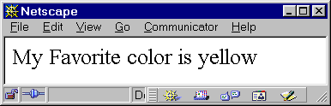
Constants
Constants are values that never change
Constants are defined with the define() function
  note absence of $ in using constants
  general practice is to define constants with Capitol Letters
  the defined() function allows you to test its existence
<html><body>
<?
define ("COLOR","yellow");
if ( defined ("COLOR"))echo ("My Favorite color is " . COLOR);
?>
</body></html>

Slide 9
Built-in Global Constants
a number of built-in global constants are available to scripts
  constants are mostly defined with Capitol Letters and underscores
Some examples:
  __FILE__ name of file being parsed
  __LINE__ line number being parsed
  PHP_VERSION version of PHP
  PHP_OS Operating System
  TRUE & FALSE
sql_error ( GENERAL_ERROR, ’some error msg’, ’’,__LINE__,__FILE__,$sql);

Slide 10
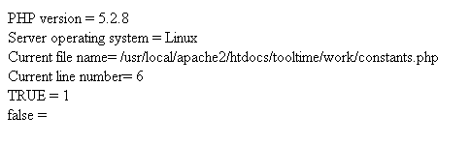
Using PHP Built In Constants
<?
// Using PHP built-in constants
echo "PHP version = " . PHP_VERSION . "<br />";
echo "Server operating system = " . PHP_OS . "<br />";
echo "Current file name= " . __FILE__ . "<br />";
echo "Current line number= " . __LINE__ . "<br />";
echo "TRUE = ". TRUE . "<br />";
echo "false = ". FALSE . "<br />";
?>

Slide 11
Pre-defined Variables
a large number of useful pre-defined variables are available to any PHP script.
These variables come from
  Apache web server
  PHP module
  Unix shell environment variables
  Externally from HTTP Forms (GET, POST)
a list of predefined variables is available with phpinfo()
  this list is not complete, but is a good indication of what is available

Slide 12
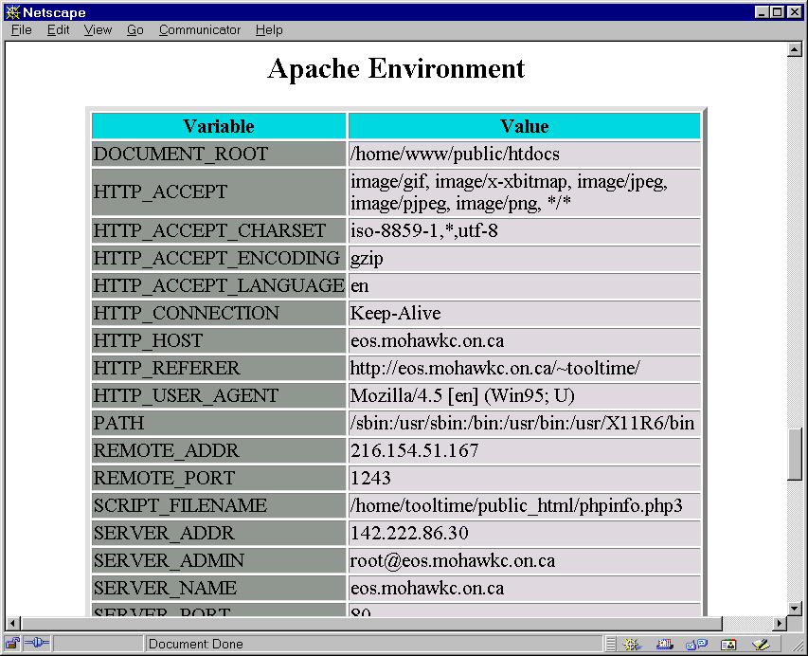
Predefined variables
<html>
<?
phpinfo();
?>
</html>
phpinfo.php
partial list of
variables
available with phpinfo();

Slide 13
Pre-defined variables (cont’d)
Apache web server variables are mostly defined by the CGI 1.1 Interface
  Some of the more popular Apache variables
    $_SERVER[REMOTE_ADDR] - IP address of browser
    $_SERVER[HTTP_USER_AGENT] - type of browser
    $_SERVER[REQUEST_URI] - URL of current script
    $_SERVER[HTTP_REFERER] - referring document
    $_SERVER[PATH_TRANSLATED] - filesystem path to current script
  See online documentation for complete list

Slide 14
Pre-defined variables (cont’d)
PHP provided pre-defined variables
  $_SERVER[PHP_SELF] - URL of current script
  $_COOKIE- array of cookie variables
  $_GET - array of GET parms
  $_POST- array of POST parms
Pre-defined Environment variables
  all predefined environment variables may be accessed through the $_GLOBALS array

Slide 15
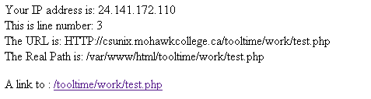
Example with Predefined Vars
<html><body>
Your IP address is: <?= $_SERVER["REMOTE_ADDR"] ;?> <br>
This is line number: <?= __LINE__ ; ?> <br>
The URL is:
<?= "HTTP://" .$_SERVER["SERVER_NAME"] .$_SERVER["REQUEST_URI"] .'<br>';?>
The Real Path is: <?= $_SERVER["PATH_TRANSLATED"] ; ?>
<p> A link to :
<a href = "<?= $_SERVER['PHP_SELF'] ?>" > <?= $_SERVER['PHP_SELF'] ?> </a>
</body> </html>

Slide 16
Type Juggling/Type Casting
Variables are automatically declared in PHP when a value is assigned to it
  assignment is done with assignment operator =
Variable type is determined automatically by the value assigned to it
  $var = "hello" //$var is a string
  $var = 55 //$var is an integer
  $var = 3.2 //$var is a double

Slide 17
Type Juggling/Type Casting
Numerical operations on strings will be evaluated as numbers
  string must begin with a valid number
  PHP attempts a smart conversion of the string
  Example:
    $str = "145XYZ389"; //$str is a string
    $var = 5 + $str; //$var = 150
Type casting allows you to change the variable data type (similar to C casts)
  Example:
    $var = 102.9 //$var is a double
    $var = (int) $var //$var is an int, value of 102
    $var = (sting) $var //$var is a string, value of "102"

Slide 18
Variable Functions
gettype(var)
  returns a string describing the type of variable var
  Possible returned values: integer, double, string, array,object,class,unknown type
isset(var)
  return TRUE if var exists in memory
  returns FALSE if var does not exist in memory
empty(var)
  returns TRUE if var doesn't exist in memory
  returns TRUE if var exists and has no value (NULL,empty string)
  returns FALSE if var exists and has been set to some value
unset(var)
  destroys var, freeing all memory associated with it.

Slide 19
Variable Functions
is_int(var),is_double(var),is_string(var)
  these functions are used to test data type of var
  returns TRUE for correct tests
  Example:
    $var = 5;
    if (is_int($var)) echo ("\$var is an integer! <p>");
intval(var),doubleval(var),strval(val)
  these functions are an alternate way to explicity set the data type of var
  Example:
    $var = "57643";
    $cost = intval($val); //$cost = 57643

Slide 20
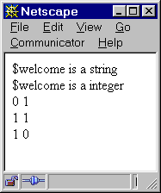
Variable Functions
Highlighting the differences between isset() and empty().
<html><body>
<?
$welcome = "123Hello There";
echo ("\$welcome is a " . gettype($welcome));
$welcome = intval($welcome);
echo ("<br>"."\$welcome is a " . gettype($welcome));
unset($welcome); //$welcome destroyed
if (empty($welcome)) echo ("<br>".isset($welcome)." ".empty($welcome));
$welcome = ""; //$welcome is an empty string
if (isset($welcome)) echo ("<br>".isset($welcome)." ".empty($welcome));
$welcome = "Hello There"; //$welcome is a full string
if (isset($welcome)) echo ("<br>".isset($welcome)." ".empty($welcome));
?>
</body></html>

Slide 21
Control Structures

Slide 22
Control Structures
very similar control structures to those used in C
  if, switch,while,do/while,for
PHP’s control structure supports two syntaxes that can be used interchangeably
  C-style curly braces to enclose statement blocks
  more verbose syntax that includes explicit ending statements

Slide 23
if Statements
if (expr) {
statements
}
elseif (expr) {
statements
}
else {
statements
}
if (expr) :
statements
elseif (expr) :
statements
else :
statements
endif;

Slide 24
if statements
  multiple statments are enclosed in curly braces {}
  condition being tested must evaluate to Boolean true or false
  conditions not met, zero, empty strings, undefined values and false all evaluate to false
  true values are non-zero, non-empty strings as well as met conditions in logic expressions
<html><body>
<?
if ($option == "home"){
echo ("Welcome");
echo ("Goodbye");
}
if ((5 < 4) or (false) or ("0") || ($var) or 0)
echo ("This will not print.");
$var = 5;
if (("false") and ("Yup") and ($var == 5) && (true))
echo("This is gonna print.");
?>
</body></html>

Slide 25
if statements
if tested condition returns false, alternate block of code is executed using else keyword
    if ($var < 0) echo ("Prints if true");
    else echo ("Prints if false");
the elseif keyword is used to test alternative conditions when if statement returns false
    if ($var < 0) echo ("Prints if true")
    elseif ($var == 0) echo("Prints if true")
    else ("Prints if conditions above are false");

Slide 26
if statements
PHP provides an alternative syntax for control structures
easier to read and useful for nesting HTML and PHP code
<html><body>
<?
if ($a == 5):
echo "a equals 5";
echo "...";
elseif ($a == 6):
echo "a equals 6";
echo "!!!";
else:
echo "a is neither 5 nor 6";
endif;
?>
</body></html>

Slide 27
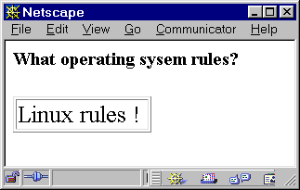
if statements
Example showing how to nest HTML code inside PHP using if statements
<html><body>
<? $select = "Linux"; ?>
<H5>What operating sysem rules? </h5>
<? if ($select == "Microsoft") : ?>
<table border=1> <tr><td>
Microsoft rules !
</td></tr></table>
<? elseif ($select == "Linux"): ?>
<table border=1> <tr><td>
Linux rules !
</td></tr></table>
<? endif; ?>
</body></html>

Slide 28
switch statement
switch (expr)
{
case expr:
case expr:
statements
break;
default:
statements
break;
}
switch (expr):
case expr:
case expr:
statements
break;
default:
statements
break;
endswitch;

Slide 29
switch statements
switch statement is used for comparing a single value against many values
Example using alternate syntax form
<html><body>
<?
$country = "us";
switch ($country):
case "ca":
case "us":
case "mx":
echo ("<p>North America");
break;
case "de":
case "uk";
echo ("<p>Europe");
break;
default:
echo ("<p>Unknown Country");
break;
endswitch;
?>
</body></html>

Slide 30
while loops and do/while loops
while (expr)
{
statements
}
while (expr):
statements
endwhile;
do
{
statements
} while (expr);
Only one valid syntax.
The break and continue statements work with both of these statements.

Slide 31
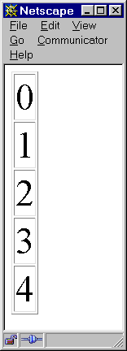
while loops
statements in a while loop are executed continually while expression evaluates TRUE
  Basic form: while (expr) {statements.....}
  Alternate form: while (expr): statements..... endwhile;
<html><body>
<table border=1>
<?
$i=0;
while ($i < 5) {
echo ("<tr><td>". $i . "</td></tr>");
$i++;
}
?>
</table>
</body></html>

Slide 32
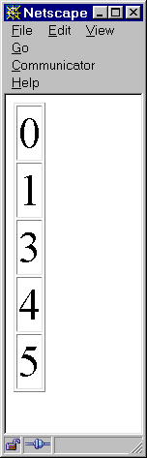
while loops
break and continue permit the loop to be altered
  break halts execution of the loop
  continue skips to next iteration of the loop
<html><body>
<table border=1>
<?
$i=-1;
while ($i++ < 8) :
if ($i == 2) continue; //skip rest at 2
echo ("<tr><td>". $i . "</td></tr>");
if ($i == 5) break; //abort at 5
endwhile;
?>
</table>
</body></html>

Slide 33
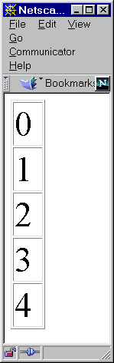
while loops
Embedding HTML and PHP together is done easily with the alternate syntax form
<html><body>
<table border=1>
<?
$i=0;
while ($i < 5) :
?>
<tr><td> <?echo $i;?> </td></tr>
<?
$i++;
endwhile;
?>
</table>
</body></html>

Slide 34
for Loops
for (start_expr; cond_expr; iter_expr)
{
statements
}
for (start_expr; cond_expr; iter_expr):
statements
endfor;
Break and continue statements work in a for loop just as they do in the while loop.

Slide 35
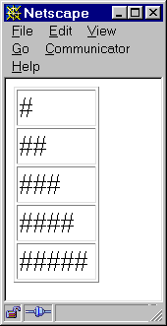
for loops
The for loop can also be used to embed blocks of HTML and PHP code together
<html><body>
<table border=1>
<?
for ($i=0; $i<5; $i++):
?>
<tr><td>
<?
for ($j=0; $j<$i+1; $j++) echo ("#");
?>
</td></tr>
<?
endfor;
?>
</table>
</body></html>

Slide 36
Including files in PHP
include statement replaces itself with the contents of the specified file
  target file is merged with source file
  useful for distributing commonly used functions, constants and other codes among many scripts
  parsing drops out of PHP mode into HTML when a file is included, so valid PHP start and end tags are needed
<?
define ("NAME","IBM");
define ("NL","<br>\n");
?>
<html><body>
<? include ("common.inc"); ?>
<h3><?echo NAME ?> is a good company. </h3>
</body></html>
common.inc
index.php

Slide 37
Exiting a PHP Page
exit statement permits immediate halt and orderly exit of PHP page
  all execution is stopped
  code after exit statement will not be executed
  useful when serious errors occur
if (somethingbadhappened) {
echo ("<br> Error occured while processing...";);
exit;
}

Slide 38
Operators

Slide 39
Operators
Operators and rules of precedence are very close to C
  Arithmetic Operators + / - * %
  Conditional == != <> < <= > >=
  Unary Operators ++a a++ --a a-- !a
  Logical Operators && || and or xor
  Assignment Operators = += *= .+ etc
  Ternary Operator condition ? true : false
Your text has all the details

Slide 40
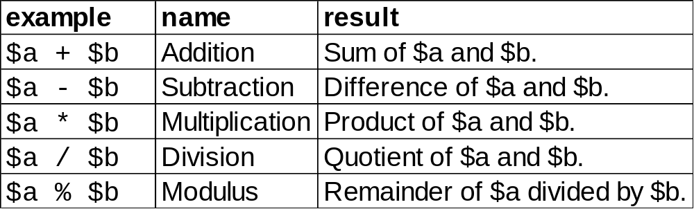
Operators
Operators in PHP are mostly similar to those in Perl, C and Java
Arithmetic Operators

Slide 41
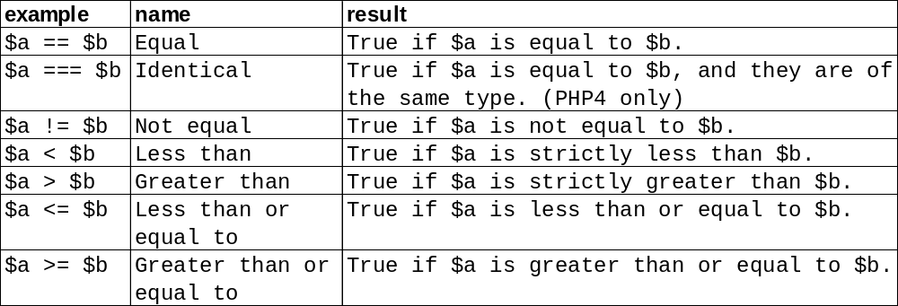
Operators
Unary Operator
  The minus sign (-) is used to negate a number
  Ex: $a = 5; $var = -$a; //$var = -5
Comparison Operators

Slide 42
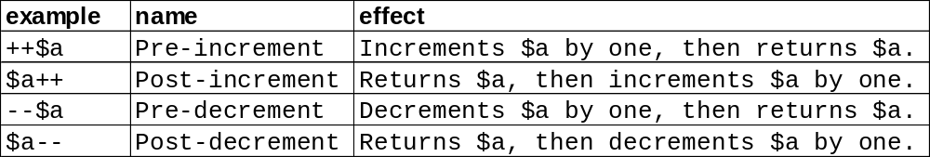
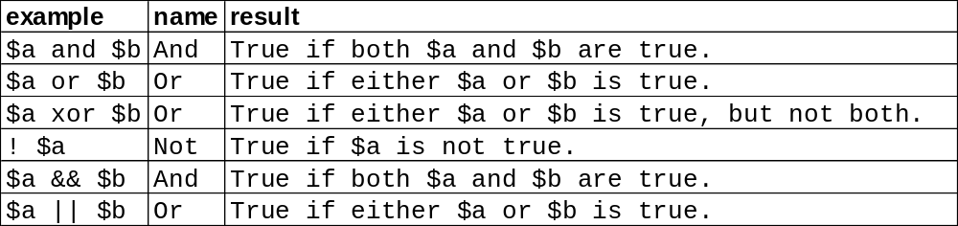
Operators
Incrementing/Decrementing Operators
Logical Operators

Slide 43
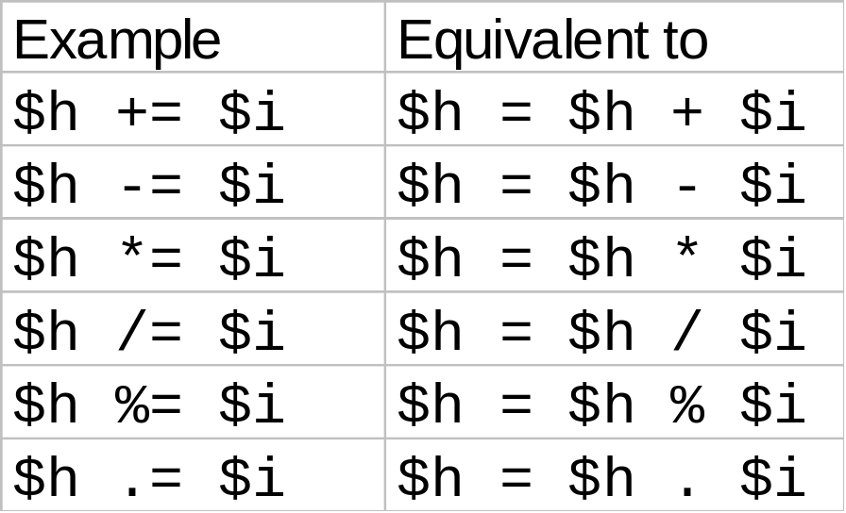
Operators
Variable Assignment Shortcuts
Ternary Operator ?:
  (expr1) ? (expr2) : (expr3);
  This expression evaluates to expr2 if expr1 evaluates to true, and expr3 if expr1 evaluates to false.

Slide 44

Ternary Operator
Ternary Operator ?:
  (expr1) ? (expr2) : (expr3);
  Only operates on the right hand side of an assignment..
  the expression (expr1) ? (expr2) : (expr3) evaluates to expr2 if expr1 evaluates to TRUE, and expr3 if expr1 evaluates to FALSE.
<html><body>
<table border="1">
<?
$j = 1;
for ($i=0; $i<6; $i++):
$COLOR = (++$j%2 == 0) ? "#EEEEEE" : "#AAAAAA" ;
echo "<tr bgcolor=$COLOR><td> ROW $i </td></tr>";
endfor;
?>
</table>
</body></html>
Table zebra striping with the ternary operator.

Slide 45
Operators
Assignment Operator =
  the left operand gets set to the value of the expression on the right.
  The value of an assignment expression is the value assigned.
  Example:
    $a = ($b = 4) + 5; //a is equal to 9 now, and $b has been set to 4
Error Suppression Operator @
  @ operator is used to turn of error reporting from built-in functions.
  Example:
    echo ("This statement prints syntax error to browser );
    @echo ("This statement will not );
    (even though both statement have syntax errors...)

Slide 46
Functions

Slide 47
Functions
syntax and use similar to C type functions
  provisions for default values included
function call is an expression that has a value
  its value is the returned value from the function
PHP provides a large number of internal functions
  see “Function Reference" list in on line documentation
Example function returning a string variable:
function checkmeout($a, $b, $c)
{
return “Here is $a , $b and $c";
}

Slide 48
Setting default argument values
default values for each optional parameter similar to C++ notation
<?
function checkmeout($a, $b=2, $c=5)
{
return “Here is $a , $b and $c";
}
echo checkmeout(10);
?>
this would print out
  Here is 10 , 2 and 5
keep uninitialized variables to left of parameter list

Slide 49
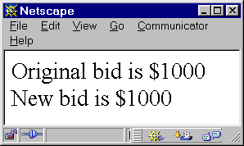
Passing Parameters to Functions
Pass By Value
  normally PHP passes parameters by value
  original value can’t be changed since only a copy is passed
<html><body>
<?
function raisebid($bid,$percent)
{
$bid = $bid * $percent/100;
}
$bid = 1000;
echo ("Original bid is \$" . $bid . "<br>");
raisebid($bid,12);
echo ("New bid is \$" . $bid . "<br>");
?>
</body></html>

Slide 50
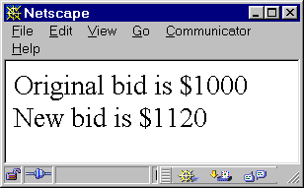
Passing Parameters to Functions
Pass By Reference
  passing by reference requires use of & operator
  address of variable is sent to function
    variable may be modified by function
<html><body>
<?
function raisebid(&$bid,$percent)
{
$bid += $bid * $percent/100;
}
$bid = 1000;
echo ("Original bid is \$" . $bid . "<br>");
raisebid($bid,12);
echo ("New bid is \$" . $bid . "<br>");
?>
</body></html>

Slide 51
Variable Scope
variables declared within a function exist only within that function (local scope)
the global statement permits access to variables outside the function (global scope)
<html><body>
<?
function raisebid($percent)
{
global $bid;
$bid += $bid * $percent/100;
}
$bid = 1000;
echo ("Original bid is \$" . $bid . "<br>");
raisebid(12);
echo ("New bid is \$" . $bid . "<br>");
?>
</body></html>

Slide 52
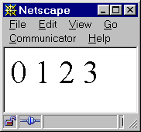
Variable Lifetime
variables declared in functions exist only for the life of the function's invocation
the static statement provides a way to create variables that persist each time function is invoked.
<html><body>
<?
function counter()
{
static $value = 0;
return strval($value++) . " ";
}
echo counter() . counter() . counter() . counter();
?>
</body></html>

Slide 53
Returning Values from Functions
Values are returned by using the optional return statement.
Any type may be returned,including lists and objects.
<html><body>
<?
function area_of_circle( $radius )
{
return(3.1415 * ($radius * $radius));
}
echo "The area is " . area_of_circle(20) . "<br>";
?>
</body></html>
Output: The area is 1256.6

