Slide 1
String Manipulation
Functions

Slide 2
htmlentities()
The htmlentities function takes a string and returns the same string with HTML converted into HTML entities.
This is an important security consideration, especially for data that is entered by a user and subsequently gets posted to a website. Ex: bulletin boards, comments, etc..
A common exploit is to inject javascript .

Slide 3
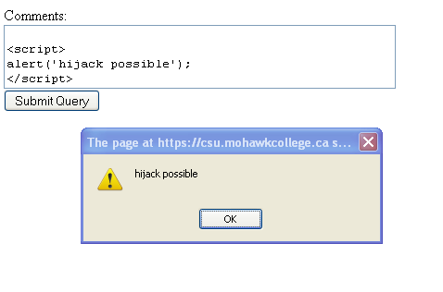
htmlentities()
<html><body>
<form action="<?= $_SERVER['PHP_SELF']?>" method="post">
Comments:<br>
<textarea name="comments" cols="50" rows="3">
<?= $_POST["comments"]?></textarea><br>
<input type="submit" >
</form>
<div><?PHP echo $_POST['comments'];?></div>
</body></html>
Entering javascript code into the form textarea will have it execute in the browser! This is a huge security risk!!

Slide 4
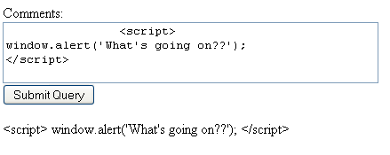
htmlentities()
<?
$_SAFE["comments"] = htmlentities($_POST["comments"]);
?>
<html><body>
<form action="<?= $_SERVER['PHP_SELF'] ?>" method="post">
Comments:<br>
<textarea name="comments" cols="50" rows="3">
<?= $_SAFE["comments"]?></textarea><br>
<input type="submit" >
</form>
<div><?PHP echo $_SAFE['comments']; ?></div>
</body></html>
Javascript is displayed, not executed. Htmlentities function has encoded the javascript code special characters like <,> into HTML entities.
<div>&lt;script&gt;window.alert('What's going on??');&lt;/script&gt;</div>

Slide 5
String Handling Functions
strlen(str)
  returns length of string str
strpos(sourcestr,searchstr)
  returns the numeric position of first occurrence of searchstring within sourcestring
  returns false if searchstring is absent
substr(sourcestr,start,length)
  returns portion of string based on start index and length
  if length is left out, length will default to end of string
  if start is negative, substr() will count backward from end of sourcestr
  if length is negative, the string returned will end length characters from the end of string

Slide 6
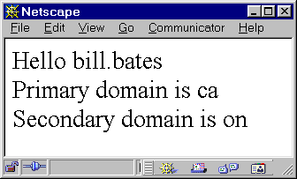
strpos() and substr()
<html><body>
<?
$email_str = "bill.bates@eos.mohawkc.on.ca";
$locate = strpos($email_str,"@");
echo "Hello ". substr($email_str,0,$locate);
echo "<br>Primary domain is ".substr($email_str,-2);
echo "<br>Secondary domain is ".substr($email_str,-5,-3);
?>
</body)</html>

Slide 7
strpos() and substr()
10
$locate = strpos($email_str,"@");
$email_str="bill.bates@eos.mohawkc.on.ca”
bill.bates
$result = substr($email_str,0,$locate);

Slide 8

Simple Example
strrpos() — Find position of last occurrence of a char in a string
<html><body>
<?
echo $_SERVER["PHP_SELF"]. "<br>";
$_SERVER["PHP_SELF"] =
substr($_SERVER["PHP_SELF"], strrpos($_SERVER["PHP_SELF"], "/") + 1 );
echo $_SERVER["PHP_SELF"]. "<br>";
?>
</body></html>

Slide 9
Other String Functions
10
$i = strpos('contrived string for testing', 'st');
$i = strpos('contrived string for testing', 'st', 12);
$s = strstr('contrived string for testing', 'st');
$s = strrchr('contrived string for testing', 'st');
$s = strrpos('contrived string for testing', 'st');
23
“string for testing”
“string”
23

Slide 10
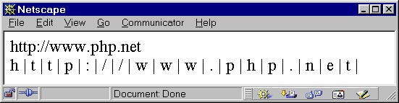
Strings as Arrays[]
Strings in PHP may also be considered to be a sequentially indexed array (just like C!!)
<html><body>
<?
$a_string="http://www.php.net";
$length = strlen($a_string);
echo $a_string . "<br>";
for ($i=0;$i < $length; $i++):
echo $a_string[$i] ." | ";
endfor;
?>
</body></html>

Slide 11
String Handling Functions
explode(delimiter,string);
  parses a string based on delimiter string
  returns an array of parsed elements
  Synonym for explode() is split()
implode(delimiter, array);
  Returns a string containing a string representation of all the array elements in the same order
  array elements are separated by delimiter string
  Synonym for implode() is join()

Slide 12
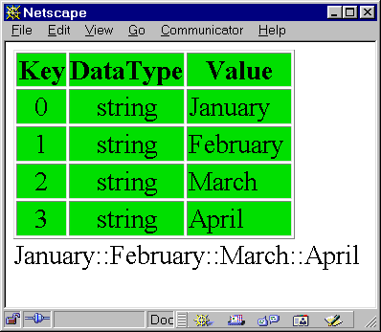
explode() - implode()
$csv_str ="January,February,March,April”
explode(",",$csv_str);
$csv_arr
implode("::",$csv_arr);
"January::February::March::April”

Slide 13
String Handling Functions
<html><body>
<?
include(”greenarray.php");
$csv_str = "January,February,March,April";
$csv_arr = explode(",",$csv_str);
dump_array($csv_arr);
echo implode("::",$csv_arr);
?>
</body></html>

Slide 14
String Handling Functions
trim() Strip whitespace from beginning and end of a string
ltrim() removes white space from beginning of string
chop() removes white space from end of string
strtolower() — Make a string lowercase
strtoupper() — Make a string uppercase
sprintf() - output a formatted string (similar to C)
chr() - ascii number to character
ord() - character to ascii number

Slide 15
trim()
trim() returns a string with the following characters removed from the beginning and end of the string
  spaces, tabs, newlines, carriage returns, nulls
  Very useful when dealing with forms.
  Destroys arrays in my experience.
<html><body>
<?
foreach ($_POST as $KEY => $VAL):
if (!is_array($VAL)
$_POST[$KEY] = trim($VAL);
endforeach;
?>
</body></html>
Removing white space from form variables.

Slide 16
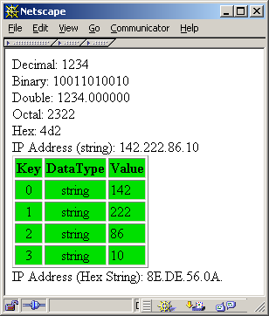
IP Address in Hex
<html><body>
<?
include(”greenarray.php");
$number = 1234;
printf("Decimal: %d<br>\n",$number);
printf("Binary: %b<br>\n",$number);
printf("Double: %f<br>\n",$number);
printf("Octal: %o<br>\n",$number);
printf("Hex: %x<br>\n",$number);
$ip_address ="142.222.86.10";
echo "IP Address (string): $ip_address <br>";
$ip_arr = explode(".",$ip_address);
dump_array($ip_arr);
for ($i=0;$i<4;$i++)
$ip_str .= sprintf("%02X.",$ip_arr[$i]);
echo "IP Address (Hex String): $ip_str <br>";
?>
</body></html>

