Slide 1
File Handling

Slide 2
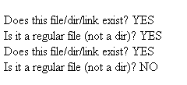
Verifying File Existence
file_exists() – checks if dir/file/link exists
is_file() – checks if file exists and is a file.
<?
$dirname = "../work";
$filename = 'greenarray.php';
echo "<br>Does this file/dir/link exist? " . (file_exists($filename)? "YES" : "NO" );
echo "<br>Is it a regular file (not a dir)? " . (is_file($filename)? "YES" : "NO" );
echo "<br>Does this file/dir/link exist? " . (file_exists($dirname)? "YES" : "NO" );
echo "<br>Is it a regular file (not a dir)? " . (is_file($dirname)? "YES" : "NO" );
?>

Slide 3
Reading File Size and Time
filesize() returns filesize in bytes
filemtime() Gets file modification time
  returns integer containing Unix timestamp (the number of seconds since January 1 1970 00:00:00 GMT beginning of time for Unix)
  Requires date() to format it into a date string
$filename = __FILE__ ;
echo 'File size: '. filesize($filename) . ' bytes<br>';
echo 'Date (now + 1 Hr): '. date ('M j ,Y g:i:s a', time() + 3600).'<br>';
echo 'Date (1 sec after creation): '. date('M j ,Y g:i:s a',1).'<br>';
echo 'Date (secs after creation): '. filemtime($filename).'<br>';
echo 'File Maketime: '.date ('M j ,Y g:i:s a', filemtime($filename)).'<br>';
File size: 396 bytes
Date (now + 1 Hr): Sep 24 ,2012 10:37:38 pm
Date (1 sec after creation): Dec 31 ,1969 7:00:01 pm
Date (secs after creation): 1348537054
File Maketime: Sep 24 ,2012 9:37:34 pm

Slide 4
Opening and Closing Files
Opening Files
  int fopen(string filename, string mode);
  opens a file called filename in users directory space
    file permissions must be set properly (chmod nnn filename)
  returns file handle if successful, false on failure
  Modes
      a - append only, data written to end of file,create file if not found
      r - read only,
      w - writing only,overwrite existing data,create file if not found
Closing Files
  int fclose(int fp);
  close file described by file handle fp

Slide 5
die() and exit()
files that do not open properly should generate an error message and exit PHP processing.
  the exit() function halts PHP processing
    if (!$fp = fopen('myfile.txt','r'))
      {
      echo ('File not opened');
      exit();
      }
this same functionality can be accomplished with the die() language construct
  $fp = fopen("myfile.txt","r")
  or die("File not Opened");

Slide 6
Reading and Writing Files
Reading a single record from file with fgets();
  string fgets(int fp, int length);
  reading ends on newline, EOF or length-1 bytes
  length is length or record expected (typically 4096)
Writing a single record into file with fputs();
  int fputs(int fp,string str]);
  newline character must be added to end of string
Testing for end of file with feof();
  int feof(int fp);
  returns TRUE at EOF, otherwise returns FALSE

Slide 7
Test File myfile.txt
Mary had a little lamb,
Its fleece was white as snow
And everywhere that Mary went,
The lamb was sure to go
myfile.txt

Slide 8

Reading File with fgets()
<?php
$myFile = 'myfile.txt';
if (is_file($myFile) and is_readable($myFile)):
$fh = fopen($myFile,'r') or die("File could not be opened" );
while (feof($fh) == FALSE) {
$oneRecord = fgets($fh);
echo $oneRecord."<br>";
}
fclose($fh) or die("File could not be closed");
else:
echo "File does not exist or is not readable. ";
endif;
?>

Slide 9
Simpler Example of Reading file
$fp = fopen('myfile.txt', 'r') or die('No file!!!');
while (($oneRecord = fgets($fp)) !== FALSE){
echo $oneRecord.'<br>';
}

Slide 10
Reading File with file_get_contents()
Reads entire file into a string. No open or close file necessary!
A more efficient way of reading the entire contents of file
$myFile = 'myfile.txt';
$fileContents = file_get_contents($myFile) or die("Could not open file");
echo $fileContents.'<br>';
$fileContents = str_replace("\n",'<br>',$fileContents);
echo $fileContents;
Mary had a little lamb, Its fleece was white as snow And everywhere that Mary went, The lamb was sure to go
Mary had a little lamb,
Its fleece was white as snow
And everywhere that Mary went,
The lamb was sure to go

Slide 11
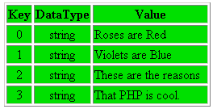
Reading files with file()
$f_arr = file(“poem.txt”)
Roses are Red
Violets are Blue
These are the reasons
That PHP is cool.
$f_arr
poem.txt
Returns the entire file in an array.
Each element of the array corresponds to a line in the file, with the newline still attached.
Upon failure, file() returns FALSE.

Slide 12
Example with file()
$myFile = 'myfile.txt';
$fileContentsArr = file($myFile) or die("Could not open file");
echo '<pre>';
print_r($fileContentsArr);
echo '</pre>';
echo implode('<br>',$fileContentsArr);
Array
(
[0] => Mary had a little lamb,
[1] => Its fleece was white as snow
[2] => And everywhere that Mary went,
[3] => The lamb was sure to go
)
Mary had a little lamb,
Its fleece was white as snow
And everywhere that Mary went,
The lamb was sure to go

Slide 13

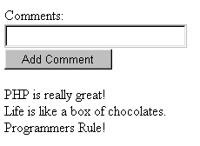
Simple Message Board
comments.txt
PHP is really great!
Life is like a box of chocolates
Programmers Rule!
post
message.php
message.php writes the “post” string to the file, then reads the file and sends the page back to the browser.

Slide 14


Simple Message Board
<html><body>
<form action="<?= $_SERVER['PHP_SELF'] ?>" method="post">
Comment:<input type="text" name="comment" value="<?= $_POST['comment'] ?>">
<input type="submit" value="Add Comment">
</form>
<?
if ($_SERVER['REQUEST_METHOD'] == 'POST')
file_put_contents('comments.txt',$_POST['comment']."\n",FILE_APPEND);
echo implode('<br>', file('comments.txt'));
?>
</body></html>

Slide 15
CSV Files
A comma-separated values (CSV) file stores tabular data (numbers and text) in plain-text form. Plain text means that the file is a sequence of characters, with no data that has to be interpreted instead, as binary numbers. A CSV file consists of any number of records, separated by line breaks of some kind; each record consists of fields, separated by some other character or string, most commonly a literal comma or tab. Usually, all records have an identical sequence of fields..
"REVIEW_DATE","AUTHOR","ISBN","DISCOUNTED_PRICE"
"1985/01/21","Douglas Adams",0345391802,5.95
"1990/01/12","Douglas Hofstadter",0465026567,9.95
"1998/07/15","Timothy ""The Parser"" Campbell",0968411304,18.99
"1999/12/03","Richard Friedman",0060630353,5.95
"2001/09/19","Karen Armstrong",0345384563,9.95
"2002/06/23","David Jones",0198504691,9.95
"2002/06/23","Julian Jaynes",0618057072,12.50
"2003/09/30","Scott Adams",0740721909,4.95
"2004/10/04","Benjamin Radcliff",0804818088,4.95
"2004/10/04","Randel Helms",0879755725,4.50
Example CSV File

Slide 16
Functions for CSV Handling
fgetcsv()
  Similar to fgets() except that fgetcsv() parses the line it reads for fields in CSV format and returns an array containing the fields read.
  Ex. $data = fgetcsv($handle, 1000, ",")
fputcsv()
  fputcsv() formats a line (passed as array) as CSV and writes it (terminated by a newline) to the specified file handle.
  Ex: fputcsv($fp, array('car','apple','plum'))

Slide 17

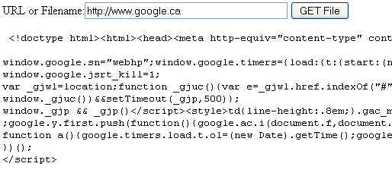
Reading Remote Web Sites via HTTP
Web Page
From
Remote Web site
1. POST
2. HTTP Request
3. HTTP Response
PHP Script
4. HTTP Response

Slide 18
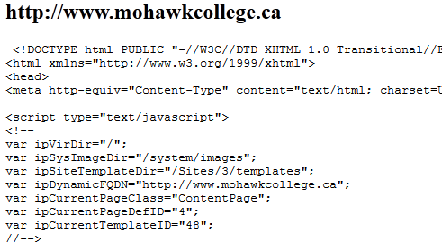
Reading Remote Files via HTTP and FTP
fopen(), file() and file_get_contents() can all be used to open files on remote servers via HTTP and FTP (read only) .
<html><body>
<? $url = "http://www.mohawkcollege.ca" ?>
<h2><?= $url ?> </h2>
<pre>
<?
echo htmlentities(file_get_contents($url));
?>
</pre>
</body></html>

Slide 19
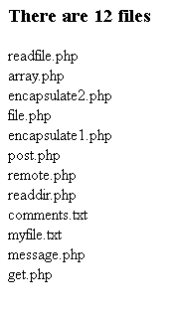
Listing Directories
Functions to manipulate directories (see online docs)
  opendir(path) opens a directory for reading
  closedir(handle) close directory
  readdir($handle) reads the next file name in the directory
<html><body>
<?
$handle = opendir('.');
while ($fileName = readdir($handle)){
if ($fileName != "." && $fileName != "..")
$fileNames[] = $fileName;
}
closedir($handle);
echo '<h3>There are '.count($fileNames). ' files </h3>';
echo implode('<br>',$fileNames);
?>
</body></html>

Slide 20
Uploading Files via HTTP
Client Side
Server Side
Browser
Mysong.mp3
PHP
Script
POST
Mysong.mp3
Mysong.mp3
Server directory

Slide 21
Uploading Files to the Server
Any type of file can be loaded from the client to the server
Useful feature since all interaction with user is done with browser and HTTP
HTML Form Elements required
  <input> element of type="file"
  <form> element requires enctype="multipart/form-data"
  browser will open up a "Browse" box on local client OS
<form action=<?= $_SERVER['PHP_SELF'] ?> method='post'
enctype='multipart/form-data'>
Submit this file:<input type='file' name='userfile'>
<input type=submit >
</form>

Slide 22
Saving Files to the Server
Once submit button is clicked, the client browser transfers the file to the server using HTTP
  File is stored in a temporary file (typically in /tmp) with a unique temporary name.
  File is destroyed immediately after end of request, so PHP script must copy() this file to a permanent location
    copy(sourcename,destinationname)
    or die ("Copy Failed");
Copy the file into a directory that has read/write permissions!

Slide 23
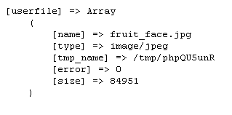
$_FILES
Important file upload data is found in the global $_FILES array
  'name' - name specified in HTML input element
  'tmp_name' – temporary filename of stored file in /tmp directory
  'size' - size of uploaded file in bytes
  'type' - MIME type of file
  'error' – error message
$_FILES

Slide 24
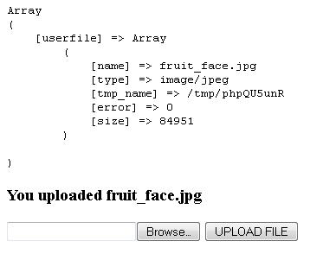
Uploading Files to the Server
<?
if ($_SERVER['REQUEST_METHOD'] == 'POST') {
echo '<pre>'.print_r($_FILES, true).'</pre>';
copy($_FILES['userfile']['tmp_name'],"upload/newname.txt")
or die ("Copy Failed");
echo "<h3>You uploaded ". $_FILES['userfile']['name']."</h3>";
}
?>
<html><body>
<form name="uploadForm" action="<?= $_SERVER['PHP_SELF'] ?>"
method="post" enctype='multipart/form-data'>
<input type="file" name="userfile" >
<input type="submit" value="UPLOAD FILE" >
</form>
</body></html>
Ensure that the uploaded file is copied into a directory with read/write permissions.
.

