Slide 1
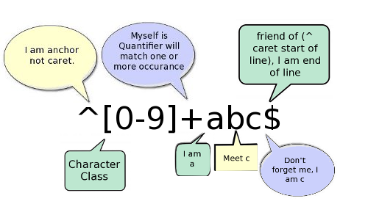
Regular Expressions
/<HR( +SIZE *= *[0-9]+)? *>/
/.+@[a-z0-9]+(\.[a-z0-9]+)*/
/(.+)@([a-z0-9]+)(\.[a-z0-9]+)(\.[a-z0-9]+)*/

Slide 2
Regular Expressions
Regular expressions are a powerful way of examining and modifying text
  enable you to search for patterns
  a regular expression describes the text you need to find
PHP supports POSIX style regular expression functions and the similar but more powerful Perl compatible regular expressions
  POSIX style is now deprecated in PHP (don't use ereg() )
We will use the Perl style reg expressions and the PHP functions which support this
  preg_match(), preg_replace()

Slide 3
ereg() is deprecated
ereg() function has been DEPRECATED as of PHP 5.3.0.
    function can still be used in our course with no error messages being generated (will update notes in the future)
    if (!ereg("^[A-Z][0-9][A-Z][0-9][A-Z][0-9]$",$pc)):
preg_match() is the replacement function
    useage is very similar but you are now required to add perl style delimiters
    if (!preg_match("/^[A-Z][0-9][A-Z][0-9][A-Z][0-9]$/",$pc)):

Slide 4
Using preg_match() to Match Patterns
int preg_match(string pattern, string source);
  pattern is a string containing regular expression wrapped in forward slashes '/ re /' (or any other character Ex. '# re #').
  source is a string of text to be searched
  returns true if a match is found, otherwise false
Literal Regular Expressions
  simplest regular expression is a literal string
  "/rain/" - matches occurrence of string "rain" anywhere in source string
<html><body>
<?
$data = 'The rain in spain stays mainly on the plain';
$regexp ='/rain/';
echo ( preg_match($regexp,$data) )?'true':'false';
//prints true
?>
</body></html>

Slide 5
M.tching Any Ch.racter
The single dot '.' is used to match any character except NULL (\x00)
  similar to an * style wild character
Examples:
<html><body>
<?
$data = '142.222.86.30 142a222b230.30 14212225230d30';
$regexp ='/142.222.230.30/';
echo ( preg_match($regexp,$data) )?'true':'false';
//Prints true. Matches first occurence.
?>
</body></html>

Slide 6
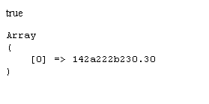
Viewing search results
preg_match ( string $pattern , string $subject , array $matches)
  If array matches is provided, then it is filled with the results of search. $matches[0] will contain the text that matched the full pattern
<html><body>
<?
$data = '142.222.86.30 142a222b230.30 14212225230d30';
$regexp ='/142.222.230.30/';
echo ( preg_match($regexp, $data, $matches) )?'true':'false';
echo '<pre>'.print_r($matches,true).'</pre>';
?>
</body></html>

Slide 7
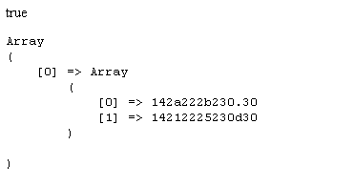
Viewing all search results
preg_match_all ( string $pattern , string $subject , array $matches)
  If array matches is provided, array of all matches in multi-dimensional array.
<html><body>
<?
$data = '142.222.86.30 142a222b230.30 14212225230d30';
$regexp ='/142.222.230.30/';
echo ( preg_match_all($regexp, $data, $matches) )?'true':'false';
echo '<pre>'.print_r($matches,true).'</pre>';
?>
</body></html>

Slide 8
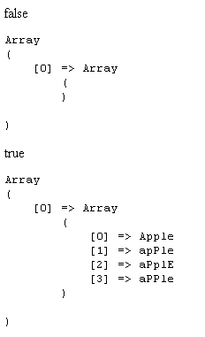
Add i for case insensitivity
<html><body>
<?
$data = 'Apple apPle aPplE aPPle';
$regexp ='/apple/';
echo ( preg_match_all($regexp,$data,$matches) )?'true':'false';
echo '<pre>'.print_r($matches,true).'</pre>';
$regexp ='/apple/i';
echo ( preg_match_all($regexp,$data,$matches) )?'true':'false';
echo '<pre>'.print_r($matches,true).'</pre>';
?>
</body></html>

Slide 9
\ | () [ {} ^ * + ? .
Certain characters are meta-characters and have a special meaning in a regular expression
  \ | () [] {} ^ * + ? .
These characters can be matched by escaping them with the backslash character \
Examples:
  '#\\\|\(\)\[\]\{\}\^\*\+\?\.#' matches "\|()[]{}^*+?."
  '/142\.222\.86\.30/' matches "142.222.86.30"
  '/\(\\$2,500\.92\)/' - matches "($2,500.92)"
    note the double escape on $. $ is not a Reg Expression meta-character, but it is a special char in PHP...

Slide 10
"^Start" and "End$" of Line
"/rain/"
  Simplest pattern is a literal string
  will return true if "rain" occurs anywhere within the source string
"/^rain/"
  the ^ symbol anchors match to start of string
  match occurs if "r" is first letter in line, followed by "a","i" and "n"
"/rain$/"
  the $ symbol anchors match to end of string
  match occurs if last 4 letters in line is "r","a","i","n"
"/^rain$/"
  match occurs if string is exactly four letters long and contains the letters "r","a","i","n" in this order

Slide 11
( Alter | nation )
The meta-character | is used for or'ing multiple expressions.
Parentheses ( ) are used to constrain the alternation
  similar to its use in math expressions
Examples:
  "/Jan|Feb|Mar/" - matches "Jan" or "Feb" or "Mar"
  "/Second Avenue|2nd Ave/" - matches "Second Ave" "2nd Ave"
  "/(Second|2nd) Ave/" matches "Second Ave", "2nd Ave"
  "/(Seco|2)nd Ave/" matches "Second Ave "," 2nd Ave"
  "/(Seco|2)nd (A|a)ve/" matches "2nd Avenue", "Second Ave",etc..
  "/\.ca|\.com|\.org/" - matches ".ca" or ".com" or ".org"
  "/\.ca$|\.com$|\.org$/" - matches ".ca" or ".com" or ".org" at end
  "/ (\.ca|\.com|\.org)$/" - matches ".ca" or ".com" or ".org" at end

Slide 12
[Character Classes]
Characters enclosed in [] are used to describe the matching parameters for a single character
  "/rain/" is the same as "[r][a][i][n]"
  "/[rR]ain/" - will match the 4 chars "rain" or "Rain"
  "/<H[12345]>/" - matches <H1>,<H2>,<H3>,etc..
Character Class Metacharacter "-" indicates a range of characters
  "/<H[1-5]>/" - is the same as "<H[12345]>"
  "/[a-z]/" - same as "[abcdefghijklmnopqrstuvwxyz]"
  "/[a-zA-Z]/" - matches all lowercase and uppercase letters
  "/[0-9]/" - matches any digit, same as "[0123456789]"
  "/[a-z?_!.]/" - matches any lowercase letter or _ or ! or . or ?

Slide 13

[Negating Character Classes]
What is this called?
Negating character classes with "^"
  a ^ inside a character class matches any character that isn't listed
  note that this is a different meaning for the same meta_character outside the character class
Examples:
  "/[^a-z]/"
    matches any character that is not a lower case letter
  "^[^1-5]"
    matches any string in which the character in the first position does not contain the numbers 1,2,3,4,5

Slide 14
[Negating Character Classes]
  "/^[^#]/"
    matches any string that does not begin with a #
  "^[^0-9][0-9]$"
    matches two chars, first is non-digit, second a digit
  "Micro[^sS]oft"
    matches words like Micro$oft, MicroLoft,etc
  "[fee|fie|foe]"
    means the same as "/[feio|]/". A vertical bar is simply a vertical bar in a character class.

Slide 15
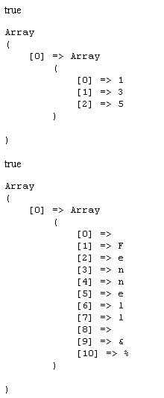
Short forms
\d - Matches any single digit
  equivalent to [0-9]
\D - Matches any single non digit character
  equivalent to [^0-9]
\w - Matches any alpha numeric character including underscore (_) Equivalent to [0-9a-zA-Z_]
\W - Matches any non alpha numeric character excluding the underscore character. Equivalent to [^0-9a-zA-Z_]
\s - Matches whitespace character. Equivalent to [ ] or .
<html><body>
<?
$data = '135 Fennell &%';
$regexp ='/\d/';
echo ( preg_match_all($regexp,$data,$matches) )?'true':'false';
echo '<pre>'.print_r($matches,true).'</pre>';
$regexp ='/\D/ ';
echo ( preg_match_all($regexp,$data,$matches) )?'true':'false';
echo '<pre>'.print_r($matches,true).'</pre>';
?>
</body></html>

Slide 16
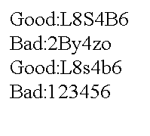
Postal Code Cleaner/Checker
<html><body>
<?
$postalcodes = array("L8S4B6","2By4zo"," L8s 4b6 ","123456");
$re = '/^[A-Z][0-9][A-Z][0-9][A-Z][0-9]$/i';
foreach ($postalcodes as $pc){
$pc = preg_replace('/ /','',$pc);
echo (preg_match($re,$pc))?"Good:$pc<br>":"Bad:$pc<br>";
}
?>
</body></html>

Slide 17
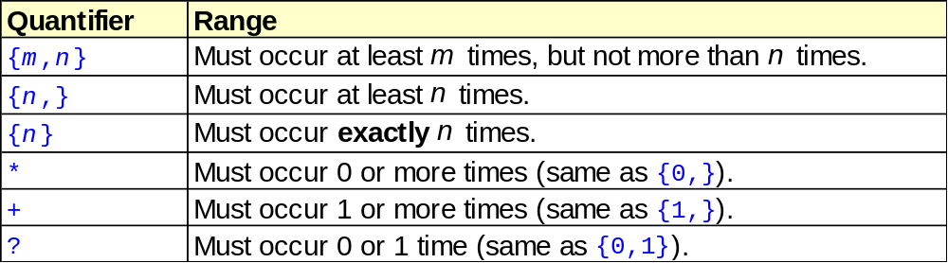
RepetitionRepetitionRepetition
Quantifiers are meta-characters which influence the quantity of a match they govern
  quantifiers attach themselves to the immediately-preceding item

Slide 18
Quantifier Examples
"/ab*/"
  matches a string that has an a followed by zero or more b's ("a", "ab", "abb", etc.)
"/ab+/"
  matches a string that has an a followed by one or more b's ("ab", "abb", "abbb", etc.)
"/smooo*th/"
  matches smooth smoooth smooooth smoooooth..
"/banan(an)*a/"
  matches banana bananana banananana ...
"/JULY? 4th/"
  matches JUL 4th and JULY 4th

Slide 19
Quantifier Examples
"/^[a-zA-Z]+$/"
  match any alphabetic word 1 or more chars long containing upper/lowercase letters only
    A Ap appl jfkdlsjfklsfjk .....
"/^[0-9]+ /"
  match any positive integer with 1 or more digits followed by a space starting at beginning of string. Ex. "123 hello"
"/Li.*on/"
  matches any word that begins in "Li" and ends in "on" like Lion, Lilipution and Litigation

Slide 20
Quantifier Examples
"/ab{2}/"
  matches an a followed by exactly two b's ("abb")
"/ab{2,}/"
  a followed by 2 or more b's ("abb", "abbbb", etc.);
"/ab{3,5}/"
  from three to five b's ("abbb", "abbbb", or "abbbbb").
"/a(bc){1,5}/"
  matches a string that has an a followed by 1 to 5 copies of the sequence "bc";
"/^\w{4,6}$/"
  matches an alphanumeric string exactly 4-6 characters long

Slide 21
Looking for <HR> tags
"/<HR( +SIZE *= *[0-9]+)? *>/"
      <HR match these 3 letters
      ( beginning of expression
      + 1 or more spaces
      SIZE followed by these 4 letters
      * followed by 0 or more spaces
      = followed by this character
      * followed by 0 or more spaces
      [0-9]+ followed by 1 or more digits
      )? this expression is optional (1 or 0 times)
      * 0 or more spaces
      > followed by this character

Slide 22
Looking for Email
A simple regular expression for an email string with three parts: gill.bates@mohawkc.on.ca
"/.+@[a-z0-9]+(\.[a-z0-9]+)*/"
    .+ 1 or more characters of any type
    @ followed by an @
    [a-z0-9]+ followed by 1 or more alphanumerics
    ( start of expression
    \. match a period .
    [a-z0-9]* followed by 0 or more alphanumerics
    )* this expression 0 or more times

Slide 23
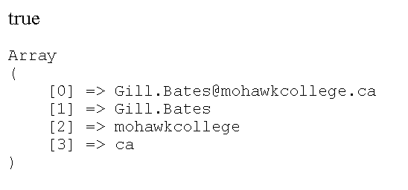
Power of Parentheses
Parentheses allow you to capture pieces of the matched string into an array.
Gill.Bates@mohawkcollege.ca
+
'/([a-z0-9.]+)@([a-z0-9]+)\.([a-z0-9]+)/i'
=

Slide 24

Example with a single ()
'/([a-z0-9.]+)@[a-z0-9]+\.[a-z0-9]+/i';
<html><body>
<?
$email = "His email is Gill.Bates@mohawkcollege.ca now. ";
$re = '/([a-z0-9.]+)@[a-z0-9]+\.[a-z0-9]+/i';
echo preg_match($re,$email,$matches)?'true':'false';;
echo '<pre>'.print_r($matches,true).'</pre>';
?>
</body></html>
Output shows a 24 char string has been matched.
$mail_arr[0] contains matched string
$mail_arr[1] contains only parenthesized piece.

Slide 25
Example with many()
'/([a-z0-9.]+)@([a-z0-9]+)\.([a-z0-9]+)/i';
<html><body>
<?
$email = "His email is Gill.Bates@mohawkcollege.ca now. ";
$re = '/([a-z0-9.]+)@([a-z0-9]+)\.([a-z0-9]+)/i';
echo preg_match($re,$email,$matches)?'true':'false';;
echo '<pre>'.print_r($matches,true).'</pre>';
?>
</body></html>
preg_match() returns the three parenthesized pieces in $matches[]

Slide 26

preg_replace()
preg-replace() performs a regular expression search and replace
  string values in parentheses are referenced with \1 \2 \3 etc.
<html><body>
<?
$NUMBERS = array("9053589876", "416-722-9876", "907.255.6789");
$RE = "/\(?([0-9]{3})\)?[-. ]?([0-9]{3})[-. ]?([0-9]{4})/";
foreach ($NUMBERS as $NUMBER):
echo "$NUMBER ---> ";
echo preg_replace( $RE,'(\1) \2-\3', $NUMBER);
echo "<br />";
endforeach;
?>
</body></html>

Slide 27
From www.php.net
^ Start of line
$ End of line
n? Zero or only one single occurrence of character 'n'
n* Zero or more occurrences of character 'n'
n+ At least one or more occurrences of character 'n'
n{2} Exactly two occurrences of 'n'
n{2,} At least 2 or more occurrences of 'n'
n{2,4} From 2 to 4 occurrences of 'n'
. Any single character
() Parenthesis to group expressions
(.*) Zero or more occurrences of any single character, ie, anything!
(n|a) Either 'n' or 'a'
[1-6] Any single digit in the range between 1 and 6
[c-h] Any single lower case letter in the range between c and h
[D-M] Any single upper case letter in the range between D and M
[^a-z] Any single character EXCEPT any lower case letter between a and z.
[_4^a-zA-Z] Any single character which can be the underscore or the
number 4 or the ^ symbol or any letter, lower or upper case

Slide 28
From www.php.net
?, +, * and the {} count parameters can be appended not only to a single
character, but also to a group() or a range[].
therefore,
^.{2}[a-z]{1,2}_?[0-9]*([1-6]|[a-f])[^1-9]{2}a+$
would mean:
^.{2} = A line beginning with any two characters,
[a-z]{1,2} = followed by either 1 or 2 lower case letters,
_? = followed by an optional underscore,
[0-9]* = followed by zero or more digits,
([1-6]|[a-f]) = followed by either a digit between 1 and 6 OR a
lower case letter between a and f,
[^1-9]{2} = followed by any two characters except digits
between 1 and 9 (0 is possible),
a+$ = followed by at least one or more
occurrences of 'a' at the end of a line.

Slide 29




