Slide 1
An Application of Machine Learning Techniques to P2P Loan Investments
David Stevens
CIS 572 Machine Learning

Slide 2
Introduction – P2P Lending
What is P2P Lending?
Companies like Lending Club match borrowers with investors
Investors fund peer loans
Borrowers pay investors back- with interest!
Win-win right?

Slide 3
Introduction – P2P Lending
Sort of…
Risks & Rewards
Still exist, but different
Related to credit history
ROI: interest rate
Risk: defaulting loans!
Lending Club assigns a credit ‘grade’
A -> G
How predictive is this though?

Slide 4
The Problem
Download historical loan data from www.lendingclub.com

Slide 5
The Problem
Download historical loan data from www.lendingclub.com
Apply Machine Learning techniques to train a classifier

Slide 6
The Problem
Download historical loan data from www.lendingclub.com
Apply Machine Learning techniques to train a classifier
????

Slide 7
The Problem
Download historical loan data from www.lendingclub.com
Apply Machine Learning techniques to train a classifier
????
PROFIT!!!

Slide 8
Choosing Function
ROI regression would be optimal, but very hard
Instead predict probability of default!
Can be used for better measure of risk
Ignores return

Slide 9
Choosing Model
Data relationships likely very complex
Past work shows mixed results with SVMs
Choice: ensemble methods!
Random Forest
Gradient Boosting
Need a simple model for baseline
Logistic Regression

Slide 10
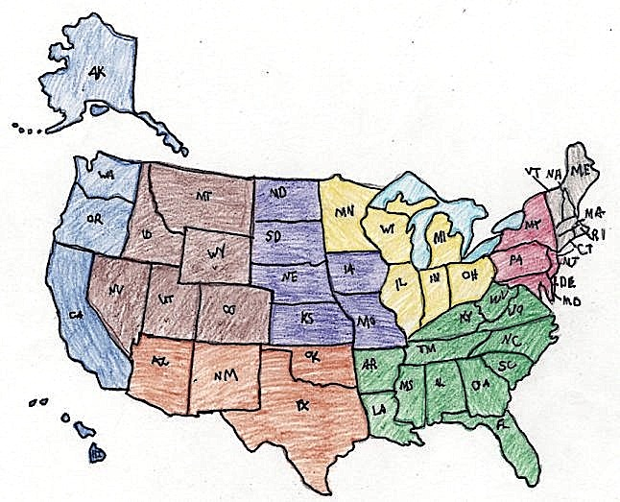
Feature Representation
Over 100 features
Include them all!
Almost..
Discard:
Unique values (User ID, Screen name, etc.)
Textual features (Loan Description)
Anything unknown at start
Incomplete loans
Binarize multivalued features
Scale everything
Mean: 0
Std Dev: 1

Slide 11
Training Models
Split Data
30% Test
70% Training
Tune Parameters
Grid Search
5-Fold Cross Validation
Notes:
[SHORT]
Clients and brokers
thin clients: create/modify/move/delete files and folders in their workspace
transparent..push changes
brokers: handle

Slide 12
Tuning Models
Logistic Regression
Regularization Constant (C)
0.001 -> 1000
Best=1
Penalty Function
L1 or L2 Norm?
Best = L2
Scikit-learn defaults!
Best Average Accuracy: 66.29%
Notes:
[SHORT]
Clients and brokers
thin clients: create/modify/move/delete files and folders in their workspace
transparent..push changes
brokers: handle

Slide 13
Tuning Models
Random Forest
# of Estimators
10 -> 100
Best: 50
Max Features
Square root, base-2 log, or all of them?
Best: base-2 log
Best Average Accuracy: 82.12%
Notes:
[SHORT]
Clients and brokers
thin clients: create/modify/move/delete files and folders in their workspace
transparent..push changes
brokers: handle

Slide 14
Tuning Models
Gradient Boosting
# of Estimators
100 -> 1000
Best: 300
Max Depth
1 -> 5
Best: 2
Best Average Accuracy: 82.15%
Notes:
[SHORT]
Clients and brokers
thin clients: create/modify/move/delete files and folders in their workspace
transparent..push changes
brokers: handle

Slide 15
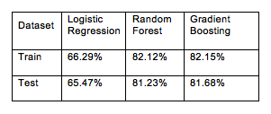
Evaluation: Accuracy
Accuracy of Each Classifier on Training & Test Data

Slide 16
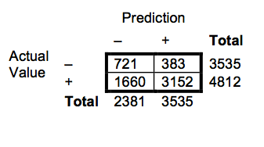
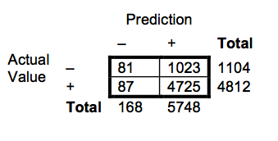
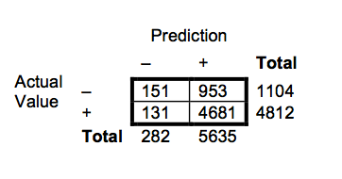
Evaluation: Confusion Matrices
Logistic Regression
Random Forest
Gradient Boosting

Slide 17

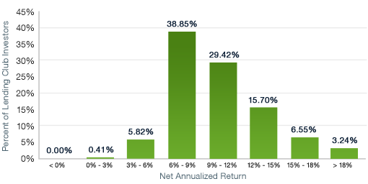
Evaluation: Return
Percent Returns for Each Classifier Maximizing Success Probability and Utility
Distribution of Investor Returns (800+ Notes)

Slide 18
Discussion
Disappointing!
Worse than 90% of investors!
Still a good foundation for future work
Feature representation
Textual analysis
Nonlinear scaling
Include current loans
Different output function
Regression possible?

Slide 19

Questions?

