Slide 1
Distributed File Hosting System
Paul Elliott and David Stevens
Dr. Jun Li
CIS 630 Distributed Systems

Slide 2
Introduction
File Hosting Systems
Dropbox and Google Drive
Inherent Issues
Centralized data
Privacy concerns
Notes:
Of all today’s powerful Internet tools, file hosting systems such as Dropbox and Google Drive are some of the most familiar and heavily used.for remote file storage and backup, collaborative work, and file sharing. These systems rely on centralized storage, which have inherent privacy issues and present a central point of failure. One solution to this problem would be to distribute data storage across all users by storing replicas on individual user machines. Such a distributed file hosting system must handle many things: replication strategy, node departures and failures, reads/writes, etc. So, given users with dynamic online times (and possible failures), can we provide a distributed file hosting system that allows online reads/writes and high data availability?

Slide 3
Our Solution
Decentralize the data
Each client has identical data
Files are kept in sync using logical time stamps
Broker network routes communication, but never stores any data

Slide 4
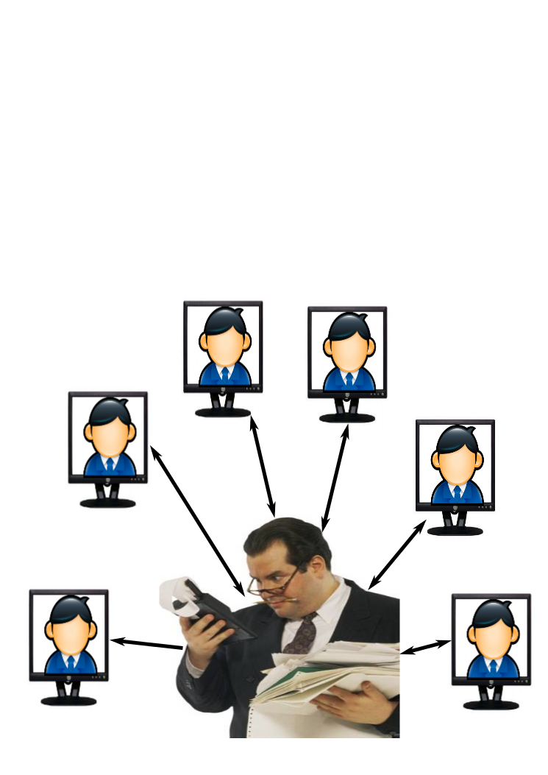
Design: System Overview
Thin clients and opulent brokers
Notes:
[SHORT]
Clients and brokers
thin clients: create/modify/move/delete files and folders in their workspace
transparent..push changes
brokers: handle

Slide 5
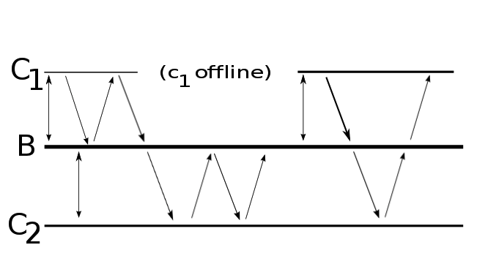

Design: Lifetime
Foo.txt
Bar.txt
2
5
3
1
4
6
Bar.png
Notes:
Clients connect
C1 makes change, sends request to broker
Broker accepts change, sends back ACK
C1 receives ACK and sends out actual change
Later C1 dies, and C2 makes a change and pushes it while C1 is dead
Later C1 returns, and connects to the broker.
C1 tries to push some stuff to the broker, but

Slide 6
Design: Issues Addressed
Discovery
Invitation only
Synchronization
Initial Batch Request
Read-Once-Write-All
Non-blocking REQUESTS to push changes
Revision Numbers to protect global state

Slide 7
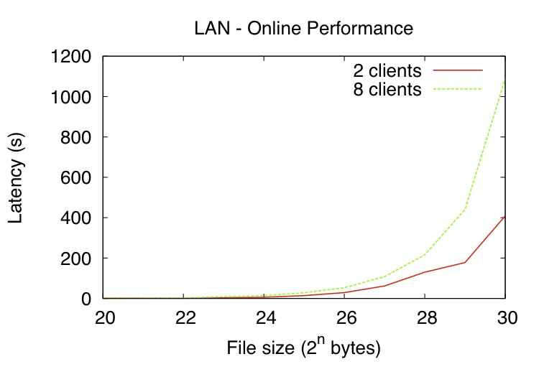
Preliminary Evaluation

Slide 8
Discussion and Future Work
Current focus: evaluation
1. Further evaluate performance across different LAN and WAN scenarios
2. Compare with Dropbox
3. Evaluate correctness
Distributed broker?
Security?

Slide 9
Demonstration Preview
Start up a broker and several clients
Demonstrate online changes and synchronization
Also demonstrate offline changes and initial batch update

