Slide 1
Accounting teaching and learning with Banana Accounting Software
Domenico Zucchetti CEO and founder of Banana.ch
Moscow 27. – 29. May 2019

Slide 2
Banana.ch SA
Empowering and supporting Enterprising People reaching their goals
Spreadsheet inspired accounting software
Developed in collaboration with accounting teachers
Used by the majority of swiss accounting schools
Leader in Switzerland for small business, associations and individual accounting software
More than 300’000 licenses sold in over 120 countries

Slide 3
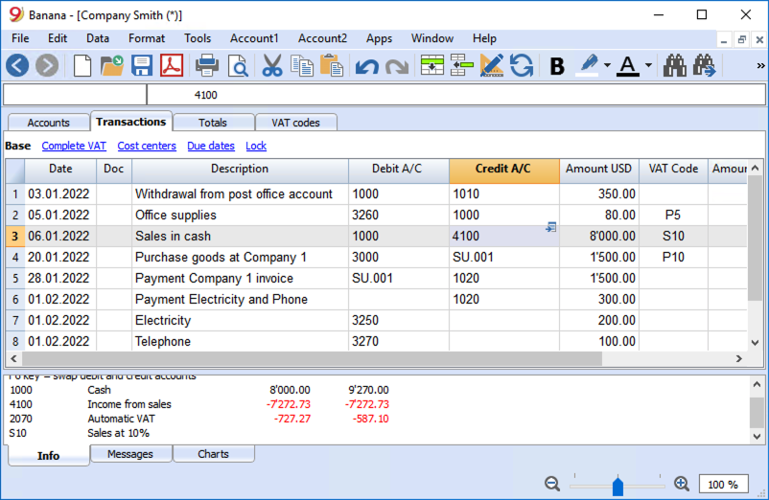
Spreadsheet inspired accounting software
Professional accounting software
Easy to use
Very flexible

Slide 4
Similar to Excel
Intuitive table based interface
Instant results next to entered data
User mode similar to Office
Edit, Undo and Redo
Search & replace
Format, colors
All accounting data saved in one file
As many files as desired (save where you want)
Single user

Slide 5
Accounting software
Professional double entry accounting software
Customizable accounting and grouping
Transactions
Balance sheet, Income & Expense, accounting card
Cost and Profit center, Segments
Import of bank statements or other data source

Slide 6
Banana Accounting only features
Accounting files with only the needed features
Complete accounting check at any time
Blockchain for transactions protection and legal compliance
Financial planning
Quantities in transactions
Invoices writing with transactions
Connect Excel sheet for data analysis
Javascript extensions
Fixed assets register, Timesheet

Slide 7
Best for teaching and practicing
Similar to Excel, no special training needed
Help understand the double entry accounting method
Each student can work on his own file
Enter data and instantly see results
Students can install on their computer, laptop, tablet or phone
Less time to check the work done by student

Slide 8
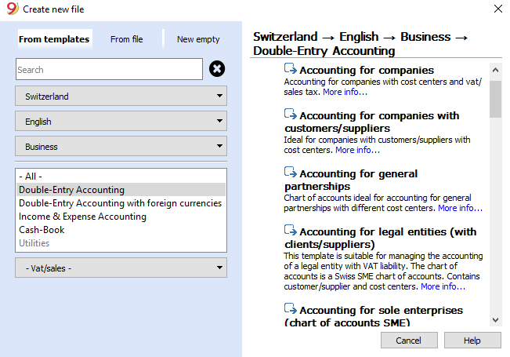
Create a new accounting file

Slide 9
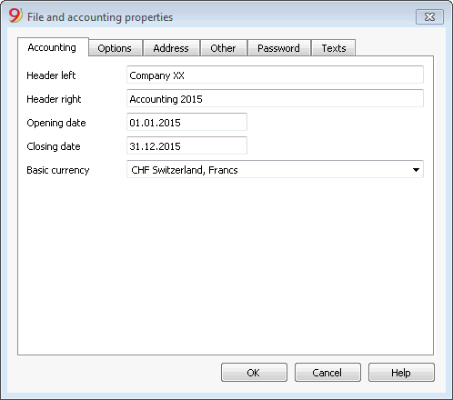
Accounting setup

Slide 10
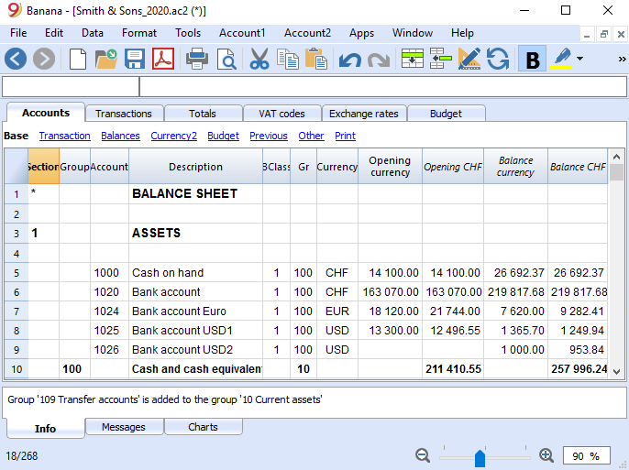
Accounts, grouping, opening and balance Enter data and see results

Slide 11
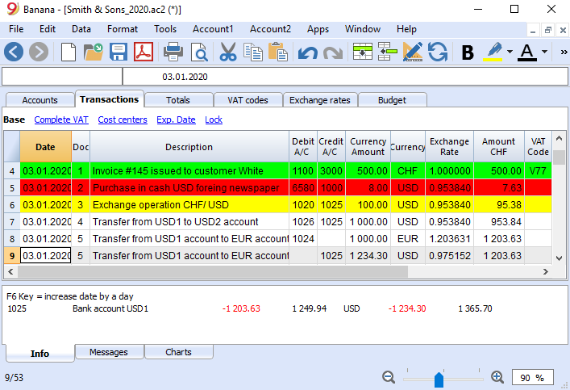
Transaction table

Slide 12
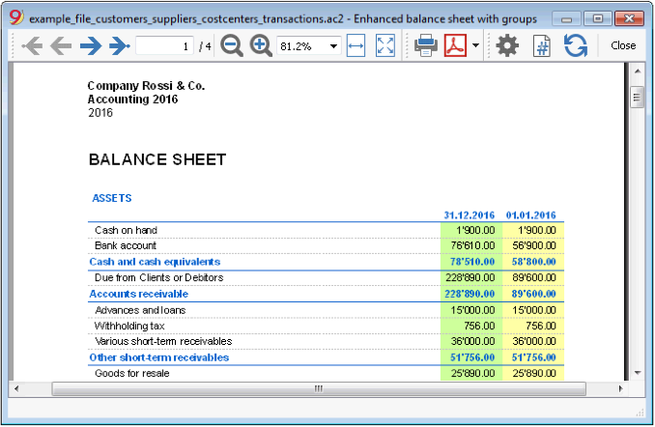
Balance sheet

Slide 13
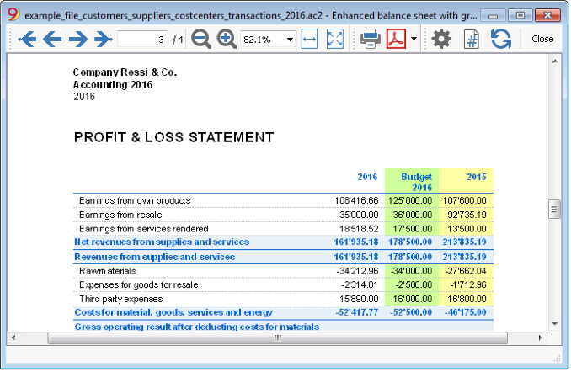
Profit & Loss Statement

Slide 14
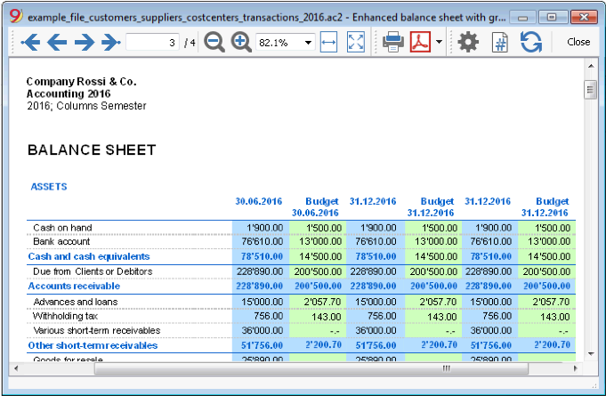
Reports by periods and comparisons

Slide 15
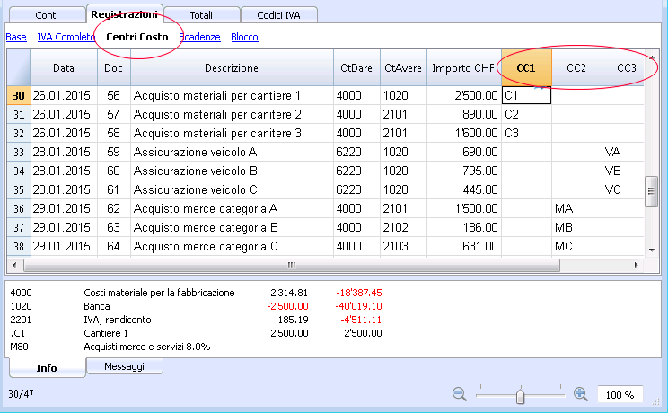
Cost and Profit Centers

Slide 16
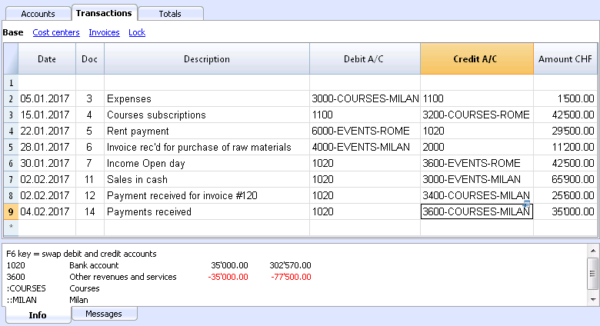
Segments

Slide 17
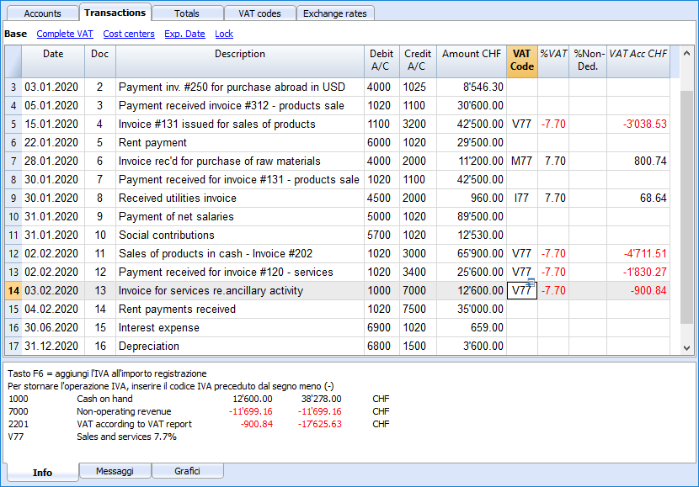
Vat information and automatic calculation

Slide 18
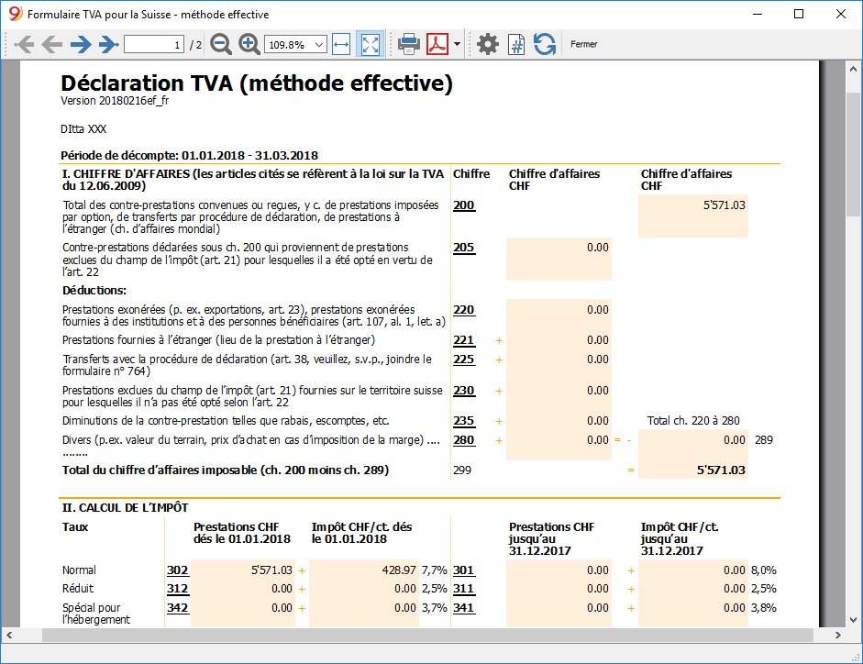
Country specific VAT Report

Slide 19
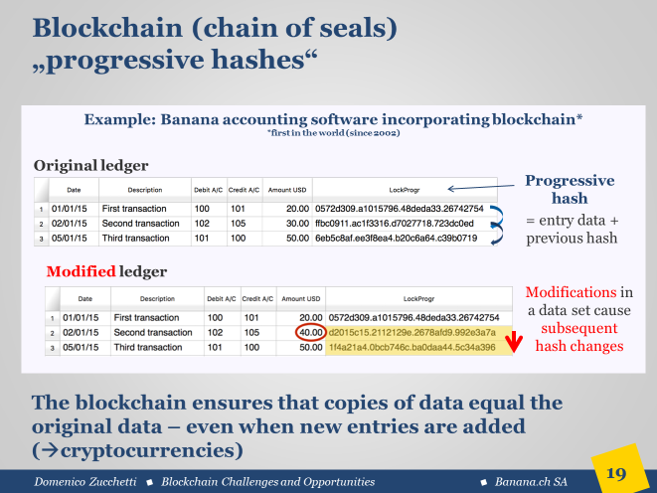
Blockchain transactions lock

Slide 20
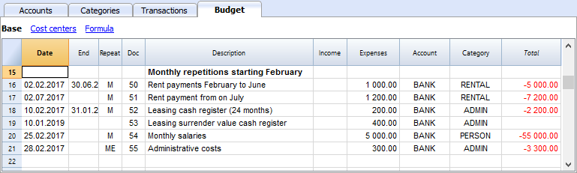
Accounting based financial planning

Slide 21
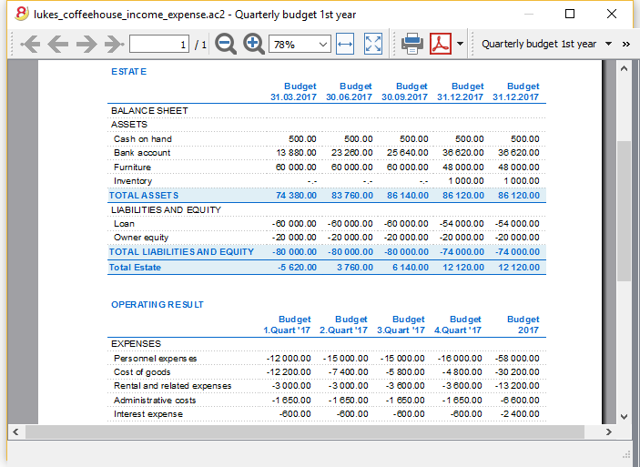
Financial projections one or more years

