Slide 1

Applied Data Science Capstone Project
Dan Zuckerman

Slide 2
Applied Data Science Capstone Project London Property Prices
What are possible predictors of London property price?
Where can we obtain data?
What are their relationships?
How good a model can we build?
What could we do next?

Slide 3
Applied Data Science Capstone Project possible predictors of London property price
London has a complex property market
Possible predictors:
Commuting distance / time to Central London
- Changing working patterns / locations
Local amenities – schools / doctors / parks / cafes
Type / size of properties
Proportion of Social Housing
Council tax / Council services

Slide 4
Applied Data Science Capstone Project possible predictors of London property price
London has a complex property market
Possible predictors:
Commuting distance / time to Central London
Local amenities – schools / doctors / parks / cafes
- Different communities prefer different amenities
Type / size of properties
Proportion of Social Housing
Council tax / Council services

Slide 5
Applied Data Science Capstone Project possible predictors of London property price
London has a complex property market
Possible predictors:
Commuting distance / time to Central London
Local amenities – schools / doctors / parks / cafes
Type / size of properties
- Larger properties will tend to be more valuable
Proportion of Social Housing
Council tax / Council services

Slide 6
Applied Data Science Capstone Project possible predictors of London property price
London has a complex property market
Possible predictors:
Commuting distance / time to Central London
Local amenities – schools / doctors / parks / cafes
Type / size of properties
Proportion of Social Housing
- Will also influence Council Tax cost and provision of services
Council tax / Council services

Slide 7
Applied Data Science Capstone Project How can we obtain data?
Commuting distance / time to Central London
- Straight line distance from location to a Central London point
- Commuting time from Transport For London API
Local amenities – schools / doctors / parks / cafes
Type / size of properties
Proportion of Social Housing
Council tax / Council services

Slide 8
Applied Data Science Capstone Project How can we obtain data?
Commuting distance / time to Central London
Local amenities – schools / doctors / parks / cafes
- Foursquare search
- How to set a radius for search?
Type / size of properties
Proportion of Social Housing
Council tax / Council services

Slide 9
Applied Data Science Capstone Project How can we obtain data?
Commuting distance / time to Central London
Local amenities – schools / doctors / parks / cafes
Type / size of properties
- Census data?
Proportion of Social Housing
Council tax / Council services

Slide 10
Applied Data Science Capstone Project How can we obtain data?
Commuting distance / time to Central London
Local amenities – schools / doctors / parks / cafes
Type / size of properties
Proportion of Social Housing
- Census data?
Council tax / Council services

Slide 11
Applied Data Science Capstone Project How can we obtain data?
Commuting distance / time to Central London
Local amenities – schools / doctors / parks / cafes
Type / size of properties
Proportion of Social Housing
Council tax / Council services
- Census data
- Local councils – very time consuming to collate

Slide 12
Applied Data Science Capstone Project What are relationships?
Factors selected:
- Distance to Central London (Geo data)
- Number of Parks (Foursquare)
- Number of Doctor’s Offices (Foursquare)
- Number of Schools (Foursquare)
- Number of Train Stations (Foursquare)

Slide 13
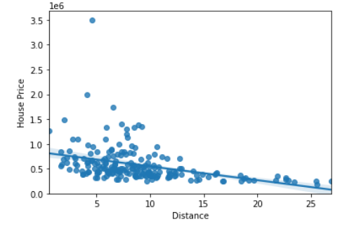
Applied Data Science Capstone Project What are relationships?
Factors selected:
- Distance to Central London (Geo data)
Pearson correlation coefficient -0.387
P value of 1.26 x 10⁻⁸
(Statistically Significant)

Slide 14
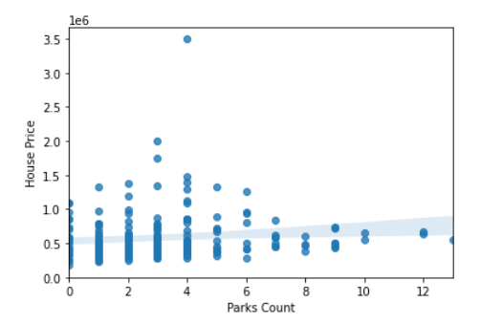
Applied Data Science Capstone Project What are relationships?
Factors selected:
- Number of Parks (Foursquare)
Pearson correlation coefficient 0.122
P value of 0.084
(Not Statistically Significant)

Slide 15
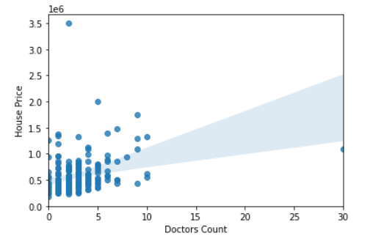
Applied Data Science Capstone Project What are relationships?
Factors selected:
- Number of Doctor’s Offices (Foursquare)
Pearson correlation coefficient 0.316
P value of 4.47 x 10⁻⁶
(Statistically Significant)

Slide 16
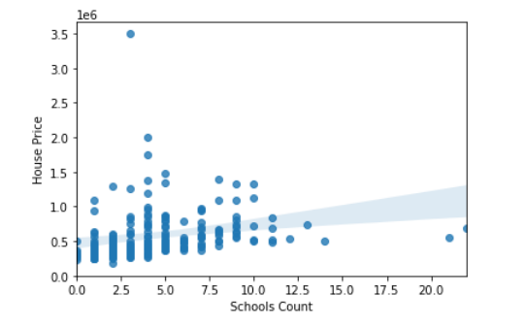
Applied Data Science Capstone Project What are relationships?
Factors selected:
- Number of Schools (Foursquare)
Pearson correlation coefficient 0.238
P value of 6 x 10⁻⁴
(Statistically Significant)

Slide 17
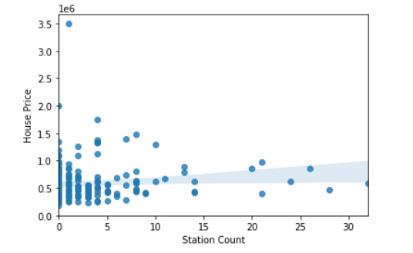
Applied Data Science Capstone Project What are relationships?
Factors selected:
- Number of Train Stations (Foursquare)
Pearson correlation coefficient 0.097
P value of 0.169
(Not Statistically Significant)

Slide 18
Applied Data Science Capstone Project How good a model can we build?
Linear Regression – Distance Only
R Squared value of 0.150
15% of variation in house price explained by distance to Central London

Slide 19
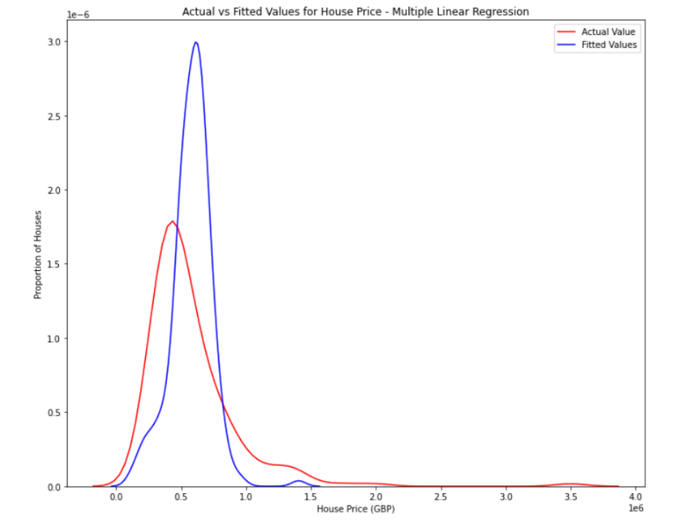
Applied Data Science Capstone Project How good a model can we build?
Multiple Linear Regression
R squared was 0.191
19% of variation in house price explained by multiple factors assuming linear relationships

Slide 20
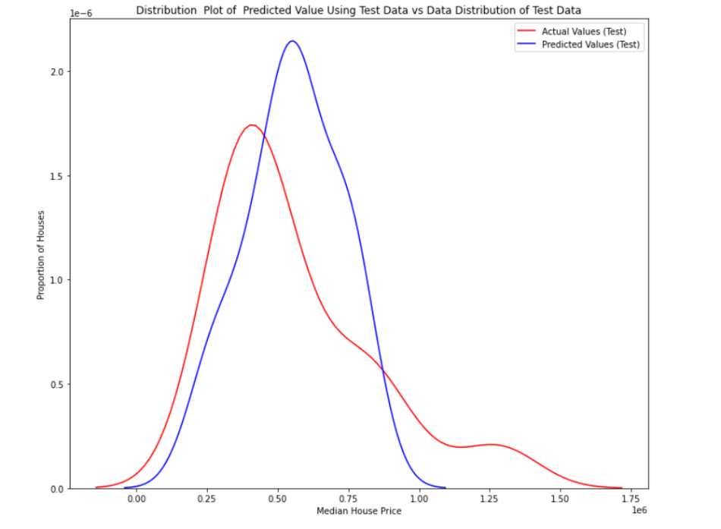
Applied Data Science Capstone Project How good a model can we build?
Multiple Polynomial Regression
R squared for test data was 0.296
30% of variation in house price explained by multiple factors assuming second degree polynomial relationships

Slide 21
Applied Data Science Capstone Project What could we do next?
Refine existing factors
- Commute time may be more relevant than distance
Identify Additional Factors
- Crossrail impact?
Identify alternative to Foursquare
- Crowd sourced / too many categories
Obtain more recent data
- House prices from 2014

