Slide 1
Programming Abstractions for Verifiable Software
Damien Zufferey
MPI-SWS
26.08.2019

Slide 2
What it is about?
Programming Abstractions for Verifiable Software
Mean: how we structure code
can help verification
Goal: automatically proving
software correct

Slide 3
Confidence in Software
Copyright (c) <year> <copyright holder>.
All rights reserved.
Redistribution and use in source and binary forms are permitted
provided that the above copyright notice and this paragraph are
duplicated in all such forms and that any documentation,
advertising materials, and other materials related to such
distribution and use acknowledge that the software was developed
by the <organization>. The name of the
<organization> may not be used to endorse or promote products derived
from this software without specific prior written permission.
THIS SOFTWARE IS PROVIDED ``AS IS'' AND WITHOUT ANY EXPRESS OR
IMPLIED WARRANTIES, INCLUDING, WITHOUT LIMITATION, THE IMPLIED
WARRANTIES OF MERCHANTABILITY AND FITNESS FOR A PARTICULAR PURPOSE.
WITHOUT FITNESS FOR A
PARTICULAR PURPOSE

Slide 4
Is it Bad?
So pervasive Wikipedia even has a category:
  https://en.wikipedia.org/wiki/Category:Software_bugs
And a list:
  https://en.wikipedia.org/wiki/List_of_software_bugs
…

Slide 5
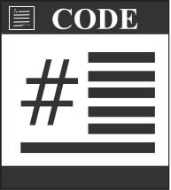


Automated Software Verification
Proof
Spec.
Counterexample

Slide 6
Unfortunately ...
Turing
machine
Proof
Halt ?
Counterexample

Slide 7
Problems Do Not Go Away Because They are Hard...
… but they still make life miserable.
Maybe the problem is ill-posed:
  Full automation is too much (ask the user for help)
  Try an easier problem (focus on null pointers)
  Programming languages are too powerful
  ...

Slide 8
Is Turing Completeness needed ?
No (most of the time)
However, it is hard to make useful non Turing complete languages:
  early versions of SQL …
  … later made Turing complete with extensions

Slide 9
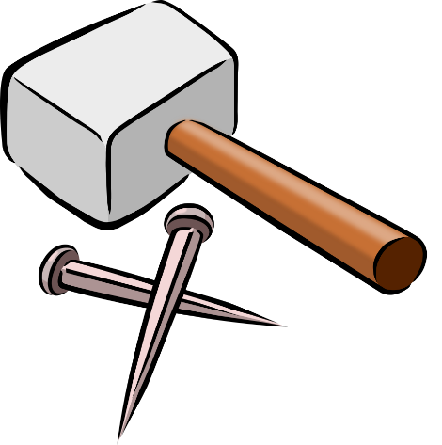

Intrinsic vs Accidental Complexity
General Purpose
Language
Domain Specific
Languages

Slide 10
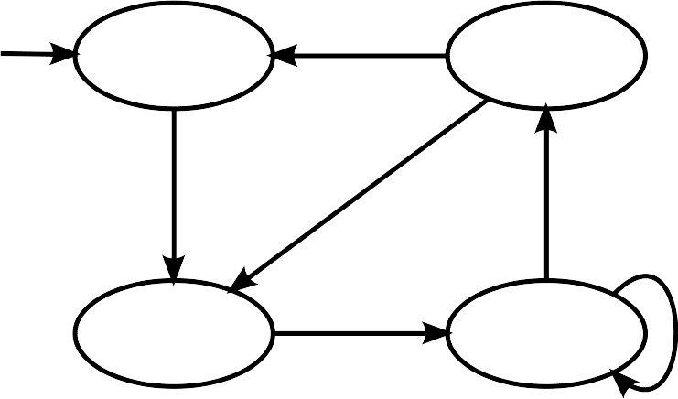

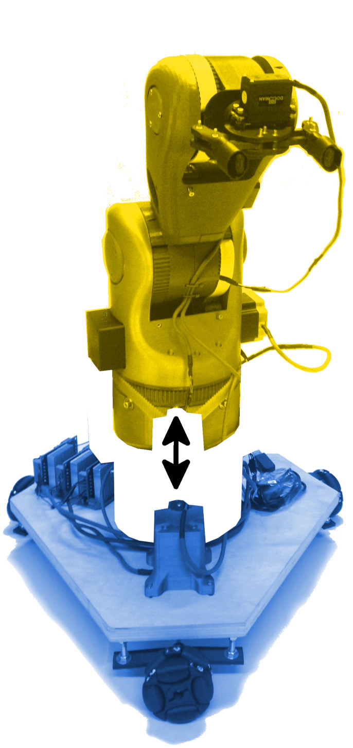
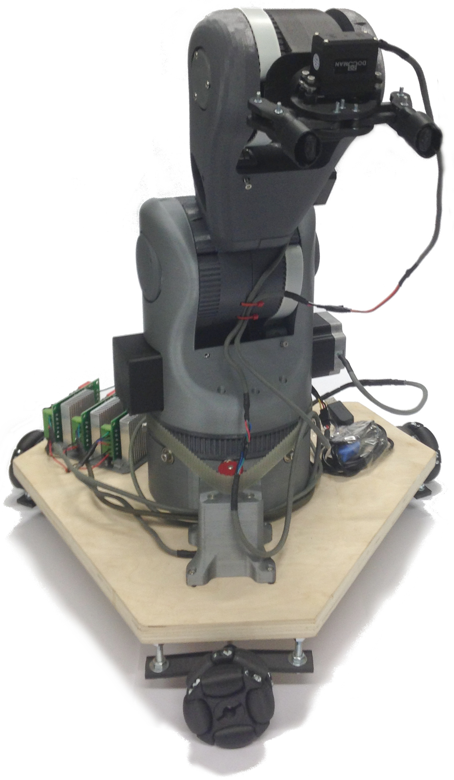
In this Talk
P(rotocol)
  Communicating state-machines
  Applied to device drivers
PSync
  Communication-closure
  Applied to fault-tolerant distributed algorithms
PGCD
  Hardware/Software link
  Applied to modular robots

Slide 11
Language to Help Decomposition
P
  Isolates Synchronization from Data
PSync
  Isolates Steps in a Distributed Algorithm
PGCD
  Isolates Discrete and Continuous, Components

Slide 12
P
Safe Asynchronous Event-Driven Programming
[PLDI 13]
Collaboration with Ankush Desai, Vivek Gupta, Ethan Jackson, Shaz Qadeer, and Sriram Rajamani

Slide 13
How Far Simple and “Stupid” goes?
Explicit state model checking
  “Stupid” (exhaustive exploration of the state space)
  > 30 years old
Used for
  Verify models, not actual code
  Can go a long way if used properly

Slide 14

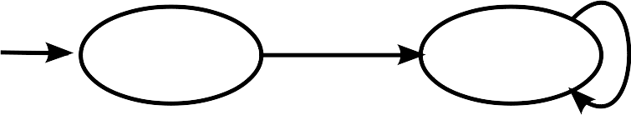
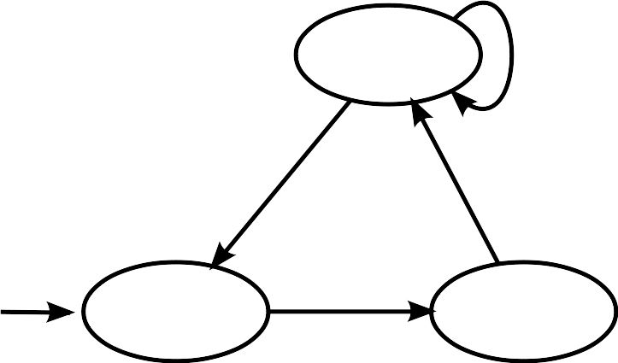
Communicating State Machines
Machines execute concurrently.
Receive message from input buffer
Compute on the local state
Send messages to other machines

Slide 15
From Modeling to Programming
Inside a state
Use external C code
Action statement
Incoming
transitions
Entry statement
Exit statement
Outgoing
transitions
Call Edges

Slide 16
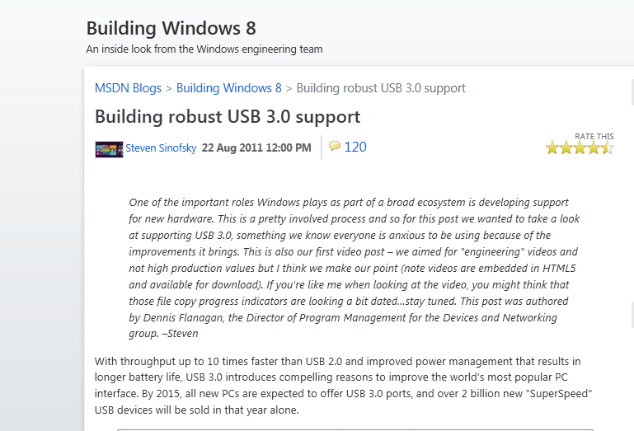
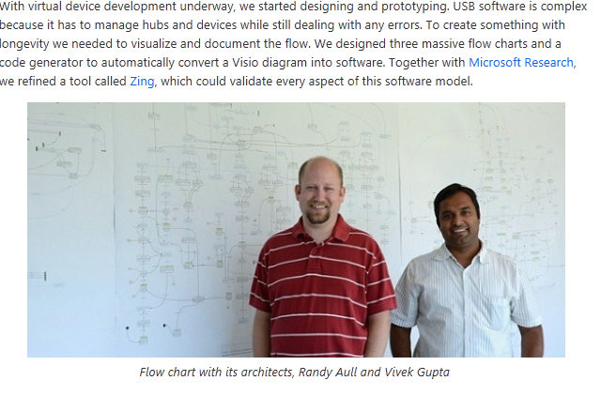
Scaling to Real Applications
P is used in testing and production:
USB Drivers
Drivers for the Hololens
within Azure
...

Slide 17
Why it works
P
External code (C)
Handle synchronization
“Small” state space
Easy for a model checker
Handle data
Large state space
Hard for a model checker
Caveat: to scale, we had to
use compositional verification technique,
ignores most of what happens in the C code, use simpler code stubs instead.

Slide 18
PSync
A Partially Synchronous Language for Fault-tolerant Distributed Algorithms
[POPL 16, SNAPL 15, VMCAI 14]
Collaboration with Cezara Drăgoi, Thomas A. Henzinger, Josef Widder, Helmut Veith

Slide 19
Language to Help Decomposition
P
  Isolates Synchronization from Data
PSync
  Isolates Steps in a Distributed Algorithm
PGCD
  Isolates Discrete and Continuous, Components

Slide 20





Why Care About Failure?
Replication

Slide 21
Replication and Consistency
X = -13
Consensus
X = 42
X = 4
X = 42
X = 42
Integrity
X = 42
Agreement
Irrevocability: Every correct process decides at most one value.
Termination: Every correct process eventually decides.

Slide 22
The Paxos Algorithm [Lamport 98]
Prepare
Promise
Accept
Accepted
Learning
Proposer
Acceptor/Learner
Acceptor/Learner
Find a quorum
Quorum agrees on the
next state/operation
Implementing Paxos: from ~50 lines of pseudo code to >500 LoC. What goes wrong?

Slide 23
Implementing Challenges
Detecting failure (and the impossibility to get it right)
Messages (side-effects) are untyped, have no scope, etc.
Control-flow inversion (losing the program structure)

Slide 24
When Processes Fail?
Asynchrony
Wait longer can help but how to avoid blocking?
Asynchronous models are not good at dealing with faults.
[FLP 85] Solving consensus requires time.
Waiting for a message
Fault

Slide 25
Communication is a Side Effect
buffer = recv(channel);
Type1 object1 =
deserialize1(buffer);
…
buffer = recv(channel);
Type2 object2 =
deserialize2(buffer);
Type object;
Byte[] buffer =
serialize(obj);
send(channel, buffer);
011001010101…
Up to the programmer to:
- interpret the bytes moving over the network,
- know which receive corresponds to which send.

Slide 26
Control-flow Inversion
Protocol structure replaced by dispatch:
var state = 1
while (true) {
on receive {
case Msg A =>
if (state == 1) …
else if (state == 2) …
case Msg B =>
if (state == 1) …
else if (state == 2) …
}
}
Protocol:
Msg A
Msg B
normal case
message reordered
message dropped
normal case

Slide 27
PSync
Goals: make things simpler (to understand and verify)
  The code preserves the algorithm structure
  Code complexity on par with pseudo-code
How: communication-closed rounds
  Syntactic scope to the messages
  Provides logical time
  Gives the illusion of synchrony

Slide 28
Communication-closed Rounds
[Elrad & Francez 82]
Prepare
Promise
Accept
Accepted
Learning
Proposer
Acceptor
Acceptor
Paxos organized in communication-closed rounds.
No message cross the boundaries between rounds.

Slide 29
How Does It Model a Real System?
Idea: model faults/asynchrony as an adversarial environment [Gafni 98]
Project all the “faults” on the messages
Lockstep semantics:
Indistinguishable
Asynchronous execution:
Theorem: Local views are preserved.

Slide 30

PSync Program Structure
Program
Round

Slide 31
Round Example
new Round[(Int,Time)]{
def send(): Map[ProcessID, (Int,Time)] =
Map(coord -> (x, ts))
def update(mailbox: Map[ProcessID, (Int,Time)]) {
if (id == coord && mailbox.size > n/2) {
vote = valueWithMaxTS(mailbox)
commit = true
}
}
}
Promise

Slide 32
Benefits for the Verification
Asynchrony (interleaving, delays)
Channels
Faults
Parametric systems
n
…

Slide 33
Evaluation
Tested on consensus algorithms: https://github.com/dzufferey/psync
Details in POPL 16 paper
Performance
(system throughput)
Verification Effort
(lines of annotation per LoC)
On going work:
- model shortcoming
(lack of compositionality)
- implementation work
(cost of generality)
20-40% slower
10
10x fewer annotation
1
Libpaxos3
PSync
Other
PSync

Slide 34
PGCD
Robot Programming and Verification with Geometry, Concurrency, and Dynamics
[ICCPS 19, ECOOP 19, IROS 19]
Collaboration with Gregor Banus̆ić, Rupak Majumdar, Marcus Pirron, Anne-Kathrin Schmuck, and Nobuko Yoshida

Slide 35
Language to Help Decomposition
P
  Isolates Synchronization from Data
PSync
  Isolates Steps in a Distributed Algorithm
PGCD
  Isolates Discrete and Continuous, Components

Slide 36
Hypothesis
“Hardware is the new Software”
Cost effective small production runs with 3D printing. Every object produced can be different.
What about robots ?
  Avoid rewriting the code when the robot change?
  Reuse and combine robots like we combine software libraries?

Slide 37
Our Goal
import Cart
import Arm
myCart = new Cart(myParam1)
myArm = new Arm(myParam2)
CartAndArm =
myCart.attach(myArm)
We are also
working on
this part.
In this talk

Slide 38
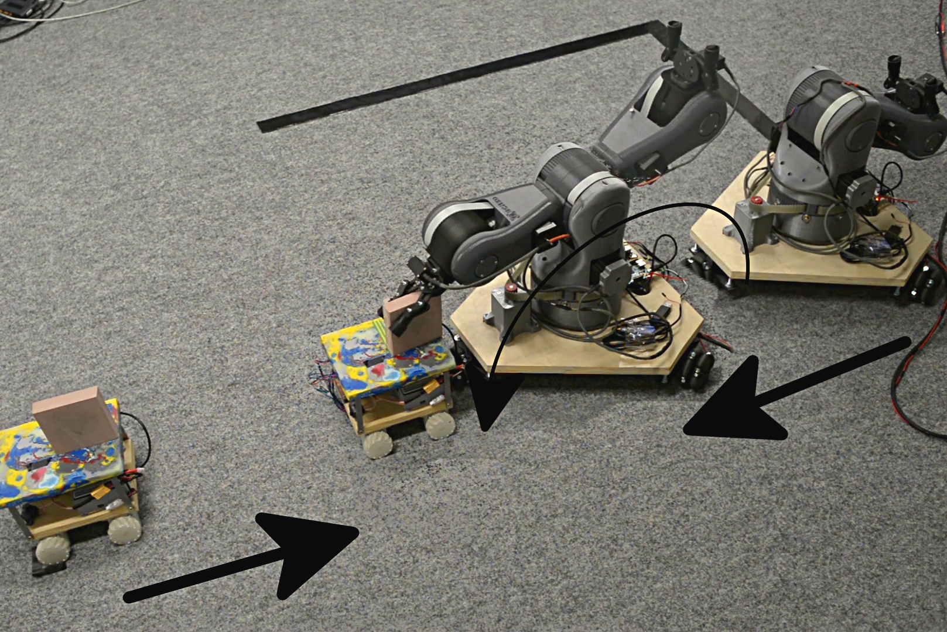
Coordinating Multiple Robots
Simple Handover example:
two robots meet,
they exchange an object, and
go their own way.

Slide 39
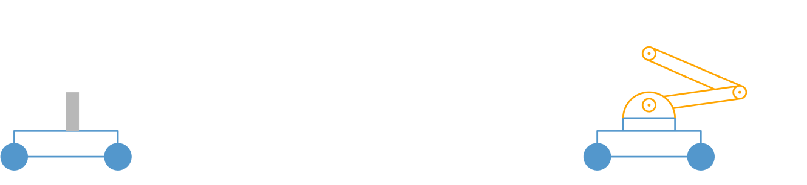



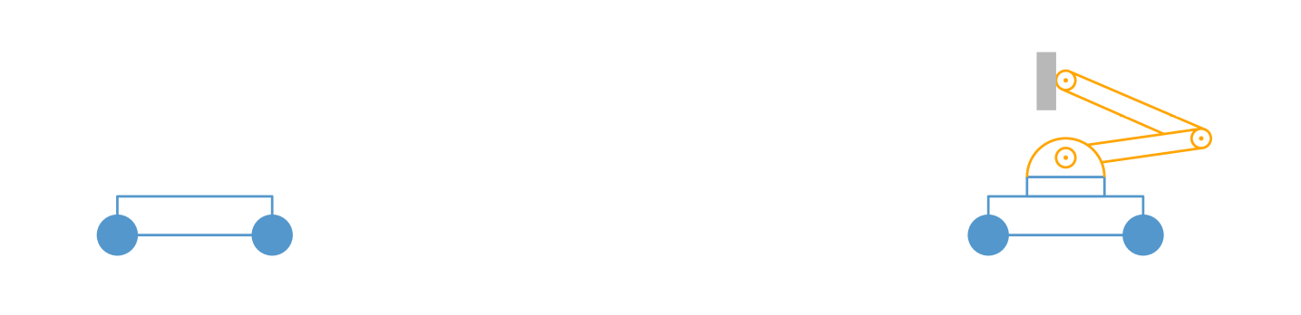
Handover, Arm’s Code
Black box controllers
(Motion primitives)
while true do
receive (idle)
grab(loc) ⇒
grab(loc);
send(cart, grabbed)
fold ⇒
move(origin);
send(cart, folded)
done ⇒
break
Motion
Communication

Slide 40
Decomposition in PGCD
Robots and their components (physical decomposition)
  Footprint to move around safely
  Coupling between components
Discrete and continuous parts (behavior decomposition)
  Discrete: communication and synchronization
  Continuous: motion and control

Slide 41
Attached Composition
Cart || Arm
Traditional parallel composition
lacks information.
Cart
Arm
Frame shift (relative position):
Arm’s position depends on Cart
Oriented operator:
- cart is the parent
- arm is the child
Dynamic coupling:
Cart’s speed depends
on arm’s weight.

Slide 42
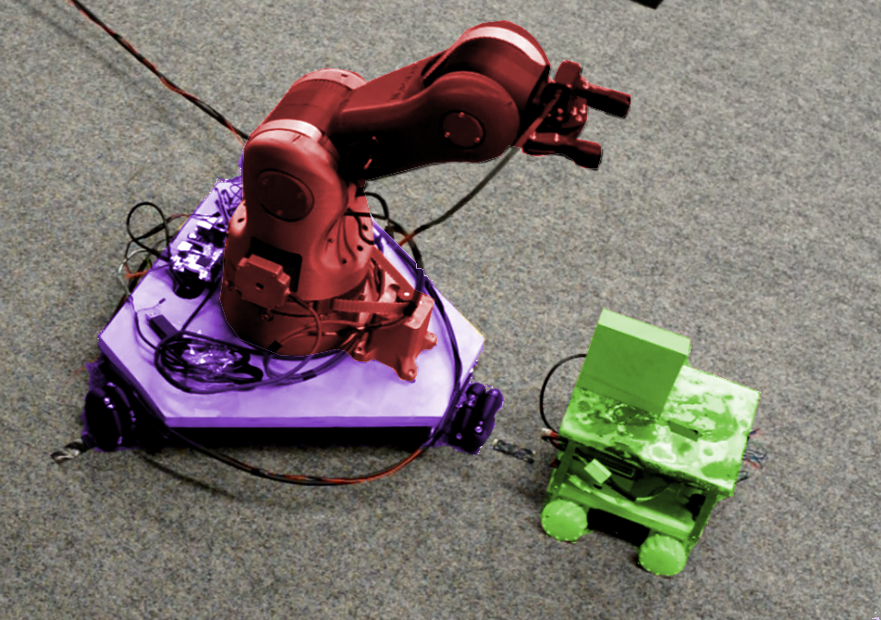
Also for Independent Robots
Arm
Cart 1
Cart 2
World

Slide 43




Making Composition Transparent
Arm
message
Cart 1
Cart 2
World

Slide 44
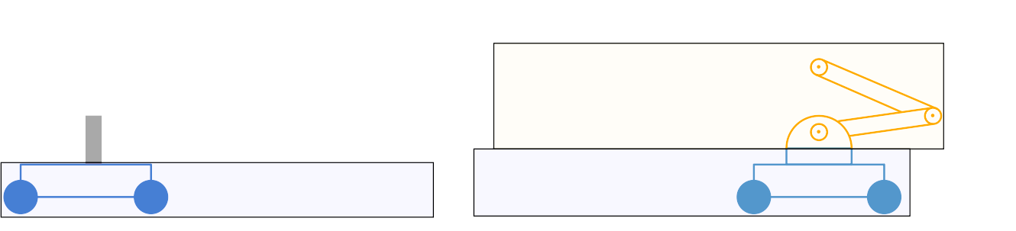
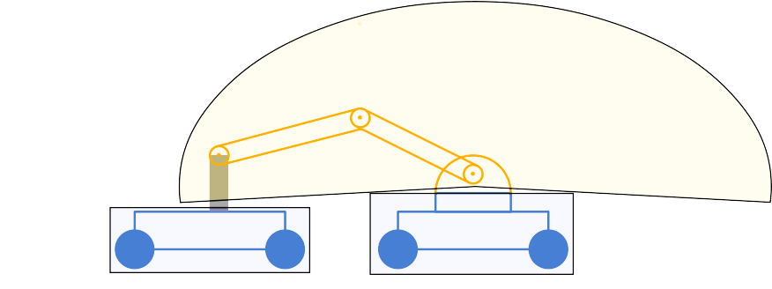
Managing Footprint during Motion
Motion primitives as black box for the sake of verification.
We require footprints to isolate the different robots.
All the footprints have to be disjoint.

Slide 45


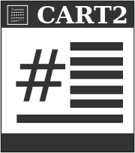
Verification Approach
Global Spec.
Multiparty session types with motions
Projections
Local Spec.
Local Spec.
Local Spec.
Discrete time hybrid automaton
Refinement
Implementation

Slide 46
Experiment

Slide 47
Experiment

Slide 48
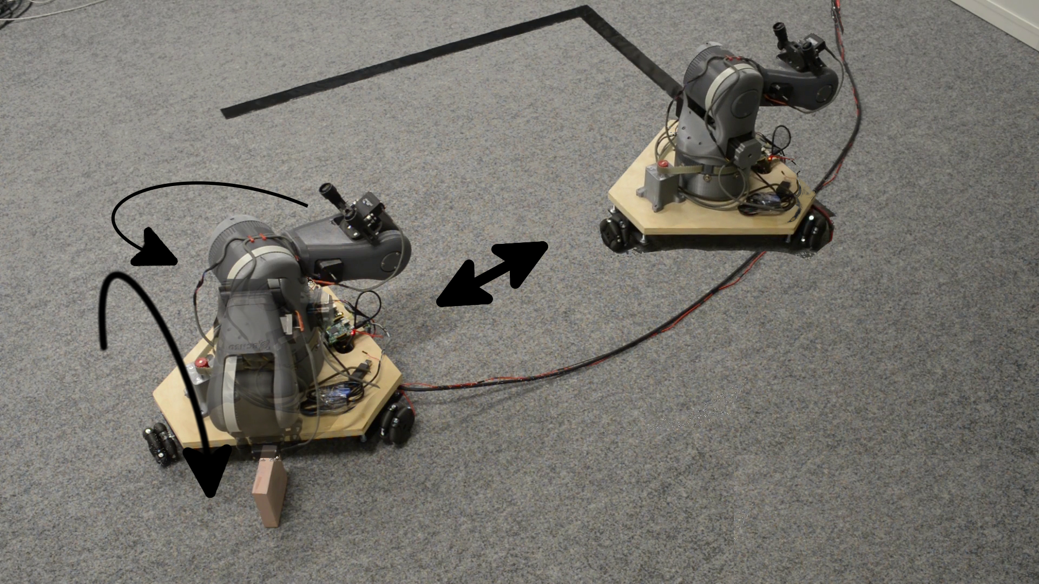
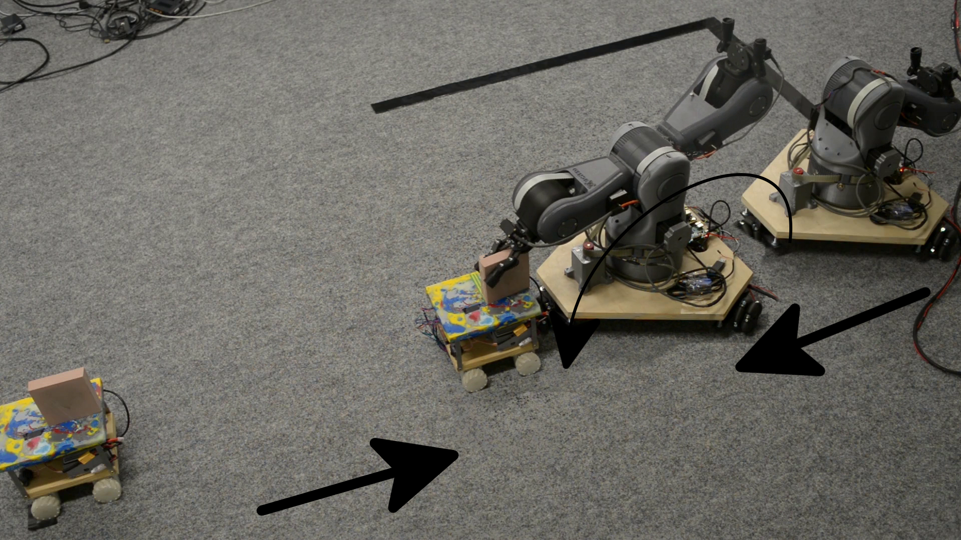
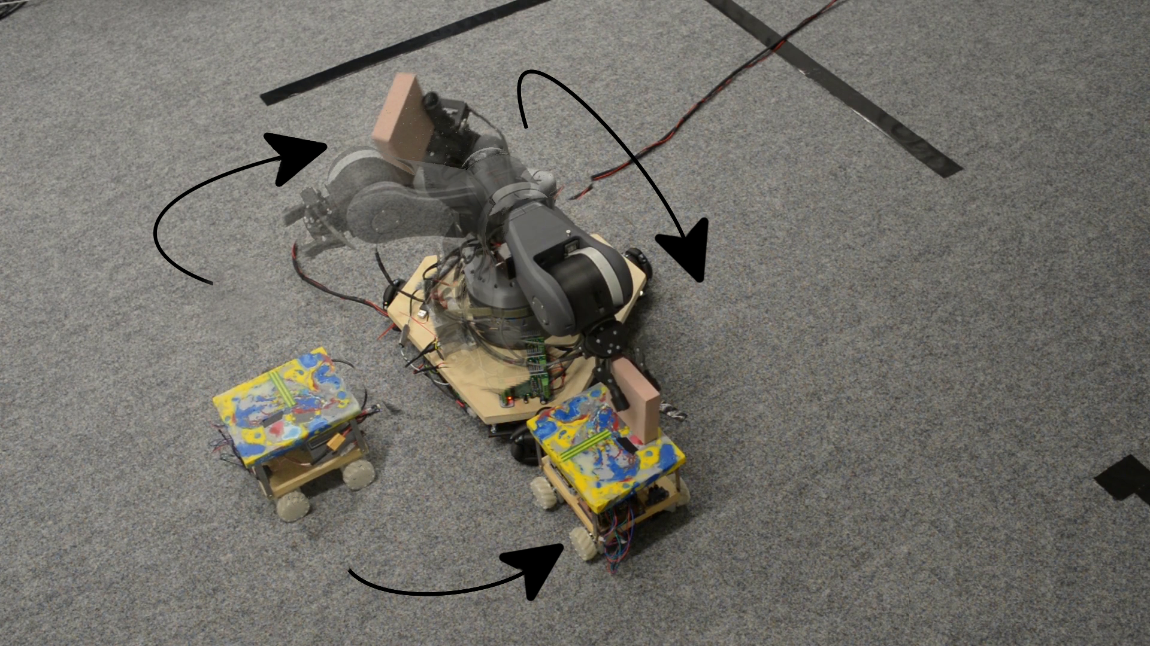
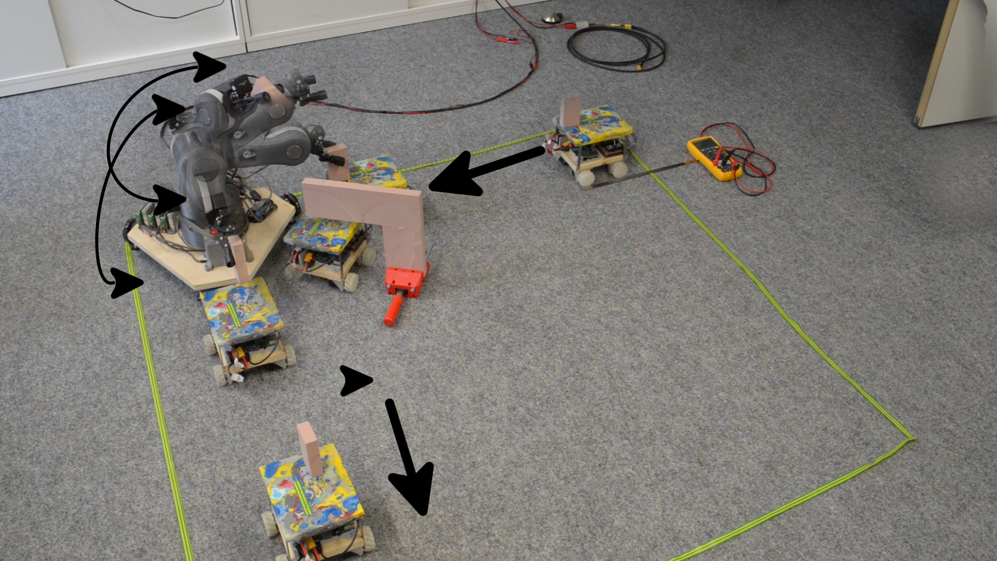
Evaluation
4 test scenarios
Program (per example)
Implementation: 30-50 LoC
Specification: 15-50 LoC
Motion primitives (all examples)
Implementation ~500 LoC
Specification ~500 LoC
Verification time: 15 sec. - 2 min.
https://github.com/MPI-SWS/pgcd
Fetch
Handover
Twist
Underpass

Slide 49
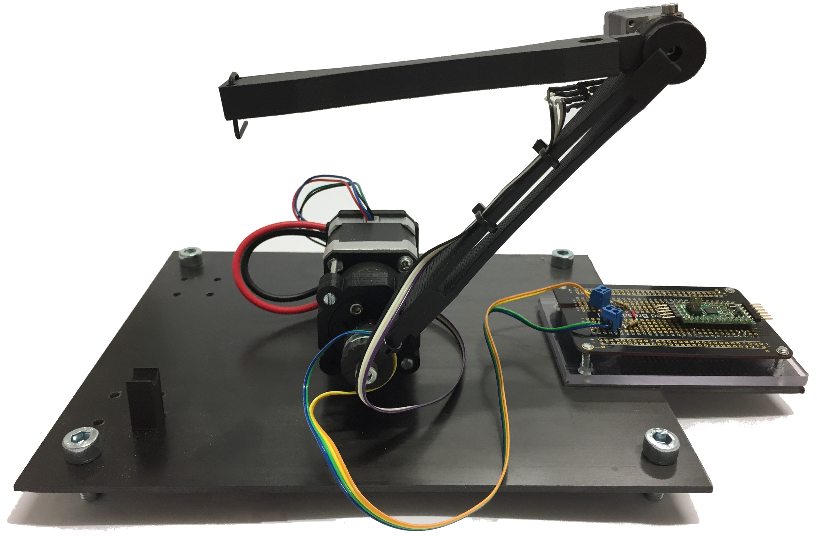
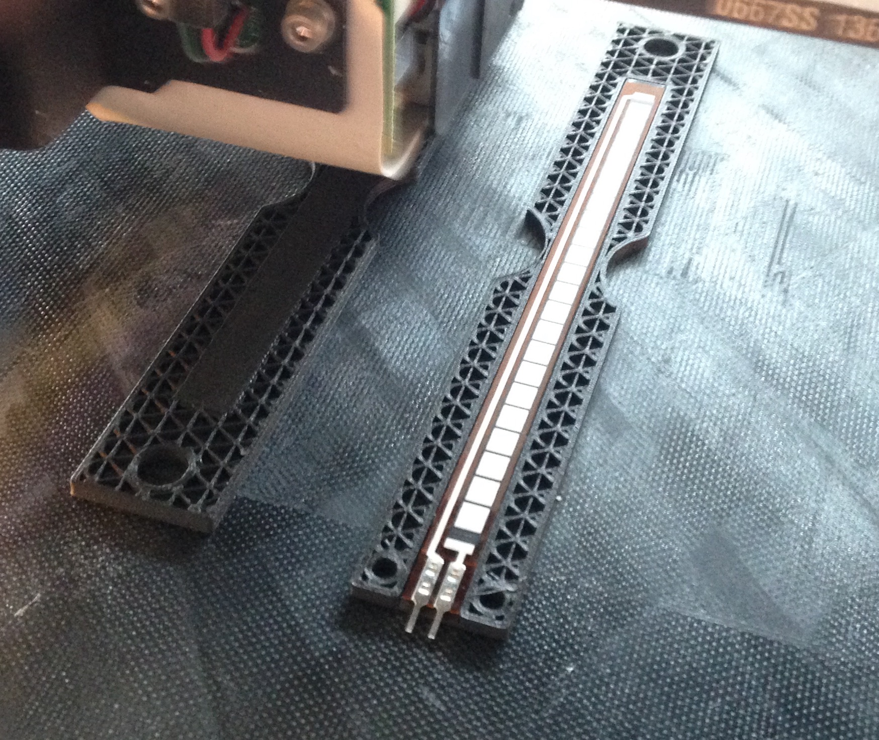
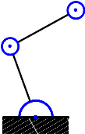
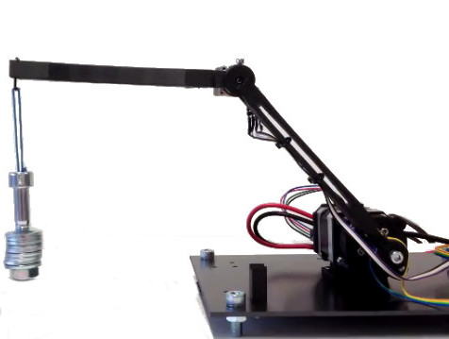
Ongoing Work: Controller Synthesis for Motion Primitives
Embedding sensors
Structural
Description
Automatically generated
feedback controller
Specification
(e.g. hold position)

Slide 50
Conclusion
Software correctness is important…
… but verification is hard.
Proposed solution:
Programming abstractions designed
with a built-in verification strategy.

Slide 51
Language to Help Decomposition
P
  Isolates Synchronization from Data
PSync
  Isolates Steps in a Distributed Algorithm
PGCD
  Isolates Discrete and Continuous, Components

