Slide 1
Implementing Communication-Closed Rounds: Toward an Efficient and General Solution
Damien Zufferey (MPI-SWS)
FRIDA, 2020.09.04
joint work with Cezara Dragoi (INRIA)
and Josef Widder (Informal Systems)

Slide 2
Back to 1st FRIDA in 2014
Small trip down memory lane… Back in 2014 we were already looking at this question:
Progress has not always been fast but we are getting there :)
https://github.com/dzufferey/presentations/blob/master/2014_07_24_FRIDA/Round%20model%20for%20DA.pdf

Slide 3
Outline
Faut-tolerant distributed algorithm (FTDA) and their implementation
Round models: benefits, shortcoming, and implementation
Toward a configurable round model
Results

Slide 4





Why FTDA?
FTDA

Slide 5
The Paxos Algorithm
Prepare
Promise
Accept
Accepted
Learning
Proposer
Acceptor/Learner
Acceptor/Learner
Find a quorum
Quorum agrees on the
next state/operation
Implementing Paxos: from ~50 lines of pseudo code to >500 LoC. What goes wrong?

Slide 6
Implementation Challenges
Detecting failure (and the impossibility to get it right)
Messages (side-effects) are untyped, have no scope, etc.
Control-flow inversion (losing the program structure)

Slide 7
When Processes Fail?
Asynchrony
Wait longer can help but how to avoid blocking?
Asynchronous models are not good at dealing with faults.
[FLP 85] Solving consensus requires time.
Waiting for a message
Fault

Slide 8
Communication is a Side Effect
buffer = recv(channel);
Type object1 =
deserialize1(buffer);
…
buffer = recv(channel);
OtherType object2 =
deserialize2(buffer);
Type object;
Byte[] buffer =
serialize(obj);
send(channel, buffer);
011001010101…
Up to the programmer to:
- interpret the bytes moving over the network,
- know which receive corresponds to which send.

Slide 9
Control-flow Inversion
Protocol structure replaced by dispatch:
var state = 1
while (true) {
on receive {
case Msg A =>
if (state == 1) …
else if (state == 2) …
case Msg B =>
if (state == 1) …
else if (state == 2) …
}
}
Protocol:
Msg A
Msg B
normal case
message duplicated
message dropped
normal case

Slide 10
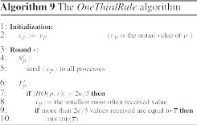
Round Model: (Pseudo)code
class OtrProcess extends Process {
var x = ???
val rounds = phase(
new Round[Int]{
def send(): Map[ProcessID,Int] = broadcast(x)
def update(mailbox: Map[ProcessID,Int]) = {
if (mailbox.size > 2*n/3) {
x = minMostOftenReceived(mailbox)
if (mailbox.filter( _._2 == x ).size > 2*n/3) {
decide(x)
} ) } } } }
From Charron-Bost and Schiper (2009)
PSync code (POPL 2016), slightly abbreviated
Complete code at: https://github.com/dzufferey/psync/blob/master/src/test/scala/example/Otr.scala

Slide 11
Communication-Closed Rounds
Rounds are syntactic units that
  Give a scope to messages (connect send receive)
  Typed (serialization)
  Failure detection provided by a dedicated runtime
The implementation difficulty is still there but hidden within the runtime that provides the round abstraction.
CC rounds also helps verification (not covered in this talk)

Slide 12
Round vs Real System
Idea: model faults/asynchrony as an adversarial environment [Gafni 98]
Project all the “faults” on the messages such that local views are preserved.
Lockstep semantics:
Indistinguishable
Asynchronous execution:

Slide 13
Benefits for the Verification
Asynchrony (interleaving, delays)
Channels
Faults

Slide 14

PSync Program Structure
Program
Round

Slide 15
PSync Runtime
Init
Send
PSync program
PSync program
Receive
...
PSync runtime
PSync runtime
Timeout,
Catching-up
Next round
Network
Update
The runtime deals with the network and hides events.

Slide 16
Liveness Guarantees
PSync runtime only work for partial synchrony (Dwork et al. 1988).
  During bad period, the processes can get arbitrarily desynchronized.
  During good period, the processes work in lockstep.
To resynchronize, slow processes need to catch-up, i.e., progress to the next round as soon as they receive a message from an higher round.

Slide 17


Programming with Rounds
For round to work as programming abstraction, we need:
  Generality:
    Algorithm
    Fault model
  Reasonable overhead:
    Algorithm
    Fault model
    Deployment
PSync

Slide 18
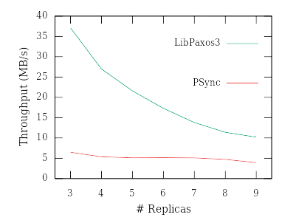
One of PSync’s Limitations
The rate of progress is limited by the timeout!
  Small TO: faster but less resilient to jitter
  Large TO: slower but more resilient to jitter
Many algorithms only needs timeout to detect faults but could progress as soon as all the messages for a round are received.

Slide 19
All-to-All needs TO
Communication pattern
Message delays
Assumptions
All messages needed to progress.
All processes start at “t = 0”.
Snd \ Rcv | A | B | C
A | 0 | 1 | 3
B | 1 | 0 | 1
C | 1 | 1 | 0
A
B
C
A
B
C

Slide 20
All-to-All needs TO
Communication pattern
Message delays
Assumptions
All messages needed to progress.
All processes start at “t = 0”.
Snd \ Rcv | A | B | C
A | 0 | 1 | 3
B | 1 | 0 | 1
C | 1 | 1 | 0
A
B
C
A
Round 1
B
C

Slide 21
All-to-All needs TO
Communication pattern
Message delays
Assumptions
All messages needed to progress.
All processes start at “t = 0”.
Snd \ Rcv | A | B | C
A | 0 | 1 | 3
B | 1 | 0 | 1
C | 1 | 1 | 0
A
B
C
A
Round 1
B
Round 2
C

Slide 22
All-to-All needs TO
Communication pattern
Message delays
Assumptions
All messages needed to progress.
All processes start at “t = 0”.
Snd \ Rcv | A | B | C
A | 0 | 1 | 3
B | 1 | 0 | 1
C | 1 | 1 | 0
A
B
C
A
Round 1
B
Round 2
C
Message triggers
catch-up

Slide 23
All-to-All needs TO
Communication pattern
Message delays
Assumptions
All messages needed to progress.
All processes start at “t = 0”.
Snd \ Rcv | A | B | C
A | 0 | 1 | 3
B | 1 | 0 | 1
C | 1 | 1 | 0
A
B
C
A
Round 1
B
Round 2
Round 3
C
Late message
(out of scope)

Slide 24
All-to-All needs TO
Communication pattern
Message delays
Assumptions
All messages needed to progress.
All processes start at “t = 0”.
Snd \ Rcv | A | B | C
A | 0 | 1 | 3
B | 1 | 0 | 1
C | 1 | 1 | 0
A
B
C
A
Round 1
B
Round 2
Round 3
C

Slide 25
All-to-One/One-to-All w/o TO
Communication
topology
Communication pattern for leader-based algorithms.
The leader acts as “synchronization bottleneck.”
Processes can proceed as soon as they have received the messages without compromising global progress.
A
B
C
and
A
B
C

Slide 26
Progress and Message Values
Round models process messages in a single batch for the whole round. For some algorithm, specific messages can trigger faster progress.
Commit?
Yes/No
Commit/Abort
A single “No” in the 2nd round leads to “Abort”.
Two Phase Commit protocol (2PC)

Slide 27
Giving Control to the Programmer
Rather than case-splitting on the algorithm, let the programmer decide.
The programmer knows what the algorithm needs.
The programmer knows the deployment scenario.

Slide 28

New Round
Progress hints to tell the runtime what to do. Progress has two parts:
GoAhead
Timeout t
WaitMessage
timeout ≤ 0
timeout ∈ (0, ∞)
timeout = ∞
1) When to finish a round?
2) Automatic resynch. ?
Allow catch-up (default)
Block catch-up

Slide 29
Old vs New: 2nd Round of 2PC
new Round[Boolean](timeout){
def send(): Map[ProcessID,Boolean] = {
Map( coord -> vote )
}
def update(mailbox: Map[ProcessID,Boolean]) = {
if (id == coord) {
commit = mailbox.size == n && mailbox.forall( _._2 )
}
}
}
new Round[Boolean]{
var nMsg = 0
var ok = true
def send(): (Map[ProcessID,Boolean], Progress) = {
val msg = Map( coord -> vote )
val prog = if (id != coord) Progress.goAhead
else Progress.timeout(timeout)
(msg, prog)
}
def receive(sender: ProcessID, payload: Boolean) = {
nMsg += 1
ok &= payload
if (!ok || nMsg == n) Progress.goAhead
else Progress.timeout(timeout)
}
def finishRound() = {
if (id == coord) commit = ok && nMsg == n
}
}
The new version is more complex but it gives more control. When a “false” message is received the coordinator can progress.

Slide 30
New Runtime
Init
Send / goAhead
Send / timeout-wait
Receive / timeout-wait
Receive /
goAhead
Timeout,
Catching-up (if allowed)
Next round
Finish

Slide 31
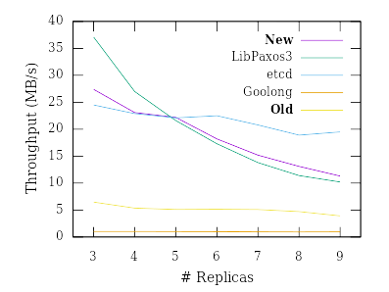
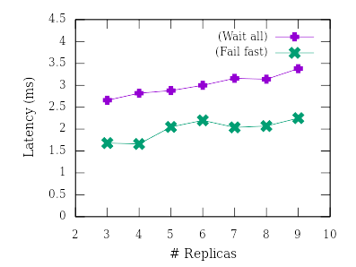
In Practice
Throughput for Paxos style consensus
Latency for 2PC

Slide 32
Some Implementation Notes
FTDA are tolerant to faults for safety but performance is not.
The runtime algorithm in the paper is not quite how you implement:
  Cost is not in the computation but in the "plumbing" (moving data around)
  fast-path optimization (make sure the most common path is fast)
  pooling resources (thread, memory, etc.)
  Multithreading is not always your friend (scheduling jitter)
Catching errors low in the stack is cheaper ...

Slide 33
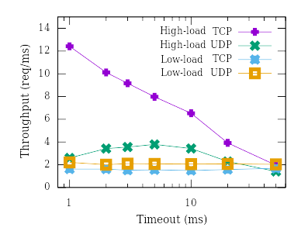
Deployment is also Important
The algorithm is one part, tuning parameters like timeout, transport layer, etc., also has a large impact.

Slide 34
About Byzantine Faults
Byzantine Faults not cover due to time…
Progress abstraction can work with Byzantine faults:
  Need to update the catch-up mechanism.
  Add primitive to block until enough processes have reached a certain round.
Stay tuned for the paper for the full explanation.

Slide 35
Conclusion
Communication-closed rounds are a good abstraction for FTDA (simplify programming and verification)
For more generality and performances, the programmer needs more control over the runtime.
  Progress indication for timeout and resynchronization
Implemented in https://github.com/dzufferey/psync

