Slide 1
Choreographic Programming for CPS
Damien Zufferey, MPI-SWS
2020.10.02 CPEC meetting

Slide 2
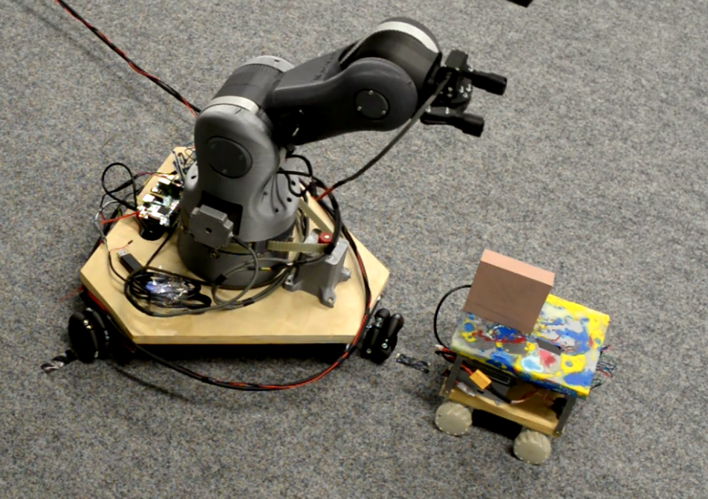
Verification of CPS

Slide 3
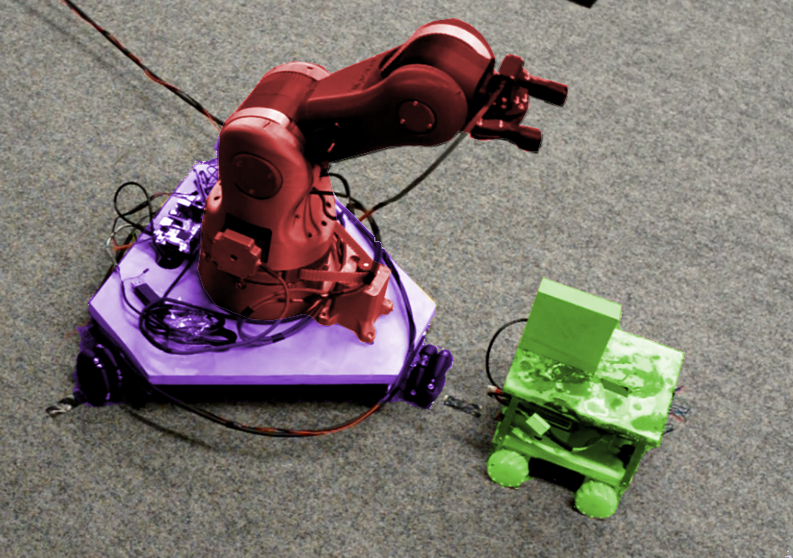
Arm
Cart & Arm:
Two robots attached together that
act as “one” robot (communication)
Cart
Carrier

Slide 4


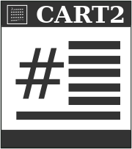
Global Spec.
The product is expensive.
(state-space explosion!)
We need to be compositional.
refines

Slide 5
Programming to Help Verification
Global Spec.
Choreography (Global)
projects to
Local Spec.
Local Spec.
Local Spec.
Endpoints Projection (Local)
refines
Implementation

Slide 6
Technical Challenges
Choreography as executable specification: more detailed than abstract specification but not overwhelming.
Choreography should be projectable.

Slide 7
Example
Cue for the video...

Slide 8
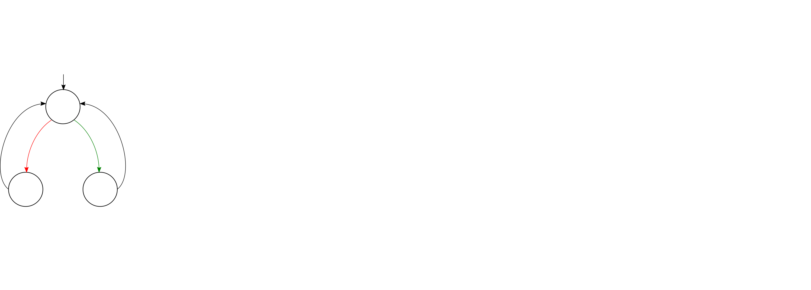
Choreography for the Example

Slide 9
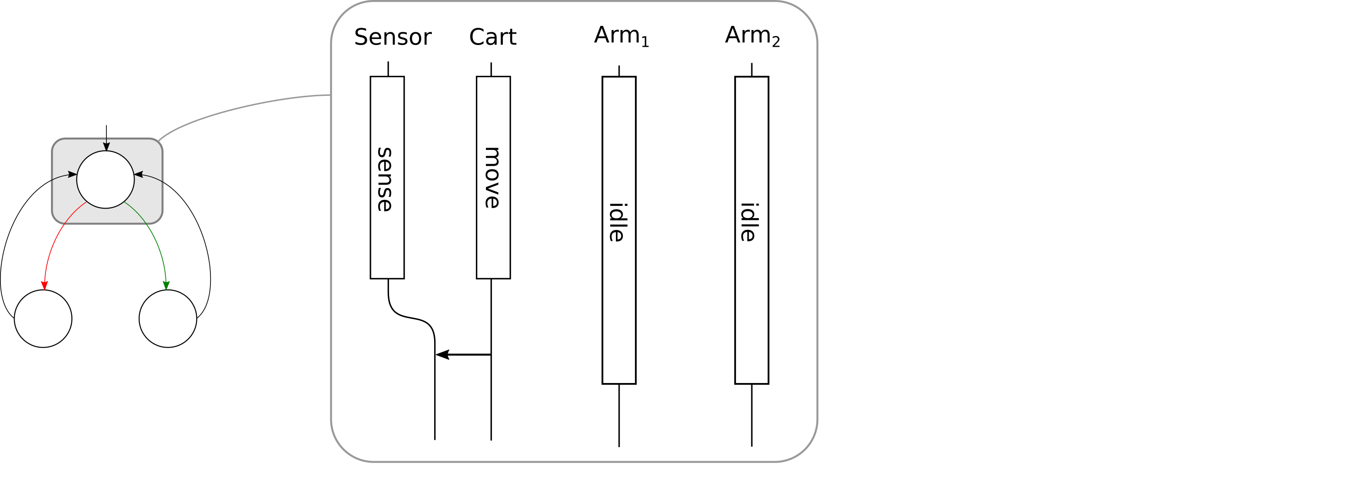
Choreography for the Example

Slide 10
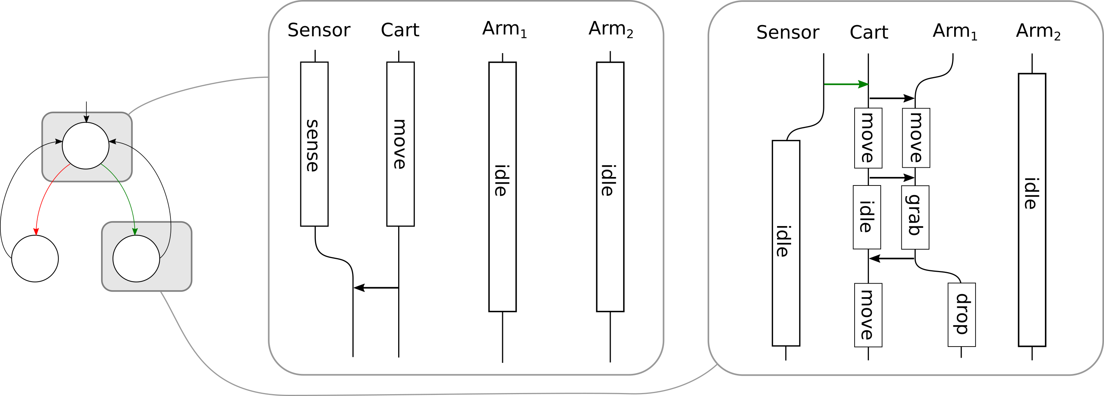
Choreography for the Example

Slide 11

Motion
Physical components:
Assume-Guarantee contracts:
  Duration interval, (un)interruptible
  Pre/post conditions (ℝ^{X} × ℝ^{W}), invariant (T→ℝ^{X} × ℝ^{W})
External inputs (W)
Internal state (X)
ℝ³
Footprint (X → 2 )

Slide 12
Communication
Choice propagates through messages to all involved processes.
Respects motion duration / interruptibility.
Interaction/independence changes with communication.

Slide 13
References
PGCD: Robot Programming and Verification with Geometry, Concurrency, and Dynamics. Gregor B. Banus̆ić, Rupak Majumdar, Marcus Pirron, Anne-Kathrin Schmuck, and Damien Zufferey. ICCPS 2019.
Motion Session Types for Robotic Interactions. Rupak Majumdar, Marcus Pirron, Yoshida Nobuko, and Damien Zufferey. ECOOP 2019.
Multiparty Motion Coordination: From Choreographies to Robotics Programs. Rupak Majumdar, Yoshida Nobuko, and Damien Zufferey. OOPSLA 2020.

