Slide 1
Programming Abstractions for Verifiable Software
Damien Zufferey
MPI-SWS
18.01.2020

Slide 2
What it is about?
Programming Abstractions for Verifiable Software
Mean: how we structure code
can help verification
Goal: automatically proving
software correct

Slide 3
Confidence in Software
Copyright (c) <year> <copyright holder>.
All rights reserved.
Redistribution and use in source and binary forms are permitted
provided that the above copyright notice and this paragraph are
duplicated in all such forms and that any documentation,
advertising materials, and other materials related to such
distribution and use acknowledge that the software was developed
by the <organization>. The name of the
<organization> may not be used to endorse or promote products derived
from this software without specific prior written permission.
THIS SOFTWARE IS PROVIDED ``AS IS'' AND WITHOUT ANY EXPRESS OR
IMPLIED WARRANTIES, INCLUDING, WITHOUT LIMITATION, THE IMPLIED
WARRANTIES OF MERCHANTABILITY AND FITNESS FOR A PARTICULAR PURPOSE.
WITHOUT FITNESS FOR A
PARTICULAR PURPOSE

Slide 4
Is it Bad?
So pervasive Wikipedia even has a category:
  https://en.wikipedia.org/wiki/Category:Software_bugs
And a list:
  https://en.wikipedia.org/wiki/List_of_software_bugs
…

Slide 5
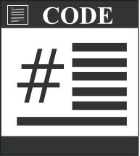


Automated Software Verification
Proof
Spec.
Counterexample

Slide 6
Unfortunately ...
Turing
machine
Proof
Halt ?
Counterexample

Slide 7
Problems Do Not Go Away Because They are Hard...
… but they still make life miserable.
Maybe the problem is ill-posed:
  Full automation is too much (ask the user for help)
  Try an easier problem (focus on null pointers)
  Programming languages are too powerful
  ...

Slide 8
Is Turing Completeness needed ?
No (most of the time)
However, it is hard to make useful non Turing complete languages:
  early versions of SQL …
  … later made Turing complete with extensions

Slide 9


Intrinsic vs Accidental Complexity
General Purpose
Language
Domain Specific
Languages

Slide 10
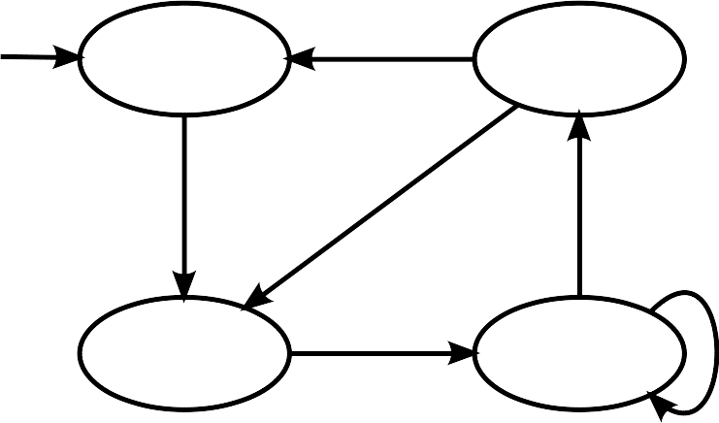

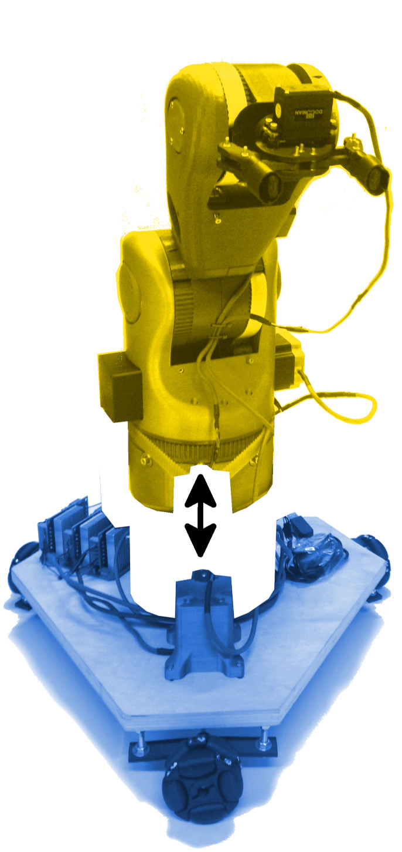
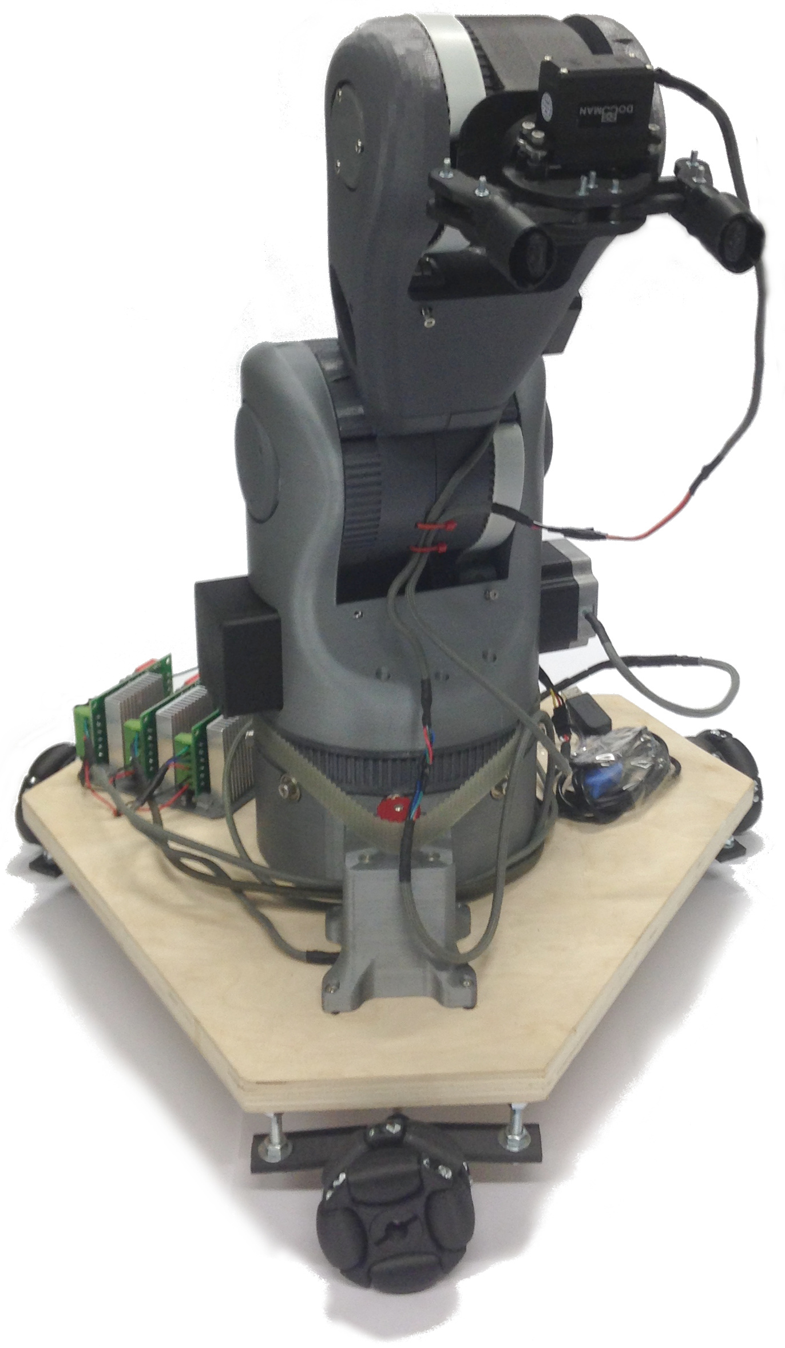
In this Talk
P(rotocol)
  Communicating state-machines
  Applied to device drivers
PSync
  Communication-closure
  Applied to fault-tolerant distributed algorithms
PGCD
  Hardware/Software link
  Applied to modular robots

Slide 11
P: Safe Asynchronous Event-Driven Programming
[PLDI 13]
Collaboration with Ankush Desai, Vivek Gupta, Ethan Jackson, Shaz Qadeer, and Sriram Rajamani

Slide 12
How Far Simple and “Stupid” goes?
Explicit state model checking
  “Stupid” (exhaustive exploration of the state space)
  > 30 years old
Used for
  Verify models, not actual code
  Can go a long way if used properly

Slide 13

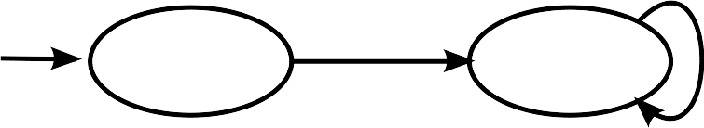
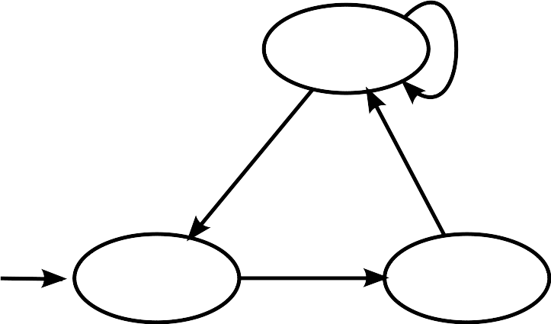
Communicating State Machines
Machines execute concurrently.
Receive message from input buffer
Compute on the local state
Send messages to other machines

Slide 14
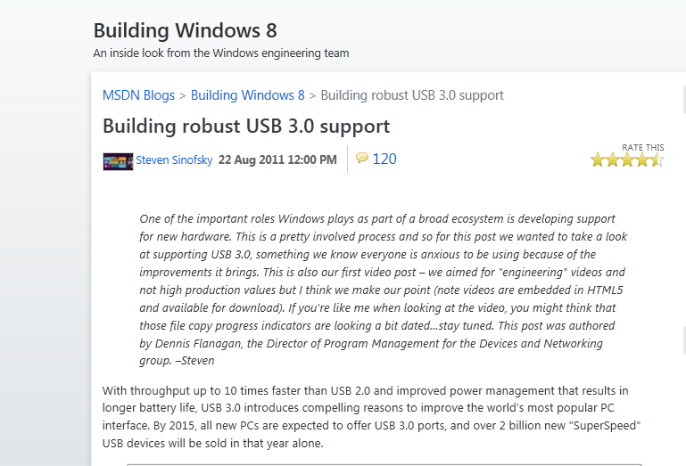
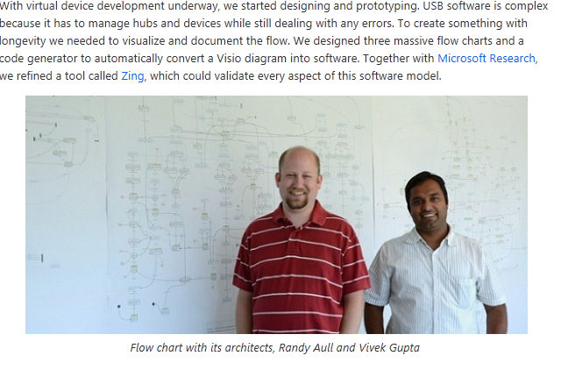
Scaling to Real Applications
P is used in testing and production:
USB Drivers
Drivers for the Hololens
within Azure
...

Slide 15
Why it works
P
External code (C)
Handle synchronization
“Small” state space
Easy for a model checker
Handle data
Large state space
Hard for a model checker
Caveat: to scale, we had to
use compositional verification technique,
ignores most of what happens in the C code, use simpler code stubs instead.

Slide 16
Language to Help Decomposition
P
  Isolates Synchronization from Data
PSync
  Isolates Steps in a Distributed Algorithm

Slide 17
PSync: A Partially Synchronous Language for Fault-tolerant Distributed Algorithms
[POPL 16, SNAPL 15, VMCAI 14]
Collaboration with Cezara Drăgoi, Thomas A. Henzinger, Josef Widder, Helmut Veith

Slide 18





Why Care About Failure?
Replication

Slide 19
Replication and Consistency
X = -13
Consensus
X = 42
X = 4
X = 42
X = 42
Integrity
X = 42
Agreement
Irrevocability: Every correct process decides at most one value.
Termination: Every correct process eventually decides.

Slide 20
The Paxos Algorithm [Lamport 98]
Prepare
Promise
Accept
Accepted
Learning
Proposer
Acceptor/Learner
Acceptor/Learner
Find a quorum
Quorum agrees on the
next state/operation
Implementing Paxos: from ~50 lines of pseudo code to >500 LoC. What goes wrong?

Slide 21
What is Hard to Verify?
Asynchrony
Channels
Faults
Parametric systems
Interleavings →
combinatorial
explosion
reliable FIFO → undecidable
another combinatorial explosion
n
usually undecidable
…

Slide 22
Implementation Challenges
Detecting failure (and the impossibility to get it right)
Messages (side-effects) are untyped, have no scope, etc.
Control-flow inversion (losing the program structure)

Slide 23
When Processes Fail?
Asynchrony
Wait longer can help but how to avoid blocking?
Asynchronous models are not good at dealing with faults.
[FLP 85] Solving consensus requires time.
Waiting for a message
Fault

Slide 24
Communication is a Side Effect
buffer = recv(channel);
Type1 object1 =
deserialize1(buffer);
…
buffer = recv(channel);
Type2 object2 =
deserialize2(buffer);
Type object;
Byte[] buffer =
serialize(obj);
send(channel, buffer);
011001010101…
Up to the programmer to:
- interpret the bytes moving over the network,
- know which receive corresponds to which send.

Slide 25
Control-flow Inversion
Protocol structure replaced by dispatch:
var state = 1
while (true) {
on receive {
case Msg A =>
if (state == 1) …
else if (state == 2) …
case Msg B =>
if (state == 1) …
else if (state == 2) …
}
}
Protocol:
Msg A
Msg B
normal case
message duplicated
message dropped
normal case

Slide 26
PSync
Goals: make things simpler (to understand and verify)
  The code preserves the algorithm structure
  Code complexity on par with pseudo-code
How: communication-closed rounds
  Syntactic scope to the messages
  Provides logical time
  Gives the illusion of synchrony

Slide 27
Communication-closed Rounds
[Elrad & Francez 82]
Prepare
Promise
Accept
Accepted
Learning
Proposer
Acceptor
Acceptor
Paxos organized in communication-closed rounds.
No message cross the boundaries between rounds.

Slide 28
How Does It Model a Real System?
Idea: model faults/asynchrony as an adversarial environment [Gafni 98]
Project all the “faults” on the messages
Lockstep semantics:
Indistinguishable
Asynchronous execution:
Theorem: Local views are preserved.

Slide 29

PSync Program Structure
Program
Round

Slide 30
Round Example
new Round[(Int,Time)]{
def send(): Map[ProcessID, (Int,Time)] =
Map(coord -> (x, ts))
def update(mailbox: Map[ProcessID, (Int,Time)]) {
if (id == coord && mailbox.size > n/2) {
vote = valueWithMaxTS(mailbox)
commit = true
}
}
}
Promise

Slide 31
Benefits for the Verification
Asynchrony
Channels
Faults
Parametric systems
No interleavings
Buffer of size 1
Project all faults on messages
(less nondeterminism)
n
Decidable with further restrictions
[Marić et al. CAV 17]
…

Slide 32
Evaluation
Tested on consensus algorithms: https://github.com/dzufferey/psync
Details in POPL 16 paper
Performance
(system throughput)
Verification Effort
(lines of annotation per LoC)
On going work:
- model shortcoming
(lack of compositionality)
- implementation work
(cost of generality)
20-40% slower
10
10x fewer annotation
1
Libpaxos3
PSync
Other
PSync

Slide 33
Conclusion
Software correctness is important…
… but verification is hard.
Proposed solution:
Programming abstractions designed
with a built-in verification strategy.

