Slide 1
Verification of message-passing programs: model checking and session types perspectives
Damien Zufferey
2020.10.7

Slide 2





What is this about ?
Distributed systems
(message-passing)
Verification
+
Spec.

Slide 3
“Hello world” of message-passing
A
B
?Pong
!Ping
!Pong
?Ping
CSP notation: ‘!’ is send, ‘?’ is receive

Slide 4
What to verify?
A communication protocol is
correctly implemented:
messages follow a prescribed order
Deadlock-free
no dangling messages
Spec.

Slide 5
Model for the software
Programs:
- Finite state machines
- Pushdown automata
- Turing machines
Communication channels:
- routing: point-to-point, broadcast, ...
- capacity: unbounded, bounded
- reliability: reliable, lossy, fair, ...
- ordering: FIFO, bag

Slide 6
Communicating state machines (CSM)
Programs:
- Finite state machines
- Pushdown automata
- Turing machines
Communication channels:
- routing: point-to-point, broadcast, ...
- capacity: unbounded, bounded
- reliability: reliable, lossy, fair, ...
- ordering: FIFO, bag

Slide 7
CSM: expressive power
Knowing the expressive power tells us what method can or cannot be applied.
(Don’t try to solve undecidable problems)
It can tell us what feature of the model is important.
Unfortunately, CSM can simulate Turing machines.

Slide 8
Turing machine (TM)
TM = finite control + unbounded tape (RAM)
Operations: read/write memory, move left/right
Head

Slide 9
TM → CSM
Idea:
use the communication channels to store the content of the tape.
Store only the (finite) written part
Turn the tape into a loop
Extract the “Head part” of the tape
Split the loop in two parts (2 communication channels)

Slide 10
TM → CSM
used
empty
Head
Head
“end of tape” symbol,
extend the tape on demand.

Slide 11
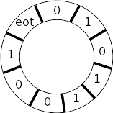
TM → CSM
Head
Head

Slide 12



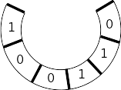
TM → CSM
Bigger state machine that
remembers 3 positions
Head
Head
Head
echo
“echo” send back the message it receives

Slide 13
TM → CSM
Head
Emulating TM operations:
1) read/write: change local state of the head machine
2) move right: send to echo, receive from echo
3) move left:
- insert position marker before current position
- loop around the tape (move right) until the marker
echo

Slide 14
Other channel models
- capacity: unbounded, bounded
- reliability: reliable, lossy, ...
- ordering: FIFO, bag
Finite state machine
- capacity: unbounded, bounded
- reliability: reliable, lossy, ...
- ordering: FIFO, bag
Petri Net
- capacity: unbounded, bounded
- reliability: reliable, lossy, ...
- ordering: FIFO, bag
WSTS

Slide 15
Memory vs communication slack
A
B
Some protocols using unbounded channels can be harmless.
What is the difference between
channel as memory
(store information for later)
communication slack
(delay in the propagation of information)
!Cons
?Cons
!Nil
?Nil

Slide 16
Looking at the channels
Operations on channel endpoints are dual.
send here = receive there
A
B
A
B
A
B

Slide 17
Binary session types (BST)
Idea: one side of the channel determines the operation on the other side.
1) get the operations for A
2) compute the operations for B using duality
3) check B executes the specified operations
A
B
!Ping
?Ping
type
dual
type
?Pong
!Pong

Slide 18
BST and choice
Internal
External
Mixed
!x
?x
!x
+
&
!y
?y
?y
dual
deterministic choice: all outgoing transitions have different labels

Slide 19
BST example with choice
A
B
!Cons
type
dual
type
?Cons
!Nil
?Nil

Slide 20
BST and model checking
The syntactic restrictions on the protocols allowed by BST fall within the class of half-duplex protocols.
Half-duplex: buffer empty when communication switch direction
Half-duplex CSM with 2 processes are not Turing complete.
BST enforce this restriction on the protocol and runs the same on half- and full-duplex systems.

Slide 21
More than two processes...
2 processes: well understood
3+ processes: badly understood
  Projection of global description is lossy. It can introduce non-determinism.
  Messages sent by different processes are independent.

Slide 22
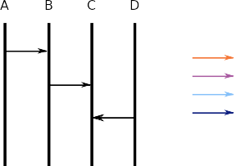
High level message sequence charts notation
Processes
(often omitted)
Color indicates message type.
Messages

Slide 23
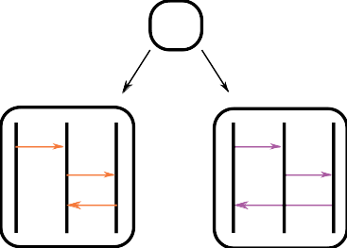
A correct example
B!
A
B!
C?
C!
A?
project
B
A?
C!
B!
B?
C
B?
A!

Slide 24
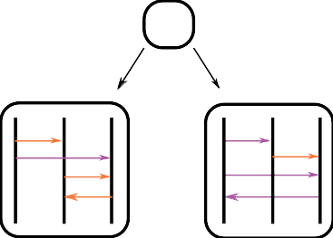
A wrong example (1)
C!
B!
A
B!
C!
C?
C!
A?
project
B
A?
C!
B?
B!
A?
C
B?
A?
A!

Slide 25
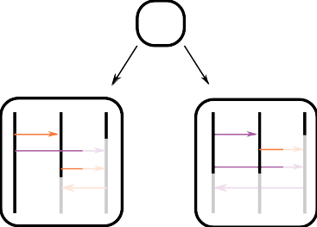
A wrong example (2)
C!
B!
A
B!
C!
C?
C!
A?
project
B
A?
C!
B?
B!
A?
C
B?
A?
A!
The messages from A,B are independent.
C cannot rely on their ordering.

Slide 26
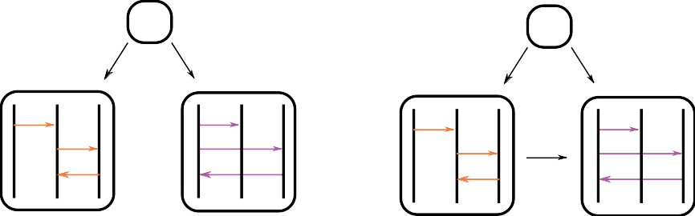
No compositionality
Composing two correct subprotocols can result in an incorrect one...

Slide 27
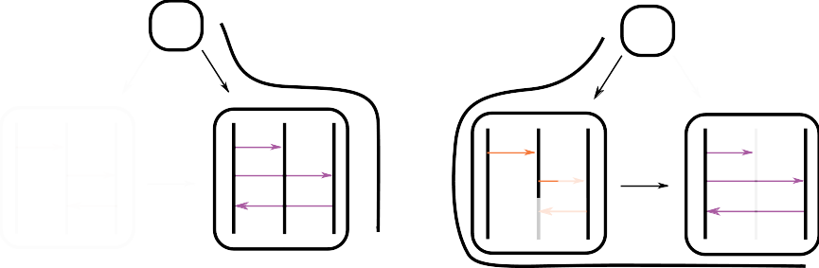
Counterexample

Slide 28
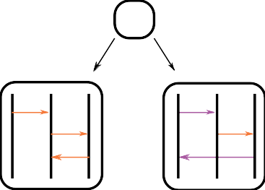
Determinism does not carry over
B!
A
B!
C?
C!
A?
project
B
A?
C!
B!
A makes the choice,
B is deterministic,
but C is not...
B?
C
B?
A!

Slide 29
HMSC vs MST
HSMC
Compact notation for CSM
Verification based on state space exploration
Mutliparty session types (MST)
Try to generalize the ideas of BST
Verification based on proof search

Slide 30
HMSC vs MST*
HSMC
Permissive choice
Mostly undecidable
(unfold loops to get all behaviors)
Mutliparty session types (MST)
Restricted choice
Works when it works
(proof search without unfolding)
* comparison so simplified it is kind of wrong

Slide 31
MST in a nutshell (1)
Projects the protocol and checks the projection does not introduce unwanted nondeterminism.
B!
A
+
B!
C?
project
C!
A?
B
&
A?
C!
Keep track of internal/external choice

Slide 32
MST in a nutshell (2)
Same message on both side
Postpone choice resolution
Projects the protocol and checks the projection does not introduce unwanted nondeterminism.
B!
B?
C
&
B?
A!
project
merge
External choice + send = error
B!
B?
C
&
A!

Slide 33
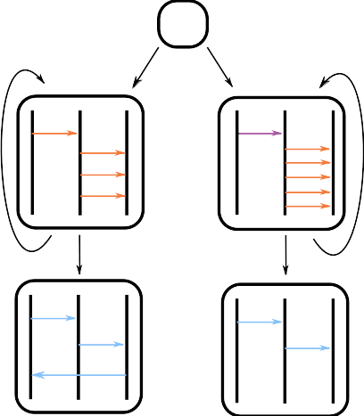
Unfolding loops (1)
Loops can create an unbounded state space.
Model checking (BFS) finds an error unfolding the left 5x and the right 3x.
Rejected by MST without any unfolding, i.e., C does not learn the branch on the 1st iteration.

Slide 34
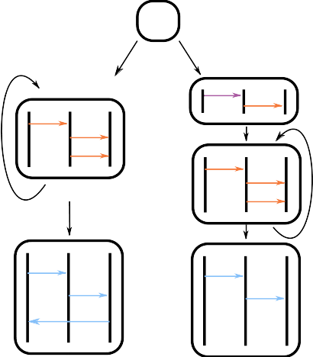
Unfolding loops (2)
Here is a projectable protocol.
Model checking diverges.
MST rejects it.

Slide 35
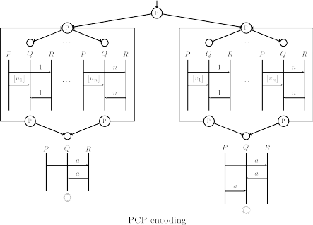
Resolving choice with unfolding...
… is hard.

Slide 36
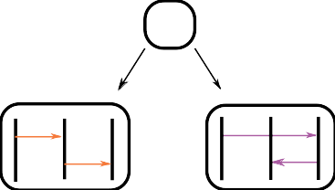
Conclusion
Good understanding of binary communication
  Clean theory and (mostly) effective results
More research needed in the multiparty case
  Expressive and predictable
  No need to be complete but interesting enough
We only scratched the surface
  safety properties only, no liveness yet
  No mechanism to handle failure
  Fixed set of processes
  ...

