Slide 1
Multiparty Motion Coordination: From Choreographies to Robotics Programs
Rupak Majumdar MPI-SWS
Nobuko Yoshida Imperial College London
Damien Zufferey MPI-SWS
OOPSLA 2020

Slide 2
Sorting Example
Insert video

Slide 3
Programming & Verification of CPS
CPS = communication + computation + control
Communication: coordination and planning, synchronization
Computation: following protocol, trajectory planning
Control: following trajectory
Communication proceeds correctly:
no communication error (wrong message type)
no deadlock
Motion proceeds correctly:
a trajectory exists for each component
no collision

Slide 4
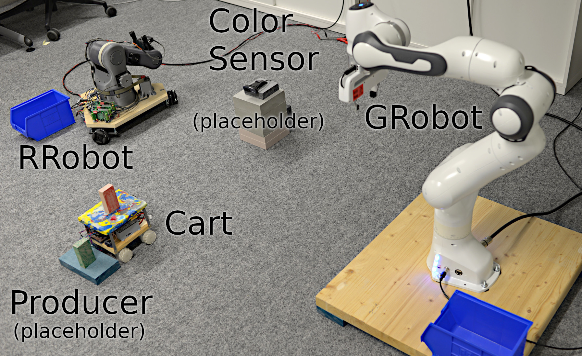
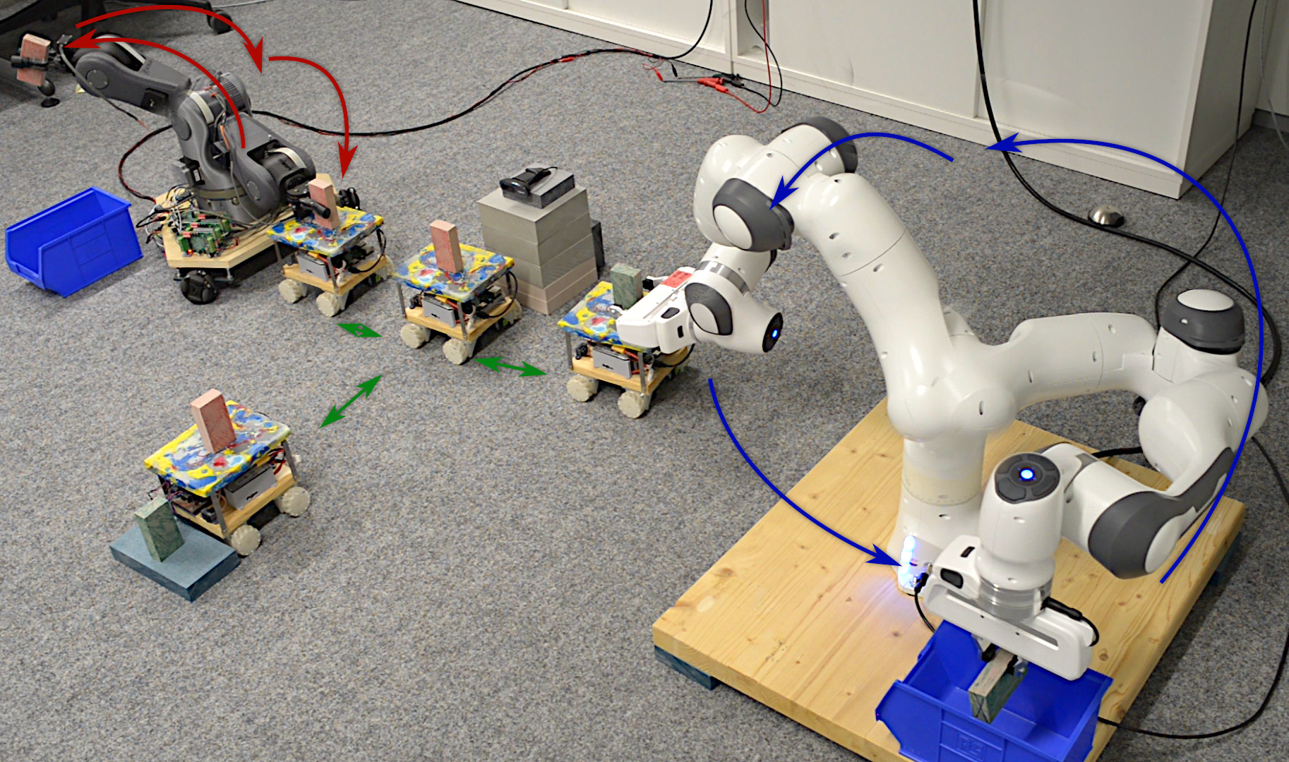
Sorting Example
5 participants
16 messages
53 motion primitives
(12 kinds of motion)

Slide 5

State-space Explosion
Global Spec.
State-space grows exponentially with the number of robots.
We need to avoid doing a product construction.
refines
×
×
×
× ...

Slide 6
From Global to Local (and back)
Multiparty session types
(Communication)
Motion primitives
(Trajectories)
Global Spec.
Projection
Assume-Guarantee
Local Spec.
Local Spec.
Local Spec.
Local Spec.
Typing
Refinement

Slide 7
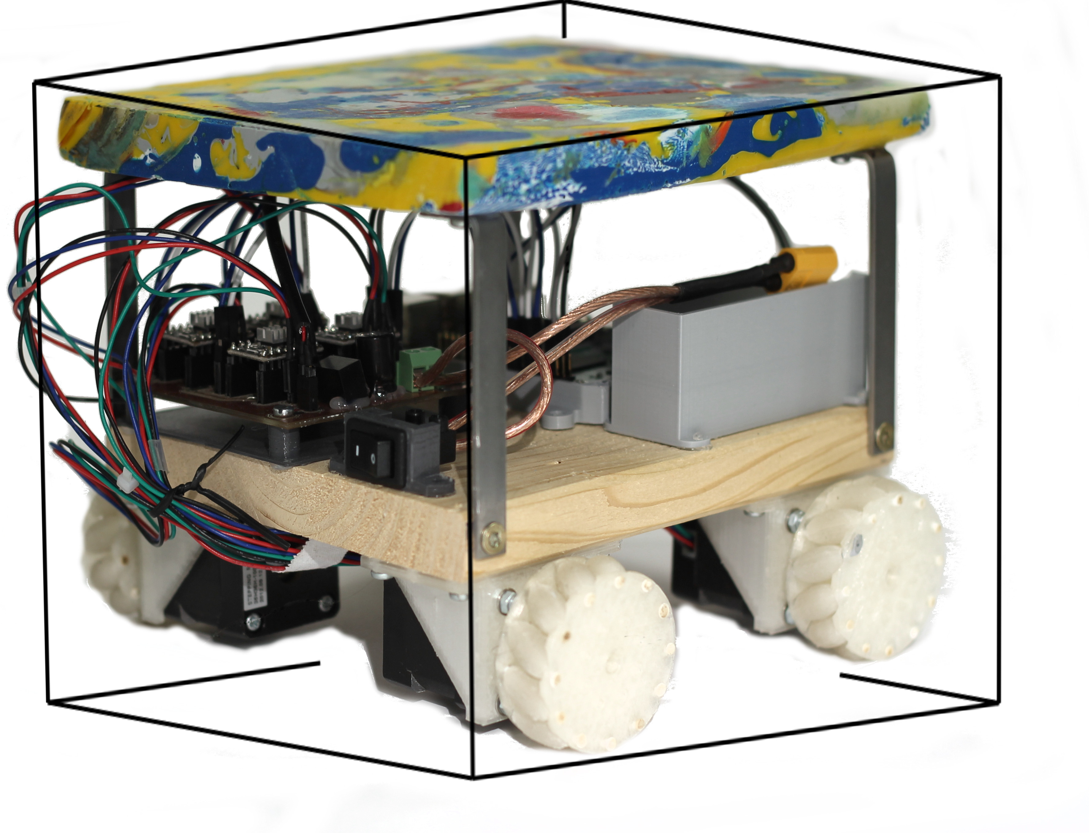
Model
Communication: point-to-point, synchronous
Computation: 0-time
Physical components:
ℝ³
Resources (X → 2 )
External inputs (W)
Internal state (X)

Slide 8
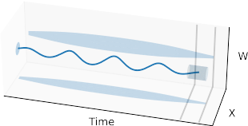
Motion Primitives
Precondition
Assumption
FP footprint X ∪ {x, y, z, clock}
‡ interruptible {⇝, ↯}
  ⇝ run to completion
  ↯ terminate on message
Guarantee
Duration
Postcondition

Slide 9
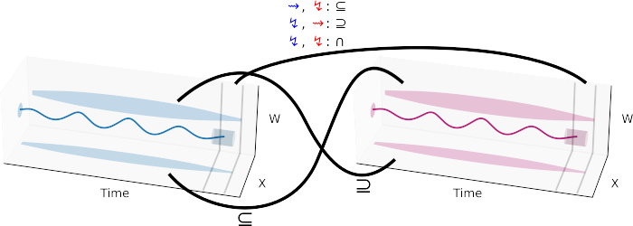
Assume-Guarantee Reasoning
Duration compatible with communication
A-G mirror each other
Footprints are disjoint (no collision)
Simplified picture: see paper for the details

Slide 10
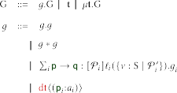
Motion Session Calculus
“big while loop”
sequence
separation (parallel comp. + disjoint footprints)
guard
value restricted by predicate
choice + communication
motion primitives

Slide 11
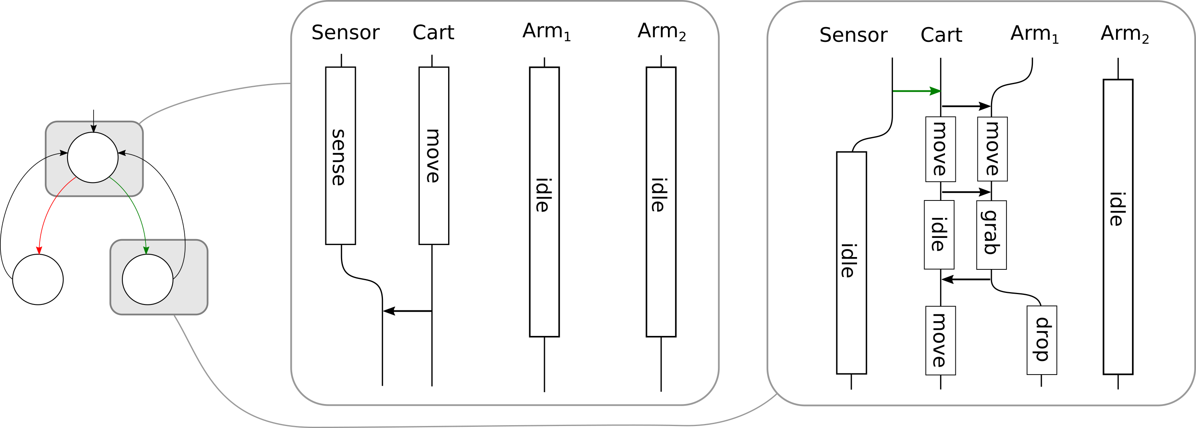
Example Choreography
Choice (object color)
Close: joint spec.
Far: independent (*)

Slide 12
Projection
Global type
partitions the processes
Unique minimal comm. (↯ followed my msg.)
Sender readiness (followed by ⇝)
Total synch. (all participants receive msg.)
Check synchronizability
Erasure (projection)
Resolve non-determinism (merge)
Local type

Slide 13
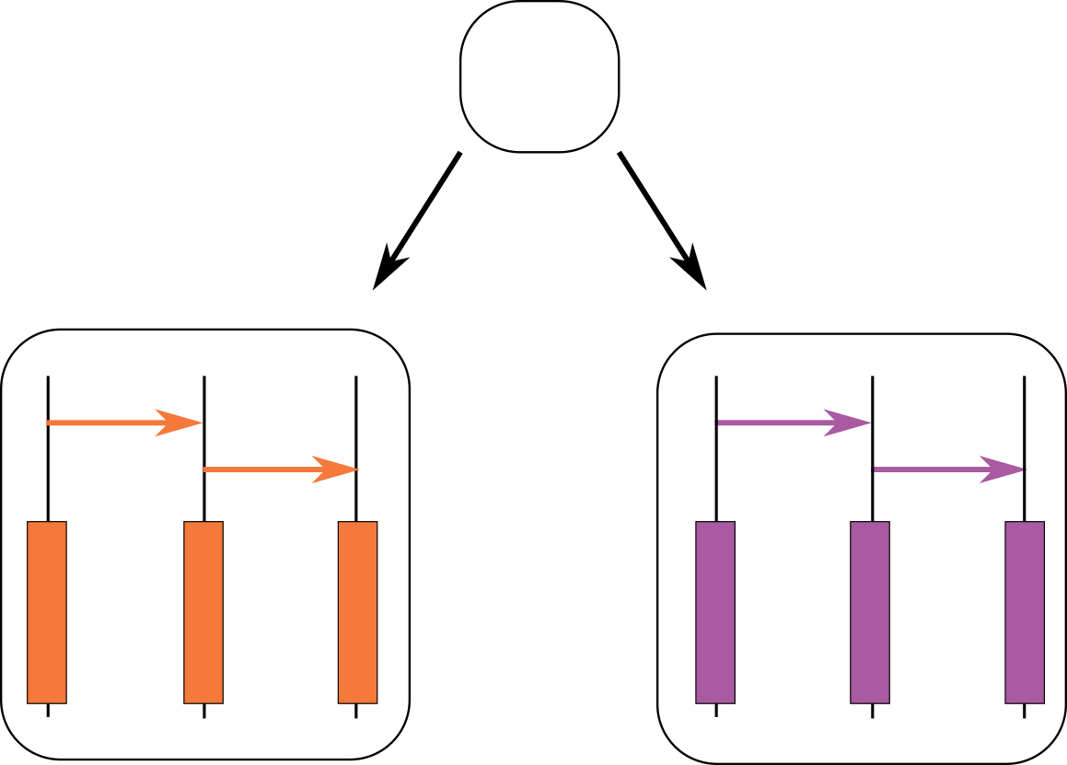

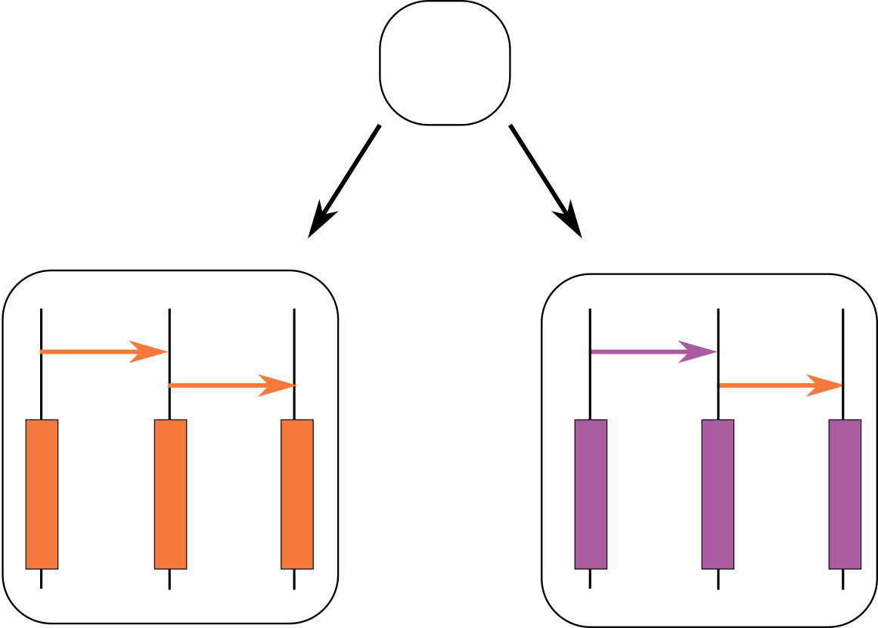
Merge
B?
Communication carries enough information.
project
C
B?
B?
Projection introduces unexpected non-determinism.
project
C
B?

Slide 14

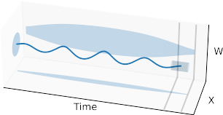
Typing and Subtyping
!a
≥
!a
:
if (…) {
send(a); ...
} else {
send(c); ...
}
Send
!b
!c
!c
?a
≥
?a
:
receive(m) {
case a => ...
case b => ...
case c => ...
}
Receive
?b
?c
?c
dt⟨m⟩
≥
:
Motion
m(…);

Slide 15
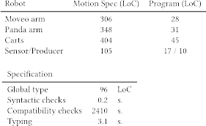
Evaluation
Compared to previous work [ECOOP 19]
Annotation overhead: 1-3x
Verification speed-up: 1.5-40x

Slide 16

Implementation
Artifact functional and available
Implemented on top of PGCD
  https://github.com/MPI-SWS/pgcd
Code available in the repo and in the artifact:
  https://zenodo.org/record/4051784
Comment from one artifact reviewer:
  “All in all, except for the high runtimes, this artifact was pleasant to use. I just wish I could also have a robot to play with...”

