Slide 1
On Choice in Protocol Specification
Generalizing Projection in Asynchronous Multiparty Session Types
CONCUR 21, with Rupak Majumdar, Madhavan Mukund, and Felix Stutz
On Channel Use in Protocols and General Point-to-Point Communication under submission, with Felix Stutz
Damien Zufferey
MPI-SWS
2021.09.30

Slide 2
Overview
Detour: why it is hard to reason about CSM?
Binary session types and half-duplex channels
Binary to multiparty session types
Directed to generalized choice
Future work

Slide 3





What is this about ?
Distributed systems
(message-passing)
Verification
+
Spec.

Slide 4
What to Verify?
A communication protocol is
correctly implemented:
messages follow a prescribed order
deadlock-free
no dangling messages
Spec.

Slide 5
Model for the Software
Programs:
- Finite state machines
- Pushdown automata
- Turing machines
Communication channels:
- routing: point-to-point, broadcast, ...
- capacity: unbounded, bounded
- reliability: reliable, lossy, fair, ...
- ordering: FIFO, bag

Slide 6
Communicating State Machines (CSM)
Programs:
- Finite state machines
- Pushdown automata
- Turing machines
Communication channels:
- routing: point-to-point, broadcast, ...
- capacity: unbounded, bounded
- reliability: reliable, lossy, fair, ...
- ordering: FIFO, bag

Slide 7
“Hello World” of Message-Passing
A
B
?Pong
!Ping
!Pong
?Ping
CSP notation: ‘!’ is send, ‘?’ is receive

Slide 8
CSM: Expressive Power
Knowing the expressive power tells us what method can or cannot be applied.
(Don’t try to solve undecidable problems)
It can tell us what feature of the model is important.
Unfortunately, CSM can simulate Turing machines.

Slide 9
Turing Machine (TM)
TM = finite control + unbounded tape (RAM)
Operations: read/write memory, move left/right
Head

Slide 10
TM → CSM
Idea:
use the communication channels to store the content of the tape.
Store only the (finite) written part
Turn the tape into a loop
Extract the “Head part” of the tape
Split the loop in two parts (2 communication channels)

Slide 11
TM → CSM
used
empty
Head
Head
“end of tape” symbol,
extend the tape on demand.

Slide 12
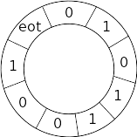
TM → CSM
Head
Head

Slide 13



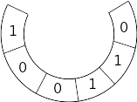
TM → CSM
Bigger state machine that
remembers 3 positions
Head
Head
Head
echo
“echo” send back the message it receives

Slide 14
TM → CSM
Head
Emulating TM operations:
1) read/write: change local state of the head machine
2) move right: send to echo, receive from echo
3) move left:
- insert position marker before current position
- loop around the tape (move right) until the marker
echo

Slide 15
Other Channel Models
- capacity: unbounded, bounded
- reliability: reliable, lossy, ...
- ordering: FIFO, bag
Finite state machine
- capacity: unbounded, bounded
- reliability: reliable, lossy, ...
- ordering: FIFO, bag
Petri net
- capacity: unbounded, bounded
- reliability: reliable, lossy, ...
- ordering: FIFO, bag
WSTS

Slide 16
Memory vs Communication Slack
A
B
Some protocols using unbounded channels can be harmless.
What is the difference between
channel as memory
(store information for later)
communication slack
(delay in the propagation of information)
!Cons
?Cons
!Nil
?Nil

Slide 17
Looking at the Channels
Operations on channel endpoints are dual.
send here = receive there
A
B

Slide 18
Binary Session Types (BST)
Idea: one side of the channel determines the operation on the other side.
1) get the operations for A
2) compute the operations for B using duality
3) check B executes the specified operations
A
B
!Ping
?Ping
type
dual
type
?Pong
!Pong

Slide 19
Duality in Choice
Internal
External
Mixed
!x
?x
!x
+
&
!y
?y
?y
dual
deterministic choice: all outgoing transitions have different labels

Slide 20
BST Example with Choice
A
B
!Cons
type
dual
type
?Cons
!Nil
?Nil

Slide 21
BST and Model Checking
BST specifies only half-duplex protocols. [Cécé05]
Half-duplex:
Buffers are empty when communication switch direction
With 2 processes: not Turing complete
BST enforce this restriction on the protocol: runs the same on half- and full-duplex systems.
[Cécé05] Gérard Cécé and Alain Finkel. Verification of programs with half-duplex communication. Inf. Comput., 2005.

Slide 22
Duality and Message Spec.
Dual operations are easily specified together.
A→B:m ≈ A!B(m) . B?A(m)
A
B
A
B
A
B

Slide 23
More than two Processes...
2 processes: well understood
3+ processes: badly understood
  Projection of global description is lossy. It can introduce non-determinism.
  Messages sent by different processes are independent.

Slide 24
Binary to Multiparty
Find some restriction to keep protocol “well-behaved”.
Keep track of choices without getting confused.
First with directed choice (classical MST)
Then with generalized choice (CONCUR paper)

Slide 25
Directed vs Generalized Choice
Globally
A→B:a
A→B:a
A→B:b
A→B:b
A→B:c
A→C:c
A,B are constant.
Only the messages (a,b,c) change
Sender A is constant.
The receivers (B,C) and messages
changes

Slide 26
Directed vs Generalized Choice
Locally
B!a
A?a
B!a
A?a
B!b
A?b
B!b
A?b
B!c
A?c
C!c
C?c
A,B are constant.
Only the messages (a,b,c) change
Everything can change.

Slide 27
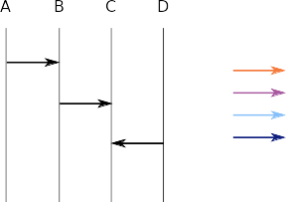
High Level Message Sequence Charts Notation
Processes
(often omitted)
Color indicates message label.
Messages

Slide 28
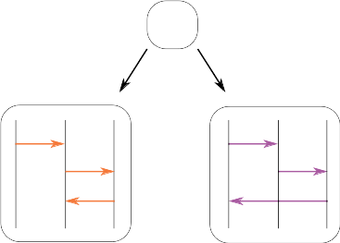
From Duality to Projection
B!
A
B!
C?
C!
B?
A?
project
B
A?
C!
B!
B?
C
B?
A!

Slide 29
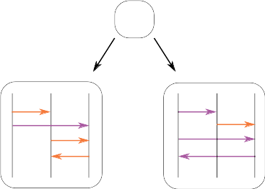
Another Example
C!
B!
A
B!
C!
C?
C!
A?
project
B
A?
C!
B?
B!
A?
C
B?
A?
A!

Slide 30
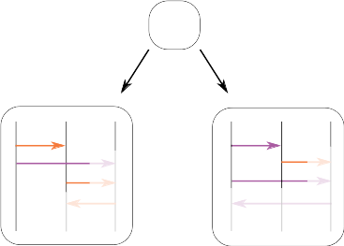
Which is Wrong
C!
B!
A
B!
C!
C?
C!
A?
project
B
A?
C!
B?
B!
A?
C
B?
A?
A!
The messages from A,B are independent.
C cannot rely on their ordering.

Slide 31
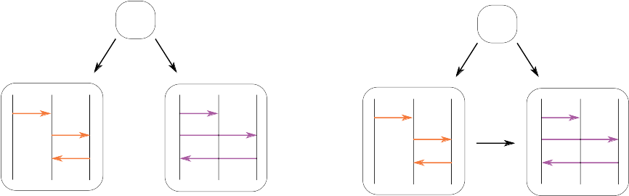
No Compositionality
Composing two correct subprotocols can result in an incorrect one...

Slide 32
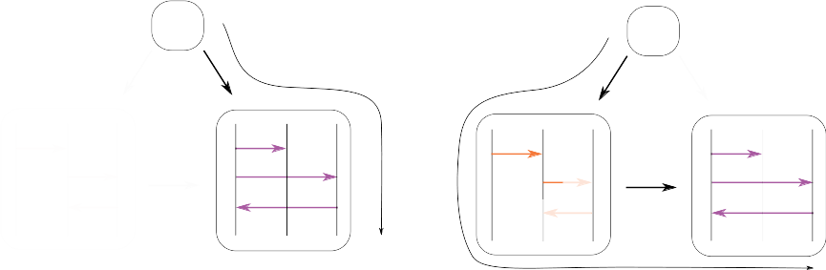
Counterexample

Slide 33
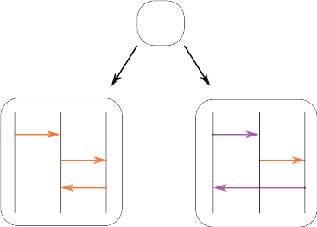
Determinism does not carry over
B!
A
B!
C?
C!
A?
project
B
A?
C!
B!
A makes the choice,
B is deterministic,
but C is not...
B?
C
B?
A!

Slide 34
MST in a Nutshell (1)
Projects the protocol and checks the projection does not introduce unwanted nondeterminism.
B!
A
+
B!
C?
project
C!
A?
B
&
A?
C!
Keep track of internal/external choice

Slide 35
MST in a Nutshell (2)
Same message on both side
Postpone choice resolution
Projects the protocol and checks the projection does not introduce unwanted nondeterminism.
B!
B?
C
&
B?
A!
project
merge
External choice + send = error
B!
B?
C
&
A!

Slide 36
Generalized Choice
A→B:a
A→B:b
A?a
A→C:c
A?b
C?c
A→B:a
Local generalize receive that matters.
Global and sending can be simulated
with an extra process.
A→Z:a
A→B:b
A→Z:b
A→Z:c
A→C:c

Slide 37
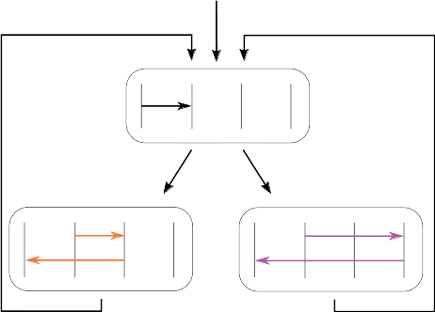
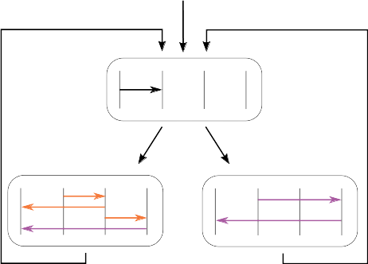
Partial Order Across Channels
Well-formed
Wrong

Slide 38
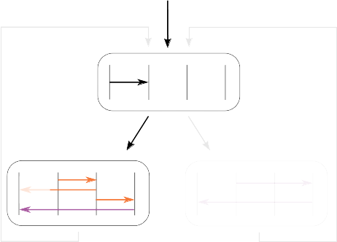
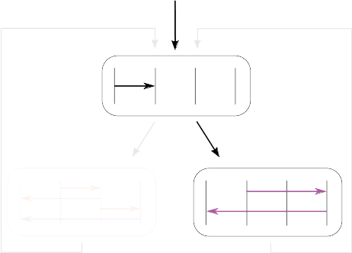
Wrong Example

Slide 39

Projection and Merge
Projection is similar to MST
Merge checks for potential confusion
Available messages
No confusion

Slide 40
Available Messages
1st message in the channels (FIFO)
Messages indep. from the receptions to merge
Effectively computable (unfold recursion once)

Slide 41
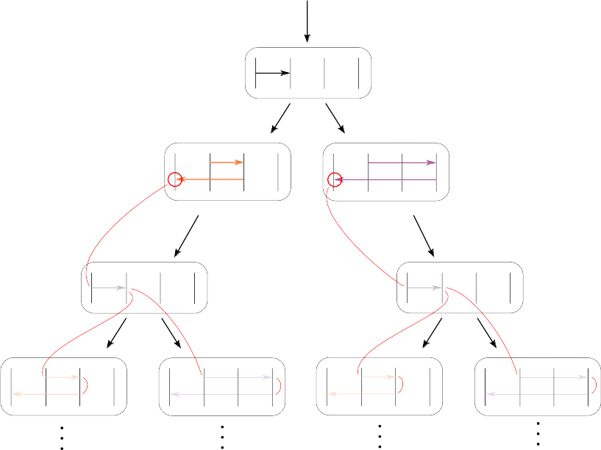
Computing Available Messages 1
Available messages are ∅.
Protocol is one long causal chain.

Slide 42
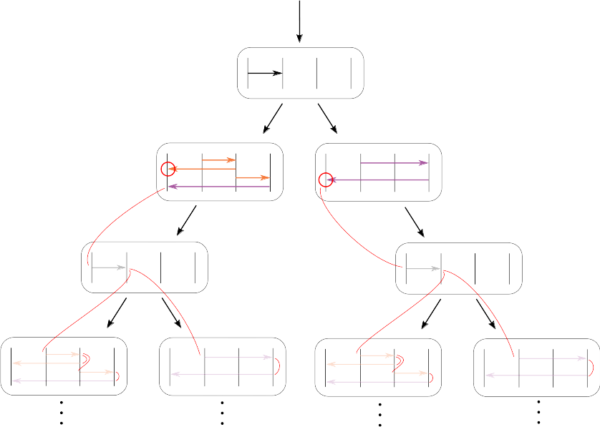
Computing Available Messages 2
Available left branch: {←}
Available right branch: ∅
Potential confusion:
The right receive ← but it is also available on the left branch.

Slide 43
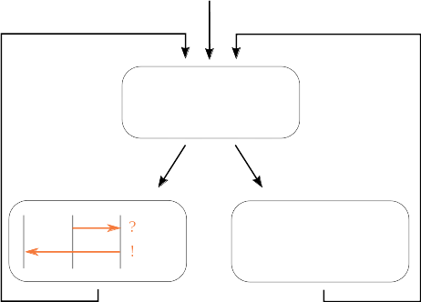
Empty Paths (Loops) Elimination
Each worker only appears in one branch.
More general projection that allows loops where a process is not involved.
!
?

Slide 44
Future Work
Understanding MST languages
Completeness and loops
Reordering of independent receive
Subtyping

Slide 45
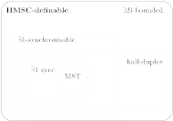
Understanding MST Languages

Slide 46
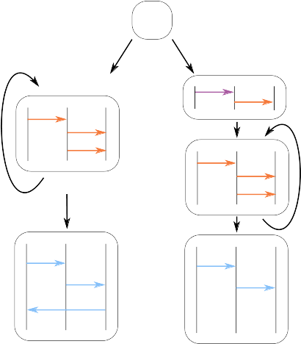
Completeness and Loops
Implementable but rejected by MST.
directed choice
∃1-bounded
∃1-sync
half-duplex

Slide 47

Intra-Process Reordering
Somewhat similar to precise subtyping
Motivation: performance, process independent messages in their order of arrival

Slide 48
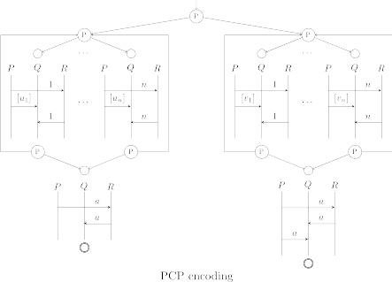
Unfolding with Reordering ...
… is hard.

Slide 49
Subtyping
What we expect for “typical” subtyping rules
!a
≥
!a
Send
!b
!c
!c
?a
≥
?a
Receive
?b
?c
?c

Slide 50
Subtyping: Receive
?a
≥
?a
?b
If ?b is an available messages.
?c
?c
Subtyping is not local but needs global information.

Slide 51
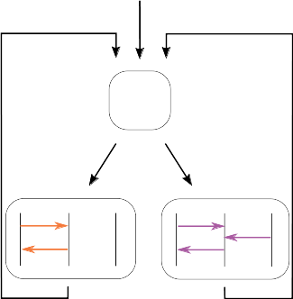
Subtyping: Send
B?
B!
A
B!
B?
A!
A?
project
B
A?
C?
A!
C
A!

Slide 52
Conclusion
Understanding how to specify communication protocols
Finding the balance between expressiveness and complexity
Generalized choice with projection that computes the available messages.
https://gitlab.mpi-sws.org/fstutz/async-mpst-gen-choice

