Slide 1
Tool
Accessible Automated Reasoning for Human Robot Collaboration
Ortwin Mailahn, Richard Peifer, Rainer Müller
Ivan Gavran, Damien Zufferey
ZeMA
MPI-SWS

Slide 2
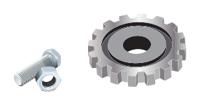

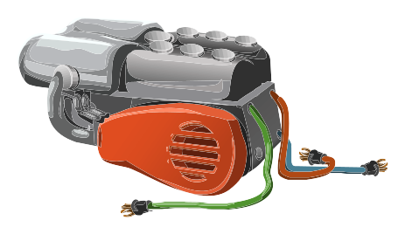
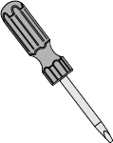


Goal
Tool: Accessible Automated Reasoning for Human Robot Collaboration
In 10 easy steps...
User friendly (planning experts)
Build on top of off-the-shelf tools
Flexible, easy to modify
Predictable performances
I. Gavran, O. Mailahn, R. Müller, R. Peifer, and D. Zufferey

Slide 3
Tool =
Tool Ontology and Optimization Language
Tool: Accessible Automated Reasoning for Human Robot Collaboration
What
Why
How
DSL for planning of assembly systems with human robot cooperation
Increased flexibility in manufacturing needs more automation in planning
Off-the-shelf tools too hard to use for non-expert
A DSL that closely match a tractable logic with names matching the target domain to “force” the expert to formulate their problem in way that is nice for constraint solvers.
I. Gavran, O. Mailahn, R. Müller, R. Peifer, and D. Zufferey

Slide 4
Under the Hood (Not That Easy)
Tool: Accessible Automated Reasoning for Human Robot Collaboration
Large
Smaller
Small
Description:
- operations
- resources
- workers
- ...
Classification
picks the relevant
elements
(OWL reasoner)
Scheduling
order the actions
(PDDL planner)
Schedule
Tractable
Hard
Tool DSL makes sure this part stays tractable.
I. Gavran, O. Mailahn, R. Müller, R. Peifer, and D. Zufferey

Slide 5
Why is a Reasoner needed?
Tool: Accessible Automated Reasoning for Human Robot Collaboration
“Life is complicated”
  There is not a 1-to-1 match between data from multiple sources. For instance, both gluing and welding can attach two objects but they are not always interchangeable.
Why OWL / Description Logic:
  There is a push in the industry for OWL (Web Ontology Language): Standard Ontologies for Robotics and Automation [IEEE Std 1872-2015]
I. Gavran, O. Mailahn, R. Müller, R. Peifer, and D. Zufferey

Slide 6
Expertise for Automated Reasoning
Tool: Accessible Automated Reasoning for Human Robot Collaboration
Task
Subject
Result
Formulate a small product structure in OWL
(No guidance, access to internet resources)
Employee at ZeMA with CS background
(programming but not formal logic)
The product structure expressed in a logic that is 2NEXPTIME…
The reasoner was never able to do anything about it (2h timeout).
We tried again with Tool.
The same structure was handled by the reasoner in less than a second.
I. Gavran, O. Mailahn, R. Müller, R. Peifer, and D. Zufferey

Slide 7
Tractable Fragments of FOL
Tool: Accessible Automated Reasoning for Human Robot Collaboration
First-order logic
(undecidable)
Quantifier-free first order theories:
- Difference logic (cubic)
- Linear programming (P)
- Linear integer programming (NP)
Restriction on quantifiers:
- EPR (NEXPTIME)
- Two-variable logic (2NEXPTIME)
Description logics are roughly fragments of two-variables logic with better complexity.
I. Gavran, O. Mailahn, R. Müller, R. Peifer, and D. Zufferey

Slide 8
Description Logic (DL)
Tool: Accessible Automated Reasoning for Human Robot Collaboration
FOL | DL
constants | individuals
unary predicate | concept
binary predicate | role
DL is FOL restricted to [0;2]-ary predicates
Concept (set) operations: ⊓(∩), ⊑(⊆), ≡(=), ⊥(∅)
Quantification: existential/universal restrictions
  ∃R.C is { a | ∃b. (a,b) ∊ R ∧ C(b) }
  ∀R.C is { a | ∀b. (a,b) ∊ R ⇒ C(b) }
...
I. Gavran, O. Mailahn, R. Müller, R. Peifer, and D. Zufferey

Slide 9
DL used in Tool
Tool: Accessible Automated Reasoning for Human Robot Collaboration
SROEL(D)
Data (types and values)
ALC
Existential language:
Concept intersection
Existential restrictions
Nominals (enumerations)
Attributive language
Atomic negation
Concept intersection
Universal restrictions
role inclusion axioms, reflexivity and irreflexivity, and role disjointness
Concept negation
I. Gavran, O. Mailahn, R. Müller, R. Peifer, and D. Zufferey

Slide 10
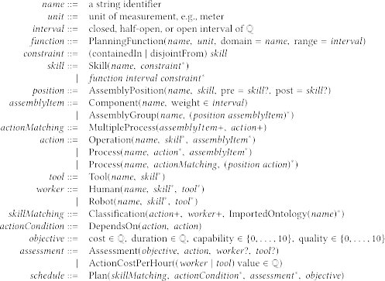
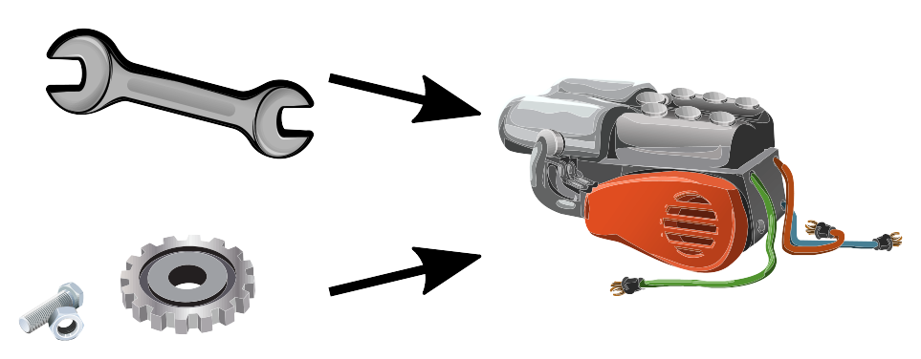
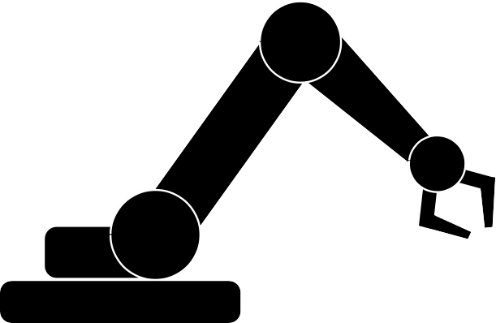



Tool Language
Tool: Accessible Automated Reasoning for Human Robot Collaboration
Skills and Constraints:
gluing ⊑ bonding
gluing ⊓ shredding ≡ ⊥
I. Gavran, O. Mailahn, R. Müller, R. Peifer, and D. Zufferey

Slide 11
Tool Language
Tool: Accessible Automated Reasoning for Human Robot Collaboration
Skills are capabilities.
Workers and tools provide skills.
Operations require skills.
Constraints:
- between skills
gluing ⊑ bonding
gluing ⊓ shredding ≡ ⊥
- on skills
lift object up to a certain height
I. Gavran, O. Mailahn, R. Müller, R. Peifer, and D. Zufferey

Slide 12
Tool Language: Actions
Tool: Accessible Automated Reasoning for Human Robot Collaboration
Components at specific positions makes assemblies.
Operations list the skills realize assemblies.
I. Gavran, O. Mailahn, R. Müller, R. Peifer, and D. Zufferey

Slide 13

Tool Language: Tools
Tool: Accessible Automated Reasoning for Human Robot Collaboration
Tools provide skills.
I. Gavran, O. Mailahn, R. Müller, R. Peifer, and D. Zufferey

Slide 14
Tool Language: Workers
Tool: Accessible Automated Reasoning for Human Robot Collaboration
Human
Robot
Workers have their own skills and acquires the skill provided by their tools.
I. Gavran, O. Mailahn, R. Müller, R. Peifer, and D. Zufferey

Slide 15
Tool Language: Cost Functions
Tool: Accessible Automated Reasoning for Human Robot Collaboration
I. Gavran, O. Mailahn, R. Müller, R. Peifer, and D. Zufferey

Slide 16
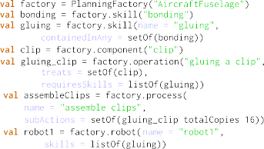
Tool Implementation
Tool: Accessible Automated Reasoning for Human Robot Collaboration
As a shallow DSL embedded in Kotlin
HermiT as OWL reasoner
LPG-TD as PDDL planner
I. Gavran, O. Mailahn, R. Müller, R. Peifer, and D. Zufferey

Slide 17
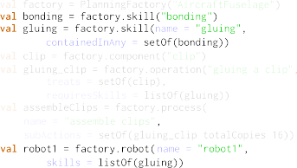
DL Encoding
Tool: Accessible Automated Reasoning for Human Robot Collaboration
Mostly straightforward:
Introduce concept
Introduce concepts and constraint:
gluing ⊑ bonding
Introduce concepts and constraint:
skillOf_robot1 × robot1 ⊑
canBeHandledByWorker
gluing ⊑ skillOf_robot1
CanBeHandledByWorker is a role between skills and workers.
I. Gavran, O. Mailahn, R. Müller, R. Peifer, and D. Zufferey

Slide 18

Cardinality Constraints
Tool: Accessible Automated Reasoning for Human Robot Collaboration
Cardinality constraints combined with combined with other axioms is untractable.
Sometime is cardinality constraints can be avoided altogether:
  Instead we introduce 16 constants / individuals.
  This effectively gives a lower bound of 16 (but no upper bound).
I. Gavran, O. Mailahn, R. Müller, R. Peifer, and D. Zufferey

Slide 19
Data Constraints
Tool: Accessible Automated Reasoning for Human Robot Collaboration
Skills can range over values
    lift an object up to 1m.
Rational function restrictions ∃F.J is { a | F(a) ∊ J }
      F is a data property (function), e.g., height
      J is an interval in ℚ, e.g., [0,1]
∃F.J is more powerful than ∃R.C because F is a function.
Easily untractable:
    C ≡ A ⊔ B ⇔ C ≡ ∃F.[x,z] ∧ A ≡ ∃F.[x, y] ∧ B ≡ ∃F.(y, z]
    Adding concept unions (⊔) push the DL above NP (ExpTime)
I. Gavran, O. Mailahn, R. Müller, R. Peifer, and D. Zufferey

Slide 20
Convex Under-approximation
Tool: Accessible Automated Reasoning for Human Robot Collaboration
Problem: not convex anymore
  ∃F.(−∞,1] ⊑ ∃F.(−∞, 0] ⊔ ∃F.(0, ∞) holds
  ∃F.(−∞,1] ⊑ ∃F.(−∞, 0] does not hold
  ∃F.(−∞,1] ⊑ ∃F.(0, ∞) does not hold
Solution: only allows convex deductions
  Prevent the solver from deducing ∃F.(−∞,1] ⊑ ∃F.(−∞, 0] ⊔ ∃F.(0, ∞)
  Incomplete reasoning, we can lose solutions.
I. Gavran, O. Mailahn, R. Müller, R. Peifer, and D. Zufferey

Slide 21
Planning
Tool: Accessible Automated Reasoning for Human Robot Collaboration
Typical planning problem:
  Choose which worker/tool will perform an action
  Respect operation’s dependencies
  Optimize cost/time/quality
Tool specific:
  On top of the problem’s element, generate actions
  with their own cost for tool change, etc.
I. Gavran, O. Mailahn, R. Müller, R. Peifer, and D. Zufferey

Slide 22
Using Tool
Tool: Accessible Automated Reasoning for Human Robot Collaboration
Product analysis, importing data
Model the product structure in Tool
Skill-Matching (Classification)
Assessment and Cost
Scheduling
Refine
Model
Refine
Model
I. Gavran, O. Mailahn, R. Müller, R. Peifer, and D. Zufferey

Slide 23
Experiment Setting
Tool: Accessible Automated Reasoning for Human Robot Collaboration
Subject
Effort
Planning expert (Ortwin), but not a computer scientist
No prior experience in using automated reasoner
Did learn the basic of Kotlin programming
Prior analysis of the planning problem not counted (days-weeks)
2/3 of the time for the initial Tool formalization
1/3 of the time iterating to get the desired result
I. Gavran, O. Mailahn, R. Müller, R. Peifer, and D. Zufferey

Slide 24
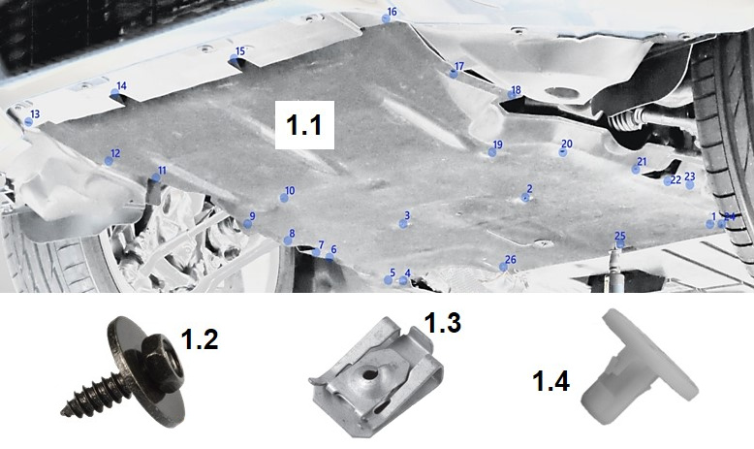
Case Study: Car Underbody Panel
Tool: Accessible Automated Reasoning for Human Robot Collaboration
Thin panel with low rigidity that protects the engine and electronics
Assembly (simplified):
1. Install c-clips (1.3)
2. Install expanding nuts (1.4)
3. Install panel (1.1)
4. Fasten with screws (1.2)
Workers: 2 robots, 1 human
Workstation fits at most 2 of them
Some operations and tools are human/robot specific.
I. Gavran, O. Mailahn, R. Müller, R. Peifer, and D. Zufferey

Slide 25
Case Study: Car Underbody Panel
Tool: Accessible Automated Reasoning for Human Robot Collaboration
Implementation effort | 1 | day
Tool input size | 179 | LoC
Classification time | 0.3 | min
Planning time | 0.1 | min
Schedule size | 113 | #actions
I. Gavran, O. Mailahn, R. Müller, R. Peifer, and D. Zufferey

Slide 26
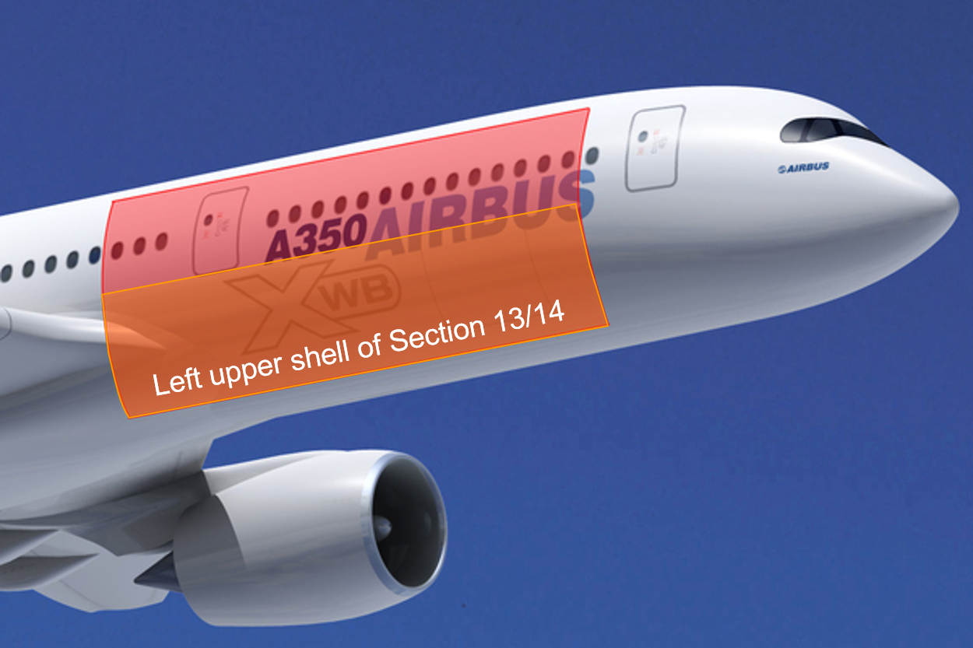
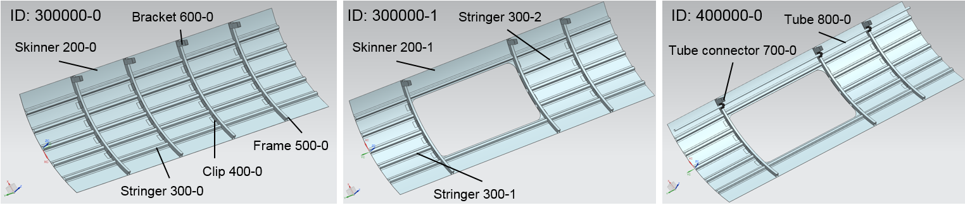
Case Study: Airplane Fuselage Shell
Tool: Accessible Automated Reasoning for Human Robot Collaboration
Fuselage shell element of section 13/14 of an Airbus A350
Assembly (extract):
1. The stringers and clips are glued to the shell
1.1 Apply glue
1.2 Join and fix elements
1.3 Activate the curing process with heat
1.4 Inspect
….
Image © Airbus
I. Gavran, O. Mailahn, R. Müller, R. Peifer, and D. Zufferey

Slide 27
Case Study: Airplane Fuselage Shell
Tool: Accessible Automated Reasoning for Human Robot Collaboration
Implementation effort | 2 | days
Tool input size | 501 | LoC
Classification time | 19 | min
Planning time | 15 | min
Schedule size | 170 | #actions
Image © Airbus
I. Gavran, O. Mailahn, R. Müller, R. Peifer, and D. Zufferey

Slide 28
Classification and Planning Details
Tool: Accessible Automated Reasoning for Human Robot Collaboration
 | Underbody | Fuselage
Tool input size | 179 | 501 | LoC
Unclassified OWL axioms | 707 | 2534 | #axioms
Classified OWL axioms | 991 | 2963 | #axioms
Classification time with HermiT | 0.3 | 19 | min
PDDL actions | 249 | 5863 | #actions
PDDL initial facts | 500 | 1063 | #facts
Planning time with LPG-TD | 0.1 | 15 | min
Schedule size | 113 | 170 | #actions
I. Gavran, O. Mailahn, R. Müller, R. Peifer, and D. Zufferey

Slide 29
Finding a Good Solver (Ongoing...)
Tool: Accessible Automated Reasoning for Human Robot Collaboration
 | Underbody | Fuselage
Implementation effort | 1 | 2 | days
Tool input size | 179 | 501 | LoC
Classification time with HermiT | 0.3 | 19 | min
Classification time with Konclude* | 0.1 | 0.4 | min
Planning time with LPG-TD | 0.1 | 15 | min
Schedule size | 113 | 170 | #actions
* Does not support all the features used by Tool
I. Gavran, O. Mailahn, R. Müller, R. Peifer, and D. Zufferey

Slide 30
Future Work
Tool: Accessible Automated Reasoning for Human Robot Collaboration
Importing data from Product Life-cycle Management (PLM) systems (early prototype done)
  Connects to Siemens Teamcenter and generate Kotlin code.
Graphical user interface
  Ortwin: “Now I feel like a programmer” (mission accomplished ?!)
  Programming not that common outside CS.
  Can a scratch-like GUI work?
I. Gavran, O. Mailahn, R. Müller, R. Peifer, and D. Zufferey

Slide 31
Take-Home Messages/Questions
Tool: Accessible Automated Reasoning for Human Robot Collaboration
Software development and manufacturing have similar challenges (most of the “tools” contain computer)
  (Talk to them, there are interesting collaboration opportunities!)
Automated reasoning technique (DL reasoner, SMT solver, etc.) are “too powerful” and, therefore, brittle. Especially in untrained hands. How can we fix that?
Lot of work on DL and complexity. Maybe also applicable to software verification?
I. Gavran, O. Mailahn, R. Müller, R. Peifer, and D. Zufferey

