Slide 1
On Structuring Communication and Verification
Damien Zufferey
MPI-SWS
VDS @ NETYS
21.06.2019

Slide 2
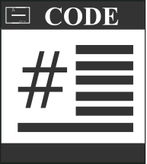
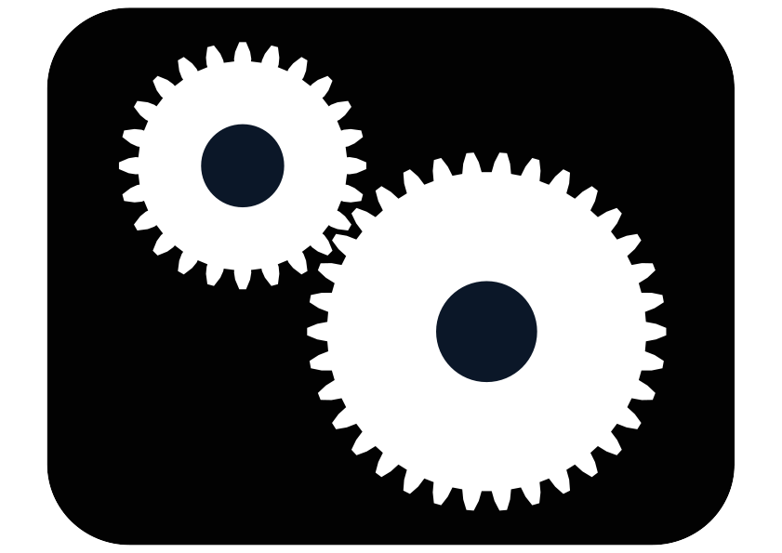

Automated Software Verification
Proof
Spec.
Counterexample

Slide 3
Unfortunately ...
Turing
machine
Proof
Halt ?
Counterexample

Slide 4
What is Hard to Verify?
Asynchrony
Channels
Faults
Parametric systems
Interleavings →
combinatorial
explosion
reliable FIFO → undecidable
another combinatorial explosion
n
usually undecidable
…

Slide 5
Problems Do Not Go Away Because They are Hard...
… but they still make life miserable.
Maybe the problem is ill-posed:
  Full automation is too much (ask the user for help)
  Try an easier problem (not sound and/or not complete)
  Models/PL are too powerful
  ...

Slide 6


Intrinsic vs Accidental Complexity
General Purpose
Language
Domain Specific
Languages

Slide 7
The Paxos Algorithm
Prepare
Promise
Accept
Accepted
Learning
Proposer
Acceptor/Learner
Acceptor/Learner
Find a quorum
Quorum agrees on the
next state/operation
Implementing Paxos: from ~50 lines of pseudo code to >500 LoC. What goes wrong?

Slide 8
Implementing Challenges
Detecting failure (and the impossibility to get it right)
Messages (side-effects) are untyped, have no scope, etc.
Control-flow inversion (losing the program structure)

Slide 9
When Processes Fail?
Asynchrony
Wait longer can help but how to avoid blocking?
Asynchronous models are not good at dealing with faults.
[FLP 85] Solving consensus requires time.
Waiting for a message
Fault

Slide 10
Communication is a Side Effect
buffer = recv(channel);
Type1 object1 =
deserialize1(buffer);
…
buffer = recv(channel);
Type2 object2 =
deserialize2(buffer);
Type object;
Byte[] buffer =
serialize(obj);
send(channel, buffer);
011001010101…
Up to the programmer to:
- interpret the bytes moving over the network,
- know which receive corresponds to which send.

Slide 11
Control-flow Inversion
Protocol structure replaced by dispatch:
var state = 1
while (true) {
on receive {
case Msg A =>
if (state == 1) …
else if (state == 2) …
case Msg B =>
if (state == 1) …
else if (state == 2) …
}
}
Protocol:
Msg A
Msg B
normal case
message reordered
message dropped
normal case

Slide 12
Communication-closed Rounds
[Elrad & Francez 82]
Prepare
Promise
Accept
Accepted
Learning
Proposer
Acceptor
Acceptor
Paxos organized in communication-closed rounds.
No message cross the boundaries between rounds.

Slide 13
PSync
Goals: make things simpler (to understand and verify)
  The code preserves the algorithm structure
  Code complexity on par with pseudo-code
How: communication-closed rounds
  Syntactic scope to the messages
  Provides logical time
  Gives the illusion of synchrony

Slide 14
How Does It Model a Real System?
Idea: model faults/asynchrony as an adversarial environment [Gafni 98]
Project all the “faults” on the messages
Lockstep semantics:
Indistinguishable
Asynchronous execution:
Local views are preserved.

Slide 15
Round Example
new Round[(Int,Time)]{
def send(): Map[ProcessID, (Int,Time)] =
Map(coord -> (x, ts))
def update(mailbox: Map[ProcessID, (Int,Time)]) {
if (id == coord && mailbox.size > n/2) {
vote = valueWithMaxTS(mailbox)
commit = true
}
}
}
Promise

Slide 16
Benefits for the Verification
Asynchrony
Channels
Faults
Parametric systems
No interleavings
Buffer of size 1
Project all faults on messages
(less nondeterminism)
n
Decidable with further restrictions
[Marić et al. CAV 17]
…

Slide 17
Limitations
Only sequential composition of rounds
  synchronize after network partition → control-flow cannot branch
Runtime overhead
  Extra bookkepping (metadata added to messages)
  Typed abstraction introduce extra copy of data

Slide 18
On the Power of the Syntax (1)
We can recover synchrony and bounded buffers from asynchronous code. (Next two talks)
However, it will be brittle because the underlying model is Turing complete.
Let us avoid this problem altogether but picking a better model in the first place.

Slide 19
On the Power of the Syntax (2)
Handling exceptions:
  in C: setlongjmp, trap signal, etc.
  in C++: try catch block
Why is scope a good thing?
  “Engineering is, abstractly, managing complexity.
  Software Engineering is, abstractly, managing complexity in software!
  Scope is a tool to help manage complexity, like any tool it can be used or abused, and sometimes can be overkill.
  ...”
  From https://softwareengineering.stackexchange.com/a/374138

Slide 20
Session Types: Message Scope without Round?
A
B
B→A: pong
!ping
?ping
Project
A→B: ping
?pong
!pong
Take advantage of duality: send/receive, internal/external choice, etc.

Slide 21
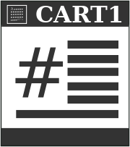

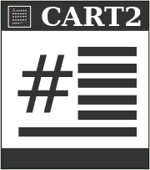
Verification Approach
Global Spec.
Multiparty session type
Projection
Local Spec.
Local Spec.
Local Spec.
Local type (automaton)
Refinement
Implementation

Slide 22
Multiparty Session Types
+ async communication with unbounded buffers
+ rich set of construct: branching, parallel
+ no runtime overhead
- need a strong model (reliable FIFO, no crash)
+ was figured out [Honda et al. POPL 08]
- until it was not [Scalas and Yoshida POPL 19]

Slide 23
Ongoing works
Re “figuring out” multiparty session types
Hybrid model: rounds + sessions
Much more...

