Slide 1


A System for Programming and Verifying
Interacting State Machines
Damien Zufferey
RiSE MSR / IST Austria
Randy Aull and Vivek Gupta,
Windows, Microsoft
Sriram Rajamani and Ankush Desai,
Rigorous Software Engineering Microsoft Research, Bangalore
Markus Dahlweid and Laurent Bussard,
Advance Technology Labs Europe
Microsoft Research
Shaz Qadeer, Ethan Jackson,
Research in Software Engineering
Microsoft Research

Slide 2

Overview of the Talk
Overview of the project *
Compositional verification
Implementation
* Thanks to Ethan for the slides

Slide 3
Bird’s Eye View
Visual Studio
Visual construction of state machines. Container for diagrams, specifications, and generated code.
FORMULA
Evolvable semantics for state machines; implements static analysis.
Zing
Compositional model checking of large state machines.

Slide 4
Verification Technologies
Formal Specification using FORUMLA
Define the meanings of your concepts by a concise set of rules
Your rules yield instant static analysis; easily evolvable.
Compositional Rule for Verification
Allow using the specifications as assumptions
No restriction on the specifications
Translation to Zing (model checker)
“Push button” verification
Provide a counterexample in case of error

Slide 5
Modular and Layered Specifications
Customizing the state machines to the programmer’s need:
Frontend and static analysis
Foo
X
Full machines extend basic machines with other capabilities, such as “Whenever X do Foo()”.
Call machines extend basic machines with guarded calls to submachines.
Basic machines only have states, transitions and operations. Static checks for deadlock, non-determinism, and malformed operations.

Slide 6
Visual Editing And Code-Behind
Diagrammatically construct state machines within Visual Studio
Behind diagrams are FORMULA specifications. Project results of static analysis back onto diagrams.
Flexible and user extensible static analysis rules
Visual diffing of state machines
Etc.

Slide 7
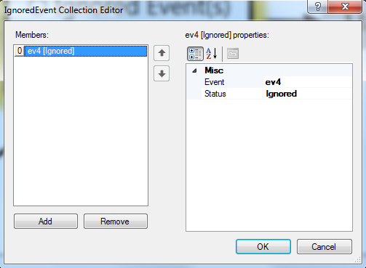
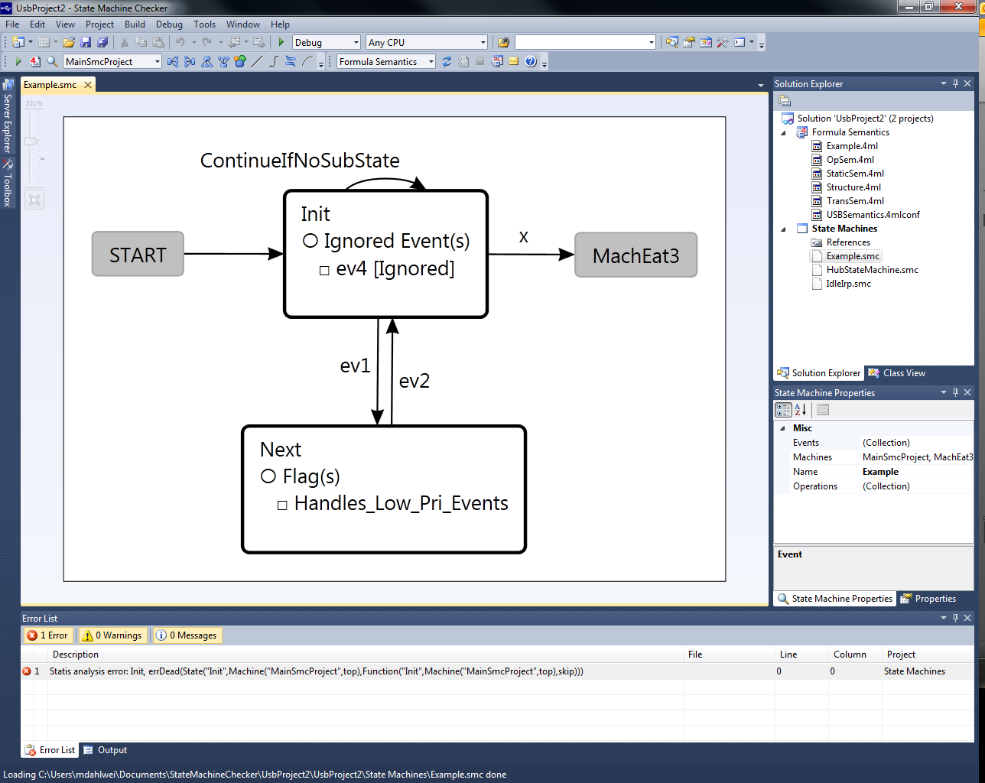
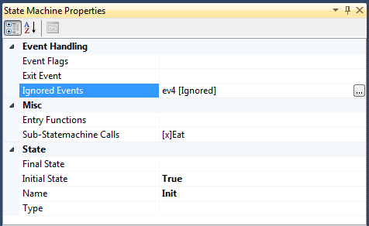
State Machine Project in VS
What the UI looks like:

Slide 8
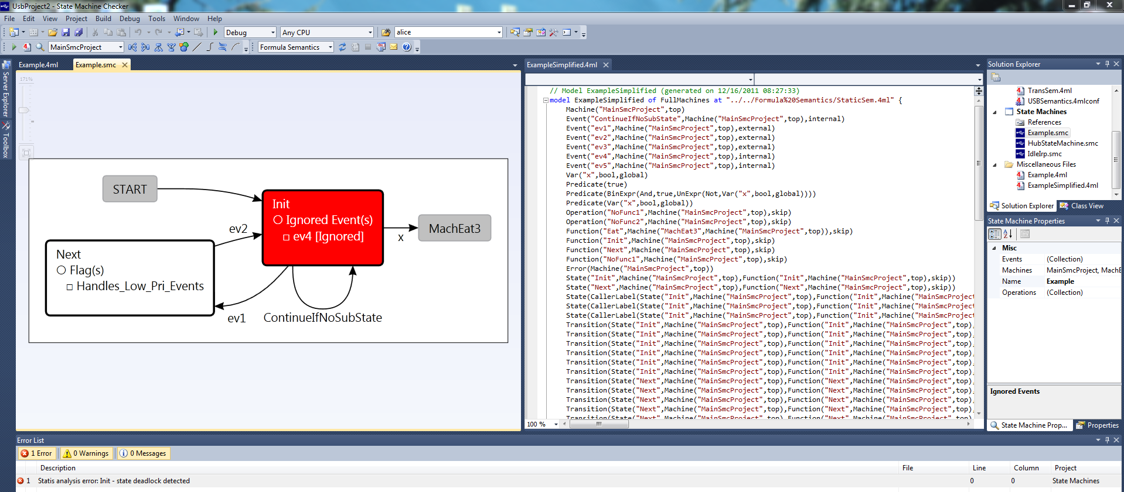
Code Behind
Can move between visual and textual specifications.

Slide 9
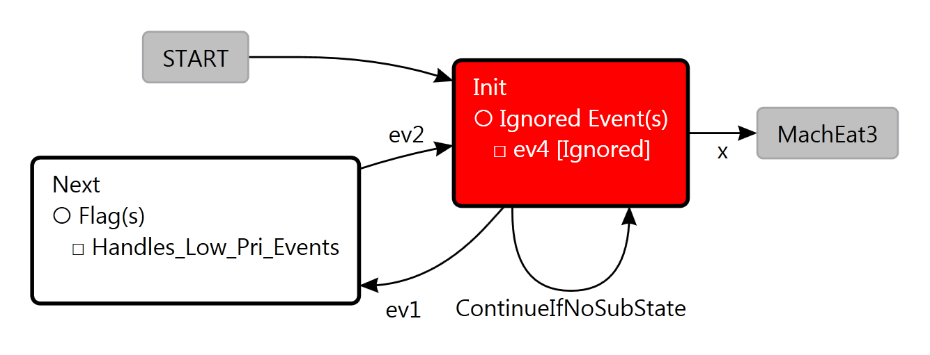
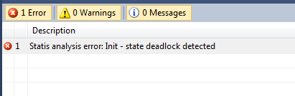
Static Analysis
Code driving the analysis:
syncPath ::= (st: State, stp: State).
syncPath(s, t) :- Transition(s, e, t), e.kind = internal, t in State;
Transition(s, e, t), e = Predicate(_), t in State;
syncPath(s, tp), Transition(tp, e, t), e.kind = internal, t in State;
syncPath(s, tp), Transition(tp, e, t), e = Predicate(_), t in State.
// Check for deadlocks
[Format("detected state deadlock")]
errDead ::= (state: State).
errDead(s) :- syncPath(s, s).
isError := errDead(_).

Slide 10
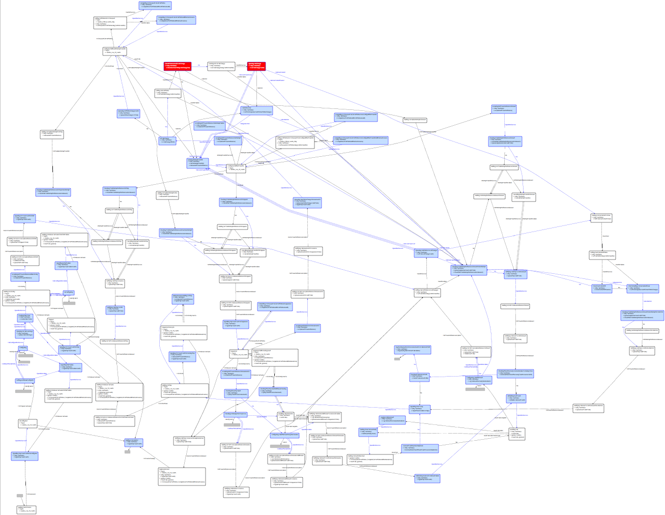
USB Driver’s State Machines
What one of the USB state machine looks like:

Slide 11
Compositional Verification
The theoretical model
The proof rule
Why the rule is correct ?
Example

Slide 12
Theoretical Model
Automata are used for
implementation and
specification.
||
B
A
C
A
Parallel composition is
the synchronous product.
(trace intersection)
C
B
A
Refinement is trace inclusion.
B
C

Slide 13
Compositional Rule
Given a spec S, and a set of implementation machine I:
If for all E in the alphabet of S,
there is I’ a subset of I s.t.
I’ || (S weakened by E) refines S
Then I refines S.
A
B
A
Weaken by A
B
A
A

Slide 14
Why does it works ?
The idea:
(S weakened by E) means assuming that S is true up to E.
Proof by induction on the trace:
Assuming that the trace is safe after i steps
we must show it is safe after i+1 steps.
A
Does not prevent A from occurring
at step i+1. So an implementation
machine must restrict A.
B
A
A
The weakening is done w.r.t. all E.

Slide 15
Example: Pingpong (1)
Implementations
(machines and channels)
Specification
Send A
Receive B
Send A
Receive A
Send B
Receive A
Receive B
Send A
Send B
Receive A
Need to prove 4 lemmas:
I’ || (S weakened by Send A)
I’’ || (S weakened by Receive A)
I’’’ || (S weakened by Send B)
I’’’’ || (S weakened by Receive B)
Send B
Receive B

Slide 16
Example: Pingpong (2)
Send B
Receive A
Receive B
Send A
refines
Receive B
Send A
Send B
Send B
Receive A
Send B
Send B
Send B
Send B
Receive A

Slide 17
Implementation
Overview
Matching the semantics of the machine to the automata used in the compositional rules.
Structure of a proof (user perspective)

Slide 18
Overview
Input Machines
Compiling complex features into simpler ones, etc.
Creating the proof
obligations
User input
Extended Machines
Proof
Compilation
Lemma to prove
Zing
Correct
Counterexample

Slide 19

Emphasis on the Reactive Aspect
Only the “receive” events are shown on the edges.
Sending occurs within the states.
Receive B
Send A
Send A
(hidden in the state)
Receive B
External events come from the input buffer;
Internal events are the result of calling some function.
Receive B
public Event foo(Bar arg) {
…
return e;
}

Slide 20
Communication Channels
Unbounded FIFO channels
A
B
A
A
B
B
Look ahead to pick a specific message type
Unbounded channels can give a hard time to an explicit-state model checker.
Fortunately, the proof (usually) requires only simple lemma about the channel:
Send A
Send A
0
1
*
Send A
Receive A
Receive A
These lemmas (finite abstraction of the channel) are generated per event.
No ordering between events
Precision of the event is up to a bound.

Slide 21
Synchronous Product using Zing
The synchronous product is constructed lazily by the model checker.
Barriers are used for the synchronization.
class FA_1 {
void run()
{
FA_1_state_0:
select end {
sync( Barriers.A) ->
goto FA_1_state_1;
}
FA_1_state_1:
select end {
sync( Barriers.B) ->
goto FA_1_state_0;
}
}
};
B
A

Slide 22
User Interacting with the Proof Infrastructure
Dependency graph for
the specifications
The proof of a specification S can only use other specification if it depends on it.
Within the strongly connected components (SCC), the compositional rule is applied.
In this example:
S1 cannot be used to prove itself.
{S2,S3}, {S4} are weakened for their respective proof.
{S2,S3} can use S1 without weakening.
S4 can use {S1,S2,S3} without weakening.
The system generates the proof obligation and the user pick the left hand side of the lemma. For instance:
I || S1 || S2 || (S4 weakened by E) refines S4.
S1
S3
S2
SCC
S4

Slide 23
Experiments
We have applied the tool to:
Pingpong (and other similar examples)
The GSM handover protocol [Orava and Parrow, 96]
The German protocol [Pnueli, Ruah, and Zuck, 01]
The verification part is currently being integrated to the VS frontend and the verification of the USB 3.0 should start soon.

Slide 24
Thanks And Questions!

