Slide 1
Towards Compositional Explicit State Model Checking
Damien Zufferey
RiSE MSR / IST Austria
Shaz Qadeer, Ethan Jackson,
Research in Software Engineering
Microsoft Research, Redmond
Sriram Rajamani, Ankush Desai,
Rigorous Software Engineering Microsoft Research, Bangalore

Slide 2

Overview
Motivation
Automata, parallel composition, and properties
Compositional rule
(Non-)Compositional verification
Semantic gap

Slide 3
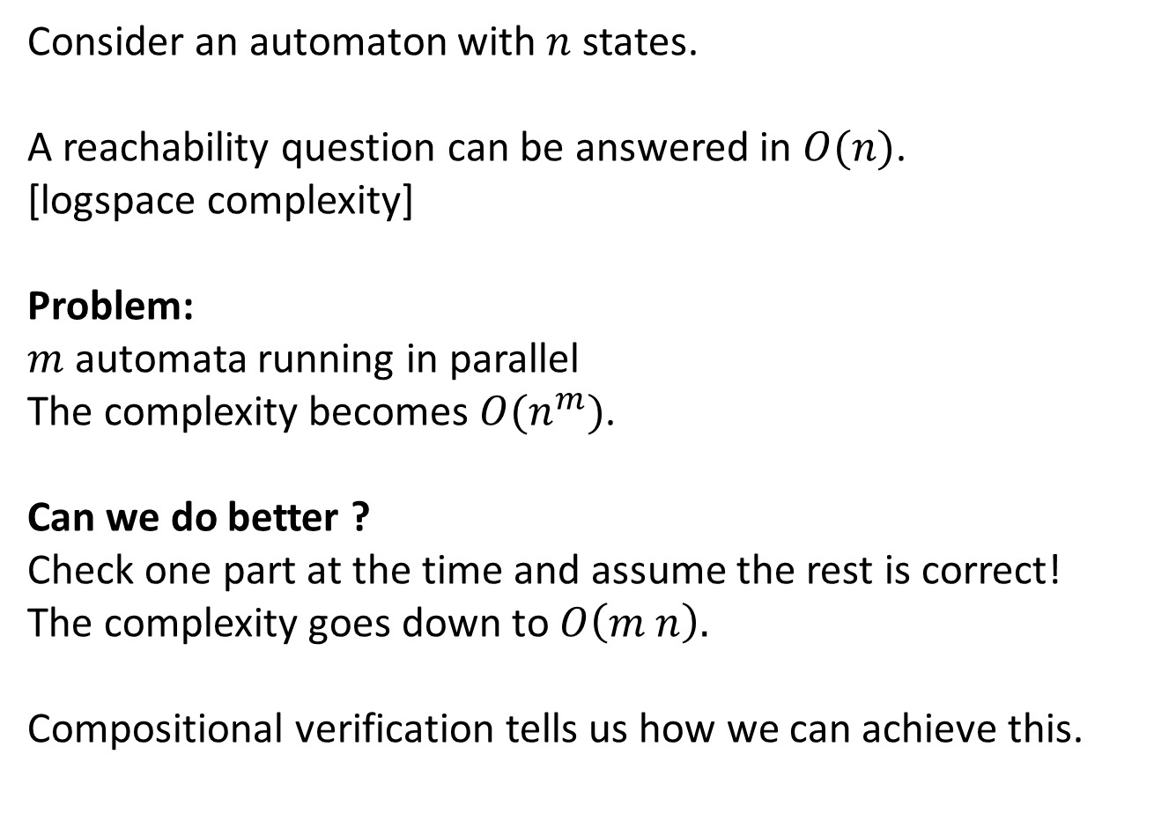
Motivation
Consider an automaton with $n$ states.
A reachability question can be answered in $O(n)$.
[logspace complexity]
Problem:
$m$ automata running in parallel
The complexity becomes $O(n^{m})$.
Can we do better ?
Check one part at the time and assume the rest is correct!
The complexity goes down to $O\left(m n\right).$
Compositional verification tells us how we can achieve this.

Slide 4


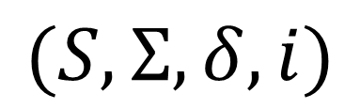
Automata
Automata are used for implementation and specification.
Set of states
Transitions: $δ⊆S×Σ×S$
$$(S, Σ, δ, i)$$
B
A
Alphabet
Initial state
$Σ=$ { A, B }

Slide 5


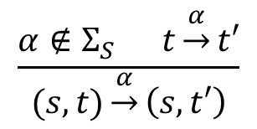
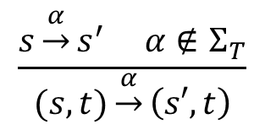
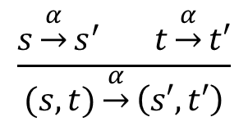

Parallel composition
Parallel composition is
the synchronous product.
(trace intersection)
$$S$$
$$T$$
B
A
C
A
Shared transition
$$\frac{s\underset{→}{α}s^{′} t\underset{→}{α}t′}{(s,t)\underset{→}{α}\left(s′,t′\right)}$$
$$S || T$$
Local transition
C
B
$$\frac{s\underset{→}{α}s^{′} α∉Σ_{T}}{(s,t)\underset{→}{α}\left(s′,t\right)}$$
$$\frac{α∉Σ_{S} t\underset{→}{α}t′}{(s,t)\underset{→}{α}\left(s,t′\right)}$$
A
B
C

Slide 6

Properties
Specifications are monitors that define the set of allowed traces.
An implementation is correct if it refines the specifications.
Refinement is trace inclusion.
B
A
$$≼$$
B
B
A
B
For a reachability question we can create a monitor that is respected iff the target is not reachable. A monitor enforces a safety property and reachability is the “dual” of safety.
On the other hand, we are not checking liveness properties.

Slide 7
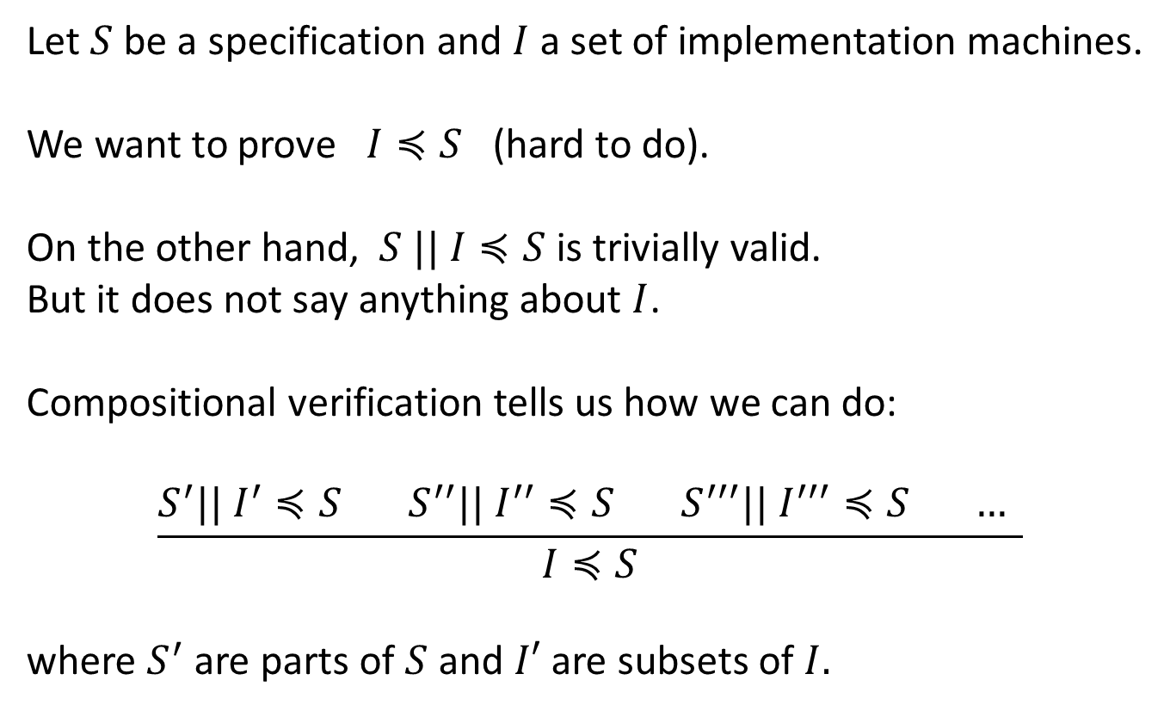
Compositional verification
Let $S$ be a specification and $I$ a set of implementation machines.
We want to prove $I≼S$ (hard to do).
On the other hand, $S || I≼S$ is trivially valid.
But it does not say anything about $I$.
Compositional verification tells us how we can do:
$$\frac{S^{′}|| I^{′}≼S S^{′′}|| I^{′′}≼S{ S}^{′′′}|| I^{′′′}≼S … }{I≼S}$$
where $S^{′}$ are parts of $S$ and $I′$ are subsets of $I.$

Slide 8
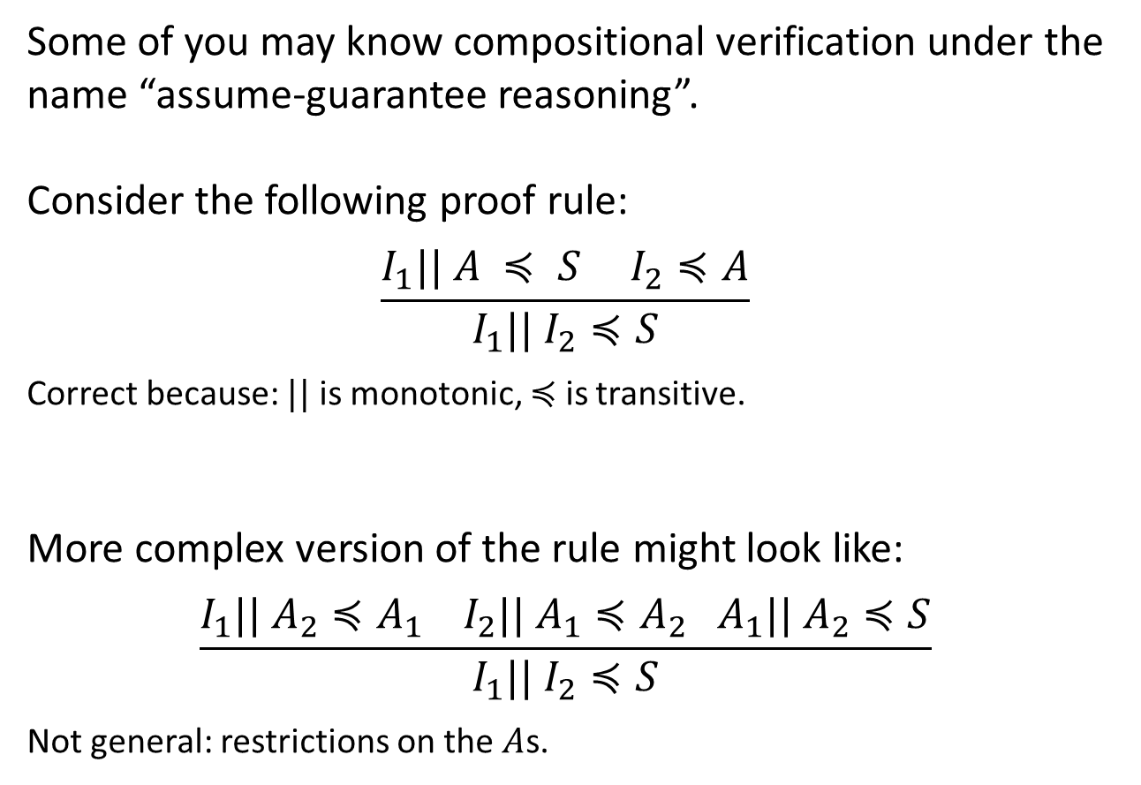
Simple hierarchical case
Some of you may know compositional verification under the name “assume-guarantee reasoning”.
Consider the following proof rule:
$$\frac{I_{1}|| A ≼ S I_{2}≼A}{I_{1}|| I_{2}≼S}$$
Correct because: $||$ is monotonic, $≼$ is transitive.
More complex version of the rule might look like:
$$\frac{I_{1}|| A_{2}≼A_{1} I_{2}|| A_{1}≼A_{2} A_{1}|| A_{2}≼S}{I_{1}|| I_{2}≼S}$$
Not general: restrictions on the $A$s.

Slide 9
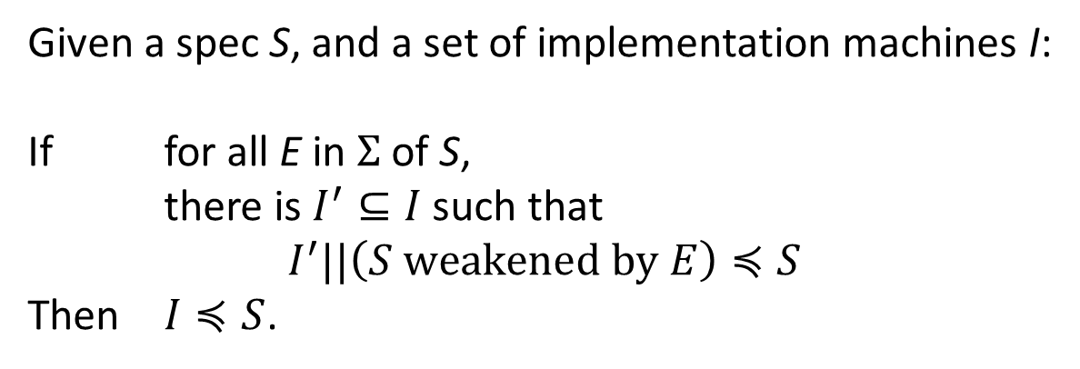
The compositional rule
Given a spec S, and a set of implementation machines I:
If for all E in $Σ$ of S,
there is $I^{′}⊆I$ such that
$$I^{′}||\left(S \text{weakened} \text{by} E\right)≼S$$
Then $I≼S$.
A
B
A
Weaken by A
B
A
A

Slide 10
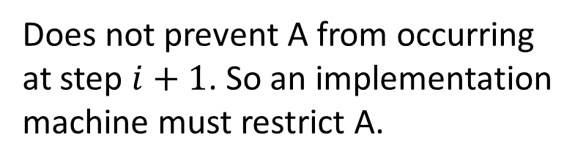
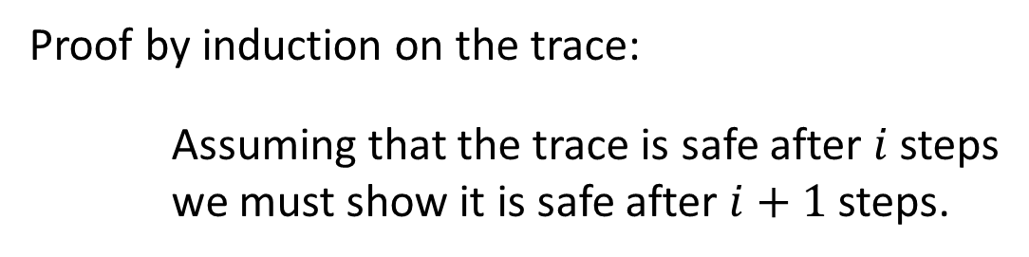
Why does it works ?
The idea:
(S weakened by E) means “assumes that S is true up to E”.
Proof by induction on the trace:
Assuming that the trace is safe after $i$ steps
we must show it is safe after $i+1$steps.
A
Does not prevent A from occurring
at step $i+1$. So an implementation
machine must restrict A.
B
A
A
The weakening is done w.r.t. all E.

Slide 11
Example: Pingpong (1)
Implementations
(machines and channels)
Specification
Send A
Receive B
Send A
Receive A
Send B
Receive A
Receive B
Send A
Send B
Receive A
Need to prove 4 lemmas:
I’ || (S weakened by Send A)
I’’ || (S weakened by Receive A)
I’’’ || (S weakened by Send B)
I’’’’ || (S weakened by Receive B)
Send B
Receive B

Slide 12
Example: Pingpong (2)
Send B
Receive A
Receive B
Send A
refines
Receive B
Send A
Send B
Send B
Receive A
Send B
Send B
Send B
Send B
Receive A

Slide 13
(Non-)Compositional verification
Dependency graph for
the specifications
The rule generalizes to more than one spec.
However, it tends to generates many lemmas.
We want to apply it only when it is needed.
We use a dependency graph of specification.
The LHS of a lemma for some S can only use other specification if S depends on it.
Within the strongly connected components (SCC), the compositional rule is applied.
For the acyclic part the dependencies can be assumed without modification.
S1
S3
S2
SCC
S4

Slide 14
(Non-)Compositional example
Dependency graph for
the specifications
What the graph means:
S1 do not use any other spec.
{S2,S3} uses {S1,S2,S3}.
S4 uses {S2,S4}.
{S2,S3} and S4 are weakened for their respective lemmas.
{S2,S3} can use S1 without weakening.
S4 can use {S1,S2,S3} without weakening.
The system generates the proof obligations and the user pick the LHS for each lemma.
For example:
I || S1 || S2 || (S4 weakened by E) refines S4.
S1
S3
S2
S4

Slide 15
Semantic gap
Matching the semantics of the machine to the automata used in the compositional rules:
Asynchronous message-passing
Unbounded mailboxes
…

Slide 16
Overview
Input Machines
Compiling complex features into simpler ones, etc.
Creating the proof
obligations
User input
Extended Machines
Proof
Compilation
Lemma to prove
Zing
Correct
Counterexample

Slide 17

Emphasis on the Reactive Aspect
Only the “receive” events are shown on the edges.
Sending occurs within the states.
Receive B
Send A
Send A
(hidden in the state)
Receive B
External events come from the input buffer;
Internal events are the result of calling some function.
Receive B
public Event foo(Bar arg) {
…
return e;
}

Slide 18
Communication Channels
Unbounded FIFO channels
A
B
A
A
B
B
Look ahead to pick a specific message type
Unbounded channels can give a hard time to an explicit-state model checker.
Fortunately, the proof (usually) requires only simple lemma about the channel:
Send A
Send A
0
1
*
Send A
Receive A
Receive A
These lemmas (finite abstraction of the channel) are generated per event.
No ordering between events
Precision of the event is up to a bound.

Slide 19
Synchronous Product using Zing
The synchronous product is constructed lazily by the model checker.
Barriers are used for the synchronization.
class FA_1 {
void run()
{
FA_1_state_0:
select end {
sync( Barriers.A) ->
goto FA_1_state_1;
}
FA_1_state_1:
select end {
sync( Barriers.B) ->
goto FA_1_state_0;
}
}
};
B
A

Slide 20
Thanks And Questions!

