Slide 1



PSync: a partially synchronous language for fault-tolerant distributed algorithms
Cezara Drăgoi
Thomas A. Henzinger
Josef Widder
Damien Zufferey
18.12.2014, EPFL

Slide 2
Outline
Motivation: the consensus problem
The PSync language
Implementation
Verification
Scala embedding
Evaluation

Slide 3
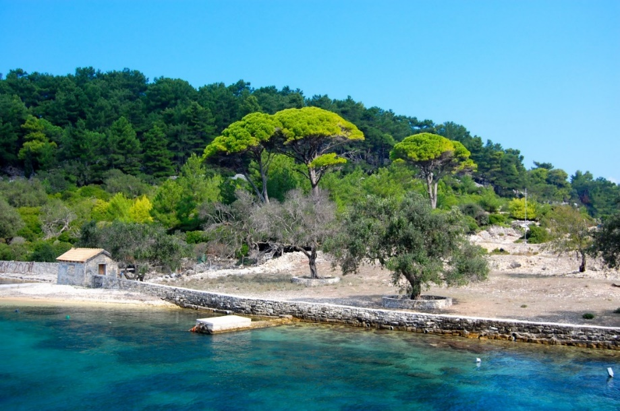
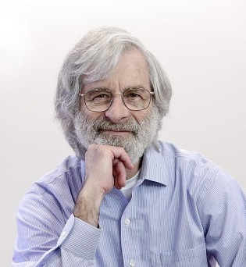
Our journey starts on the island of Paxos …
… where archeologists made an interesting discovery about a parliament system.
CC-BY-SA-NC Matt Taylor Copyright ACM
Used at Google (Chubby [06]), Microsoft (Autopilot [07]), Yahoo/Apache (Zookeeper[10])
Still a hard: Paxos made simple [01], Paxos made live [07], Raft [14], etc.
Notes:
Using another model we can make thing better
Consensus is just an example: interested in whatever can be proved using the same techniques.

Slide 4
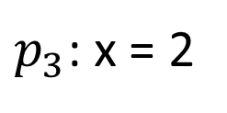
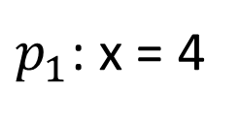
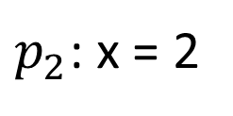
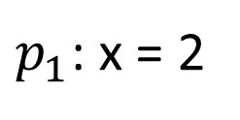
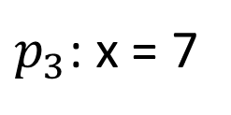
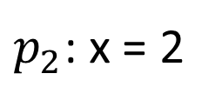
Consensus 101
$p_{1}$: x = 4
$p_{1}$: x = 2
Consensus
$p_{2}$: x = 2
$p_{2}$: x = 2
$p_{3}$: x = 7
$p_{3}$: x = 2
Agreement, Validity, Irrevocability, Termination

Slide 5
Running example: One-Third-Rule (OTR)
Send
send x to all processes
Update
if received more than 2n/3 messages then
x := minimal most often received value
if more than 2n/3 received values are equal with x then
decide(x)
Original algorithm: consensus in one communication step [Brasileiro et al. 2001]
Here we use an adaptation from [Charron-Bost and Schiper 2009]
Notes:
If you want Paxos (LV),

Slide 6



Sample run of the OTR (without faults)
decide(2)
4
2
2
$$p_{1}$$
2
2
2
$$p_{2}$$
$$p_{3}$$
7
2
2
mmor({2,4,7}) = 2
Notes:
We will introduce the faults later when we introduce the abstraction and the fault model.

Slide 7
Sample run of the OTR (with faults)
4
4
2
$$p_{1}$$
2
2
2
$$p_{2}$$
$$p_{3}$$
7
2
Notes:
We will introduce the faults later when we introduce the abstraction and the fault model.

Slide 8
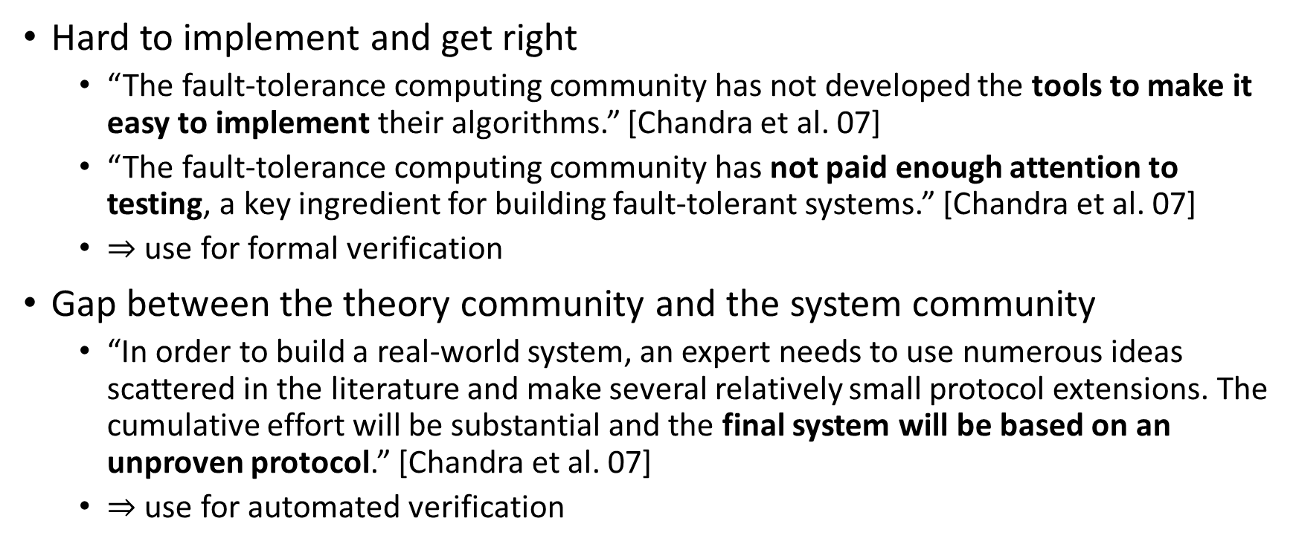
What language/verification can do ?
Hard to implement and get right
“The fault-tolerance computing community has not developed the tools to make it easy to implement their algorithms.” [Chandra et al. 07]
“The fault-tolerance computing community has not paid enough attention to testing, a key ingredient for building fault-tolerant systems.” [Chandra et al. 07]
$⇒$ use for formal verification
Gap between the theory community and the system community
“In order to build a real-world system, an expert needs to use numerous ideas scattered in the literature and make several relatively small protocol extensions. The cumulative effort will be substantial and the final system will be based on an unproven protocol.” [Chandra et al. 07]
$⇒$ use for automated verification
Notes:
Nothing wrong with proofs of algorithms, but can do more.
Hard to test: fault masking
Automation: I also don’t like to make proofs, but I like to make algorithm that make proofs for me

Slide 9
Goal
source code + specifications
verifier
runtime
proof or
counterexample
executable
Notes:
Source and spec in the same language (or very close)
don’t need to learn another tool
lower the barrier of entry

Slide 10
Model and language
Notes:
Really understand the complaints of the system guys

Slide 11
What is hard ?
n
Parametric systems
Asynchrony (interleaving, delays)
Channels
Faults
…
Notes:
Picking the right model to make verification easier
Parametric systems: undecidable in general
Interleaving: combinatorial blow-up
Channels: undecidable if FIFO, non-primitive recursive if lossy, NEXP if without order.
Faults: one more dimension in non-determinism (again a combinatorial blow-up)

Slide 12



Communication-closed Rounds
$$p_{1}$$
$$p_{2}$$
$$p_{3}$$
[Elrad & Francez 82]: decomposition of algorithm in communication-closed rounds.
[Dwork & Lynch & Stockmeyer, 88] defines round model for non-synchronous models: partial synchrony
Notes:
Round: get ride of the interleaving
Communication-closed: get rid of the channel

Slide 13
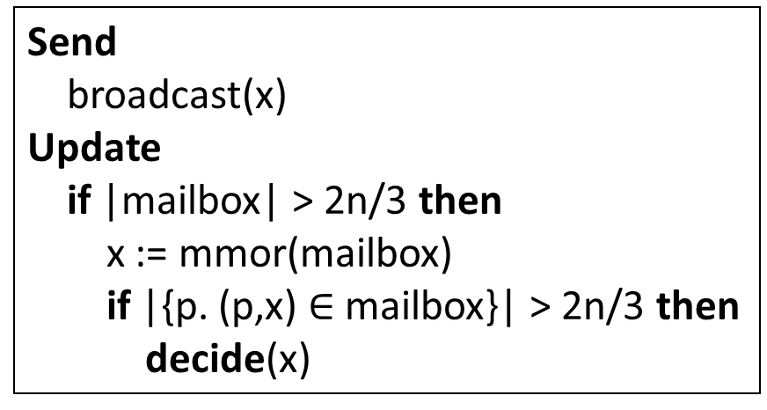
PSync: building blocks
Program:
Initialization function
Sequence of rounds
Each round has
Send function
Unit => Set[(ProcessID, A)]
Update function
Set[(ProcessID, A)] => Unit
Send
broadcast(x)
Update
if |mailbox| > 2n/3 then
x := mmor(mailbox)
if |{p. (p,x) $∈$ mailbox}| > 2n/3 then
decide(x)
Notes:
Rounds in the algo vs rounds in the execution

Slide 14



PSync: lockstep semantics
Send
Update
$$p_{1}$$
$$p_{2}$$
$$p_{3}$$
Environment

Slide 15
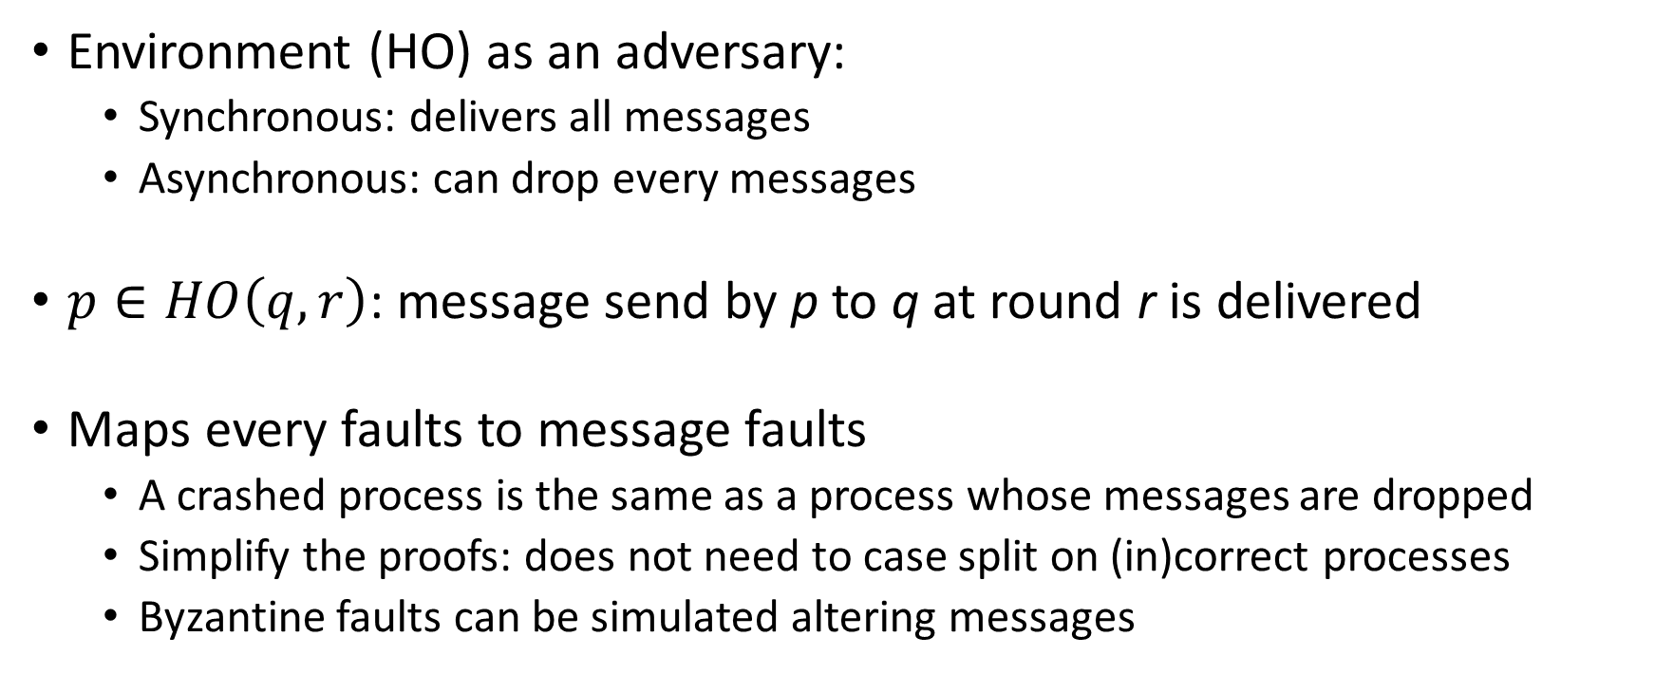
The Heard-Of model [Charron-Bost & Schiper 09]
Environment (HO) as an adversary:
Synchronous: delivers all messages
Asynchronous: can drop every messages
$p∈HO\left(q,r\right)$: message send by p to q at round r is delivered
Maps every faults to message faults
A crashed process is the same as a process whose messages are dropped
Simplify the proofs: does not need to case split on (in)correct processes
Byzantine faults can be simulated altering messages

Slide 16
Mapping asynchrony to faults
Implementation in an asynchronous world
Programming/Reasoning with rounds
HO(p1) = {p1, p2}
HO(p2) = {p2}
HO(p3) = {p1, p2}
Notes:
Reasoning in round-based model (partial synchrony):
Communication-closed rounds (simple model for the channels)
Lockstep semantics (no interleaving, mapping asynchrony to faults)
Heard-of model: map process faults on communication faults
Implementation in an asynchronous world
Asynchrony: no round structure, delays and buffering of messages
Failure detectors to recover some degree of synchrony

Slide 17








Invariant for the OTR
$$∀i. ¬decided\left(i\right)$$
Initial state
$$∨$$
$$∃ v, A.$$
$$∧$$
$$A=\left\{ i. x\left(i\right)=v\right\}$$
Majority
$$∧$$
$$\left|A\right|>2n/3$$
$$∧$$
$$∀i. decided(i)⇒x\left(i\right)=v$$
Agreement
Notes:
At the rounds’ boundaries
I have no idea what it the invariant in an asynchronous system

Slide 18
Implementation

Slide 19
Architecture
User application
Algorithm
Round abstraction (Communication predicate)
Network

Slide 20
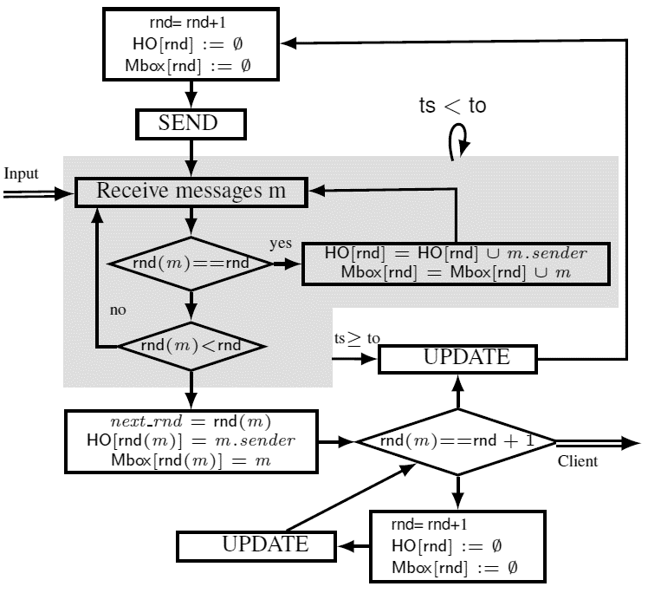
Implementation for asynch + crash-fault
Notes:
Each process in the distributed system runs a copy of that algorithm
Also unreliable communication (UDP)
When all the messages are received, no need to wait for the TO
Example of the scala embedding will come in the evaluation section

Slide 21
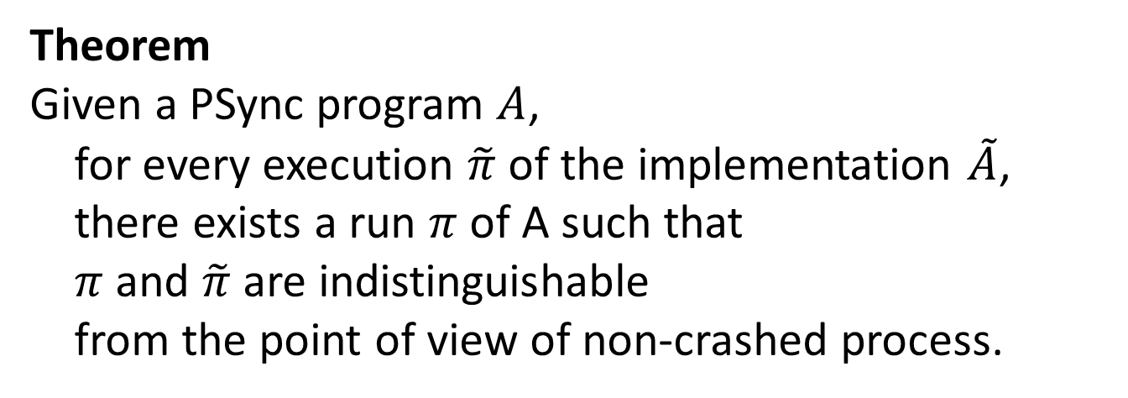
Correctness of the implementation (1)
Theorem
Given a PSync program $A$,
for every execution $\tilde{π}$ of the implementation $\tilde{A}$,
there exists a run $π$ of A such that
$π$ and $\tilde{π}$ are indistinguishable
from the point of view of non-crashed process.
Notes:
In the verification part we will discuss about progress/liveness

Slide 22
Using PSync (1)
Algorithm:
OTR, Last Voting (Paxos-like), Min flood
Lattice agreement, K-set agreement
Two-phase commit
However, an algorithm is nothing without a system using it.

Slide 23
Using PSync (2)
Integration in the user program
Rounds are encapsulated in the runtime
Communicates though callbacks
Starting consensus
Each replicas starts a service
The number of replicas can change
(dynamic group membership)
Termination & recovery
Up to the user
val alg = new OTR()
val rt = new RunTime(alg)
rt.startService(defaultHandler, conf)
val io = new ConsensusIO {
val initialValue = …
def decide(v: Int) = …
}
rt.startInstance(ID, io)
Notes:
-what are realistic assumptions ?
-formalizing the boundaries of the algorithms

Slide 24
Verification

Slide 25
Goals for the verification
Safety and liveness properties
Agreement, Validity, Irrevocability
Termination
User provided invariants
Simpler due to the abstraction
No channels
All the processes have the same PC
Properties proved in the sync model transfer* to the async impl.
Notes:
John Howell about the benefit of writing a spec in TLA.
But TLC did not scale enough to test the interesting cases.
I doubt that the Joe the system guy will use interactive proof assistants
Hope that logic used for consensus is representative

Slide 26
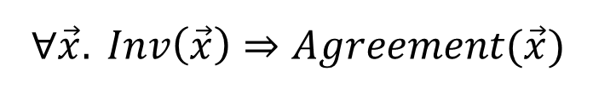
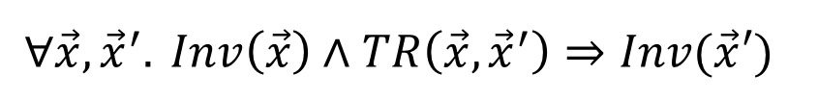
Invariant for the OTR example
$$∀i. ¬decided\left(i\right)$$
Set comprehensions
$$∨$$
$$∃ v, A.$$
$$∧$$
$$A=\left\{ i. x\left(i\right)=v\right\}$$
Universal quantification
over processes
$$∧$$
$$\left|A\right|>2n/3$$
Cardinality constraints over sets
$$∧$$
$$∀i. decided(i)⇒x\left(i\right)=v$$
Proof by generating VCs:
$$∀\vec{x},{\vec{x}}^{′}. Inv\left(\vec{x}\right)∧TR\left(\vec{x},{\vec{x}}^{′}\right)⇒Inv(\vec{x}′)$$
$$∀\vec{x}. Inv\left(\vec{x}\right)⇒Agreement(\vec{x})$$
Notes:
Majority argument
More than ½ because uses the mmor
Compared to BAPA: -limited quantifier alternation, + comprehesions

Slide 27
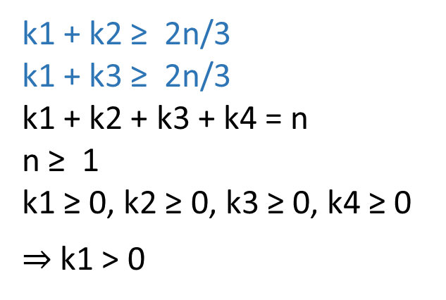
Semi-decision procedure [VMCAI 14]
∃ p1, p2.
|A|≥ 2n/3 ∧ |B|≥ 2n/3 ∧
A = { z. x(z) = x(p1) } ∧ B = { z. x(z) = x(p2) } ∧
x(p1) ≠ x(p2)
k1 + k2 ≥ 2n/3
k1 + k3 ≥ 2n/3
k1 + k2 + k3 + k4 = n
n ≥ 1
k1 ≥ 0, k2 ≥ 0, k3 ≥ 0, k4 ≥ 0
$⇒$ k1 > 0
k4
k3
k2
2
1
k1
A
B

Slide 28
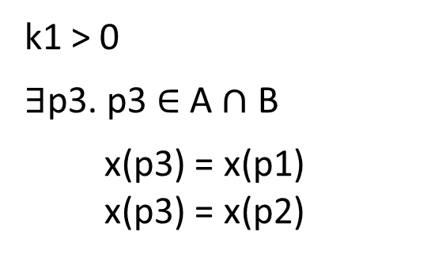
Semi-decision procedure [VMCAI 14]
∃ p1, p2.
|A|≥ 2n/3 ∧ |B|≥ 2n/3 ∧
A = { z. x(z) = x(p1) } ∧ B = { z. x(z) = x(p2) } ∧
x(p1) ≠ x(p2)
k4
k1 > 0
$∃$p3. p3 $∈$ A $∩$ B
x(p3) = x(p1)
x(p3) = x(p2)
k3
k2
2
1
k1
A
B
Notes:
Logic restricts what we can express so that one representative process for each Venn region is enough.

Slide 29

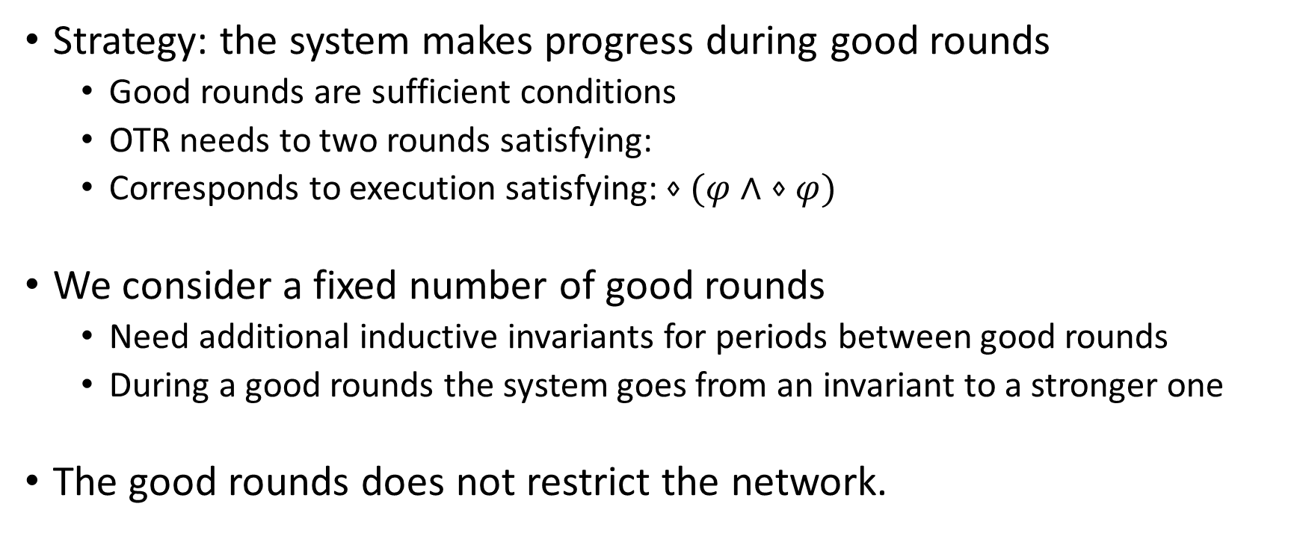
Proving progress
Strategy: the system makes progress during good rounds
Good rounds are sufficient conditions
OTR needs to two rounds satisfying:
Corresponds to execution satisfying: $⋄(φ∧ ⋄φ)$
We consider a fixed number of good rounds
Need additional inductive invariants for periods between good rounds
During a good rounds the system goes from an invariant to a stronger one
The good rounds does not restrict the network.
$φ: ∃ K. \left|K\right|>2n/3∧∀i. HO\left(i\right)=K$

Slide 30















Progress for the OTR
First good round:
$∃ K. \left|K\right|>2n/3∧∀i. HO\left(i\right)=K$
$$∀i. ¬decided\left(i\right)$$
$$∨$$
$$∃ v, A.$$
$$∃ v, A.$$
$$∧$$
$$A=\left\{ i. x\left(i\right)=v\right\}$$
$$∧$$
$$A=\left\{ i. x\left(i\right)=v\right\}$$
$$∧$$
$$\left|A\right|>2n/3$$
$$∧$$
$$\left|A\right|=n$$
$$∧$$
$$∀i. decided(i)⇒x\left(i\right)=v$$
$$∧$$
$$∀i. decided(i)⇒x\left(i\right)=v$$
Notes:
I have no idea what it the invariant in an asynchronous system

Slide 31










Progress for the OTR
Second good round:
$∀i. \left|HO\left(i\right)\right|>2n/3$
$$∃ v, A.$$
$$∧$$
$$A=\left\{ i. x\left(i\right)=v\right\}$$
$$∃ v.$$
$$∀i. decided\left(i\right)∧x\left(i\right)=v$$
$$∧$$
$$\left|A\right|=n$$
$$∧$$
$$∀i. decided(i)⇒x\left(i\right)=v$$
Notes:
I have no idea what it the invariant in an asynchronous system

Slide 32
Correctness of the implementation (2) Preserving properties
Properties are checked on the lockstep semantics
Stable properties are preserved in the asynchronous implementation
For the correct process only
Stable: once true, stays true.
Holds for consensus and many similar coherence problem
Counter-example: self-stabilizing system ?
Progress properties relies on partial synchrony
and that the network satisfies the liveness assumptions

Slide 33
Benefit of PSync for verification
Paxos:
no automated technique in an asynchronous setting
a mechanized proof > 1500 lines [Chaudhuri et al 10]
Last voting [Charron-Bost & Schiper 09]
Paxos-like algorithm in the HO-model
Inductive invariants ~35 LOC in PSync
Can be checked automatically

Slide 34
Scala embedding of PSync

Slide 35
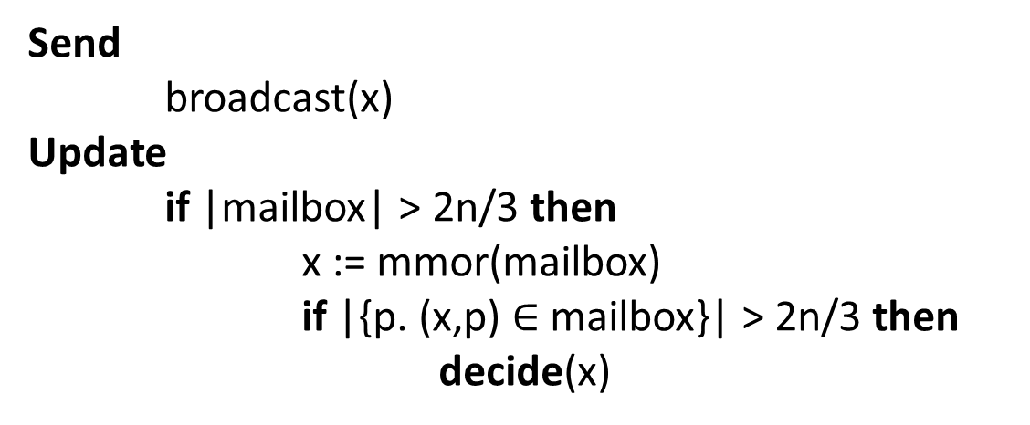
Algorithm
Send
broadcast(x)
Update
if |mailbox| > 2n/3 then
x := mmor(mailbox)
if |{p. (x,p) $∈$ mailbox}| > 2n/3 then
decide(x)

Slide 36
Algorithm: send
Send
broadcast(x)
def send(): Set[(Int, ProcessID)] = {
broadcast(x)
}

Slide 37

Algorithm: update
Update if |mailbox| > 2n/3 then
x := mmor(mailbox)
if |{p. (x,p) $∈$ mailbox}| > 2n/3 then
decide(x)
def update(mailbox: Set[(Int, ProcessID)]) {
if (mailbox.size > 2*n/3) {
val v = mmor(mailbox)
x <~ v
if (mailbox.filter(_._1 == v).size > 2*n/3) {
decided <~ true
decision <~ v
} } }

Slide 38
Complete update
def update(mailbox: Set[(Int, ProcessID)]) {
if (mailbox.size > 2*n/3) {
val v = mmor(mailbox)
x <~ v
if (mailbox.filter(_._1 == v).size > 2*n/3) {
if (!decided) callback.decide(v)
decided <~ true
decision <~ v
} }
if ((decided: Boolean)) {
after <~ after - 1
if(after <= 0) terminate()
} }

Slide 39








Scala embedding of PSync: invariant
$$∀i. ¬decided\left(i\right)$$
f(( P.forall( i => !decided(i) )
|| V.exists( v => {
val A = P.filter( i => x(i) == v);
A.size > 2*n/3 &&
P.forall( i => decided(i) ==> (decision(i) == v))
}))
&& P.forall( i => P.exists( j1 => x(i) == init(x)(j1) ))
)
$$∨$$
$$∃ v, A.$$
$$∧$$
$$A=\left\{ i. x\left(i\right)=v\right\}$$
$$∧$$
$$\left|A\right|>2n/3$$
$$∧$$
$$∀i. decided(i)⇒x\left(i\right)=v$$

Slide 40
Implementation
Implementing an algorithm is done by extending classes:
Algorithm: global view of the system, contains the spec and a Process
Process: local view, contains the initialization function and a list of rounds
Round: type of the message payload, send and update functions
Uses Scala macro to do some rewriting at compile time
On top of Netty (asynchronous event-driven network application framework)
Uses the Pickling library for serialization (PSync is fully typed)
Verifier generate VCs and discharge them using Z3

Slide 41
Evaluation

Slide 42
Algorithms
We have implemented:
OTR
Last Voting (Paxos-like)
Lattice agreement*
K-set agreement*
Two-phase commit
Min flood consensus*
However, an algorithm without a system that uses it is nothing. For a case study we will focus on the consensus: OTR, Last Voting (LV).
We evaluate the algorithm in Psync (and the corresponding runtime)

Slide 43
Case study: distributed key-value store
Store: key -> (version, value) with 50 different keys.
Clients makes requests to write a value to a key.
Write requests over different keys are processed in parallel.
Replicas use consensus to agree on the write operations

Slide 44
Statistics about the code
Algorithm (LOC) | #Invariants (LOC) | #VCs | Solving time in s.
OTR (30) | 4 (23) | 27 | 5
LV (85) | 8 (35) | 45 | 16
Key-value store, about 300 LOCs, includes
Setup of PSync runtime
Recovery procedure
Handling requests, client
...

Slide 45
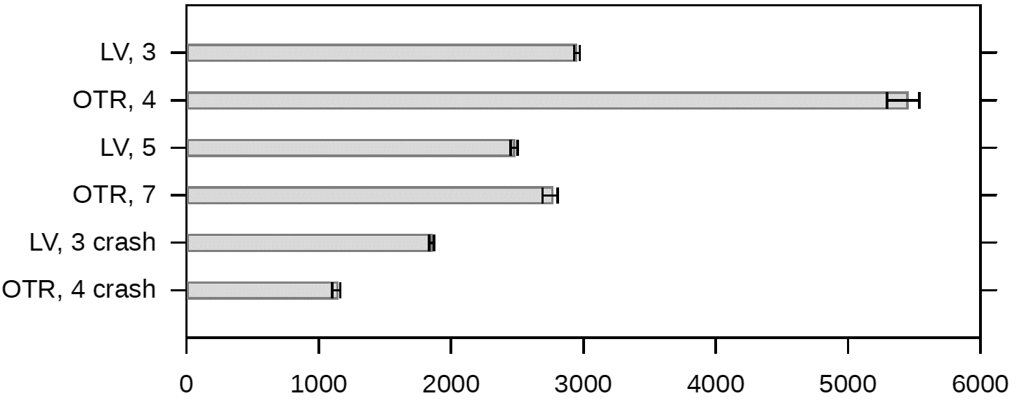
Throughput (request/sec)
Compared to existing consensus implementations:
[Moraru et al., SOSP 2013]: Epaxos algorithm, one order of magnitude faster then Psync
[Biely et al., DSN 2013]: Distal: A framework for implementing fault-tolerant distributed algorithms, one order of magnitude slower than PSync
Notes:
LV:
slower (surprise)
scale better
less affected by the crash

Slide 46
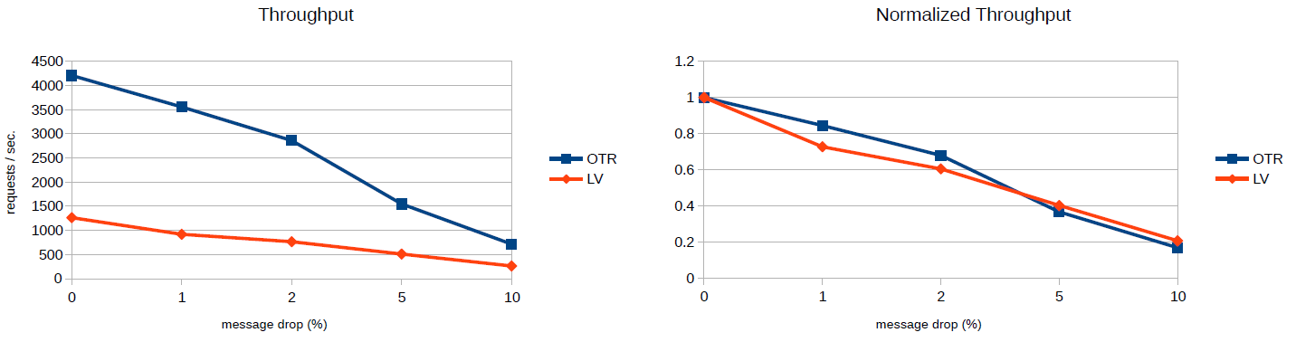
Throughput against message loss

Slide 47
Related work
Alternative formalization round models [Gafni 98]
TLA+ [Lamport 91] that comes with a model checker and proof assistant [Chaudhuri et al. 08]
Isabelle formalization of algorithms in the HO model [Charron-Bost & Merz 09]
Mace [Killian et al. 07] a DSL for distributed systems, comes with a model-checker.
Declarative networking: (logic) programming [Loo et al. 06] and verification [Wang et al. 09]
Notes:
TLA/TLC: sometime less is better, does not run
Mace: (+) runs and verif together, (-) bounded MC

Slide 48
PSync Summary
An appropriate abstraction:
Partial synchrony + communication-closed rounds (HO-model)
Simplifies programming of fault-tolerant distributed algorithms
Simplifies the verification of those algorithms
Scala embedding:
Implemented a runtime
Implemented verification (VCs + SMT-solver)
Cases study on the consensus problem
https://github.com/dzufferey/round

Slide 49
The Paxos Algorithm [Lamport 98]
Prepare
Promise
Accept
Accepted
Proposer
Acceptor
Acceptor
Notes:
Prepare: new sequence #,
Promise to accept the proposer for that seq #, reply with last accepted # and value
Accept the value (commit the decision)

Slide 50
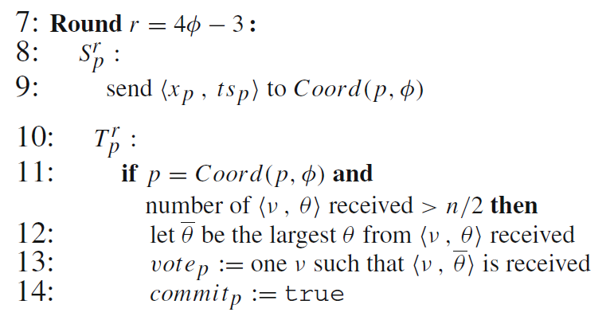
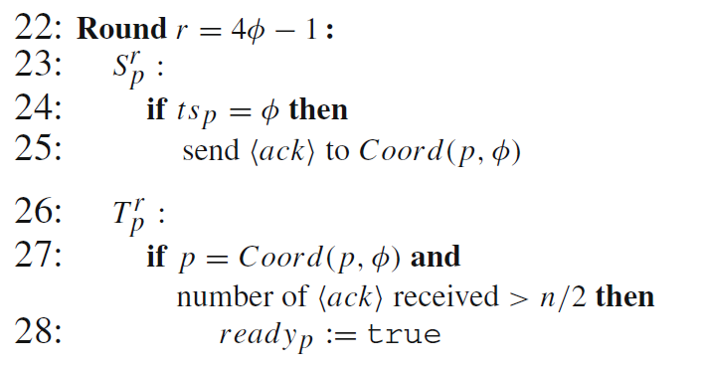
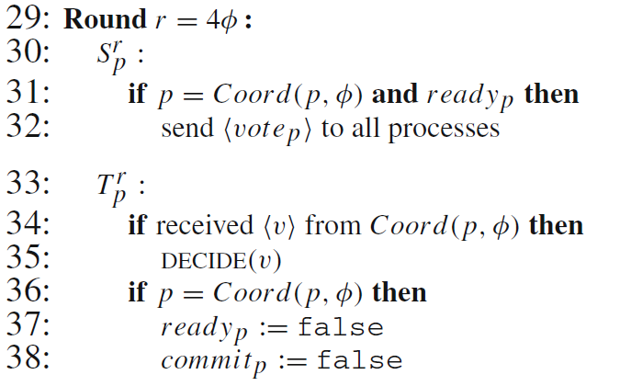
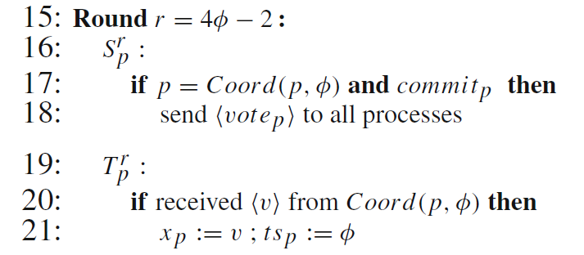
Last Voting Algorithm
Coordinator

Slide 51






Invariant for the Last Voting example
$$∀i. ¬decided\left(i\right)∧¬ready\left(i\right)$$
$$∨$$
$$∃ v, t, A. A=\left\{ i. ts\left(i\right)>t\right\}∧\left|A\right|>n/2$$
$$∧$$
$$∀i. i∈A⇒x\left(i\right)=v$$
$$∧$$
$$∀i. decided(i)⇒x\left(i\right)=v$$
$$∧$$
$$∀i. commit\left(i\right)∨ready(i)⇒vote\left(i\right)=v$$
$$∧$$
$$t≤Φ$$
$$∧$$
$$∀i. ts\left(i\right)=Φ⇒commit(coord\left(i\right))=v$$

Slide 52
Consensus vs Atomic broadcast
In theory, we can solve atomic broadcast by reduction to consensus.
Reverse is also true
In practice, we need another algorithm.
Paxos vs Zab
Zab [Junqueira et al. 11]: atomic broadcast algorithm used in Zookeeper
For performance reason
Share many ideas but Zab is designed to enable quick recovery
Also customized properties (stronger than atomic broadcast ?)
Notes:
-Paxos modified until is became so different that it is a publishable result.
Can we make the tools so this is not publishable anymore ?
-recovery is usually presented on the side
=> Things “on the side” are as important as the main algorithms ?

Slide 53
Scala embedding of PSync: properties
val properties = List(
("Termination",
f(P.forall( i => decided(i)) )),
("Agreement",
f(P.forall( i => P.forall( j => (decided(i) && decided(j)) ==>
(decision(i) == decision(j)) )))),
("Validity",
f(P.forall( i => decided(i) ==> P.exists( j => init(x)(j) == decision(i) )))),
("Integrity",
f(P.exists( j => P.forall( i => decided(i) ==> (decision(i) == init(x)(j)) )))),
("Irrevocability",
f(P.forall( i => old(decided)(i) ==> (decided(i) && old(decision)(i) == decision(i)) )))
)

