Slide 1
PL for robots (and distributed systems)
2015.04.07
Damien Zufferey

Slide 2
React
PL for robots
With Stelios, Martin, Joseph, Ankur, Daniela

Slide 3
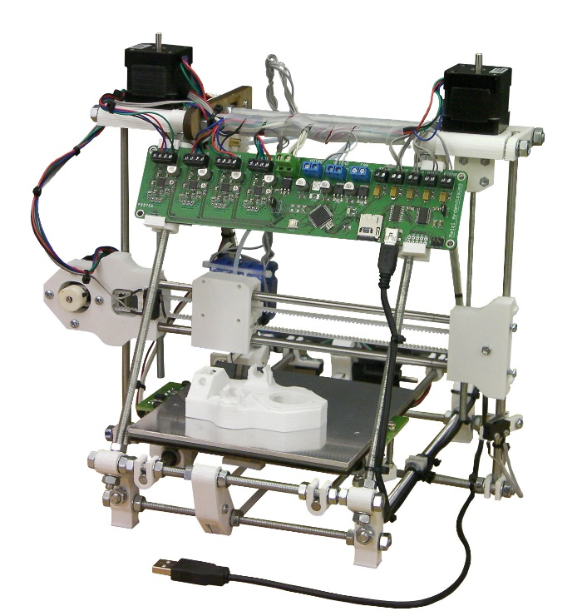
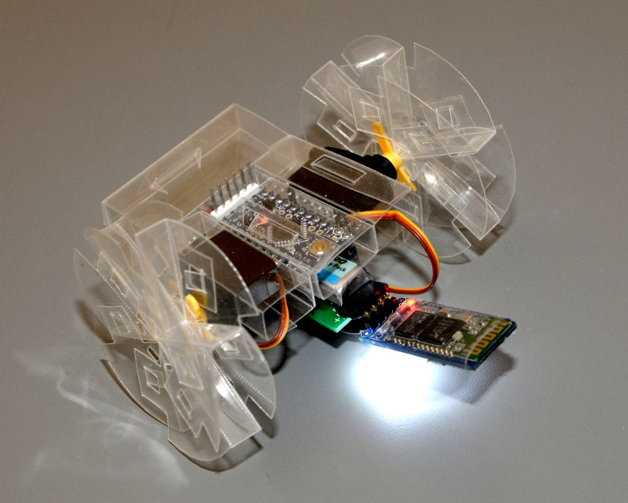
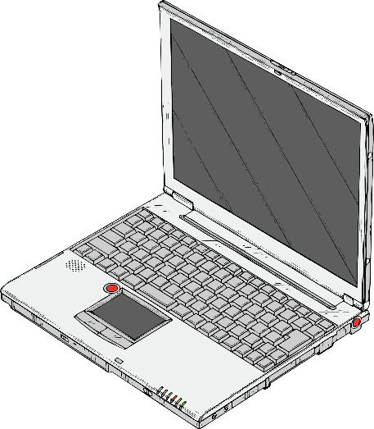
Motivation
+
=

Slide 4
What can we improve ?
For the developer:
Printing is slow (easily 10+ hours for a robot not too small)
Hardly any support for testing
For the user:
Robots that you download comes with no guarantees
(i.e., nobody is responsible if the robot burns down your house)

Slide 5
“Full stack” robot compiler
Controller program
+
Robot specification
REACT
Compiler
Robot
Compiler
[Mehta et al. 14]
Verifier
3D printer,
Laser cutter
Counter-example
Robot
Notes:
Mathias Althoff!

Slide 6
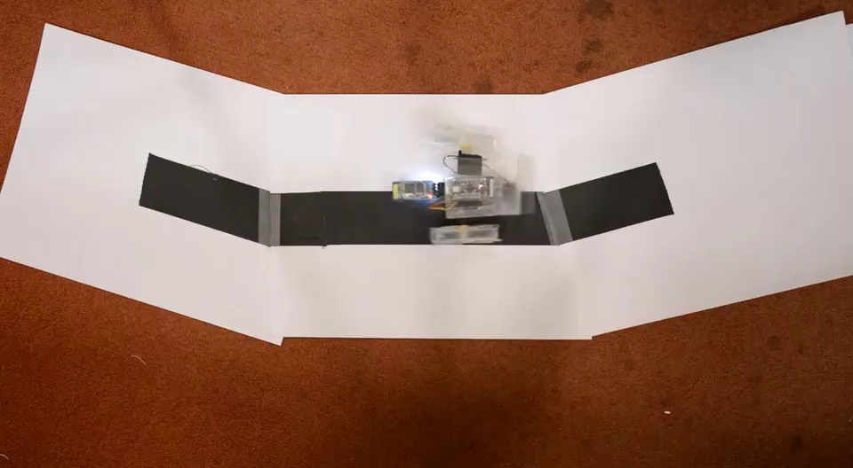
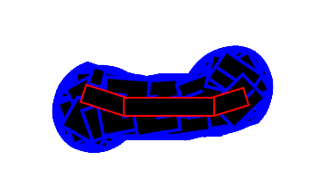
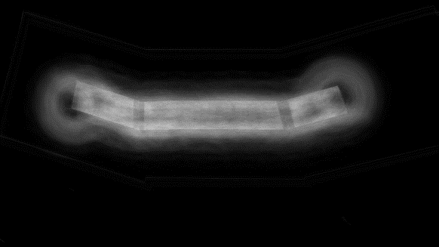
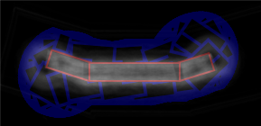
Example: Edge Follower
Verifier
State-space coverage
Background subtraction

Slide 7
The language
var onTarget = false
sensor[Bool](sensorPort){
case Bool(b) => onTarget = b
}
every(300) {
if (onTarget) {
publish(servoLeft, Int16(5))
publish(servoRight, Int16(0))
} else {
publish(servoLeft, Int16(0))
publish(servoRight, Int16(5))
}
}
Event handler
Periodic loop
Sending messages
(also to hardware)
State:
state('loop) {
on { case Key.UP => nextState('moving) }
}
state('moving) { every(100){ ... } }

Slide 8
Verification
State-space exploration for hybrid systems
alternate between discrete (controller) and continuous transitions (robot)
Controller: timed automata
as simple as it can get
Robot: non-linear differential algebraic equations
So complicated that you need to change your model of computation
(type 2 computability) to be able to do anything …

Slide 9
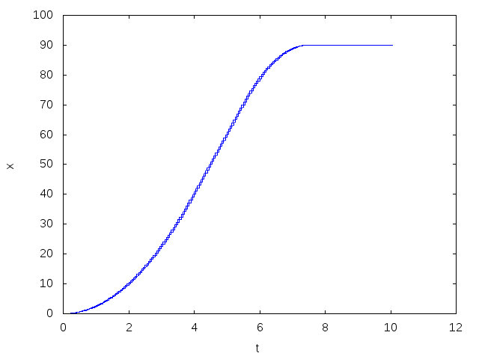






Hybrid system: example
Spherical car moving along a line in frictionless vacuum.
accelerate
$$\dot{x}=20$$
cruise
brake
$$\ddot{x}=5$$
$$\ddot{x}=0$$
stopped
obstacle
accelerate
brake
$$\dot{x}=0$$
stopped
cruise
$$\ddot{x}=−10$$
$$\ddot{x}=0$$

Slide 10
Equations for the Seg
== beam.dz rightmotor.dz )
( == beam.dx rightmotor.dx )
( == beam.dy rightmotor.dy )
( == ( + ( ^ beam.q_k 2 ) ( ^ beam.q_i 2 ) ( ^ beam.q_a 2 ) ( ^ beam.q_j 2 ) ) 1 )
( == ( + ( ^ tail.q_j 2 ) ( ^ tail.q_i 2 ) ( ^ tail.q_k 2 ) ( ^ tail.q_a 2 ) ) 1 )
( == ( + ( ^ rightmotor.q_j 2 ) ( ^ rightmotor.q_i 2 ) ( ^ rightmotor.q_a 2 ) ( ^ rightmotor.q_k 2 ) ) 1 )
( == ( D rightmotor.angle ) ( * rightmotor.input 1 ) )
( == ( + ( ^ rightwheel.q_i 2 ) ( ^ rightwheel.q_a 2 ) ( ^ rightwheel.q_j 2 ) ( ^ rightwheel.q_k 2 ) ) 1 )
( == ( + ( ^ leftwheel.q_j 2 ) ( ^ leftwheel.q_a 2 ) ( ^ leftwheel.q_k 2 ) ( ^ leftwheel.q_i 2 ) ) 1 )
( == ( + ( ^ leftmotor.q_i 2 ) ( ^ leftmotor.q_a 2 ) ( ^ leftmotor.q_j 2 ) ( ^ leftmotor.q_k 2 ) ) 1 )
( == ( D leftmotor.angle ) ( * leftmotor.input 1 ) )
( == ( + ( ^ beam.q_k 2 ) ( * -1 ( ^ beam.q_i 2 ) ) ( ^ beam.q_a 2 ) ( * -1 ( ^ beam.q_j 2 ) ) ) ( + ( * -1 ( ^ rightmotor.q_j 2 ) ) ( * -1 ( ^ rightmotor.q_i 2 ) ) ( ^ rightmotor.q_a 2 ) ( ^ rightmotor.q_k 2 ) ) )
( == ( + ( * 2 beam.q_a beam.q_i ) ( * 2 beam.q_j beam.q_k ) ) ( + ( * 2 rightmotor.q_a rightmotor.q_i ) ( * 2 rightmotor.q_j rightmotor.q_k ) ) )
( == ( + ( * -2 beam.q_a beam.q_j ) ( * 2 beam.q_i beam.q_k ) ) ( + ( * 2 rightmotor.q_i rightmotor.q_k ) ( * -2 rightmotor.q_a rightmotor.q_j ) ) )
( == ( + ( * 2 beam.q_i beam.q_j ) ( * -2 beam.q_a beam.q_k ) ) ( + ( * 2 rightmotor.q_i rightmotor.q_j ) ( * -2 rightmotor.q_a rightmotor.q_k ) ) )
( == ( + ( * -1 ( ^ beam.q_k 2 ) ) ( ^ beam.q_i 2 ) ( ^ beam.q_a 2 ) ( * -1 ( ^ beam.q_j 2 ) ) ) ( + ( * -1 ( ^ rightmotor.q_j 2 ) ) ( ^ rightmotor.q_i 2 ) ( ^ rightmotor.q_a 2 ) ( * -1 ( ^ rightmotor.q_k 2 ) ) ) )
( == ( + ( * 2 beam.q_i beam.q_j ) ( * 2 beam.q_a beam.q_k ) ) ( + ( * 2 rightmotor.q_i rightmotor.q_j ) ( * 2 rightmotor.q_a rightmotor.q_k ) ) )
( == ( + ( * 2 beam.q_a beam.q_j ) ( * 2 beam.q_i beam.q_k ) ) ( + ( * 2 rightmotor.q_i rightmotor.q_k ) ( * 2 rightmotor.q_a rightmotor.q_j ) ) )
( == ( + ( * -1 ( ^ beam.q_k 2 ) ) ( * -1 ( ^ beam.q_i 2 ) ) ( ^ beam.q_a 2 ) ( ^ beam.q_j 2 ) ) ( + ( * -1 ( ^ rightmotor.q_i 2 ) ) ( ^ rightmotor.q_j 2 ) ( ^ rightmotor.q_a 2 ) ( * -1 ( ^ rightmotor.q_k 2 ) ) ) )
( == ( + ( * -2 beam.q_a beam.q_i ) ( * 2 beam.q_j beam.q_k ) ) ( + ( * -2 rightmotor.q_a rightmotor.q_i ) ( * 2 rightmotor.q_j rightmotor.q_k ) ) )
( == ( + ( * -1 ( ^ rightmotor.q_j 2 ) ) ( * -1 ( ^ rightmotor.q_i 2 ) ) ( ^ rightmotor.q_a 2 ) ( ^ rightmotor.q_k 2 ) ) ( + ( ^ rightwheel.q_a 2 ) ( * -1 ( ^ rightwheel.q_j 2 ) ) ( * -1 ( ^ rightwheel.q_i 2 ) ) ( ^ rightwheel.q_k 2 ) ) )
( ==
( + ( * ( + ( * 2 rightmotor.q_a rightmotor.q_i ) ( * 2 rightmotor.q_j rightmotor.q_k ) ) ( cos rightmotor.angle ) )
( * -1 ( + ( * 2 rightmotor.q_i rightmotor.q_k ) ( * -2 rightmotor.q_a rightmotor.q_j ) ) ( sin rightmotor.angle ) ) )
( + ( * 2 rightwheel.q_j rightwheel.q_k )
( * 2 rightwheel.q_a rightwheel.q_i ) ) )
( ==
( + ( * ( + ( * 2 rightmotor.q_a rightmotor.q_i ) ( * 2 rightmotor.q_j rightmotor.q_k ) ) ( sin rightmotor.angle ) )
( * ( + ( * 2 rightmotor.q_i rightmotor.q_k ) ( * -2 rightmotor.q_a rightmotor.q_j ) ) ( cos rightmotor.angle ) ) )
( + ( * 2 rightwheel.q_i rightwheel.q_k )
( * -2 rightwheel.q_a rightwheel.q_j ) ) )
( == ( + ( * ( + ( * 2 rightmotor.q_i rightmotor.q_j ) ( * -2 rightmotor.q_a rightmotor.q_k ) ) ( cos rightmotor.angle ) ) ( * -1 ( + ( * -1 ( ^ rightmotor.q_j 2 ) ) ( ^ rightmotor.q_i 2 ) ( ^ rightmotor.q_a 2 ) ( * -1 ( ^ rightmotor.q_k 2 ) ) ) ( sin rightmotor.angle ) ) ) ( + ( * -2 rightwheel.q_a rightwheel.q_k ) ( * 2 rightwheel.q_i rightwheel.q_j ) ) )
( == ( + ( * ( + ( * -1 ( ^ rightmotor.q_j 2 ) ) ( ^ rightmotor.q_i 2 ) ( ^ rightmotor.q_a 2 ) ( * -1 ( ^ rightmotor.q_k 2 ) ) ) ( cos rightmotor.angle ) ) ( * ( + ( * 2 rightmotor.q_i rightmotor.q_j ) ( * -2 rightmotor.q_a rightmotor.q_k ) ) ( sin rightmotor.angle ) ) ) ( + ( ^ rightwheel.q_i 2 ) ( ^ rightwheel.q_a 2 ) ( * -1 ( ^ rightwheel.q_k 2 ) ) ( * -1 ( ^ rightwheel.q_j 2 ) ) ) )
( == ( + ( * ( + ( * 2 rightmotor.q_i rightmotor.q_j ) ( * 2 rightmotor.q_a rightmotor.q_k ) ) ( cos rightmotor.angle ) ) ( * ( + ( * -1 ( ^ rightmotor.q_i 2 ) ) ( ^ rightmotor.q_j 2 ) ( ^ rightmotor.q_a 2 ) ( * -1 ( ^ rightmotor.q_k 2 ) ) ) ( sin rightmotor.angle ) ) ) ( + ( * 2 rightwheel.q_a rightwheel.q_k ) ( * 2 rightwheel.q_i rightwheel.q_j ) ) )
( == ( + ( * 2 rightmotor.q_i rightmotor.q_k ) ( * 2 rightmotor.q_a rightmotor.q_j ) ) ( + ( * 2 rightwheel.q_i rightwheel.q_k ) ( * 2 rightwheel.q_a rightwheel.q_j ) ) )
( == ( + ( * ( + ( * -1 ( ^ rightmotor.q_i 2 ) ) ( ^ rightmotor.q_j 2 ) ( ^ rightmotor.q_a 2 ) ( * -1 ( ^ rightmotor.q_k 2 ) ) ) ( cos rightmotor.angle ) ) ( * -1 ( + ( * 2 rightmotor.q_i rightmotor.q_j ) ( * 2 rightmotor.q_a rightmotor.q_k ) ) ( sin rightmotor.angle ) ) ) ( + ( ^ rightwheel.q_a 2 ) ( * -1 ( ^ rightwheel.q_k 2 ) ) ( ^ rightwheel.q_j 2 ) ( * -1 ( ^ rightwheel.q_i 2 ) ) ) )
( == ( + ( * 16 ( + ( * -1 ( ^ rightmotor.q_j 2 ) ) ( * -1 ( ^ rightmotor.q_i 2 ) ) ( ^ rightmotor.q_a 2 ) ( ^ rightmotor.q_k 2 ) ) ) rightmotor.dz ) rightwheel.dz )
( == ( + rightmotor.dx ( * 16 ( + ( * 2 rightmotor.q_i rightmotor.q_k ) ( * 2 rightmotor.q_a rightmotor.q_j ) ) ) ) rightwheel.dx )
( == ( + rightmotor.dy ( * 16 ( + ( * -2 rightmotor.q_a rightmotor.q_i ) ( * 2 rightmotor.q_j rightmotor.q_k ) ) ) ) rightwheel.dy )
( == ( + ( * -2 rightmotor.q_a rightmotor.q_i ) ( * 2 rightmotor.q_j rightmotor.q_k ) ) ( + ( * 2 rightwheel.q_j rightwheel.q_k ) ( * -2 rightwheel.q_a rightwheel.q_i ) ) )
( == ( + ( * -1 ( ^ beam.q_k 2 ) ) ( ^ beam.q_i 2 ) ( * -1 ( ^ beam.q_a 2 ) ) ( ^ beam.q_j 2 ) ) ( + ( ^ leftmotor.q_a 2 ) ( * -1 ( ^ leftmotor.q_i 2 ) ) ( * -1 ( ^ leftmotor.q_j 2 ) ) ( ^ leftmotor.q_k 2 ) ) )
( == ( + ( * 2 beam.q_a beam.q_i ) ( * 2 beam.q_j beam.q_k ) ) ( + ( * 2 leftmotor.q_j leftmotor.q_k ) ( * 2 leftmotor.q_a leftmotor.q_i ) ) )
( == ( + ( * 2 beam.q_a beam.q_j ) ( * -2 beam.q_i beam.q_k ) ) ( + ( * -2 leftmotor.q_a leftmotor.q_j ) ( * 2 leftmotor.q_i leftmotor.q_k ) ) )
( == ( + ( * 2 beam.q_i beam.q_j ) ( * -2 beam.q_a beam.q_k ) ) ( + ( * 2 leftmotor.q_i leftmotor.q_j ) ( * -2 leftmotor.q_a leftmotor.q_k ) ) )
( == ( + ( ^ beam.q_k 2 ) ( * -1 ( ^ beam.q_a 2 ) ) ( * -1 ( ^ beam.q_i 2 ) ) ( ^ beam.q_j 2 ) ) ( + ( * -1 ( ^ leftmotor.q_k 2 ) ) ( ^ leftmotor.q_i 2 ) ( ^ leftmotor.q_a 2 ) ( * -1 ( ^ leftmotor.q_j 2 ) ) ) )
( == ( + ( * -2 beam.q_i beam.q_j ) ( * -2 beam.q_a beam.q_k ) ) ( + ( * 2 leftmotor.q_i leftmotor.q_j ) ( * 2 leftmotor.q_a leftmotor.q_k ) ) )
( == ( + ( * -2 beam.q_a beam.q_j ) ( * -2 beam.q_i beam.q_k ) ) ( + ( * 2 leftmotor.q_i leftmotor.q_k ) ( * 2 leftmotor.q_a leftmotor.q_j ) ) )
( == ( + ( * -1 ( ^ beam.q_k 2 ) ) ( * -1 ( ^ beam.q_i 2 ) ) ( ^ beam.q_a 2 ) ( ^ beam.q_j 2 ) ) ( + ( * -1 ( ^ leftmotor.q_k 2 ) ) ( ^ leftmotor.q_a 2 ) ( * -1 ( ^ leftmotor.q_i 2 ) ) ( ^ leftmotor.q_j 2 ) ) )
( == ( + beam.dz ( * -1 20 ( + ( ^ beam.q_k 2 ) ( * -1 ( ^ beam.q_i 2 ) ) ( ^ beam.q_a 2 ) ( * -1 ( ^ beam.q_j 2 ) ) ) ) ) leftmotor.dz )
( == ( + ( * -1 20 ( + ( * 2 beam.q_a beam.q_j ) ( * 2 beam.q_i beam.q_k ) ) ) beam.dx ) leftmotor.dx )
( == ( + beam.dy ( * -1 20 ( + ( * -2 beam.q_a beam.q_i ) ( * 2 beam.q_j beam.q_k ) ) ) ) leftmotor.dy )
( == ( + ( * -2 beam.q_j beam.q_k ) ( * 2 beam.q_a beam.q_i ) ) ( + ( * -2 leftmotor.q_a leftmotor.q_i ) ( * 2 leftmotor.q_j leftmotor.q_k ) ) )
( == ( + ( ^ leftmotor.q_a 2 ) ( * -1 ( ^ leftmotor.q_i 2 ) ) ( * -1 ( ^ leftmotor.q_j 2 ) ) ( ^ leftmotor.q_k 2 ) ) ( + ( * -1 ( ^ leftwheel.q_j 2 ) ) ( * -1 ( ^ leftwheel.q_i 2 ) ) ( ^ leftwheel.q_a 2 ) ( ^ leftwheel.q_k 2 ) ) )
( == ( + ( * -1 ( + ( * -2 leftmotor.q_a leftmotor.q_j ) ( * 2 leftmotor.q_i leftmotor.q_k ) ) ( sin leftmotor.angle ) ) ( * ( + ( * 2 leftmotor.q_j leftmotor.q_k ) ( * 2 leftmotor.q_a leftmotor.q_i ) ) ( cos leftmotor.angle ) ) ) ( + ( * 2 leftwheel.q_a leftwheel.q_i ) ( * 2 leftwheel.q_j leftwheel.q_k ) ) )
( == ( + ( * ( + ( * 2 leftmotor.q_j leftmotor.q_k ) ( * 2 leftmotor.q_a leftmotor.q_i ) ) ( sin leftmotor.angle ) ) ( * ( + ( * -2 leftmotor.q_a leftmotor.q_j ) ( * 2 leftmotor.q_i leftmotor.q_k ) ) ( cos leftmotor.angle ) ) ) ( + ( * 2 leftwheel.q_i leftwheel.q_k ) ( * -2 leftwheel.q_a leftwheel.q_j ) ) )
( == ( + ( * -1 ( + ( * -1 ( ^ leftmotor.q_k 2 ) ) ( ^ leftmotor.q_i 2 ) ( ^ leftmotor.q_a 2 ) ( * -1 ( ^ leftmotor.q_j 2 ) ) ) ( sin leftmotor.angle ) ) ( * ( + ( * 2 leftmotor.q_i leftmotor.q_j ) ( * -2 leftmotor.q_a leftmotor.q_k ) ) ( cos leftmotor.angle ) ) ) ( + ( * 2 leftwheel.q_i leftwheel.q_j ) ( * -2 leftwheel.q_a leftwheel.q_k ) ) )
( == ( + ( * ( + ( * 2 leftmotor.q_i leftmotor.q_j ) ( * -2 leftmotor.q_a leftmotor.q_k ) ) ( sin leftmotor.angle ) ) ( * ( + ( * -1 ( ^ leftmotor.q_k 2 ) ) ( ^ leftmotor.q_i 2 ) ( ^ leftmotor.q_a 2 ) ( * -1 ( ^ leftmotor.q_j 2 ) ) ) ( cos leftmotor.angle ) ) ) ( + ( * -1 ( ^ leftwheel.q_j 2 ) ) ( ^ leftwheel.q_a 2 ) ( * -1 ( ^ leftwheel.q_k 2 ) ) ( ^ leftwheel.q_i 2 ) ) )
( == ( + ( * ( + ( * -1 ( ^ leftmotor.q_k 2 ) ) ( ^ leftmotor.q_a 2 ) ( * -1 ( ^ leftmotor.q_i 2 ) ) ( ^ leftmotor.q_j 2 ) ) ( sin leftmotor.angle ) ) ( * ( + ( * 2 leftmotor.q_i leftmotor.q_j ) ( * 2 leftmotor.q_a leftmotor.q_k ) ) ( cos leftmotor.angle ) ) ) ( + ( * 2 leftwheel.q_i leftwheel.q_j ) ( * 2 leftwheel.q_a leftwheel.q_k ) ) )
( == ( + ( * 2 leftmotor.q_i leftmotor.q_k ) ( * 2 leftmotor.q_a leftmotor.q_j ) ) ( + ( * 2 leftwheel.q_i leftwheel.q_k ) ( * 2 leftwheel.q_a leftwheel.q_j ) ) )
( == ( + ( * ( + ( * -1 ( ^ leftmotor.q_k 2 ) ) ( ^ leftmotor.q_a 2 ) ( * -1 ( ^ leftmotor.q_i 2 ) ) ( ^ leftmotor.q_j 2 ) ) ( cos leftmotor.angle ) ) ( * -1 ( + ( * 2 leftmotor.q_i leftmotor.q_j ) ( * 2 leftmotor.q_a leftmotor.q_k ) ) ( sin leftmotor.angle ) ) ) ( + ( ^ leftwheel.q_j 2 ) ( * -1 ( ^ leftwheel.q_i 2 ) ) ( ^ leftwheel.q_a 2 ) ( * -1 ( ^ leftwheel.q_k 2 ) ) ) )
( == ( + leftmotor.dz ( * 16 ( + ( ^ leftmotor.q_a 2 ) ( * -1 ( ^ leftmotor.q_i 2 ) ) ( * -1 ( ^ leftmotor.q_j 2 ) ) ( ^ leftmotor.q_k 2 ) ) ) ) leftwheel.dz )
( == ( + leftmotor.dx ( * 16 ( + ( * 2 leftmotor.q_i leftmotor.q_k ) ( * 2 leftmotor.q_a leftmotor.q_j ) ) ) ) leftwheel.dx )
( == ( + leftmotor.dy ( * 16 ( + ( * -2 leftmotor.q_a leftmotor.q_i ) ( * 2 leftmotor.q_j leftmotor.q_k ) ) ) ) leftwheel.dy )
( == ( + ( * -2 leftmotor.q_a leftmotor.q_i ) ( * 2 leftmotor.q_j leftmotor.q_k ) ) ( + ( * -2 leftwheel.q_a leftwheel.q_i ) ( * 2 leftwheel.q_j leftwheel.q_k ) ) )
( == ( + ( * ( / 1 2 ) 50 ( + ( * 2 beam.q_i beam.q_j ) ( * -2 beam.q_a beam.q_k ) ) ) beam.dx ( * ( / 1 2 ) 25 ( + ( * -1 ( ^ beam.q_k 2 ) ) ( ^ beam.q_i 2 ) ( ^ beam.q_a 2 ) ( * -1 ( ^ beam.q_j 2 ) ) ) ) ) ( + tail.dx ( * ( / 1 2 ) 50 ( + ( * 2 tail.q_i tail.q_j ) ( * -2 tail.q_a tail.q_k ) ) ) ( * ( / 1 2 ) 25 ( + ( * -1 ( ^ tail.q_k 2 ) ) ( ^ tail.q_i 2 ) ( * -1 ( ^ tail.q_j 2 ) ) ( ^ tail.q_a 2 ) ) ) ) )
( == ( + ( * ( / 1 2 ) 25 ( + ( * 2 beam.q_i beam.q_j ) ( * 2 beam.q_a beam.q_k ) ) ) beam.dy ( * ( / 1 2 ) 50 ( + ( * -1 ( ^ beam.q_k 2 ) ) ( * -1 ( ^ beam.q_i 2 ) ) ( ^ beam.q_a 2 ) ( ^ beam.q_j 2 ) ) ) ) ( + tail.dy ( * ( / 1 2 ) 25 ( + ( * 2 tail.q_a tail.q_k ) ( * 2 tail.q_i tail.q_j ) ) ) ( * ( / 1 2 ) 50 ( + ( * -1 ( ^ tail.q_k 2 ) ) ( ^ tail.q_j 2 ) ( * -1 ( ^ tail.q_i 2 ) ) ( ^ tail.q_a 2 ) ) ) ) )
( == ( + ( * ( / 1 2 ) 25 ( + ( * -2 beam.q_a beam.q_j ) ( * 2 beam.q_i beam.q_k ) ) ) ( * ( / 1 2 ) 50 ( + ( * 2 beam.q_a beam.q_i ) ( * 2 beam.q_j beam.q_k ) ) ) beam.dz ) ( + ( * ( / 1 2 ) 25 ( + ( * 2 tail.q_i tail.q_k ) ( * -2 tail.q_a tail.q_j ) ) ) ( * ( / 1 2 ) 50 ( + ( * 2 tail.q_j tail.q_k ) ( * 2 tail.q_a tail.q_i ) ) ) tail.dz ) )
( == ( + ( * ( / 1 2 ) 50 ( + ( * 2 beam.q_i beam.q_j ) ( * -2 beam.q_a beam.q_k ) ) ) beam.dx ( * 20 ( + ( * -2 beam.q_a beam.q_j ) ( * -2 beam.q_i beam.q_k ) ) ) ( * ( / 1 2 ) 25 ( + ( * -1 ( ^ beam.q_k 2 ) ) ( ^ beam.q_i 2 ) ( ^ beam.q_a 2 ) ( * -1 ( ^ beam.q_j 2 ) ) ) ) ) ( + ( * ( / -1 2 ) 25 ( + ( * -1 ( ^ tail.q_k 2 ) ) ( ^ tail.q_i 2 ) ( * -1 ( ^ tail.q_j 2 ) ) ( ^ tail.q_a 2 ) ) ) tail.dx ( * ( / 1 2 ) 50 ( + ( * 2 tail.q_i tail.q_j ) ( * -2 tail.q_a tail.q_k ) ) ) ) )
( == ( + ( * ( / 1 2 ) 25 ( + ( * 2 beam.q_i beam.q_j ) ( * 2 beam.q_a beam.q_k ) ) ) beam.dy ( * ( / 1 2 ) 50 ( + ( * -1 ( ^ beam.q_k 2 ) ) ( * -1 ( ^ beam.q_i 2 ) ) ( ^ beam.q_a 2 ) ( ^ beam.q_j 2 ) ) ) ( * 20 ( + ( * -2 beam.q_j beam.q_k ) ( * 2 beam.q_a beam.q_i ) ) ) ) ( + tail.dy ( * ( / -1 2 ) 25 ( + ( * 2 tail.q_a tail.q_k ) ( * 2 tail.q_i tail.q_j ) ) ) ( * ( / 1 2 ) 50 ( + ( * -1 ( ^ tail.q_k 2 ) ) ( ^ tail.q_j 2 ) ( * -1 ( ^ tail.q_i 2 ) ) ( ^ tail.q_a 2 ) ) ) ) )
( == ( + ( * ( / 1 2 ) 25 ( + ( * -2 beam.q_a beam.q_j ) ( * 2 beam.q_i beam.q_k ) ) ) ( * ( / 1 2 ) 50 ( + ( * 2 beam.q_a beam.q_i ) ( * 2 beam.q_j beam.q_k ) ) ) ( * 20 ( + ( * -1 ( ^ beam.q_k 2 ) ) ( ^ beam.q_i 2 ) ( * -1 ( ^ beam.q_a 2 ) ) ( ^ beam.q_j 2 ) ) ) beam.dz ) ( + ( * ( / -1 2 ) 25 ( + ( * 2 tail.q_i tail.q_k ) ( * -2 tail.q_a tail.q_j ) ) ) ( * ( / 1 2 ) 50 ( + ( * 2 tail.q_j tail.q_k ) ( * 2 tail.q_a tail.q_i ) ) ) tail.dz ) )
( == ( + ( * ( + ( * -2 beam.q_a beam.q_j ) ( * 2 beam.q_i beam.q_k ) ) ( + ( * -1 ( ^ tail.q_i 2 ) ) ( * -1 ( ^ tail.q_j 2 ) ) ( ^ tail.q_k 2 ) ( ^ tail.q_a 2 ) ) ) ( * ( + ( * 2 beam.q_i beam.q_j ) ( * 2 beam.q_a beam.q_k ) ) ( + ( * 2 tail.q_j tail.q_k ) ( * -2 tail.q_a tail.q_i ) ) ) ( * ( + ( * 2 tail.q_a tail.q_j ) ( * 2 tail.q_i tail.q_k ) ) ( + ( * -1 ( ^ beam.q_k 2 ) ) ( ^ beam.q_i 2 ) ( ^ beam.q_a 2 ) ( * -1 ( ^ beam.q_j 2 ) ) ) ) ) 0 )
( == siminput0_input leftmotor.input )
( == siminput1_input rightmotor.input )
( >= ( + ( * ( / 1 2 ) 25 ( + ( * 2 tail.q_i tail.q_k ) ( * -2 tail.q_a tail.q_j ) ) ) ( * ( / -1 2 ) 50 ( + ( * 2 tail.q_j tail.q_k ) ( * 2 tail.q_a tail.q_i ) ) ) tail.dz ) 0 )
( >= ( + ( * ( / -1 2 ) 50 ( + ( * 2 tail.q_j tail.q_k ) ( * 2 tail.q_a tail.q_i ) ) ) ( * ( / -1 2 ) 25 ( + ( * 2 tail.q_i tail.q_k ) ( * -2 tail.q_a tail.q_j ) ) ) tail.dz ) 0 )
( Or ( == ( + ( * ( / -1 2 ) 50 ( + ( * 2 tail.q_j tail.q_k ) ( * 2 tail.q_a tail.q_i ) ) ) ( * ( / -1 2 ) 25 ( + ( * 2 tail.q_i tail.q_k ) ( * -2 tail.q_a tail.q_j ) ) ) tail.dz ) 0 ) ( == ( + ( * ( / 1 2 ) 25 ( + ( * 2 tail.q_i tail.q_k ) ( * -2 tail.q_a tail.q_j ) ) ) ( * ( / -1 2 ) 50 ( + ( * 2 tail.q_j tail.q_k ) ( * 2 tail.q_a tail.q_i ) ) ) tail.dz ) 0 ) )
( >= ( + ( * 40 ( + ( * 2 leftwheel.q_i leftwheel.q_k ) ( * -2 leftwheel.q_a leftwheel.q_j ) ) ) leftwheel.dz ) 0 )
( >= ( + leftwheel.dz ( * ( / 1 2 ) 40 ( ^ 3 ( / 1 2 ) ) ( + ( * 2 leftwheel.q_a leftwheel.q_i ) ( * 2 leftwheel.q_j leftwheel.q_k ) ) ) ( * ( / 1 2 ) 40 ( + ( * 2 leftwheel.q_i leftwheel.q_k ) ( * -2 leftwheel.q_a leftwheel.q_j ) ) ) ) 0 )
( >= ( + leftwheel.dz ( * ( / 1 2 ) 40 ( ^ 3 ( / 1 2 ) ) ( + ( * 2 leftwheel.q_a leftwheel.q_i ) ( * 2 leftwheel.q_j leftwheel.q_k ) ) ) ( * ( / -1 2 ) 40 ( + ( * 2 leftwheel.q_i leftwheel.q_k ) ( * -2 leftwheel.q_a leftwheel.q_j ) ) ) ) 0 )
( >= ( + leftwheel.dz ( * -1 40 ( + ( * 2 leftwheel.q_i leftwheel.q_k ) ( * -2 leftwheel.q_a leftwheel.q_j ) ) ) ) 0 )
( >= ( + ( * ( / -1 2 ) 40 ( ^ 3 ( / 1 2 ) ) ( + ( * 2 leftwheel.q_a leftwheel.q_i ) ( * 2 leftwheel.q_j leftwheel.q_k ) ) ) leftwheel.dz ( * ( / -1 2 ) 40 ( + ( * 2 leftwheel.q_i leftwheel.q_k ) ( * -2 leftwheel.q_a leftwheel.q_j ) ) ) ) 0 )
( >= ( + ( * ( / -1 2 ) 40 ( ^ 3 ( / 1 2 ) ) ( + ( * 2 leftwheel.q_a leftwheel.q_i ) ( * 2 leftwheel.q_j leftwheel.q_k ) ) ) leftwheel.dz ( * ( / 1 2 ) 40 ( + ( * 2 leftwheel.q_i leftwheel.q_k ) ( * -2 leftwheel.q_a leftwheel.q_j ) ) ) ) 0 )
( Or
( And ( == ( + ( * 40 ( + ( * 2 leftwheel.q_i leftwheel.q_k ) ( * -2 leftwheel.q_a leftwheel.q_j ) ) ) leftwheel.dz ) 0 )
( == ( D ( + leftwheel.dy ( * 40 ( + ( * 2 leftwheel.q_i leftwheel.q_j ) ( * 2 leftwheel.q_a leftwheel.q_k ) ) ) ) ) 0 )
( == ( D ( + leftwheel.dx ( * 40 ( + ( * -1 ( ^ leftwheel.q_j 2 ) ) ( ^ leftwheel.q_a 2 ) ( * -1 ( ^ leftwheel.q_k 2 ) ) ( ^ leftwheel.q_i 2 ) ) ) ) ) 0 ) )
( And ( == ( + leftwheel.dz ( * -1 40 ( + ( * 2 leftwheel.q_i leftwheel.q_k ) ( * -2 leftwheel.q_a leftwheel.q_j ) ) ) ) 0 )
( == ( D ( + leftwheel.dy ( * -1 40 ( + ( * 2 leftwheel.q_i leftwheel.q_j ) ( * 2 leftwheel.q_a leftwheel.q_k ) ) ) ) ) 0 )
( == ( D ( + leftwheel.dx ( * -1 40 ( + ( * -1 ( ^ leftwheel.q_j 2 ) ) ( ^ leftwheel.q_a 2 ) ( * -1 ( ^ leftwheel.q_k 2 ) ) ( ^ leftwheel.q_i 2 ) ) ) ) ) 0 ) )
( And ( == ( + ( * ( / -1 2 ) 40 ( ^ 3 ( / 1 2 ) ) ( + ( * 2 leftwheel.q_a leftwheel.q_i ) ( * 2 leftwheel.q_j leftwheel.q_k ) ) ) leftwheel.dz ( * ( / -1 2 ) 40 ( + ( * 2 leftwheel.q_i leftwheel.q_k ) ( * -2 leftwheel.q_a leftwheel.q_j ) ) ) ) 0 )
( == ( D ( + leftwheel.dx ( * ( / -1 2 ) 40 ( + ( * -1 ( ^ leftwheel.q_j 2 ) ) ( ^ leftwheel.q_a 2 ) ( * -1 ( ^ leftwheel.q_k 2 ) ) ( ^ leftwheel.q_i 2 ) ) ) ( * ( / -1 2 ) 40 ( ^ 3 ( / 1 2 ) ) ( + ( * 2 leftwheel.q_i leftwheel.q_j ) ( * -2 leftwheel.q_a leftwheel.q_k ) ) ) ) ) 0 )
( == ( D ( + ( * ( / -1 2 ) 40 ( ^ 3 ( / 1 2 ) ) ( + ( ^ leftwheel.q_j 2 ) ( * -1 ( ^ leftwheel.q_i 2 ) ) ( ^ leftwheel.q_a 2 ) ( * -1 ( ^ leftwheel.q_k 2 ) ) ) ) ( * ( / -1 2 ) 40 ( + ( * 2 leftwheel.q_i leftwheel.q_j ) ( * 2 leftwheel.q_a leftwheel.q_k ) ) ) leftwheel.dy ) ) 0 ) )
( And ( == ( + ( * ( / -1 2 ) 40 ( ^ 3 ( / 1 2 ) ) ( + ( * 2 leftwheel.q_a leftwheel.q_i ) ( * 2 leftwheel.q_j leftwheel.q_k ) ) ) leftwheel.dz ( * ( / 1 2 ) 40 ( + ( * 2 leftwheel.q_i leftwheel.q_k ) ( * -2 leftwheel.q_a leftwheel.q_j ) ) ) ) 0 )
( == ( D ( + ( * ( / 1 2 ) 40 ( + ( * -1 ( ^ leftwheel.q_j 2 ) ) ( ^ leftwheel.q_a 2 ) ( * -1 ( ^ leftwheel.q_k 2 ) ) ( ^ leftwheel.q_i 2 ) ) ) leftwheel.dx ( * ( / -1 2 ) 40 ( ^ 3 ( / 1 2 ) ) ( + ( * 2 leftwheel.q_i leftwheel.q_j ) ( * -2 leftwheel.q_a leftwheel.q_k ) ) ) ) ) 0 )
( == ( D ( + ( * ( / -1 2 ) 40 ( ^ 3 ( / 1 2 ) ) ( + ( ^ leftwheel.q_j 2 ) ( * -1 ( ^ leftwheel.q_i 2 ) ) ( ^ leftwheel.q_a 2 ) ( * -1 ( ^ leftwheel.q_k 2 ) ) ) ) ( * ( / 1 2 ) 40 ( + ( * 2 leftwheel.q_i leftwheel.q_j ) ( * 2 leftwheel.q_a leftwheel.q_k ) ) ) leftwheel.dy ) ) 0 ) )
( And ( == ( + leftwheel.dz ( * ( / 1 2 ) 40 ( ^ 3 ( / 1 2 ) ) ( + ( * 2 leftwheel.q_a leftwheel.q_i ) ( * 2 leftwheel.q_j leftwheel.q_k ) ) ) ( * ( / -1 2 ) 40 ( + ( * 2 leftwheel.q_i leftwheel.q_k ) ( * -2 leftwheel.q_a leftwheel.q_j ) ) ) ) 0 )
( == ( D ( + leftwheel.dx ( * ( / 1 2 ) 40 ( ^ 3 ( / 1 2 ) ) ( + ( * 2 leftwheel.q_i leftwheel.q_j ) ( * -2 leftwheel.q_a leftwheel.q_k ) ) ) ( * ( / -1 2 ) 40 ( + ( * -1 ( ^ leftwheel.q_j 2 ) ) ( ^ leftwheel.q_a 2 ) ( * -1 ( ^ leftwheel.q_k 2 ) ) ( ^ leftwheel.q_i 2 ) ) ) ) ) 0 )
( == ( D ( + ( * ( / 1 2 ) 40 ( ^ 3 ( / 1 2 ) ) ( + ( ^ leftwheel.q_j 2 ) ( * -1 ( ^ leftwheel.q_i 2 ) ) ( ^ leftwheel.q_a 2 ) ( * -1 ( ^ leftwheel.q_k 2 ) ) ) ) ( * ( / -1 2 ) 40 ( + ( * 2 leftwheel.q_i leftwheel.q_j ) ( * 2 leftwheel.q_a leftwheel.q_k ) ) ) leftwheel.dy ) ) 0 ) )
( And ( == ( + leftwheel.dz ( * ( / 1 2 ) 40 ( ^ 3 ( / 1 2 ) ) ( + ( * 2 leftwheel.q_a leftwheel.q_i ) ( * 2 leftwheel.q_j leftwheel.q_k ) ) ) ( * ( / 1 2 ) 40 ( + ( * 2 leftwheel.q_i leftwheel.q_k ) ( * -2 leftwheel.q_a leftwheel.q_j ) ) ) ) 0 )
( == ( D ( + ( * ( / 1 2 ) 40 ( + ( * -1 ( ^ leftwheel.q_j 2 ) ) ( ^ leftwheel.q_a 2 ) ( * -1 ( ^ leftwheel.q_k 2 ) ) ( ^ leftwheel.q_i 2 ) ) ) leftwheel.dx ( * ( / 1 2 ) 40 ( ^ 3 ( / 1 2 ) ) ( + ( * 2 leftwheel.q_i leftwheel.q_j ) ( * -2 leftwheel.q_a leftwheel.q_k ) ) ) ) ) 0 )
( == ( D ( + ( * ( / 1 2 ) 40 ( + ( * 2 leftwheel.q_i leftwheel.q_j ) ( * 2 leftwheel.q_a leftwheel.q_k ) ) ) ( * ( / 1 2 ) 40 ( ^ 3 ( / 1 2 ) ) ( + ( ^ leftwheel.q_j 2 ) ( * -1 ( ^ leftwheel.q_i 2 ) ) ( ^ leftwheel.q_a 2 ) ( * -1 ( ^ leftwheel.q_k 2 ) ) ) ) leftwheel.dy ) ) 0 ) )
)
( >= ( + ( * 40 ( + ( * 2 rightwheel.q_i rightwheel.q_k ) ( * -2 rightwheel.q_a rightwheel.q_j ) ) ) rightwheel.dz ) 0 )
( >= ( + ( * ( / 1 2 ) 40 ( ^ 3 ( / 1 2 ) ) ( + ( * 2 rightwheel.q_j rightwheel.q_k ) ( * 2 rightwheel.q_a rightwheel.q_i ) ) ) rightwheel.dz ( * ( / 1 2 ) 40 ( + ( * 2 rightwheel.q_i rightwheel.q_k ) ( * -2 rightwheel.q_a rightwheel.q_j ) ) ) ) 0 )
( >= ( + ( * ( / 1 2 ) 40 ( ^ 3 ( / 1 2 ) ) ( + ( * 2 rightwheel.q_j rightwheel.q_k ) ( * 2 rightwheel.q_a rightwheel.q_i ) ) ) ( * ( / -1 2 ) 40 ( + ( * 2 rightwheel.q_i rightwheel.q_k ) ( * -2 rightwheel.q_a rightwheel.q_j ) ) ) rightwheel.dz ) 0 )
( >= ( + rightwheel.dz ( * -1 40 ( + ( * 2 rightwheel.q_i rightwheel.q_k ) ( * -2 rightwheel.q_a rightwheel.q_j ) ) ) ) 0 )
( >= ( + ( * ( / -1 2 ) 40 ( + ( * 2 rightwheel.q_i rightwheel.q_k ) ( * -2 rightwheel.q_a rightwheel.q_j ) ) ) ( * ( / -1 2 ) 40 ( ^ 3 ( / 1 2 ) ) ( + ( * 2 rightwheel.q_j rightwheel.q_k ) ( * 2 rightwheel.q_a rightwheel.q_i ) ) ) rightwheel.dz ) 0 )
( >= ( + ( * ( / -1 2 ) 40 ( ^ 3 ( / 1 2 ) ) ( + ( * 2 rightwheel.q_j rightwheel.q_k ) ( * 2 rightwheel.q_a rightwheel.q_i ) ) ) rightwheel.dz ( * ( / 1 2 ) 40 ( + ( * 2 rightwheel.q_i rightwheel.q_k ) ( * -2 rightwheel.q_a rightwheel.q_j ) ) ) ) 0 )
( Or
( And ( == ( + ( * 40 ( + ( * 2 rightwheel.q_i rightwheel.q_k ) ( * -2 rightwheel.q_a rightwheel.q_j ) ) ) rightwheel.dz ) 0 )
( == ( D ( + ( * 40 ( + ( * 2 rightwheel.q_a rightwheel.q_k ) ( * 2 rightwheel.q_i rightwheel.q_j ) ) ) rightwheel.dy ) ) 0 )
( == ( D ( + rightwheel.dx ( * 40 ( + ( ^ rightwheel.q_i 2 ) ( ^ rightwheel.q_a 2 ) ( * -1 ( ^ rightwheel.q_k 2 ) ) ( * -1 ( ^ rightwheel.q_j 2 ) ) ) ) ) ) 0 ) )
( And ( == ( + rightwheel.dz ( * -1 40 ( + ( * 2 rightwheel.q_i rightwheel.q_k ) ( * -2 rightwheel.q_a rightwheel.q_j ) ) ) ) 0 )
( == ( D ( + ( * -1 40 ( + ( * 2 rightwheel.q_a rightwheel.q_k ) ( * 2 rightwheel.q_i rightwheel.q_j ) ) ) rightwheel.dy ) ) 0 )
( == ( D ( + ( * -1 40 ( + ( ^ rightwheel.q_i 2 ) ( ^ rightwheel.q_a 2 ) ( * -1 ( ^ rightwheel.q_k 2 ) ) ( * -1 ( ^ rightwheel.q_j 2 ) ) ) ) rightwheel.dx ) ) 0 ) )
( And ( == ( + ( * ( / -1 2 ) 40 ( + ( * 2 rightwheel.q_i rightwheel.q_k ) ( * -2 rightwheel.q_a rightwheel.q_j ) ) ) ( * ( / -1 2 ) 40 ( ^ 3 ( / 1 2 ) ) ( + ( * 2 rightwheel.q_j rightwheel.q_k ) ( * 2 rightwheel.q_a rightwheel.q_i ) ) ) rightwheel.dz ) 0 )
( == ( D ( + ( * ( / -1 2 ) 40 ( ^ 3 ( / 1 2 ) ) ( + ( * -2 rightwheel.q_a rightwheel.q_k ) ( * 2 rightwheel.q_i rightwheel.q_j ) ) ) rightwheel.dx ( * ( / -1 2 ) 40 ( + ( ^ rightwheel.q_i 2 ) ( ^ rightwheel.q_a 2 ) ( * -1 ( ^ rightwheel.q_k 2 ) ) ( * -1 ( ^ rightwheel.q_j 2 ) ) ) ) ) ) 0 )
( == ( D ( + ( * ( / -1 2 ) 40 ( + ( * 2 rightwheel.q_a rightwheel.q_k ) ( * 2 rightwheel.q_i rightwheel.q_j ) ) ) ( * ( / -1 2 ) 40 ( ^ 3 ( / 1 2 ) ) ( + ( ^ rightwheel.q_a 2 ) ( * -1 ( ^ rightwheel.q_k 2 ) ) ( ^ rightwheel.q_j 2 ) ( * -1 ( ^ rightwheel.q_i 2 ) ) ) ) rightwheel.dy ) ) 0 ) )
( And ( == ( + ( * ( / -1 2 ) 40 ( ^ 3 ( / 1 2 ) ) ( + ( * 2 rightwheel.q_j rightwheel.q_k ) ( * 2 rightwheel.q_a rightwheel.q_i ) ) ) rightwheel.dz ( * ( / 1 2 ) 40 ( + ( * 2 rightwheel.q_i rightwheel.q_k ) ( * -2 rightwheel.q_a rightwheel.q_j ) ) ) ) 0 )
( == ( D ( + ( * ( / -1 2 ) 40 ( ^ 3 ( / 1 2 ) ) ( + ( * -2 rightwheel.q_a rightwheel.q_k ) ( * 2 rightwheel.q_i rightwheel.q_j ) ) ) ( * ( / 1 2 ) 40 ( + ( ^ rightwheel.q_i 2 ) ( ^ rightwheel.q_a 2 ) ( * -1 ( ^ rightwheel.q_k 2 ) ) ( * -1 ( ^ rightwheel.q_j 2 ) ) ) ) rightwheel.dx ) ) 0 )
( == ( D ( + ( * ( / 1 2 ) 40 ( + ( * 2 rightwheel.q_a rightwheel.q_k ) ( * 2 rightwheel.q_i rightwheel.q_j ) ) ) ( * ( / -1 2 ) 40 ( ^ 3 ( / 1 2 ) ) ( + ( ^ rightwheel.q_a 2 ) ( * -1 ( ^ rightwheel.q_k 2 ) ) ( ^ rightwheel.q_j 2 ) ( * -1 ( ^ rightwheel.q_i 2 ) ) ) ) rightwheel.dy ) ) 0 ) )
( And ( == ( + ( * ( / 1 2 ) 40 ( ^ 3 ( / 1 2 ) ) ( + ( * 2 rightwheel.q_j rightwheel.q_k ) ( * 2 rightwheel.q_a rightwheel.q_i ) ) ) ( * ( / -1 2 ) 40 ( + ( * 2 rightwheel.q_i rightwheel.q_k ) ( * -2 rightwheel.q_a rightwheel.q_j ) ) ) rightwheel.dz ) 0 )
( == ( D ( + rightwheel.dx ( * ( / 1 2 ) 40 ( ^ 3 ( / 1 2 ) ) ( + ( * -2 rightwheel.q_a rightwheel.q_k ) ( * 2 rightwheel.q_i rightwheel.q_j ) ) ) ( * ( / -1 2 ) 40 ( + ( ^ rightwheel.q_i 2 ) ( ^ rightwheel.q_a 2 ) ( * -1 ( ^ rightwheel.q_k 2 ) ) ( * -1 ( ^ rightwheel.q_j 2 ) ) ) ) ) ) 0 )
( == ( D ( + ( * ( / -1 2 ) 40 ( + ( * 2 rightwheel.q_a rightwheel.q_k ) ( * 2 rightwheel.q_i rightwheel.q_j ) ) ) ( * ( / 1 2 ) 40 ( ^ 3 ( / 1 2 ) ) ( + ( ^ rightwheel.q_a 2 ) ( * -1 ( ^ rightwheel.q_k 2 ) ) ( ^ rightwheel.q_j 2 ) ( * -1 ( ^ rightwheel.q_i 2 ) ) ) ) rightwheel.dy ) ) 0 ) )
( And ( == ( + ( * ( / 1 2 ) 40 ( ^ 3 ( / 1 2 ) ) ( + ( * 2 rightwheel.q_j rightwheel.q_k ) ( * 2 rightwheel.q_a rightwheel.q_i ) ) ) rightwheel.dz ( * ( / 1 2 ) 40 ( + ( * 2 rightwheel.q_i rightwheel.q_k ) ( * -2 rightwheel.q_a rightwheel.q_j ) ) ) ) 0 )
( == ( D ( + ( * ( / 1 2 ) 40 ( + ( ^ rightwheel.q_i 2 ) ( ^ rightwheel.q_a 2 ) ( * -1 ( ^ rightwheel.q_k 2 ) ) ( * -1 ( ^ rightwheel.q_j 2 ) ) ) ) rightwheel.dx ( * ( / 1 2 ) 40 ( ^ 3 ( / 1 2 ) ) ( + ( * -2 rightwheel.q_a rightwheel.q_k ) ( * 2 rightwheel.q_i rightwheel.q_j ) ) ) ) ) 0 )
( == ( D ( + ( * ( / 1 2 ) 40 ( ^ 3 ( / 1 2 ) ) ( + ( ^ rightwheel.q_a 2 ) ( * -1 ( ^ rightwheel.q_k 2 ) ) ( ^ rightwheel.q_j 2 ) ( * -1 ( ^ rightwheel.q_i 2 ) ) ) ) ( * ( / 1 2 ) 40 ( + ( * 2 rightwheel.q_a rightwheel.q_k ) ( * 2 rightwheel.q_i rightwheel.q_j ) ) ) rightwheel.dy ) ) 0 ) )
)
Typical equation:
Challenges:
Non-linear
Polynomial
Transcendental
Differential
$$tail.j^{2}+tail.i^{2}+tail.k^{2}+tail.a^{2}=1$$

Slide 11
What we are trying
Simplifying the model
Quantifier elimination
Craig interpolations
Type 2 computability
Transcendental equations over the reals are usually undecidable.
Intuition: use the arbitrary precision of the real to encode a memory
Instead we consider the reals up to a given precision:
Non-linear equations: NP
ODE: PSpace (also holds for DAE ?)
Not quite fast enough yet …

Slide 12
PSync
Fault-tolerant distributed systems
With Cezara Drăgoi, Thomas A. Henzinger

Slide 13
Fault-tolerant distributed algorithms
How to get it right when things go wrong ?
Crash, network delay/partition, …
Typical problem: Consensus
Termination: Every correct process decides some value.
Validity: If all processes propose the same value v, then all correct processes decide v.
Integrity: If value v is a decision, then v must have been proposed by some process.
Irrevocability: Every correct process decides at most one value.
Agreement: Every correct process must agree on the same value.
Unfortunately, consensus is not solvable in an asynchronous system where at least one process can crash ([FLP 85]).

Slide 14
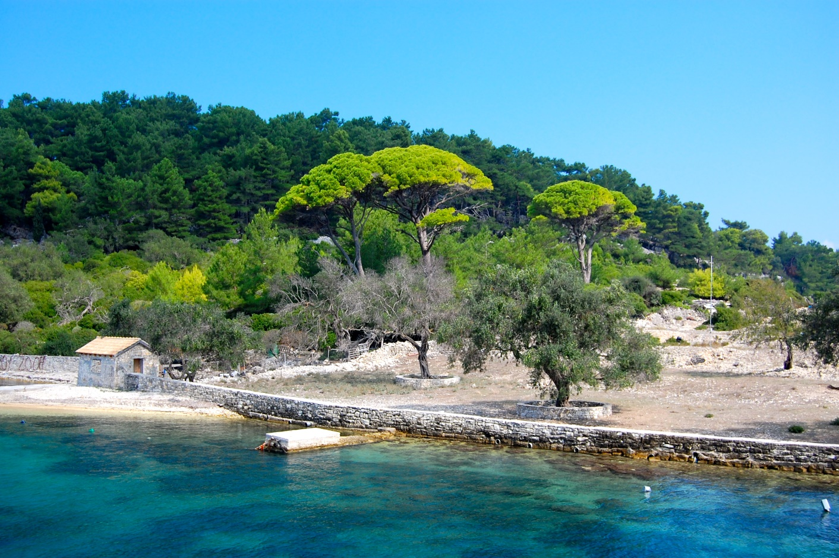
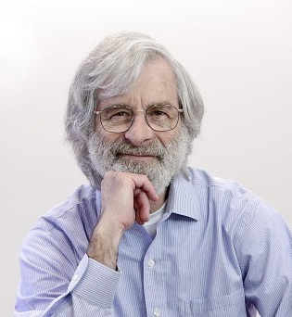
Our journey starts on the island of Paxos …
… where archeologists made an interesting discovery about a parliament system …
CC-BY-SA-NC Matt Taylor Copyright ACM
Notes:
Consensus is just an example: interested in whatever can be proved using the same techniques.

Slide 15
The Paxos Algorithm [Lamport 98]
Prepare
Promise
Accept
Accepted
Proposer
Acceptor
Acceptor
Used at Google (Chubby), Yahoo/Apache (Zookeeper), Microsoft (Autopilot)
Notes:
Prepare: new sequence #,
Promise to accept the proposer for that seq #, reply with last accepted # and value
Accept the value (commit the decision)

Slide 16
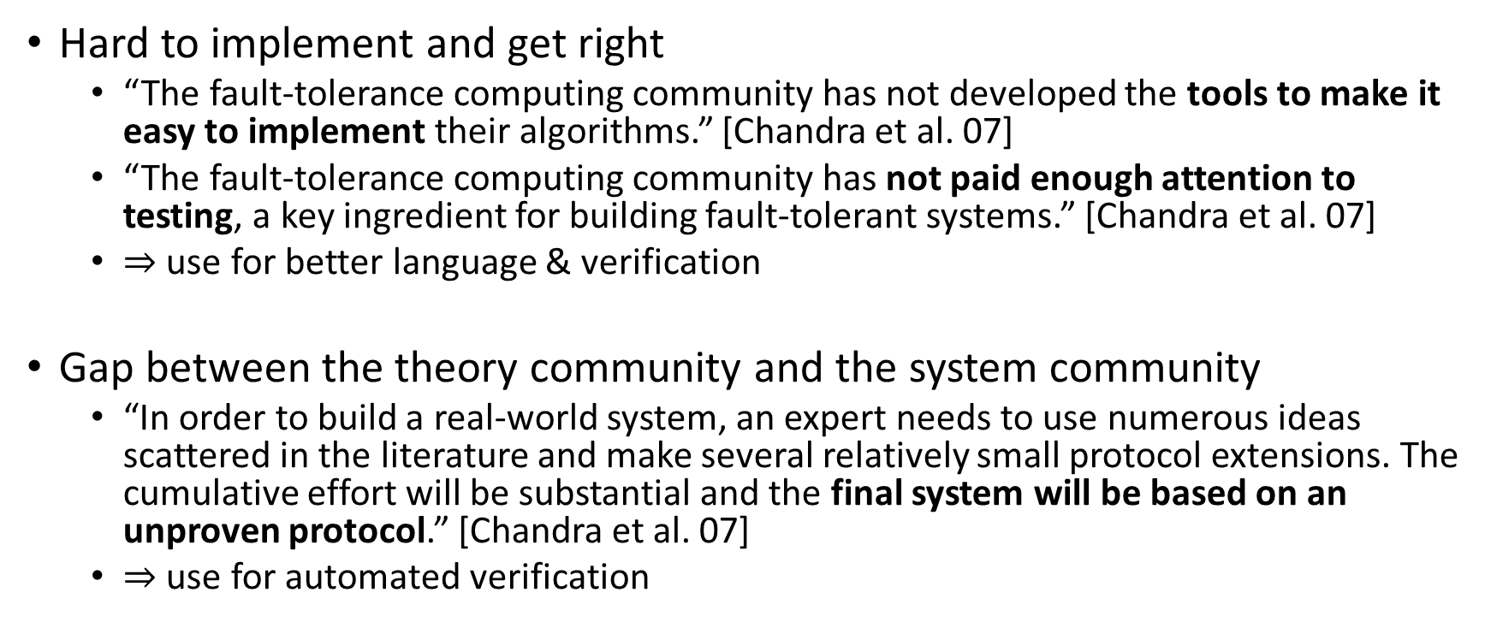
What verification can do ?
Hard to implement and get right
“The fault-tolerance computing community has not developed the tools to make it easy to implement their algorithms.” [Chandra et al. 07]
“The fault-tolerance computing community has not paid enough attention to testing, a key ingredient for building fault-tolerant systems.” [Chandra et al. 07]
$⇒$ use for better language & verification
Gap between the theory community and the system community
“In order to build a real-world system, an expert needs to use numerous ideas scattered in the literature and make several relatively small protocol extensions. The cumulative effort will be substantial and the final system will be based on an unproven protocol.” [Chandra et al. 07]
$⇒$ use for automated verification
Notes:
Nothing wrong with proofs of algorithms, but can do more.
Hard to test: fault masking
1st talk: I also don’t like to make proofs, but I like to make algorithm that make proofs for me

Slide 17
The goal
source code + specifications
verifier
runtime
proof or
counterexample
executable
Notes:
Source and spec in the same language (or very close)
don’t need to learn another tool
lower the barrier of entry

Slide 18
Challenges to understanding what is going on
n
Parametric systems
Asynchrony (Interleaving, delays)
Channels
Faults
…
Notes:
Picking the right model to make verification easier
Parametric systems: undecidable in general
Interleavings: combinatorial blow-up
Channels: undecidable if FIFO, non-primitive recursive if lossy

Slide 19
Communication-closed Rounds
Prepare
Promise
Accept
Accepted
Proposer
Acceptor
Acceptor
[Elrad & Francez 82]: decomposition of algorithm in communication-closed rounds.
[Dwork & Lynch & Stockmeyer, 88] defines round model for non-synchronous models: partial synchrony
Notes:
get ride of the interleavings and channel problem at the same time

Slide 20
Mapping asynchrony to faults
Programming abstraction in round-based model
Implementation in an asynchronous world
Notes:
Reasoning in round-based model (partial synchrony):
Communication-closed rounds (simple model for the channels)
Lockstep semantics (no interleaving, mapping asynchrony to faults)
Heard-of model: map process faults on communication faults
Implementation in an asynchronous world
Asynchrony: no round structure, delays and buffering of messages
Failure detectors to recover some degree of synchrony

Slide 21
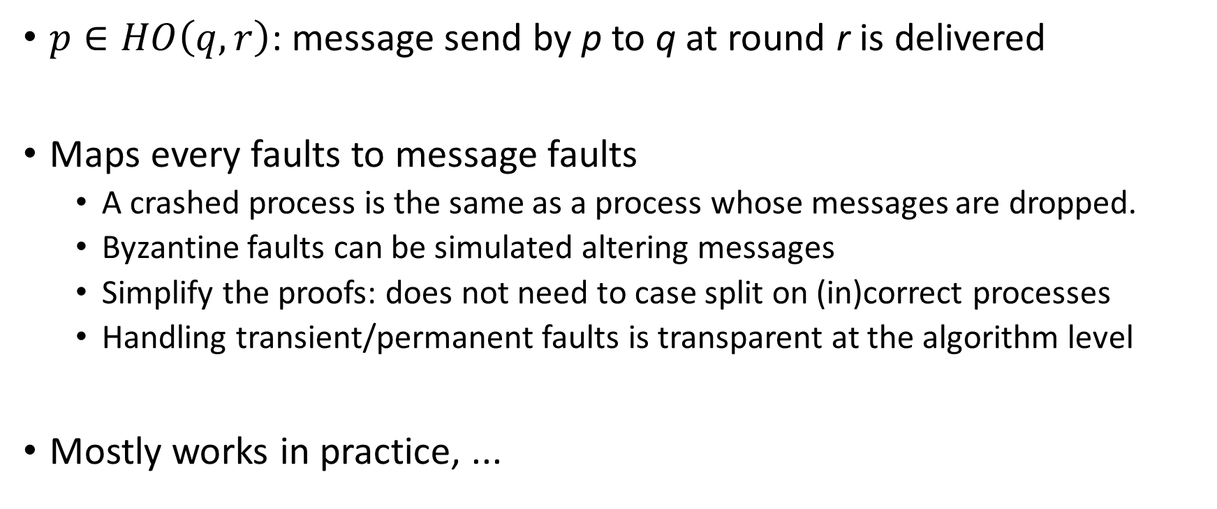
The Heard-Of model [Charron-Bost & Schiper 09]
$p∈HO\left(q,r\right)$: message send by p to q at round r is delivered
Maps every faults to message faults
A crashed process is the same as a process whose messages are dropped.
Byzantine faults can be simulated altering messages
Simplify the proofs: does not need to case split on (in)correct processes
Handling transient/permanent faults is transparent at the algorithm level
Mostly works in practice, ...

Slide 22
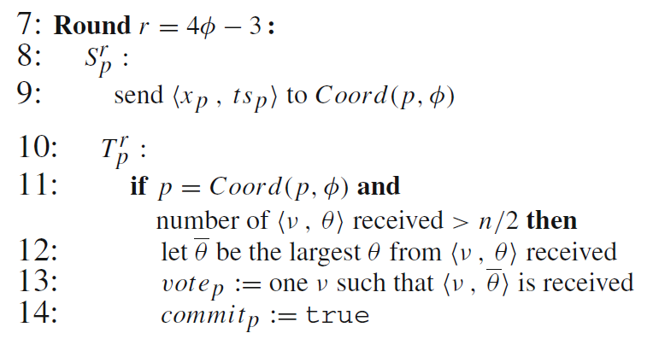
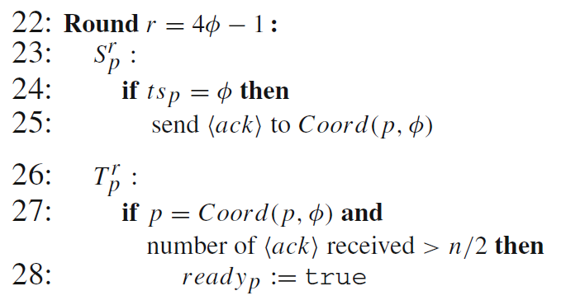
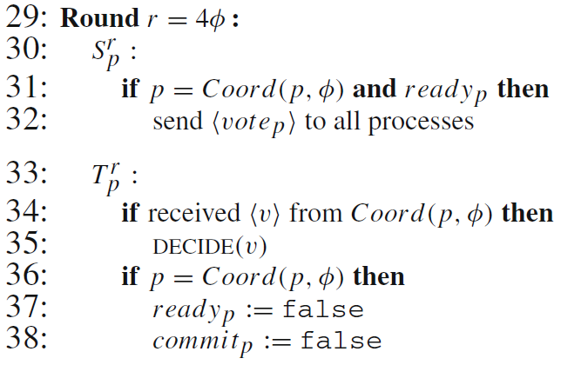
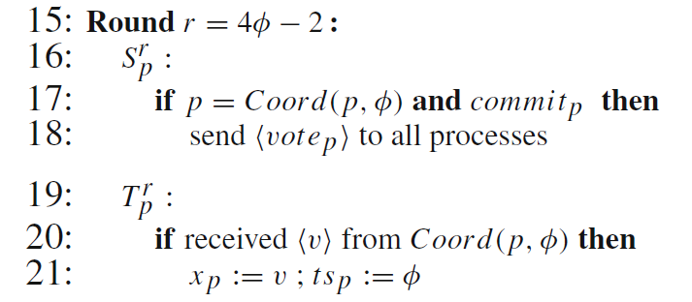
Example: Last Voting Algorithm
Coordinator

Slide 23
The Language
rnd(new Round{
type A = (Int, Int)
def send(): Set[((Int, Int), ProcessID)] =
Set( (x: Int, ts: Int) -> coord(r / 4) )
def update( mailbox: Set[((Int, Int), ProcessID)]){
if (id == coord(r/4) && mailbox.size > n/2) {
vote <~ mailbox.maxBy(_._1._2)._1._1
commit <~ true
} }
override def expectedNbrMessages =
if (id == coord(r/4)) n/2 + 1 else 0
})

Slide 24
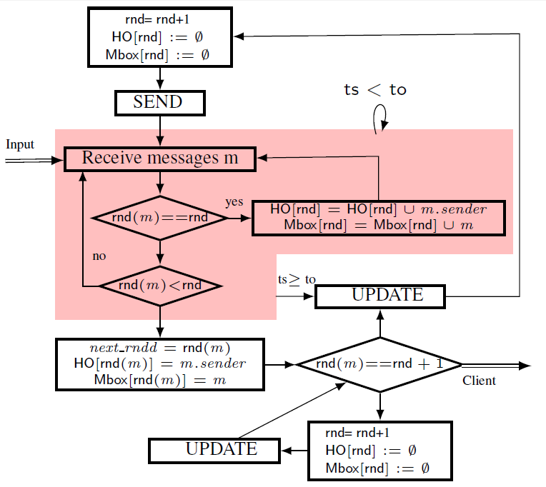
Runtime

Slide 25









Verification: partial invariant for the LV alg.
$$∀i. ¬decided\left(i\right)∧¬ready\left(i\right)$$
$$∨$$
$$∃ v, t, A. A=\left\{ i. ts\left(i\right)>t\right\}∧\left|A\right|>n/2$$
$$∧$$
$$∀i. i∈A⇒x\left(i\right)=v$$
$$∧$$
$$∀i. decided(i)⇒x\left(i\right)=v$$
$$∧$$
$$∀i. commit\left(i\right)∨ready(i)⇒vote\left(i\right)=v$$
$$∧$$
$$t≤Φ$$
$$∧$$
$$∀i. ts\left(i\right)=Φ⇒commit(coord\left(i\right))=v$$

Slide 26
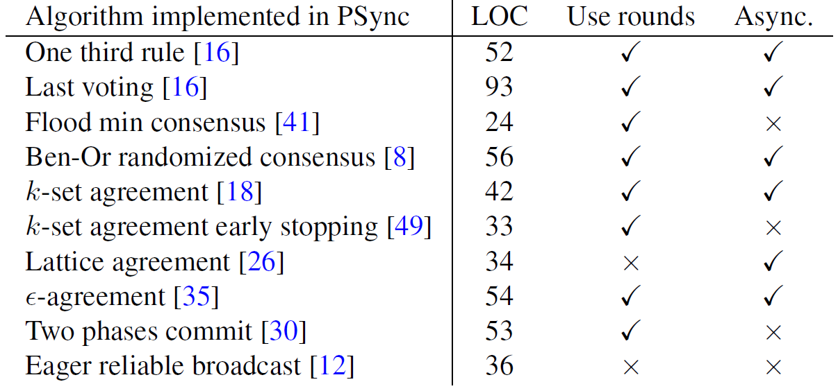
Result: do algorithms use rounds ?

Slide 27
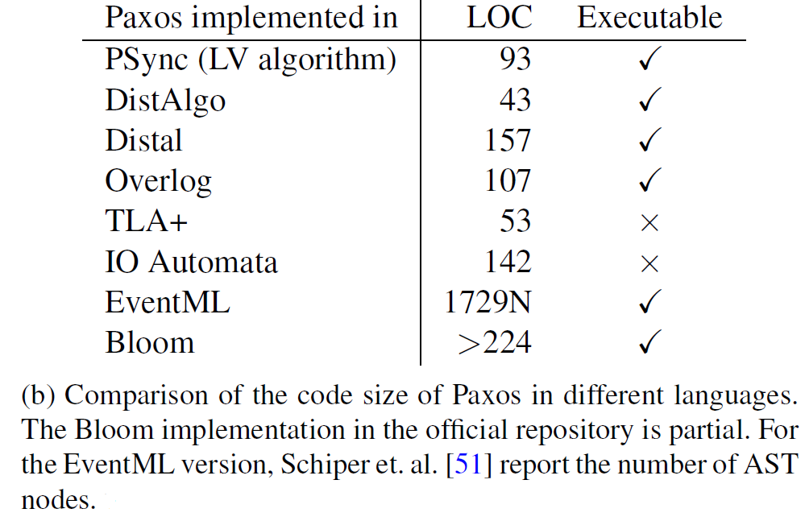
Result: code size (easy to implement)

Slide 28
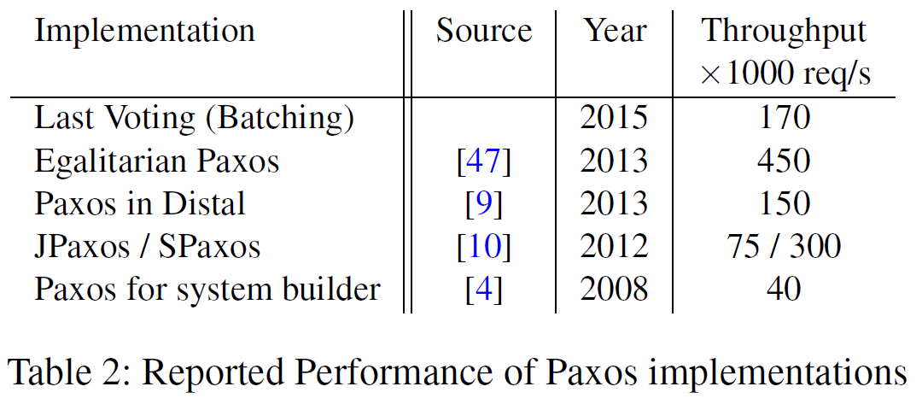
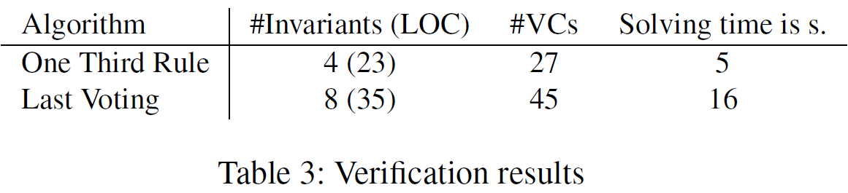
Result: performance and verification

