Slide 1
PSync : A Partially Synchronous Language for Fault-tolerant Distributed Algorithms
Cezara Drăgoi, INRIA ENS CNRS
Thomas A. Henzinger, IST Austria
Damien Zufferey, MIT CSAIL
NYU, 2015.12.03

Slide 2



Motivation
Replication

Slide 3
Replication and consistency
X = -13
Consensus
X = 42
X = 4
X = 42
X = 42
X = 42

Slide 4
Consensus
Agreement:
Every correct process must agree on the same value.
Irrevocability:
Every correct process decides at most one value.
Validity:
If all processes propose the same value v, then all correct processes decide v.
Integrity:
If value v is a decision, then v must have been proposed by some process.
Termination:
Every correct process decides some value.
Notes:
Cloud, etc.
Replication:
-copies to resists crashes
-consensus to maintain consistency

Slide 5

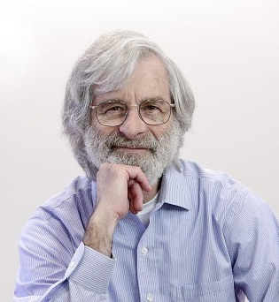
Our journey starts on the island of Paxos …
… where archeologists made an interesting discovery about a parliament system …
CC-BY-SA-NC Matt Taylor Copyright ACM
Notes:
Our original goal was just the verification of implementation of existing algorithms.

Slide 6
The Paxos Algorithm [Lamport 98]
Prepare
Promise
Accept
Accepted
Proposer
Acceptor
Acceptor
Used at Google (Chubby), Microsoft (Autopilot), …
Notes:
Prepare: new sequence #,
Promise to accept the proposer for that seq #, reply with last accepted # and value
Accept the value (commit the decision)

Slide 7
Paxos in the Literature
The part-time parliament [Lamport 98]
Paxos made simple [Lamport 01]
Paxos made live: An engineering perspective [Chandra et al. 07]
In search of an understandable consensus algorithm [Ongaro and Ousterhout 14]
Paxos made moderately complex [van Renesse and Altinbuken 15]
Paxos made transparent [Cui et al. 15]
...
Claim:
If it is hard, more of the same is not going to help.
Changing the way we think about it might.
Notes:
Paxos is also know to confuse people

Slide 8
Why is the PL community concerned ?
Quotes from Paxos made live [Chandra et al. 07]
“The fault-tolerance computing community has not developed the tools to make it easy to implement their algorithms.”
“The fault-tolerance computing community has not paid enough attention to testing, a key ingredient for building fault-tolerant systems.”
“In order to build a real-world system, an expert needs to use numerous ideas scattered in the literature and make several relatively small protocol extensions. The cumulative effort will be substantial and the final system will be based on an unproven protocol.”
Notes:
Nothing wrong with proofs of algorithms, but can do more.
Hard to test: fault masking

Slide 9
Goal: appropriate programming abstraction
source code + specifications
runtime
verifier
executable
proof or
counterexample
Notes:
Source and spec in the same language (or very close)
don’t need to learn another tool
lower the barrier of entry

Slide 10
Challenges to understanding what is going on
n
Parametric systems
Asynchrony (Interleaving, delays)
Channels
Faults
…
Notes:
Picking the right model to make verification easier
Parametric systems: undecidable in general
Interleavings: combinatorial blow-up
Channels: undecidable if FIFO, non-primitive recursive if lossy

Slide 11
Programming Models & Languages
Asynchronous
Faults introduce a middle ground
Synchronous (timed)
We don’t want a model/language for each variation.
We want a simple model that unifies all of them.
Actor model, CSP,
CCS, pi-calculus, …
Timed-automata, timed process calculi
Alternation between synchronous and asynchronous period
Many PL based on or implementing those models
Lustre, Esterel,
Giotto, LabVIEW
?
Partial synchrony
Failure detectors
Crash-stop, crash-recovery
Benign, Byzantine faults
Consensus is not solvable with asynchrony and faults ([FLP 85]).
Not realistic for distributed system
network contention
crash
Notes:
Fault: alternation between synch and asynch

Slide 12
Structure of distributed algorithms: Communication-closed Rounds
Prepare
Promise
Accept
Accepted
Proposer
Acceptor
Acceptor
A round defines the scope of its messages.
[Elrad & Francez 82]: decomposition of algorithm in communication-closed rounds.
[Dwork & Lynch & Stockmeyer, 88] defines round model for non-synchronous models: partial synchrony
Notes:
Round defines a *scope* for the messages

Slide 13
Faults: the environment as an adversary.
C-c rounds + adversary = Heard-Of model [Charron-Bost & Schiper 09]
Semantics:
Our contribution: DSL + runtime
Execution:
Notes:
Implementation in an asynchronous world
Asynchrony: no round structure, delays and buffering of messages
Failure detectors to recover some degree of synchrony
We formalize the correspondence between the two worlds in terms of observational refinement.

Slide 14
PSync example: OTR
new Round[Int]{
def send(): Map[ProcessID,Int] = broadcast(x)
def update(mailbox: Map[ProcessID,Int]) {
if (mailbox.size > 2*n/3) {
x = mmor(mailbox) //min most often received
if (mailbox.filter{ _._2 == x }.size > 2*n/3) {
decide(x)
terminate()
}
}
}

Slide 15
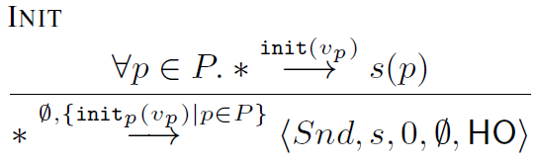
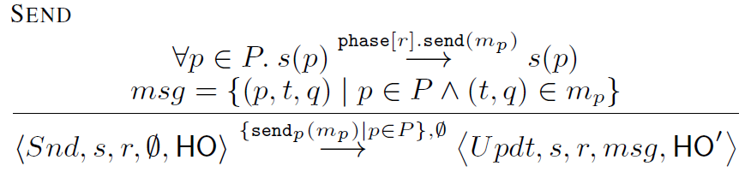
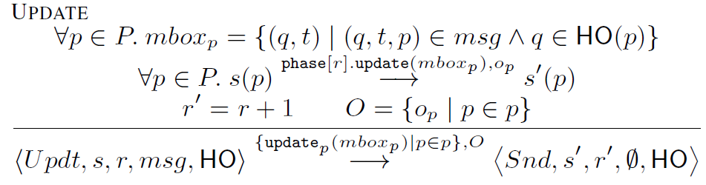
PSync Lockstep Semantics

Slide 16
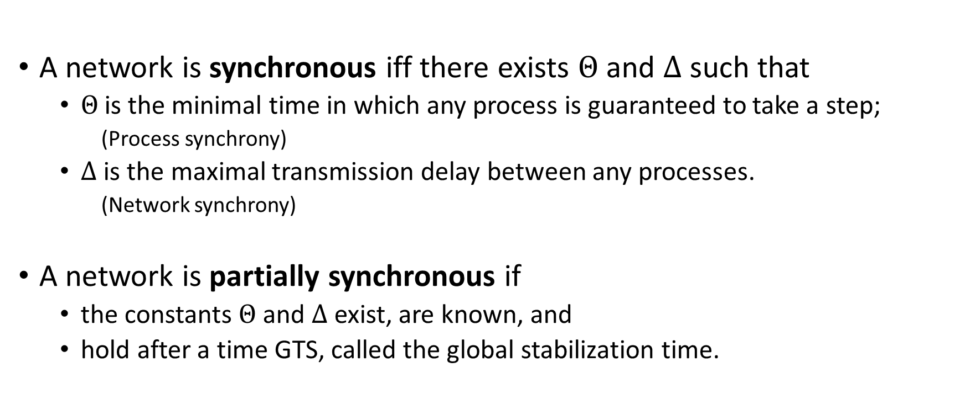
Partial Synchrony [Dwork et al. 88]
A network is synchronous iff there exists $Θ$ and $Δ$ such that
$Θ$is the minimal time in which any process is guaranteed to take a step;
(Process synchrony)
$Δ$ is the maximal transmission delay between any processes.
(Network synchrony)
A network is partially synchronous if
the constants $Θ$ and $Δ$ exist, are known, and
hold after a time GTS, called the global stabilization time.
Notes:
Alternation between good and bad period:
the duration of good period is dependent on each algorithm
this definition takes the supremum of all sufficiently long good period

Slide 17
Result (1)
Indistinguishability:
for every process, the transitions and states of the projection of the traces on that process agree up to finite stuttering.
Lockstep:
Asynchronous:
Notes:
Two parts:
bad period
free to pick the HO
good period
deliver all the messages sent after a finite prefix of the good period

Slide 18
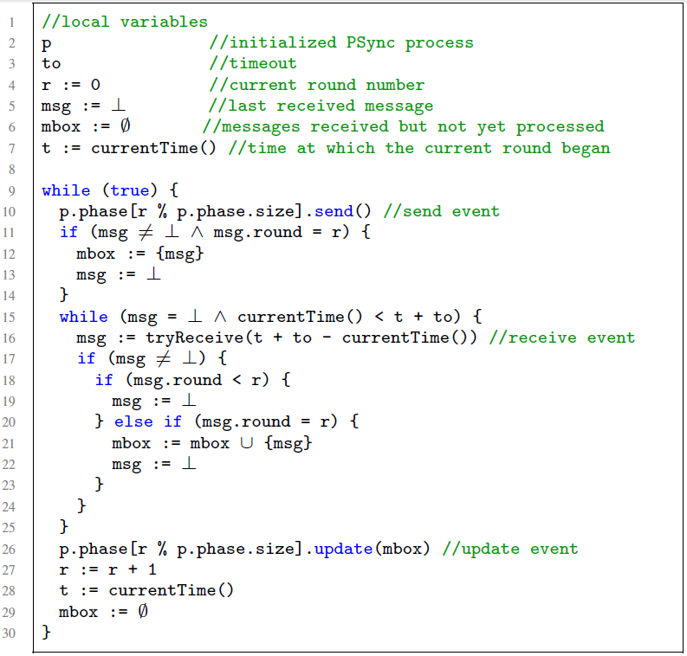
Runtime Algorithm
Round operations
Accumulate messages
Discard late messages
Catching up

Slide 19
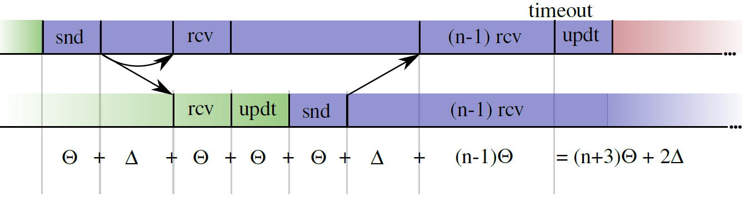

Synchronizing
After GTS, $Θ$ and $Δ$ holds. But, the processes are not be synchronized.
The runtime eventually catches up if the timeout is large enough:

Slide 20
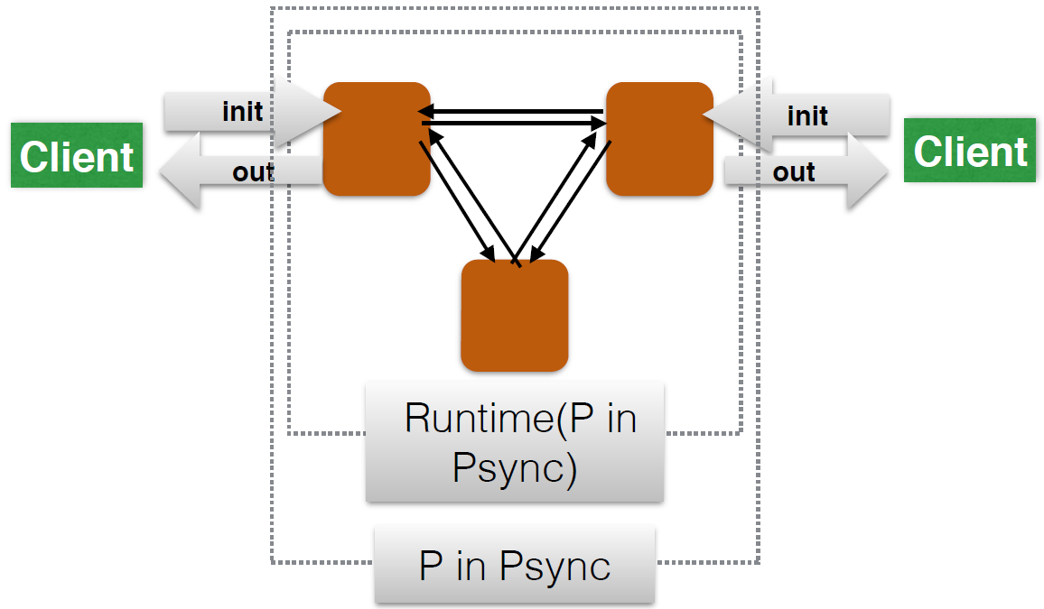
Result (2)
Theorem: Runs(Client || Runtime(P)) ⊆ Runs(Client || P )

Slide 21
Verification

Slide 22
Benefits
Reason about rounds in isolation.
Lock-step semantics, no interleaving.
Promise
Accept
Simple invariants that connects the round at the boundaries.
No message in flight, only local state of the processes.
Notes:
Reasoning in round-based model (partial synchrony):
Communication-closed rounds (simple model for the channels)
Lockstep semantics (no interleaving, mapping asynchrony to faults)
Heard-of model: map process faults on communication faults

Slide 23
Correctness of Fault-tolerant Algorithms
Majority of acceptors
Majority of acceptors
Non-empty intersection
enforces unique decision

Slide 24






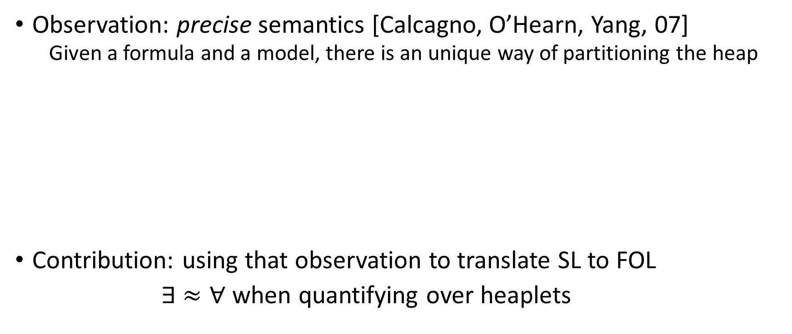


Verification: partial invariant for Paxos
$$∀i. ¬decided\left(i\right)∧¬ready\left(i\right)$$
$$∨$$
$$∃ v, t, A. A=\left\{ i. ts\left(i\right)>t\right\}∧\left|A\right|>n/2$$
$$∧$$
$$∀i. i∈A⇒x\left(i\right)=v$$
$$∧$$
$$∀i. decided(i)⇒x\left(i\right)=v$$
$$∧$$
$$∀i. commit\left(i\right)∨ready(i)⇒vote\left(i\right)=v$$
$$∧$$
$$t≤Φ$$
$$∧$$
$$∀i. ts\left(i\right)=Φ⇒commit(coord\left(i\right))=v$$

Slide 25
Result (3)
Theorem:
Given a specification S closed under indistinguishability,
if a PSync program P satisfies S then
the asynchronous semantics of P refines S.
Consensus is closed under indistinguishability

Slide 26

Implementation
https://github.com/dzufferey/psync
Implemented in Scala, Apache 2.0 license
Runtime is stable
Verification is still proof of concept

Slide 27
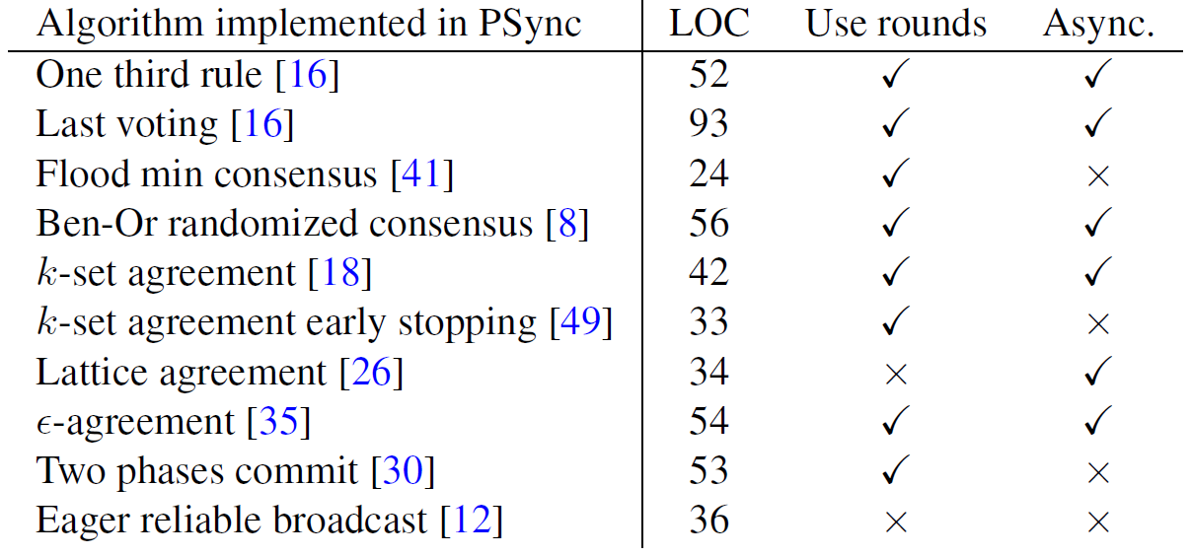
Result: do algorithms use rounds ?

Slide 28
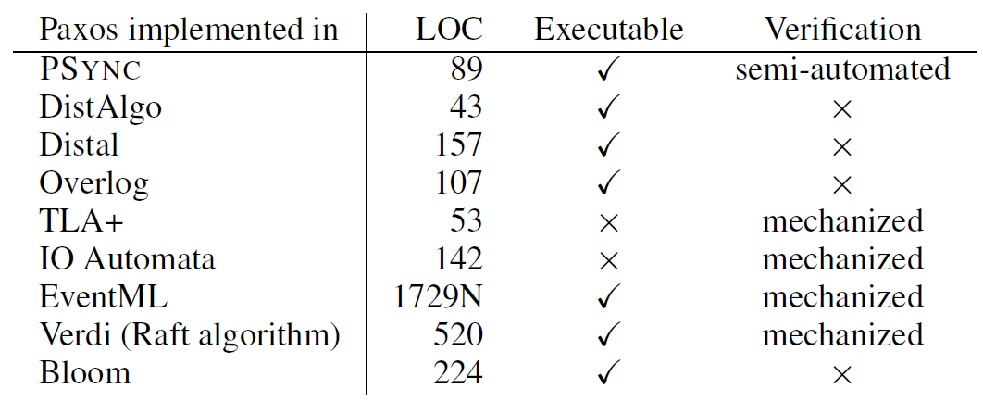
Result: code size (easy to implement)

Slide 29
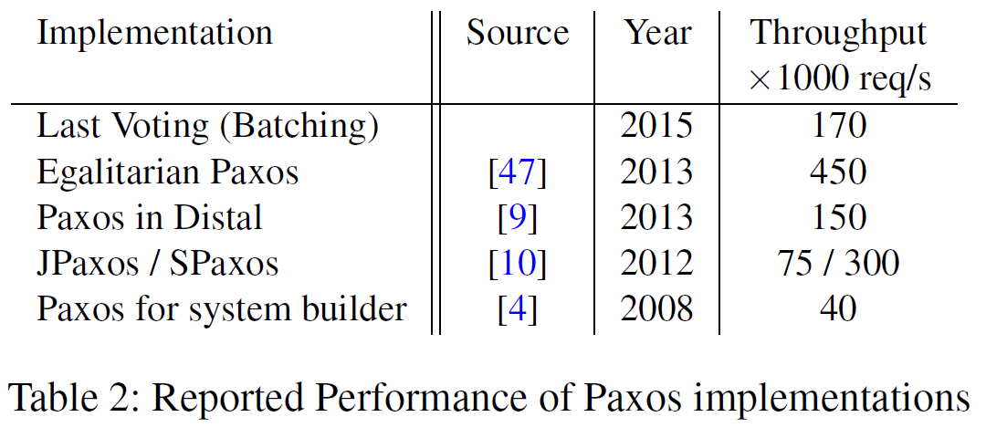
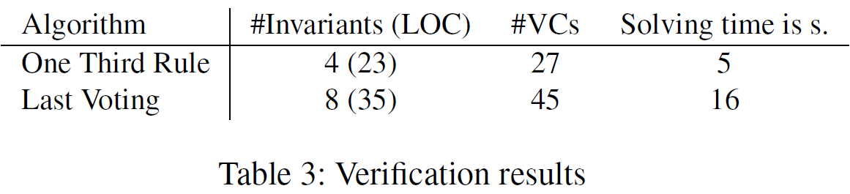
Result: performance and verification

Slide 30
Conclusion
Building fault-tolerant distributed systems is hard and important
PSync uses a simple programming abstraction: the HO-model
Lockstep semantics
Communication-closed rounds
Asynchrony and faults as an adversary that drops messages
Automated reasoning/verification becomes possible
Runtime
Asynchronous semantics which is indistinguishable from the lockstep semantics
Can be implemented efficiently

Slide 31
The Heard-Of model [Charron-Bost & Schiper 09]
Intuitive model:
communication-closed rounds
send and update operations
Illusion of synchrony
a single process cannot distinguish between a synchronous and an asynchronous execution
Maps every faults to message faults
A crashed process is the same as a process whose messages are dropped.
Byzantine faults can be simulated altering messages
Simplify the proofs: does not need to case split on (in)correct processes
Handling transient/permanent faults is transparent at the algorithm level
Developed for theoretical simplicity
Notes:
We try to the HO-model into a DSL.

Slide 32
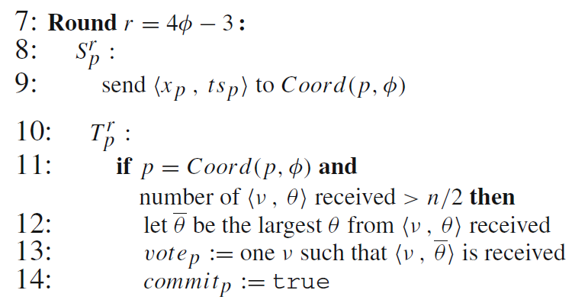
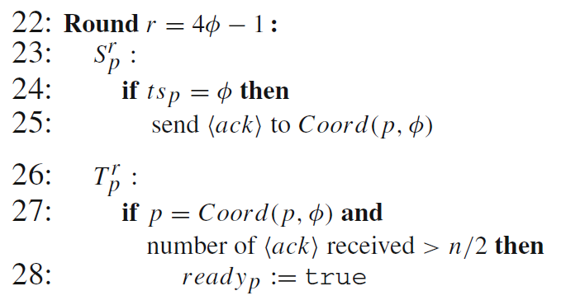
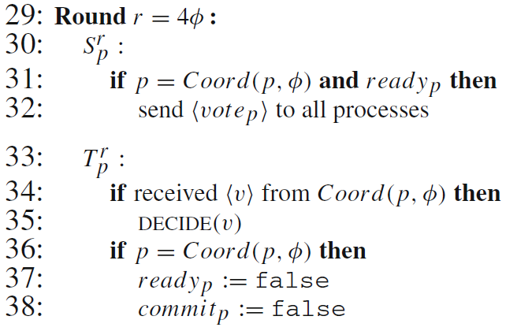
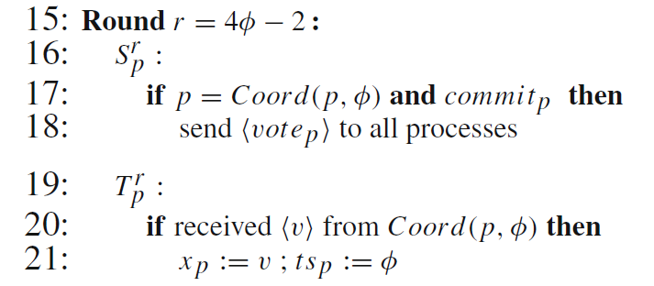
Example: Last Voting Algorithm
Coordinator

