Slide 1
PSync: A Partially Synchronous Language for Fault-tolerant Distributed Algorithms
Cezara Drăgoi, INRIA ENS CNRS
Thomas A. Henzinger, IST Austria
Damien Zufferey, MIT CSAIL
EPFL, 2015.12.22

Slide 2



Motivation
Replication

Slide 3
Replication and consistency
X = -13
Consensus
X = 42
X = 4
X = 42
X = 42
Integrity
X = 42
Agreement
Irrevocability: Every correct process decides at most one value.
Termination: Every correct process eventually decides.

Slide 4
The Paxos Algorithm [Lamport 98]
Prepare
Promise
Accept
Accepted
Proposer
Acceptor
Acceptor
Used at Google (Chubby), Microsoft (Autopilot), …
Notes:
Principle
establish majority
witness majority
decision becomes effective
Retry if fails

Slide 5
Paxos in the Literature
The part-time parliament [Lamport 98]
Paxos made simple [Lamport 01]
Paxos made live: An engineering perspective [Chandra et al. 07]
In search of an understandable consensus algorithm [Ongaro and Ousterhout 14]
Paxos made moderately complex [van Renesse and Altinbuken 15]
Paxos made transparent [Cui et al. 15]
...
Question:
Could the same problem be simpler in different model ?
Notes:
Paxos is also know to confuse people

Slide 6
Why is the PL community concerned ?
Quotes from Paxos made live [Chandra et al. 07]
“The fault-tolerance computing community has not developed the tools to make it easy to implement their algorithms.”
“The fault-tolerance computing community has not paid enough attention to testing, a key ingredient for building fault-tolerant systems.”
“In order to build a real-world system, an expert needs to use numerous ideas scattered in the literature and make several relatively small protocol extensions. The cumulative effort will be substantial and the final system will be based on an unproven protocol.”
Notes:
Nothing wrong with proofs of algorithms, but can do more.
Hard to test: fault masking

Slide 7
Goal: appropriate programming abstraction
source code + specifications
runtime
verifier
executable
proof or
counterexample
Notes:
Source and spec in the same language (or very close)
don’t need to learn another tool
lower the barrier of entry

Slide 8
Challenges to understanding what is going on
n
Parametric systems
Asynchrony (Interleaving, delays)
Channels
Faults
…
Notes:
Picking the right model to make verification easier
Parametric systems: undecidable in general
Interleavings: combinatorial blow-up
Channels: undecidable if FIFO, non-primitive recursive if lossy

Slide 9
Programming Models, Distributed Systems, and Faults
Asynchronous
Synchronous/Timed
We want a simple model that unifies the variations:
Communication-closed rounds
Environment as an adversary
Actor model, CSP,
CCS, pi-calculus, …
Faults as a middle ground
Timed-automata, timed process calculi
Alternation between
good (synchronous) and
bad (asynchronous) periods
Many PL based on or implementing those models
Lustre, Esterel,
Giotto, LabVIEW,
?
Consensus is not solvable with asynchrony and faults [FLP 85].
Benign, Byzantine faults
Crash-stop, crash-recovery
Omission, delay, reordering
…
Not realistic for distributed systems
network contention
crash
Notes:
Fault: alternation between synch and async.

Slide 10
Structure of distributed algorithms: Communication-closed Rounds
Prepare
Promise
Accept
Accepted
Proposer
Acceptor
Acceptor
A round defines the scope of its messages.
[Elrad & Francez 82]: decomposition of algorithm in communication-closed rounds.
[Dwork & Lynch & Stockmeyer, 88] defines round model for non-synchronous models: partial synchrony
Notes:
Round defines a *scope* for the messages

Slide 11
Faults: the environment as an adversary.
C-c rounds + adversary = Heard-Of model [Charron-Bost & Schiper 09]
Semantics:
Contributions: DSL + runtime
Execution:
Notes:
Implementation in an asynchronous world
Asynchrony: no round structure, delays and buffering of messages
Failure detectors to recover some degree of synchrony
We formalize the correspondence between the two worlds in terms of observational refinement.

Slide 12
PSync Program Structure
Program
Round_{T}

Slide 13
PSync example: One Third Rule
new Round[Int]{
def send(): Map[Id,Int] = broadcast(x)
def update(mailbox: Map[Id,Int]) {
if (mailbox.size > 2*n/3) {
x = mmor(mailbox) //min most often received
if (mailbox.filter{ _._2 == x }.size > 2*n/3)
decide(x)
}
}
}
Notes:
In crimson: local variable
In purple: the interface

Slide 14
PSync Lockstep Semantics
Init
Round[0]
Round[1] …
Round[ i%r ]
Send
Update
Env (HO)
Challenge:
Executing the lockstep semantics on a system which
is not synchronous and still guaranteeing liveness.

Slide 15
Result (1)
Indistinguishability:
for every process p, the transitions and states of the projection
of the traces on p agree up to finite stuttering.
Lockstep:
Asynchronous:
Notes:
Importance:
if a process cannot distinguish between two executions then it produce the same result

Slide 16
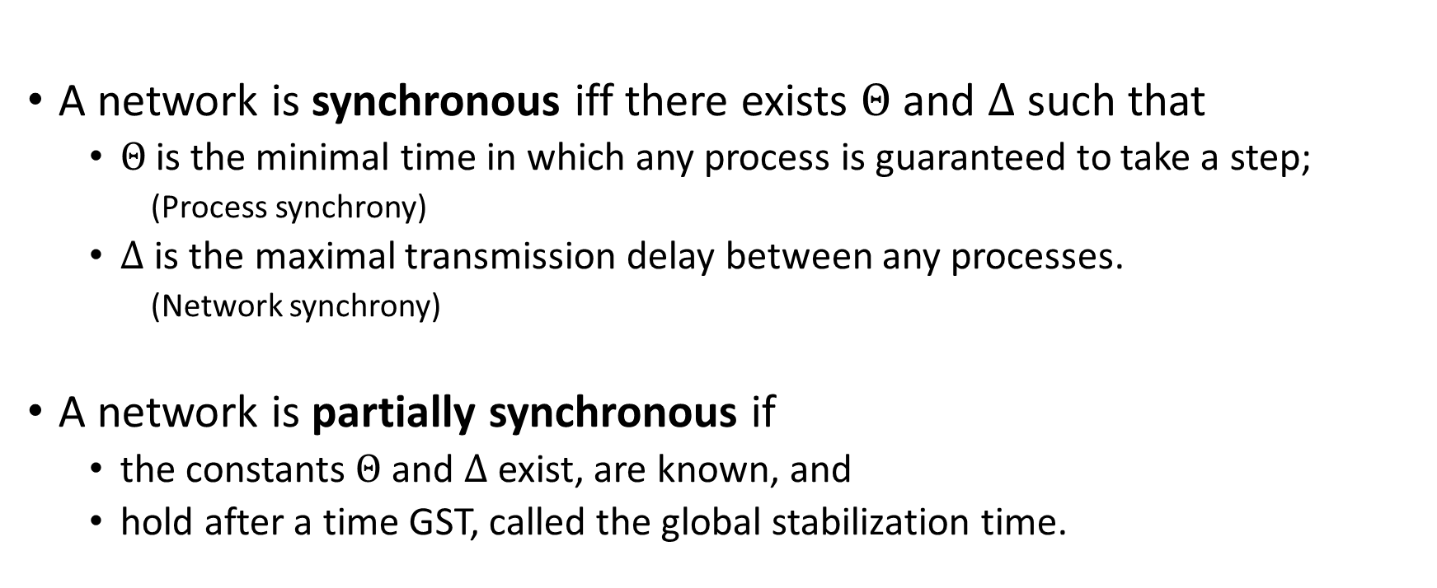
Partial Synchrony [Dwork et al. 88]
A network is synchronous iff there exists $Θ$ and $Δ$ such that
$Θ$is the minimal time in which any process is guaranteed to take a step;
(Process synchrony)
$Δ$ is the maximal transmission delay between any processes.
(Network synchrony)
A network is partially synchronous if
the constants $Θ$ and $Δ$ exist, are known, and
hold after a time GST, called the global stabilization time.
Notes:
Alternation between good and bad period:
the duration of good period is dependent on each algorithm
this definition takes the supremum of all sufficiently long good period

Slide 17
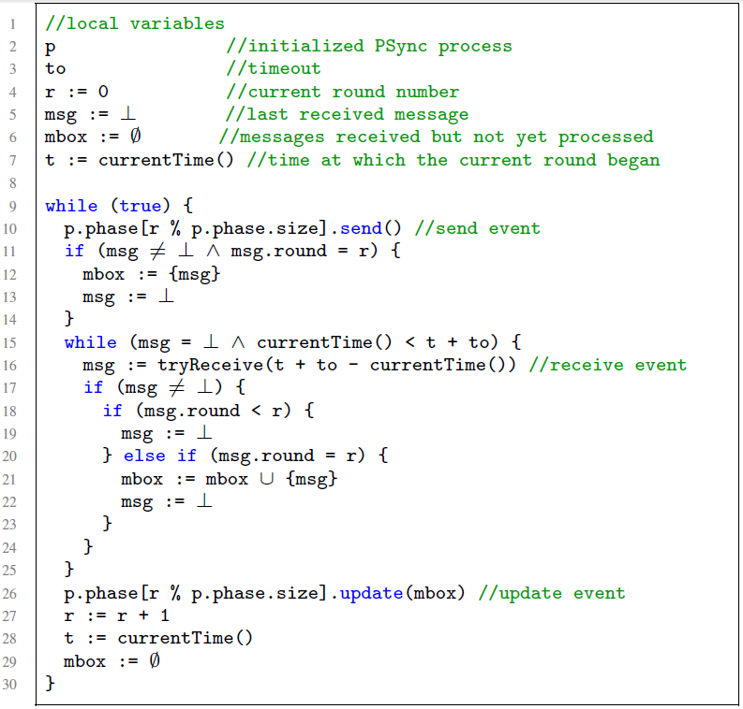
Runtime Algorithm
Round operations
Accumulate messages
Discard late messages
Catching up

Slide 18
Synchronizing: Lockstep trace from exec
For every runtime execution, we build an indistinguishable lockstep execution.
Lockstep:
Runtime synchronized
Asynchronous
Asynchronous
Respect liveness assumptions
Network:
Asynchronous
Synchronous
GST
Notes:
Crashed processes cannot distinguish!!

Slide 19
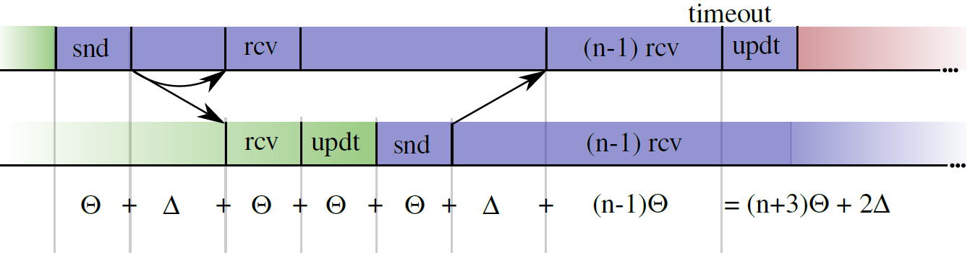

Synchronizing: choosing the timeout
After GST, $Θ$ and $Δ$ holds and the processes synchronize.
The runtime eventually catches up if the timeout is large enough:

Slide 20
Result (2)
Client₁
Init
Init
Client₂
Decide
Decide
Client₃
Init
Decide
Theorem: Observational refinement
Clients ∥ Runtime(P) ⊆ Clients ∥ P
Notes:
Client communicate only with one process
Operation commutes across processes

Slide 21
Verification

Slide 22
Benefits
Reason about rounds in isolation.
Lock-step semantics, no interleaving.
Promise
Accept
Simple invariants that connects the round at the boundaries.
No message in flight, only local state of the processes.
Notes:
Reasoning in round-based model (partial synchrony):
Communication-closed rounds (simple model for the channels)
Lockstep semantics (no interleaving, mapping asynchrony to faults)
Heard-of model: map process faults on communication faults

Slide 23
Correctness of Paxos-like Algorithms
Majority of acceptors
Majority of acceptors
Non-empty intersection
enforces unique decision

Slide 24






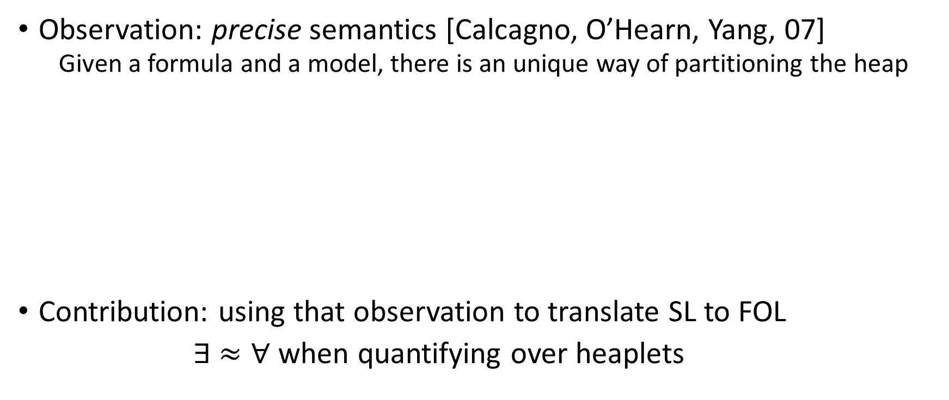


Verification: partial invariant for Paxos
$$∀i. ¬decided\left(i\right)∧¬ready\left(i\right)$$
$$∨$$
$$∃ v, t, A. A=\left\{ i. ts\left(i\right)>t\right\}∧\left|A\right|>n/2$$
$$∧$$
$$∀i. i∈A⇒x\left(i\right)=v$$
$$∧$$
$$∀i. decided(i)⇒x\left(i\right)=v$$
$$∧$$
$$∀i. commit\left(i\right)∨ready(i)⇒vote\left(i\right)=v$$
$$∧$$
$$t≤Φ$$
$$∧$$
$$∀i. ts\left(i\right)=Φ⇒commit(coord\left(i\right))=v$$

Slide 25
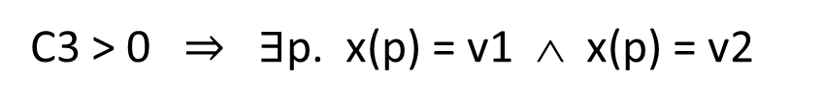
Semi-decision procedure [VMCAI 14]
A
B
|A| > n/2 ∧ |B| > n/2 ∧ v1 ≠ v2 ∧
C3
A = { p. x(p) = v1 } ∧ B = { p. x(p) = v2 }
C1
C2
C4
Venn regions
Linking cardinality and data
C1, C2 > n/2
C1 + C2 + C3 + C4 = n
C1, C2, C3, C4 ≥ 0
n ≥ 1
C3 > 0 $⇒$ $∃$p. x(p) = v1 ∧ x(p) = v2
Decision procedure requires constructing the complete model. (Small model property)

Slide 26
Result (3)
Theorem:
Given a specification S closed under indistinguishability,
if a PSync program P satisfies S then
the asynchronous semantics of P refines S.
Consensus is closed under indistinguishability

Slide 27

Implementation
https://github.com/dzufferey/psync
Implemented in Scala, Apache 2.0 license

Slide 28
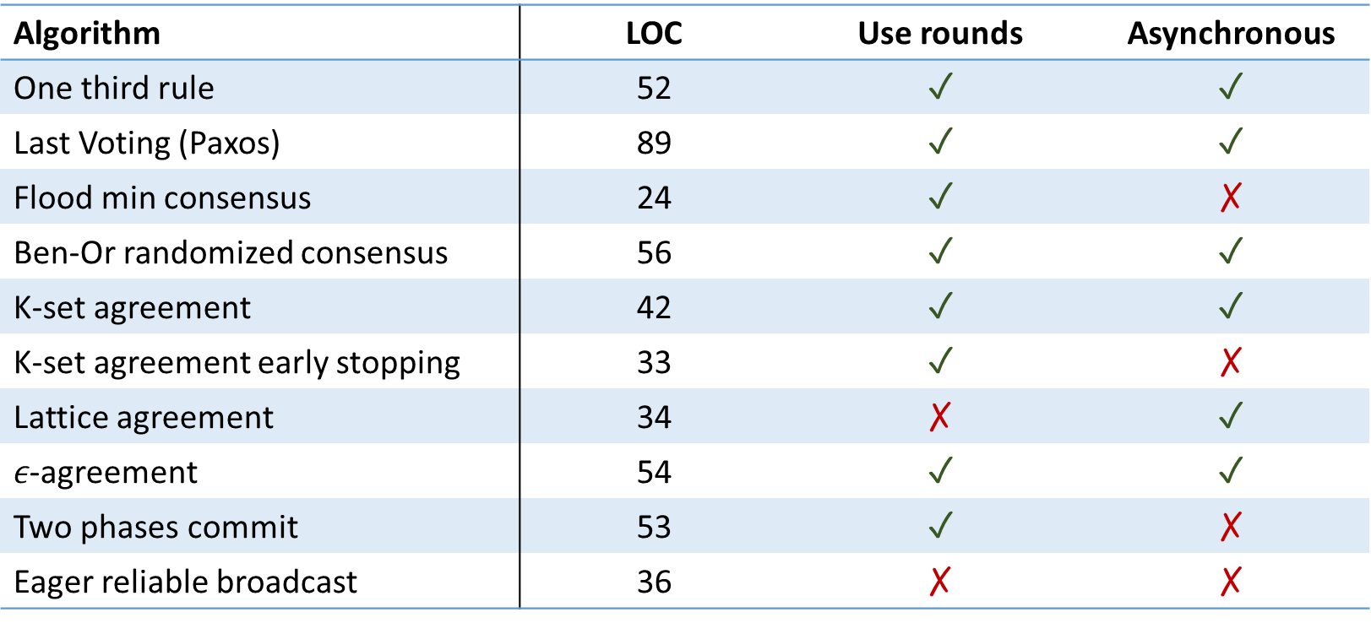
Evaluation: do algorithms use rounds ?
Algorithm | LOC | Use rounds | Asynchronous
One third rule | 52 | ✓ | ✓
Last Voting (Paxos) | 89 | ✓ | ✓
Flood min consensus | 24 | ✓ | ✗
Ben-Or randomized consensus | 56 | ✓ | ✓
K-set agreement | 42 | ✓ | ✓
K-set agreement early stopping | 33 | ✓ | ✗
Lattice agreement | 34 | ✗ | ✓
$ε$-agreement | 54 | ✓ | ✓
Two phases commit | 53 | ✓ | ✗
Eager reliable broadcast | 36 | ✗ | ✗

Slide 29
Evaluation: code size (easy to implement)
Paxos in | LOC | Executable | Verification
PSync | 89 | ✓ | Semi-automated
DistAlgo | 43 | ✓ | ✗
Distal | 157 | ✓ | ✗
Overlog | 107 | ✓ | ✗
TLA+ | 53 | ✗ | Interactive
IO Automata | 142 | ✗ | Interactive
EventML | 1729 N | ✓ | Interactive
Verdi (Raft, linearizability) | 520 | ✓ | Interactive
Bloom | 224 | ✓ | ✗

Slide 30
Evaluation: performance and verification
Implementation | Year | Throughput (x 1000 req./s)
Last Voting in PSync | 2015* | 170
Egalitarian Paxos | 2013 | 450
Paxos in Distal | 2013 | 150
JPaxos / SPaxos | 2012 | 75 / 300
Paxos for system builder | 2008 | 40
Verification of | # Invariants (LOC) | # VCs | Solving time in s.
One third rule | 4 (23) | 27 | 5
Last Voting | 8 (35) | 45 | 16

Slide 31
Conclusion
Building fault-tolerant distributed systems is hard and important
PSync uses a simple programming abstraction: the HO-model
Lockstep semantics
Communication-closed rounds
Asynchrony and faults as an adversary that drops messages
Automated reasoning/verification becomes possible
Runtime
Asynchronous semantics which is indistinguishable from the lockstep semantics
Can be implemented efficiently

Slide 32
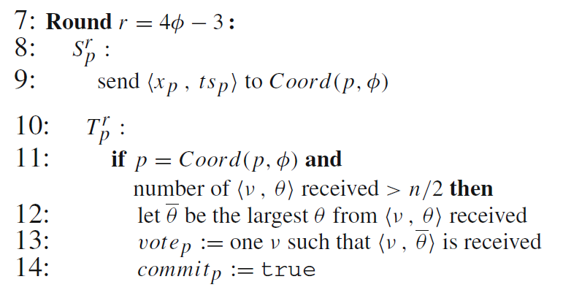
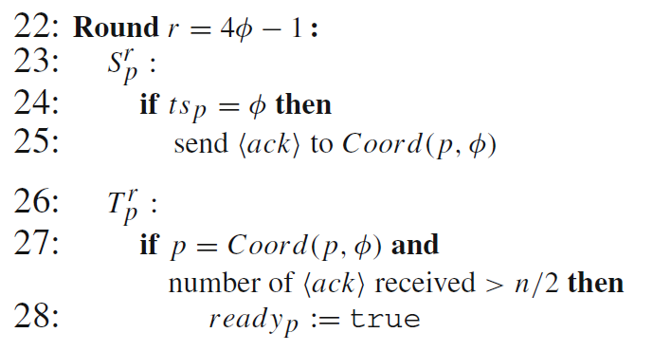
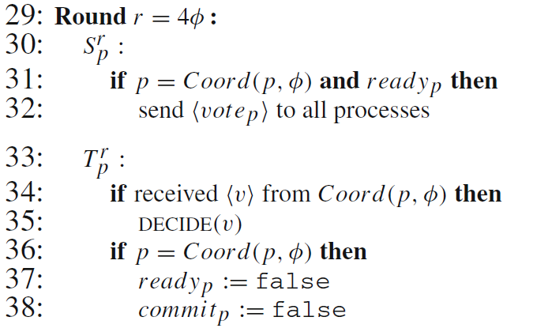
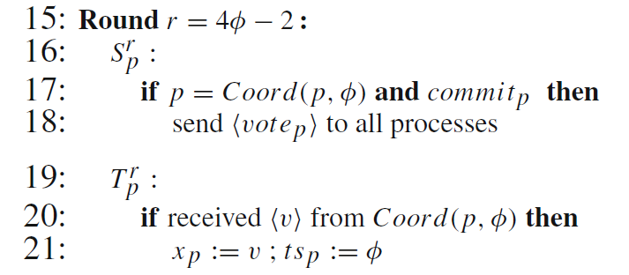
Example: Last Voting Algorithm
Coordinator

