Slide 1
PSync: A Partially Synchronous Language for Fault-tolerant Distributed Algorithms
Cezara Drăgoi, INRIA ENS CNRS
Thomas A. Henzinger, IST Austria
Damien Zufferey, MIT CSAIL
POPL, 2016.1.21

Slide 2



Motivation
Replication

Slide 3
Replication and Consistency
X = -13
Consensus
X = 42
X = 4
X = 42
X = 42
X = 42

Slide 4
The Paxos Algorithm [Lamport 98]
Prepare
Promise
Accept
Accepted
Proposer
Acceptor
Acceptor
Used at Google (Chubby), Microsoft (Autopilot), …
Notes:
Principle
establish majority
witness majority
decision becomes effective
Retry if fails
Not alice and bob, or in the slides

Slide 5
Paxos in the Literature
The part-time parliament [Lamport 98]
Paxos made simple [Lamport 01]
Paxos made live: An engineering perspective [Chandra et al. 07]
In search of an understandable consensus algorithm [Ongaro and Ousterhout 14]
Paxos made moderately complex [van Renesse and Altinbuken 15]
Paxos made transparent [Cui et al. 15]
...
Question:
Could the same problem be simpler in different model ?
Notes:
Paxos is also know to confuse people

Slide 6
Contributions
Main elements:
Communication-closed rounds
The environment as an adversary
PSync: a DSL to simplify the implementation and reasoning about fault-tolerant algorithms.
Simple round-based model
Efﬁcient runtime system
Automated veriﬁcation
source code + specifications
runtime
verifier
executable
proof or
counterexample
Notes:
Decouple network and timer code from the logic
We are not going to replace Paxos but get you part of the way

Slide 7
Asynchronous Programming Model and Faults
Asynchrony
Actor model, CSP,
CCS, pi-calculus, …
Many PL based on or implementing these models
Fault
Consensus is not solvable with asynchrony and faults [FLP 85].
Waiting for a message
Notes:
Fault: alternation between synch and async.
Result: complex code, timer all over the place

Slide 8
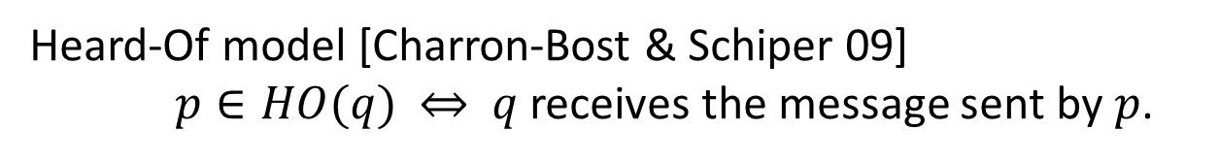
Faults as an adversarial Environment [Gafni 98]
Abstraction:
Execution:
Heard-Of model [Charron-Bost & Schiper 09]
$p∈HO(q)$ $⇔$ $q$ receives the message sent by $p$.
Notes:
We formalize the correspondence between the two worlds in terms of observational refinement.

Slide 9
Communication-closed Rounds [Elrad & Francez 82]
Prepare
Promise
Accept
Accepted
Proposer
Acceptor
Acceptor
A round is
a logical unit of time,
a scope for the messages,
the granularity of messages reception.

Slide 10
PSync Program Structure
Program
Round_{T}

Slide 11
PSync Lockstep Semantics
Init
Round[0]
Round[1] …
Round[ i mod r ]
Send
Update
Env (HO)
Challenge:
Executing the lockstep semantics on a system which
is not synchronous and provide liveness guarantees.
Notes:
Says what r is

Slide 12
Example: Last Voting Algorithm
Collect
Candidate
Quorum
Accept
Coordinator
new Round[(Int,Time)]{
def send(): Map[ProcessID, (Int,Time)] = Map( coord -> (x, ts) )
def update(mailbox: Map[ProcessID, (Int,Time)]) {
if (id == coord && mailbox.size > n/2) {
vote = mailbox.maxBy(_._2._2)._2._1 // value with maximal ts
commit = true
}
} }

Slide 13
Preserving Local Views
Theorem
Lockstep:
Indistinguishable
Runtime:
Indistinguishability
for every process p, the transitions and states of the projection
of the traces on p agree up to finite stuttering.
Notes:
Importance:
if a process cannot distinguish between two executions then it produce the same result
No Assumptions for safety
Partial Synchrony for liveness

Slide 14
Runtime Algorithm
Send
Accumulate
Receive
Next round
Catching up
Discard late
messages
TO
Update
Preserve liveness assuming partial synchrony [Dwork et al. 88]
Notes:
TODO as an automaton

Slide 15
From Indistinguishability to Refinement
Client₁
Init
Init
Client₂
Decide
Decide
Client₃
Init
Decide
Theorem: Observational refinement
Clients ∥ Runtime(P) ⊆ Clients ∥ Lockstep(P)
Notes:
Client communicate only with one process
Operation commutes across processes

Slide 16
Benefits for Verification
Reason about rounds in isolation.
Lockstep semantics, no interleaving.
Promise
Accept
Simple invariants that connects the round at the boundaries.
No message in flight, only local state of the processes.
Previous work on a logic verification of consensus algorithms [VMCAI 14]
Notes:
Reasoning in round-based model (partial synchrony):
Communication-closed rounds (simple model for the channels)
Lockstep semantics (no interleaving, mapping asynchrony to faults)
Heard-of model: map process faults on communication faults

Slide 17
Preserving Global Properties
Theorem:
Given a specification S closed under indistinguishability,
if a PSync program P satisfies S then
the asynchronous semantics of P refines S.
Consensus is closed under indistinguishability.
Verification engine for safety and liveness properties based on SMT.

Slide 18

Implementation
https://github.com/dzufferey/psync
Implemented in Scala, Apache 2.0 license

Slide 19
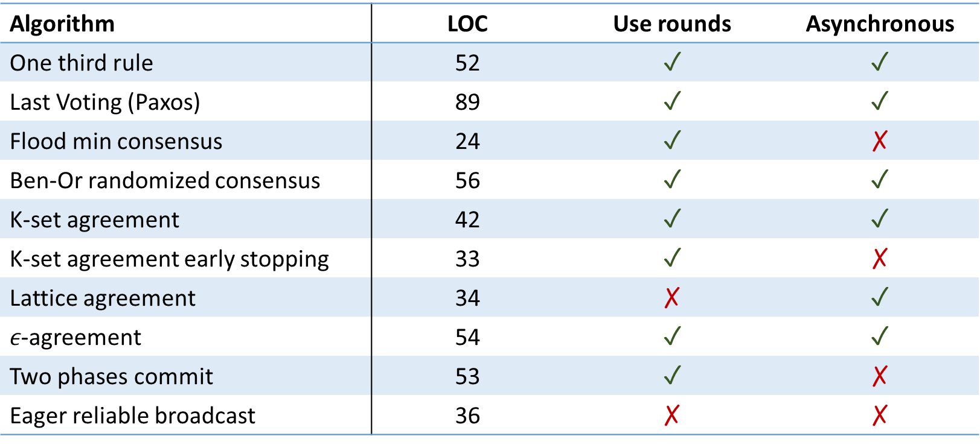
Do Algorithms use Rounds ?
Algorithm | LOC | Use rounds | Asynchronous
One third rule | 52 | ✓ | ✓
Last Voting (Paxos) | 89 | ✓ | ✓
Flood min consensus | 24 | ✓ | ✗
Ben-Or randomized consensus | 56 | ✓ | ✓
K-set agreement | 42 | ✓ | ✓
K-set agreement early stopping | 33 | ✓ | ✗
Lattice agreement | 34 | ✗ | ✓
$ε$-agreement | 54 | ✓ | ✓
Two phases commit | 53 | ✓ | ✗
Eager reliable broadcast | 36 | ✗ | ✗

Slide 20
Code Size (Easy to Implement)
Paxos in | LOC | Executable | Verification
PSync | 89 | ✓ | Semi-automated
DistAlgo | 43 | ✓ | ✗
Distal | 157 | ✓ | ✗
Overlog | 107 | ✓ | ✗
TLA+ | 53 | ✗ | Interactive
IO Automata | 142 | ✗ | Interactive
EventML | 1729 N | ✓ | Interactive
Verdi (Raft) | 520 | ✓ | Interactive
Bloom | 224 | ✓ | ✗

Slide 21
Performance and Verification
Implementation | Year | Language | Throughput (x 1000 req./s)
Last Voting in PSync | 2015 | Scala | 170
Egalitarian Paxos | 2013 | Go | 450
Paxos in Distal | 2013 | Scala | 150
JPaxos / SPaxos | 2012 | Java | 75 / 300
Paxos for system builder | 2008 | C | 40
Verification of | # Invariants (LOC) | # VCs | Solving time in s.
One third rule | 4 (23) | 27 | 5
Last Voting | 8 (35) | 45 | 16

Slide 22
Conclusion
PSync uses a simple programming abstraction: the HO-model
Lockstep semantics
Communication-closed rounds
Asynchrony and faults as an adversary that drops messages
Automated verification becomes possible
Runtime
Asynchronous semantics indistinguishable from the lockstep semantics
Can be implemented efficiently

Slide 23
Replication and Consistency
X = -13
Consensus
X = 42
X = 4
X = 42
X = 42
Integrity
X = 42
Agreement
Irrevocability: Every correct process decides at most one value.
Termination: Every correct process eventually decides.

Slide 24
Challenges
n
Parametric systems
Asynchrony (interleaving, delays)
Channels
Faults
…
Notes:
Picking the right model to make verification easier
Parametric systems: undecidable in general
Interleavings: combinatorial blow-up
Channels: undecidable if FIFO, non-primitive recursive if lossy

Slide 25
Programming Models, Distributed Systems, and Faults
Asynchronous
Synchronous/Timed
We want a simple model that unifies the variations:
Communication-closed rounds
Environment as an adversary
Actor model, CSP,
CCS, pi-calculus, …
Timed-automata, timed process calculi
Faults as a middle ground
Many PL based on or implementing those models
Alternation between
good (synchronous) and
bad (asynchronous) periods
Lustre, Esterel,
Giotto, LabVIEW,
?
Consensus is not solvable with asynchrony and faults [FLP 85].
Not realistic for distributed systems
network contention
crash
Notes:
Fault: alternation between synch and async.

Slide 26
Example: Last Voting Algorithm (2)
Collect
Candidate
Quorum
Accept
Coordinator
new Round[Int]{
def send(): Map[ProcessID,Int] =
if (id == coord && commit) broadcast(vote)
else Map.empty
def update(mailbox: Map[ProcessID,Int]) {
if (mailbox contains coord) {
x = mailbox.get(coord)
ts = r/4
} } }
Notes:
remove

Slide 27
Example: Last Voting Algorithm (3)
Collect
Candidate
Quorum
Accept
Coordinator
new Round[Int]{
def send(): Map[ProcessID,Int] =
if ( ts == r/4 ) Map( coord -> x )
else Map.empty
def update(mailbox: Map[ProcessID,Int]) {
if (id == coord && mailbox.size > n/2)
ready = true
} }

Slide 28
Example: Last Voting Algorithm (4)
Collect
Candidate
Quorum
Accept
Coordinator
new Round[Int]{
def send(): Map[ProcessID, Int] =
if (id == coord && ready) broadcast(vote)
else Map.empty
def update(mailbox: Map[ProcessID,Int]) {
if (mailbox contains coord))
decide( mailbox(coord) )
ready = false; commit = false
} }

Slide 29
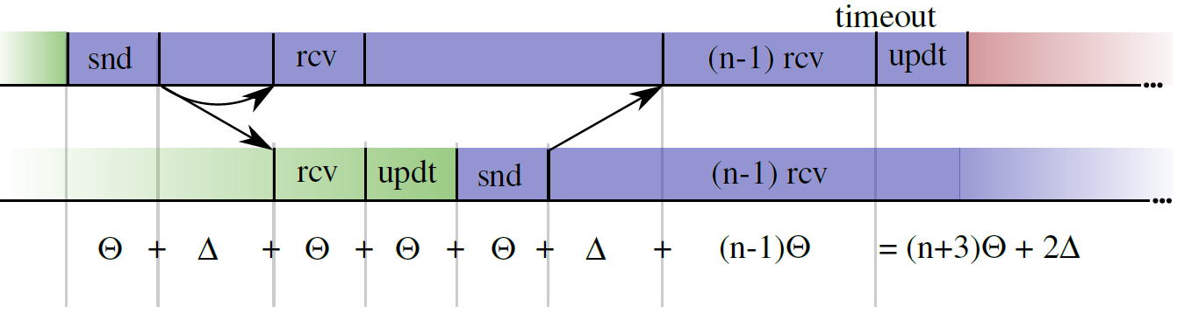

Synchronizing: Choosing the Timeout
$Θ$: time needed for the slowest process to make a step
$Δ$: network delay
After GST, $Θ$ and $Δ$ holds

Slide 30
Partial Synchrony: Lockstep Trace from an Exec.
For every runtime execution, we build an indistinguishable lockstep execution.
Runtime Execution
Synchronized
Asynchronous
Asynchronous
Respects liveness assumptions
Network
Asynchronous
Synchronous
GST
Notes:
Crashed processes cannot distinguish!!

Slide 31
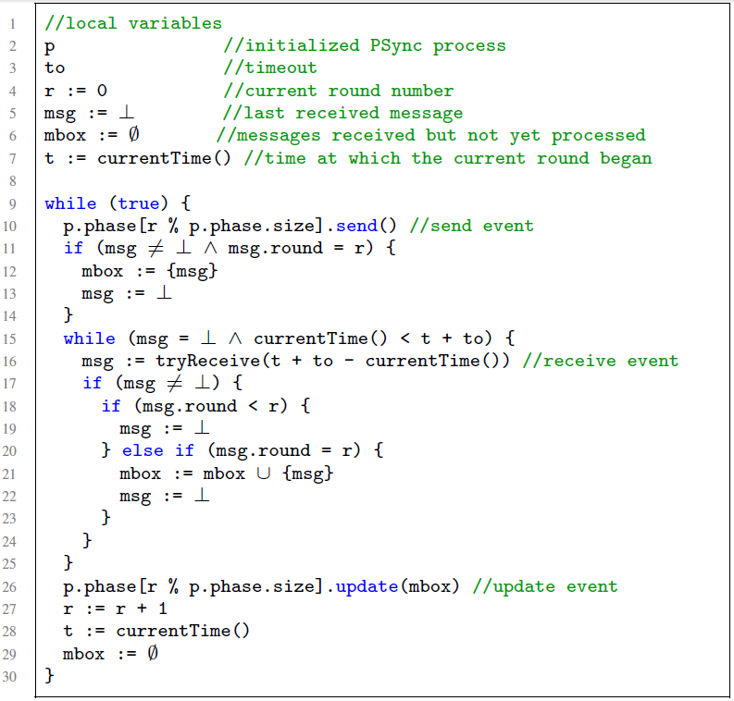
Runtime Algorithm
Round operations
Accumulate messages
Discard late messages
Catching up
Notes:
TODO as an automaton

