Slide 1
δ-Complete Decision Procedure and dReal
Damien Zufferey
MIT CSAIL
ARSBM 2016, 20 Sept 2016
Based on the work of Sicun Gao and Soonho Kong

Slide 2
Outline
Interval constraints propagation (ICP)
  Branch and Prune Algorithm
  Completeness
  dReal Example
Adding ODEs
  dReach Example
  SMT encoding
dReal Tricks

Slide 3
Interval Constraints Propagation
Search for a solution using
  Pruning: interval arithmetic to prune the search space.
  Branching: when pruning is stuck, split the domain of a variable and continue recursively.
Interval arithmetic on double precision numbers
  Rounding errors taken into account
  dReal uses IBEX and CAPD libraries
Use δ>0 to guarantee the termination

Slide 4
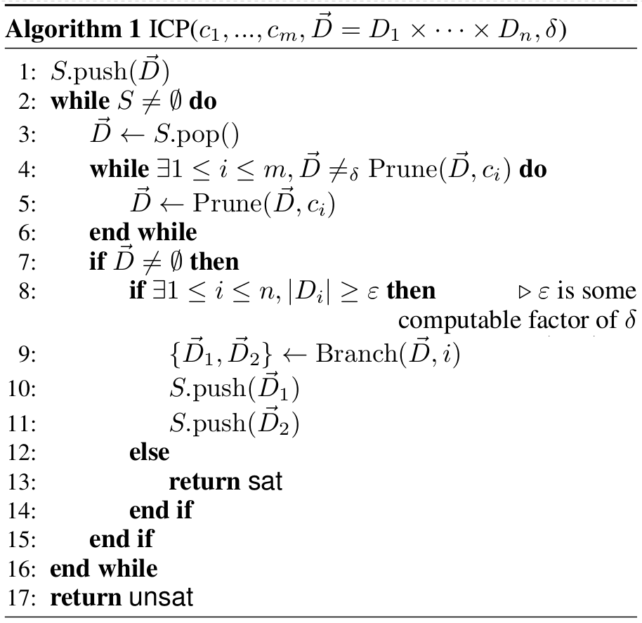
Branch and Prune ICP
D
D
prune
D
branch
D₁
D₂

Slide 5
Branch-and-Prune Example
Prune by B
Prune by A
Branch
Prune by A
Prune by B
Prune by A
Prune by B
A
B

Slide 6
Completeness
δ-satisfiability is NP (PSpace with ODE).
Idea:
  If we can guess a small enough box containing the solution, we can check it in polynomial time using interval arithmetic.
  If the problem is unsatisfiable, we need to explore a potentially exponential number of small boxes and show that all of them are empty.
Takeaway message:
  Nonlinear theories over the reals are just polynomially harder than SAT.

Slide 7
dReal
Description: http://dreal.github.io/
Getting the tool: https://github.com/dreal/dreal3
GPL3 license
Runs natively on Linux and Mac
Runs on Windows via Docker

Slide 8
dReal Frontends
SMT2
dr
(set-logic QF_NRA)
(declare-fun x () Real)
(declare-fun y () Real)
(assert (< 2.4 x))
(assert (< x 2.6))
(assert (< -10.0 y))
(assert (< y 10.0))
(assert
(and
(= y (cos x))
)
)
(check-sat)
(exit)
var:
[2.4, 2.6] x;
[-10, 10] y;
ctr:
y = cos(x);

Slide 9
dReal Example

Slide 10
What We Support
Types: Real, Int, Bool
  Int are handled in the ICP by a special contractor.
  Bool are handled before the ICP by a SAT solver.
Functions:
  polynomials, trigonometric functions, logarithms, …
  (We will discuss very soon about the ODEs.)
NRA solver
prune
SAT solver

Slide 11
ODEs and dReach
dReal support ODEs directly in the SMT2 interface with a QF_NRA_ODE logic but the notation is non-standard.
The dReach tool is much more user-friendly.
dReach is a BMC that generates a dReal query from an hybrid automata

Slide 12
dReach Syntax
[0, 20] x;
[-9.8] g;
[-100, 100] v;
[0, 10] time;
{ mode 2;
invt:
(v >= 0);
(x >= 0);
flow:
d/dt[x] = v;
d/dt[v] = g;
jump:
(v = 0) ==>
@1 (and (x' = x)
(v' = v));
}
{ mode 1;
invt:
(v <= 0);
(x >= 0);
flow:
d/dt[x] = v;
d/dt[v] = g;
jump:
(x = 0) ==>
@2 (and (x' = x)
(v' = (0 - v)));
}
init:
@1 (and (x = 10) (v = 0));
goal:
@2 (and (x = 1) (v >= 1));

Slide 13
dReach Example

Slide 14
SMT Encoding (1)
Variables
Mode invariants
(declare-fun mode_i () Real)
(declare-fun time_i () Real)
(declare-fun x_i_0 () Real)
(declare-fun x_i_t () Real)
(declare-fun v_i_0 () Real)
(declare-fun v_i_t () Real)
(assert (and
(forall_t 1 [0 time_i] (>= x_i_t 0) (<= v_i_t 0))
(forall_t 2 [0 time_i] (>= x_i_t 0) (>= v_i_t 0))
))

Slide 15
SMT Encoding (2)
Flow declaration
Jump conditions
(declare-fun x () Real)
(declare-fun v () Real)
(define-ode flow_1 (
(= d/dt[x] v)
(= d/dt[v] g) ))
(define-ode flow_2 (
(= d/dt[x] v)
(= d/dt[v] g) ))
(assert (or (and (= mode_i 1) (= mode_j 2) (= x_i_t 0)
(= x_j_0 x_i_t) (= v_j_0 (- v_i_t)))
(and (= mode_i 2) (= mode_j 1) (= v_i_t 0)
(= x_j_0 x_i_t) (= v_j_0 v_i_t))))

Slide 16
SMT Encoding (3)
Connecting the flows
Other elements
  Initial and final conditions
  Bounds for all the variables
  ...
(assert (or
(and (= mode_i 1)
(= [x_i_t v_i_t] (integral 0. time_i [x_i_0 v_i_0] flow_1)))
(and (= mode_i 2)
(= [x_i_t v_i_t] (integral 0. time_i [x_i_0 v_i_0] flow_2)))
))

Slide 17
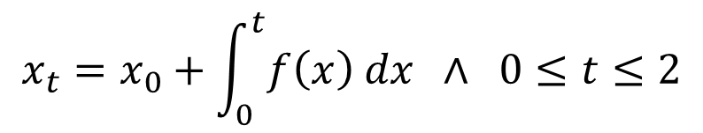



ODEs, dReal, and Completeness
is just a pruning operator over the domain

Slide 18
dReal Tricks
Julia bindings, C API, etc.
Precision (δ)
  Option: --precision 0.1
  In SMT file: (set-option :precision 0.1)
Model Generation
  Option: --model
Polytope contractor
  Option: --polytope
Branching heuristics
  Options: --gradbranch, --scoring-icp

Slide 19
What Comes Next
More efficient search heuristics (!!!)
∃∀ formula
More parallelism
...

Slide 20
Conclusion
dReal is an SMT solver for nonlinear theories over the reals
dReach is a bounded model checker for hybrid systems. dReach uses dReal as backend.
If you have questions, contact us by email, open issues on github. Pull-requests on github are also welcome.

