Slide 1

SuppBuddy
The pocket lab for your supplements
Akshay · Kevin · Will · David · Trevor · James
Notes:
Intro and Trevor

Slide 2



You Can’t Check What's in the Bottle, Till Now
776
No FDA approval before sale
Fillers and contamination are invisible to the human eye
supplements found with hidden drugs over 10 years, and that's only the ones the FDA caught
Lab tests are too expensive
JAMA Network Open, 2018 (FDA data, 2007 to 2016)
Notes:
Trevor – slides 1 and 2 should be 1 min

Slide 3
Compound Fingerprinting
Nephelometry
elastic scatter off particles
Spectral absorbance from transmission
Each compound absorbs its own mix of wavelengths (Beer–Lambert), providing a compound fingerprint.
4-light source
White, Red, Green, Blue
Transmission
absorbance, Beer–Lambert
Turbidity from 90° scatter
True solutions barely scatter, but suspended solids do, even after mixing.
Particle size from scatter vs. color
Particles smaller than the wavelength scatter blue more, but big starch granules scatter all colors alike.
Mixed Solution Sample
Notes:
Akshay – 1 minute

Slide 4
DEMO
Notes:
David – 1 minute

Slide 5
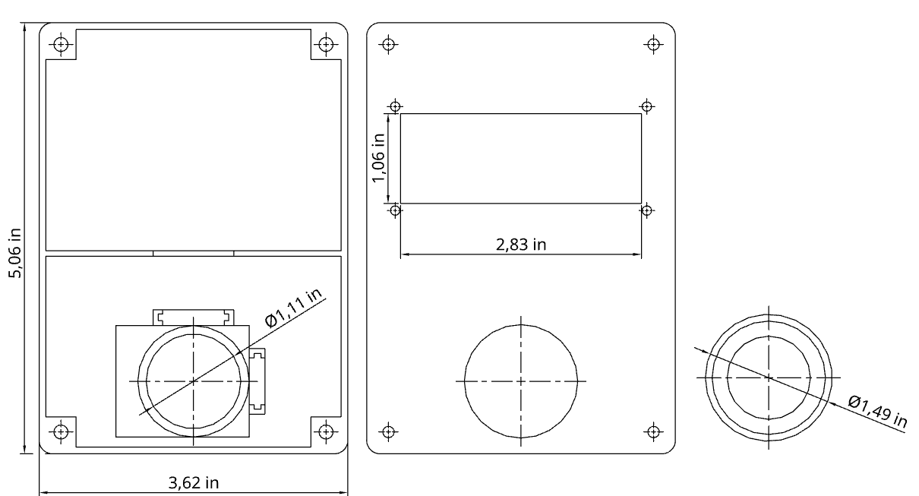
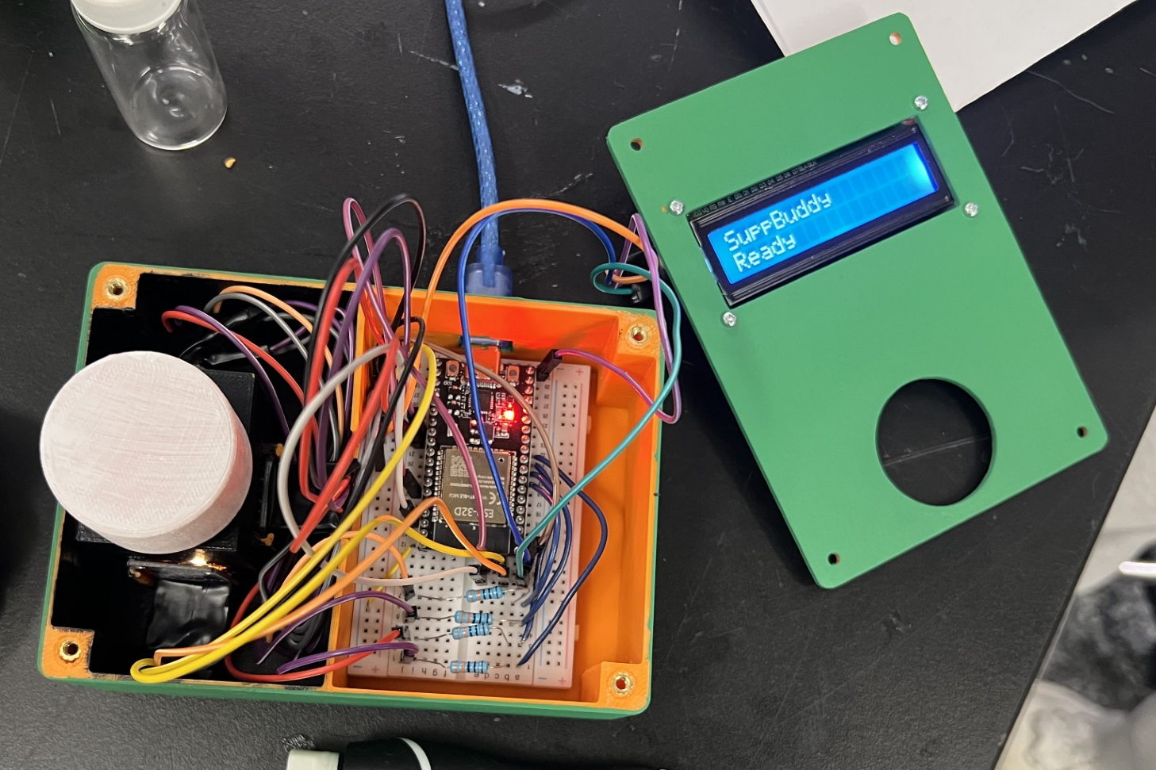
CAD Design and Manufacturing
Notes:
James – slides 5 – 8 1 minute

Slide 6
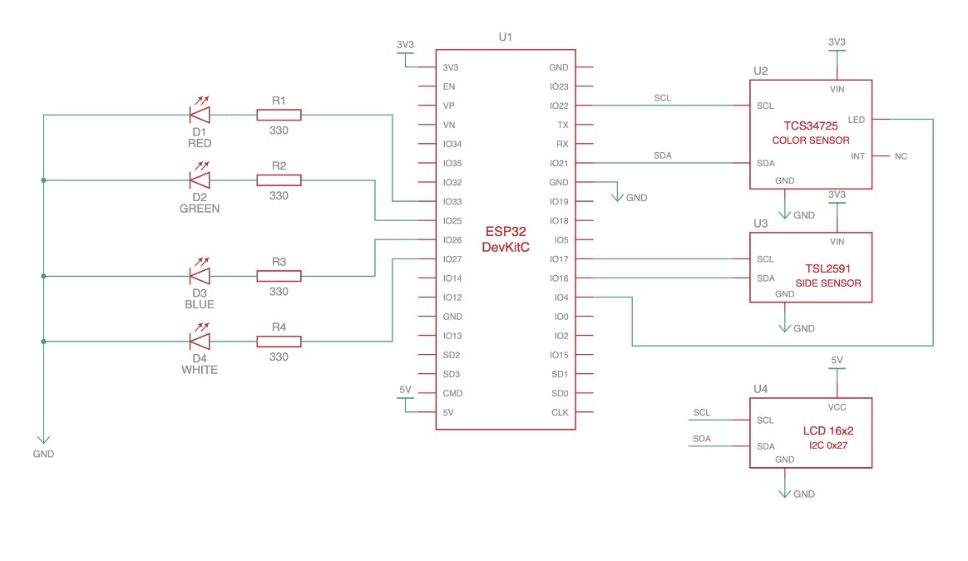
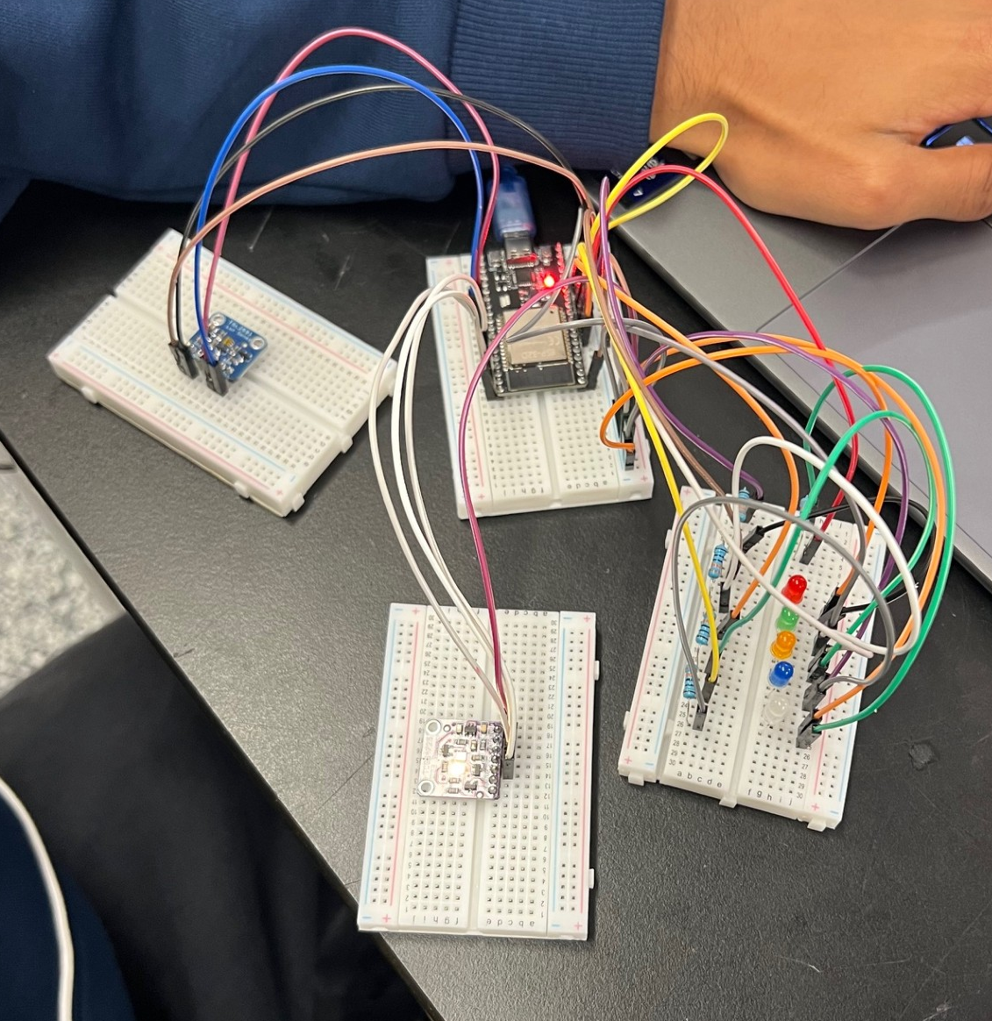
Circuit Schematic and Wiring
Notes:
Kevin

Slide 7
How SuppBuddy Works
Measure
4 colors of light in 30 seconds
Analyze
Absorbance spectrum, turbidity, light scatter
Compare
Scans the internet and cross-check FDA & NIH records
Verdict
Flag anomalies
Report
Easy-to-read results obtained using Claude API
Notes:
Will
2 weak signals
Light signal
Label and online data

Slide 8
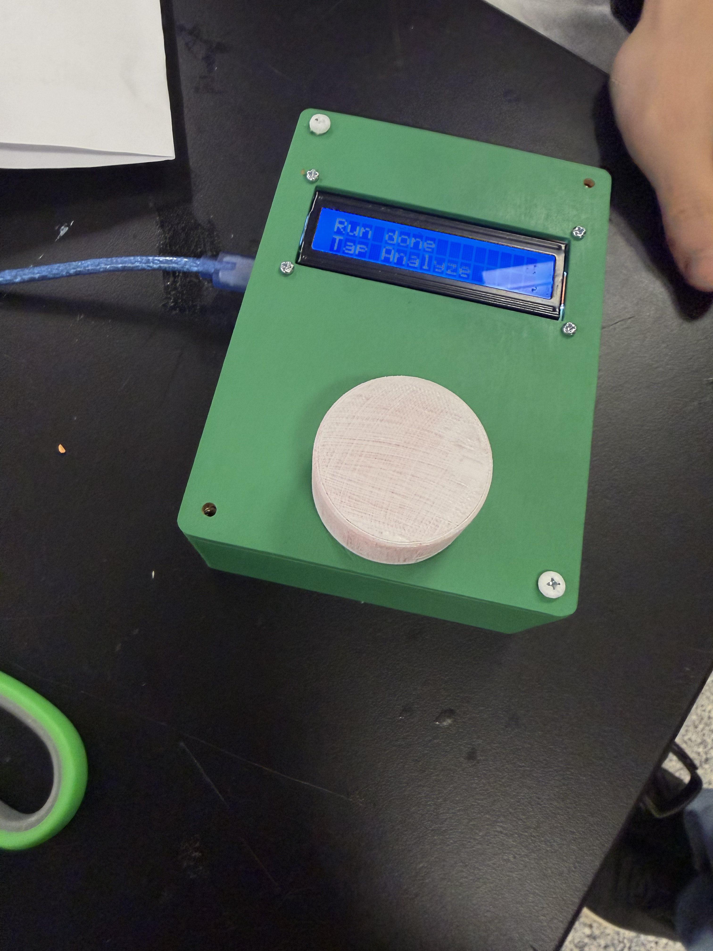
You shouldn't need a lab to know what you’re consuming
Notes:
David

