Slide 1
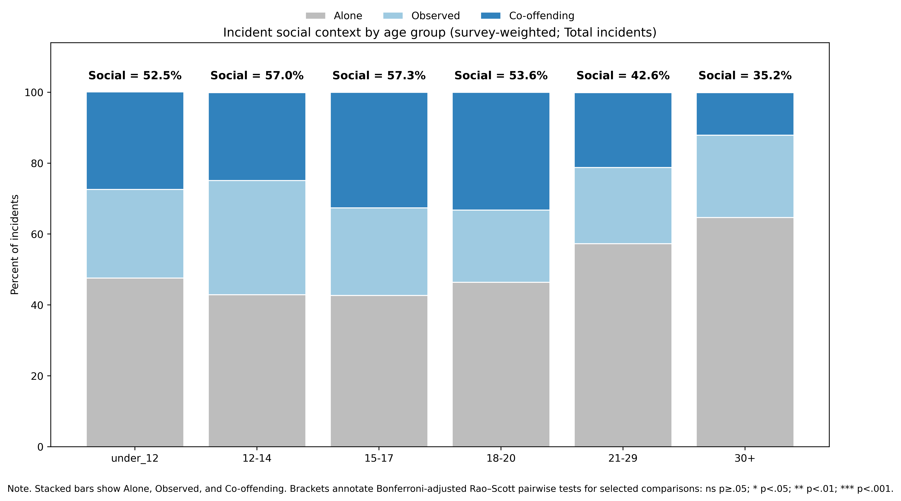
Adolescent Elevation in Social Offending: Survey-Weighted NCVS Incident Analyses (2014–2022)
Danny Zweben • CABLAB
Background & Question
Data, Measures, & Analytic Approach
Results (Effect Sizes + Inference)
• Goal: quantify whether incidents involving multiple people are more common in adolescence than adulthood.
• Primary social context: Alone vs Social, where Social = Co-offending + Observed.
• Co-offending analysis: Social = Co-offending only (conventional operationalization).
• Scopes: Total incidents, Theft/property, Violent/nonfatal personal.
Key idea: describe differences in proportions (percentage-point deltas) alongside survey-adjusted tests and odds ratios.
Dataset: National Crime Victimization Survey (NCVS), 2014–2022, incident-level records.
Age groups are NCVS categories; for co-offending incidents, youngest and oldest offender age-group fields are used.
Check on potential missing intermediate ages: 87.0% (weighted) of co-offending incidents have youngest/oldest in the same or adjacent age brackets.
Inference: survey weights + replicate weights (Fay’s BRR); Rao–Scott adjusted tests for tables with Bonferroni-adjusted planned pairwise comparisons; survey-weighted logistic regression for odds of solo offending.
Total (Primary): Social = 57.3% (15–17) vs 35.3% (30+) → Δ = +22.0 points.
Pairwise: 15–17 vs 18–20 not significant after Bonferroni; teen–adult contrasts significant.
Logit (Total): adult groups show higher odds of solo offending vs 15–17 (e.g., 30+ OR ≈ 2.46).
Pattern replicates in Theft and Violent scopes.
Co-offending-only analysis shows the adolescent elevation persists under the conventional definition.
Note: Draft poster scaffold generated from manuscript tables/figures. Final: add citations, sample sizes, and conference footer branding.

