Slide 1
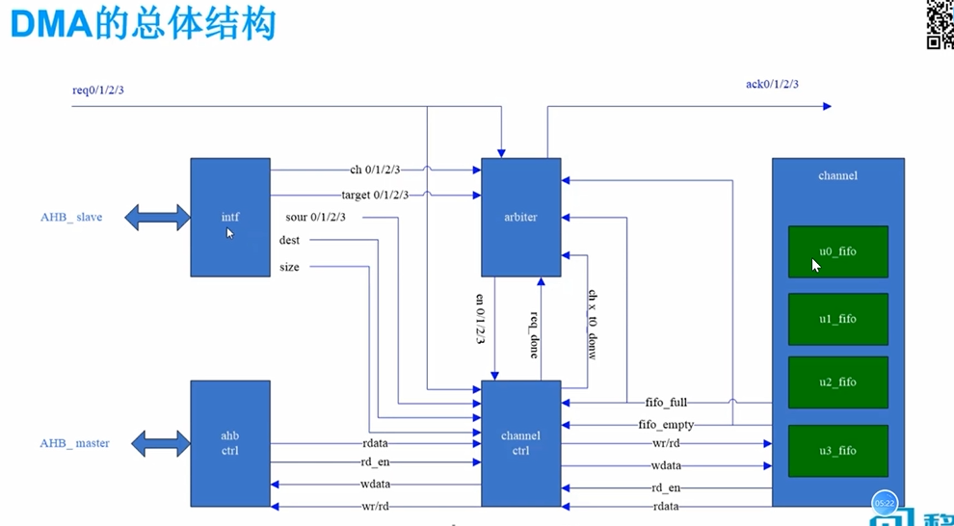

Slide 2
1. Interface模块
HCLK、HRESETn、HSEL、HREADY、HTRANS、HSIZE、HWRITE、HADDR、HWDATA
Interface
HREADYOUT、HRESP、HRDATA
ch_x_ctrl 32位控制信号
ch_x_en 0 通道x使能信号
ch_x_target 4 传输方向 0从memory到外设
ch_x_size 17-8 传输大小
ch_x_sour 32位源地址
ch_x_dest 32位目的地址
x包括0,1,2,3 共四个通道

Slide 3
parameter BASE_ADDR = 32‘h40000000; 定义初始地址
ahb_access = HTRANS[1] & HSEL & HREADY ;
ahb_read = ahb_access & (~HWRITE ) ; 读信号
ahb_write <= ahb_access & HWRITE ; 写信号
if(ahb_access & HWRITE) begin
haddr_d <= HADDR ; 如果写获取地址信号
assign ch_0_ctrl_wr = (ahb_write==1‘b1)&&(haddr_d==BASE_ADDR+0); 使能信号
if(ch_0_ctrl_wr) begin
ch_0_ctrl<= HWDATA; 写数据
assign ch_0_en = ch_0_ctrl[0] ;
assign ch_0_target= ch_0_ctrl[4] ;
assign ch_0_size = ch_0_ctrl[17:8]; 取相应地址数据
if(ahb_read==1'b1 && HADDR==BASE_ADDR+0 )begin
HRDATA <= ch_0_ctrl; 读数据
assign HRESP = 0; 传输状态ok
assign HREADYOUT = 1; 表示ahb slave已准备好或当前数据有效

Slide 4
2. ahb_ctrl模块
rdata 读数据 rd_en高有效
rd_en 读标志信号
hreadyin、hresp、hrdata
ahb_ctrl
channel_ctrl
hsel、htrans、hsize、
hwrite、haddr、hwdata
状态机 IDLE—S0—S1
wr 写使能信号
rd 读使能信号
wdata 写数据，wr高有效
addr 写地址
clk、rst
地址寄存addr_d 数据寄存data_1d
读写使能寄存wr_d、wr_1d、rd_d、rd_1d
Reg[2:0] current_state/next_state 状态机IDLE—S0--S1

Slide 5
读或写有效 IDLE—S0 否则保持
S0自动跳转S1
S1状态下hreadyin=1且有读写信号—S0 没有读写信号跳转IDLE 都没有则保持S1
读写使能寄存器赋值
有读写使能时 addr寄存addr_d
有写使能时 data_1d<=wdata;
输出信号
assign hsel = (c_state==S0)||(c_state==S1 &&(wr_d || rd_d)) ;
assign htrans = ( hsel == 1'b1 )? 2'h2:2'h0;
assign hsize = ( hsel == 1'b1 )? 2'h2:2'h0;
assign hwrite =wr_d ;
assign haddr = ( hsel == 1'b1 )?addr_d:32’h0;
assign rd_en = c_state == S1 && hreadyin==1'b1&& (rd_2d);
assign rdata = (rd_en == 1'b1 ) ? hrdata : 32'h0;
If(hsel) hwdata<=data_1d; 输出写数据

Slide 6
3. Arbiter仲裁器模块
req_x
ack_x
Interface
ch_x_en、target_x
Arbiter仲裁器
clk、rst
fifo_x_full
fifo_x_empty
req_done
ch_x_t0_done
en_x
9个状态 reg [8:0] cs、ns
IDLE ST_0123 W_0123
channel ctrl
channel
x包括0,1,2,3 共四个通道

Slide 7
状态机
IDLE: if (req_0 && (~ack_0)) ns=ST_0;
if (ch_0_en && (~ch_0_t0_done) && (~target_0)) ns=ST_0; memory到外设
if (ch_0_en && (~fifo_0_empty) && (target_0)) ns=ST_0;
ST_0:ns=W_0;自动跳转
W_0：if (~req_done) ns=W_0;
if (req_1) ns=ST_1;
if (ch_1_en && (~ch_1_t0_done) && (~target_1)) ns=ST_1;
if (ch_1_en && (~fifo_1_empty) && (target_1)) ns=ST_1;
if (req_done) ns=IDLE;
else ns=W_0;
…
W_3: if (~req_done) ns=W_3;
else ns=IDLE;
default: ns=IDLE;
if (ns==W_x) en_x<=1; 输出使能信号
if (cs==W_x && req_done && req_x) ack_x<=1; 反馈信号

Slide 8
4. channel模块—例化4个同步fifo
rdata、full、empty
full、empty
clk、rst
clear、wr、rd
wdata
单个fifo
rdata
full、empty
channel ctrl
channel
Arbiter
wr_x、rd_x
u0_fifo
reg [31:0]mem [0:7];
reg [9:0]wr_ptr; 写指针
reg [9:0]rd_ptr; 读指针
reg full_internal; 满信号
reg empty_internal; 空信号
if (wr) wr_ptr<=wr_ptr+1;
if (rd) rd_ptr<=rd_ptr+1;
mem[wr_ptr]<=wdata;
rdata<=mem[rd_ptr];
if (wr && (wr_ptr+1==rd_ptr) && (~rd) || wr_ptr==n && rd_ptr==0 )
full_internal<=1;
if (rd && (~wr)) full_internal<=0;
assign full=full_internal || (wr && (wr_ptr+1==rd_ptr) && (~rd));
clk、rst、 clr_x
u1_fifo
dmac_fifo u0_fifo (
.clk (clk),
.rst (rst),
.clear (clr_0),
.wr (wr_0),
.rd (rd_0),
.wdata (wdata_0),
.rdata (rdata_0),
.full (full_0),
.empty (empty_0)
);
u2_fifo
u3_fifo

Slide 9
5. channel_ctrl模块
Arbiter仲裁器
en_x
仲裁后的通道使能信号
req_done
ch_x_t0_done
通道操作完成信号
req_x
Interface配置: sour_x dest size
Ahb_ctrl: rdata rd_en
channel_ctrl
rdata、rd_en
full、empty
channel
wr_x、rd_x
wdata wr/rd addr
wdata wr/rd addr
T0 存储器到外设
T1 外设到存储器
peri_t0_req t0方向外设请求 mem_t0_req t0方向存储器请求
peri_t1_req t1方向外设请求 mem_t1_req t1方向存储器请求

Slide 10
Target=0时状态机 WP写外设 RM读存储器
S0_IDLE 有外设req时ns=S0_W_P 没有外设req,t0方向memory没有读空ns=S0_R_M
S0_R_M自动跳转S0_WAIT_R 延迟配合总线上两排操作
S0_WAIT_R 读操作结束未完成MAX_TRANS传输 S0_R_M
完成MAX_TRANS传输 S0_IDLE
读操作未结束 S0_WAIT_R
S0_W_P自动跳转S0_WAIT_W
S0_WAIT_W hready为高 S0_IDLE 为低 S0_WAIT_W
Target=1时状态机
S1_IDLE 有外设req时ns=S1_R_P 没有外设req,有memory要写ns=S1_W_M
S1_R_P自动跳转S1_WAIT_R 延迟配合总线上两排操作
S1_WAIT_R rd_en为高 完成读操作 S1_IDLE
rd_en为低 读操作未结束 S1_WAIT_R
S1_W_M自动跳转S1_WAIT_W
S1_WAIT_W hready为高 S1_IDLE 为低 S1_WAIT_W
assign ch0_t0_en=en_0==1 && target_0==0; ch0t0使能信号
peri_t0_req 要求req_x请求 chx_tx_en使能 fifo非空
mem_t0_req chx_t0_en使能 t0_done未完成
en_0_d<=en_0;
assign en_0_r=en_0 && (~en_0_d); 使能信号
if (en_0_r) en_0_r_d<=1;

Slide 11
5. fifo读写操作
assign wr_fifo =rd_en;//rd peri and wr into fifo
assign wr_fifo_data =rdata;
assign rd_fifo_t0 =s0_cs==S0_W_P;
assign rd_fifo_t1 =s1_cs==S1_W_M;
assign rd_fifo =rd_fifo_t0 | rd_fifo_t1;
assign wr_fifo_0 =en_0 && wr_fifo;
assign rd_fifo_0 =en_0 && rd_fifo;
assign wr_fifo_data_0 = (en_0)? wr_fifo_data:0;
assign addr =(t0_rd)? t0_rm_addr:(
(t0_wr)? t0_wp_addr:(
(t1_rd)? t1_rp_addr:(
(t1_wr)? t1_wm_addr:0
)
)
);
assign t0_done=ch_0_t0_done | ch_1_t0_done | ch_2_t0_done | ch_3_t0_done;
assign wdata =(wr)?(
(en_0)?rd_fifo_data_0:(
(en_1)?rd_fifo_data_1:(
(en_2)?rd_fifo_data_2:(
(en_3)?rd_fifo_data_3:0
)
)
)
):0;
assign wr =t0_wr | t1_wr;
assign rd =t0_rd | t1_rd;
assign req_done =(rd_en && t0_mt_done) || (rd_en && t0_done ) ||
(s0_cs==S0_WAIT_W && hready_in) || (s1_cs==S1_WAIT_R && rd_en)
|| (s1_cs==S1_WAIT_W && hready_in);

Slide 12
6. Tb验证

