Slide 1
Update of OSGi based application

Slide 2
Bundle Identifiers (1/3)
Bundle identifier
A long that is a Framework assigned unique identifier for the full lifetime of a bundle, even if it is updated or the Framework is restarted.
Its purpose is to distinguish bundles in a Framework. Bundle identifiers are assigned in ascending order to bundles when they are installed.
The method getBundleId() returns a bundle's identifier.

Slide 3
Bundle Identifiers (2/3)
Bundle location
A name assigned by the management agent (Operator) to a bundle during the installation.
This string is normally interpreted as a URL to the JAR file but this is not mandatory.
Within a particular Framework, a location must be unique.
A location string uniquely identifies a bundle and must not change when a bundle is updated.
The getLocation() method retrieves the location of a bundle.

Slide 4
Bundle Identifiers (3/3)
Bundle Symbolic Name and Bundle Version
A name and version assigned by the developer.
The combination of Bundle Version and Bundle Symbolic Name is a globally unique identifier for a bundle.
The getSymbolicName() method returns the assigned bundle name.
The Bundle getVersion() method returns the version.
Though the pair is unique, it is possible to install the same bundle multiple times if the org.osgi.framework.bsnversion framework launching property is set to managed or multiple

Slide 5
Bundle State(1/6)
INSTALLED
The bundle has been successfully installed.
RESOLVED
All Java classes that the bundle needs are available. This state indicates that the bundle is either ready to be started or has stopped.

Slide 6
Bundle State(2/6)
STARTING
The bundle is being started, the BundleActivator.start method will be called, and this method has not yet returned.
When the bundle has a lazy activation policy, the bundle will remain in the STARTING state until the bundle is activated.

Slide 7
Bundle State(3/6)
ACTIVE
The bundle has been successfully activated and is running; its Bundle Activator start method has been called and returned.
STOPPING
The bundle is being stopped. The BundleActivator.stop method has been called but the stop method has not yet returned.
UNINSTALLED
The bundle has been uninstalled. It cannot move into another state.

Slide 8
Bundle Level View
Initial Bundle
Updated Bundle
class A
class A
class B
class B’
class C
class D
class C’
class E
bundle
package
class

Slide 9
Design Time Aspects
Declaration support state mapping in manifest file when design the first version bundle
Declaration use which state mapping context xml file in manifest file when design the new version bundle
Follow the programming rules when implement new version bundle

Slide 10
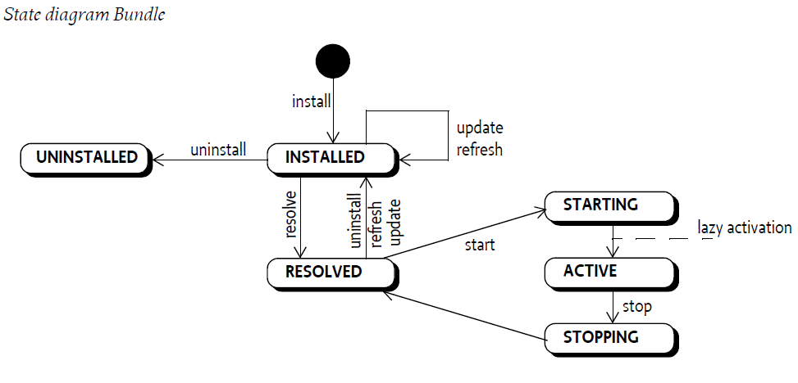
Run Time Aspects
3. Framework will check the bundle object if invoked by other bundle and run state mapping process
3
1.
2.
1. Framework will track the bundle when it started(Tracker Specification OSGi core 6.0)
2. Stop the bundle make it possible to be updated

Slide 11
Run Time Aspects
1. STOP old bundle
Old bundle go back to RESOLVED state
Block the invoking of bundle
Create bundle proxy to cache the invoking message
2. Update old bundle(core-6.0 p113)
Not allow the update until the current function call is returned.
Update bundle
Transfer the data to new version bundle
New bundle go to INSTALLED state
3. RESOLVE new bundle
New bundle go to RESOLVED state
4. START new bundle
New bundle go to ACTIVE state
5. Refresh new bundle(core-6.0 p161)
Stale wiring be cleaned up, the cached invoking message send to new bundle

