Slide 1
Lifecycle of bundle in OSGi

Slide 2
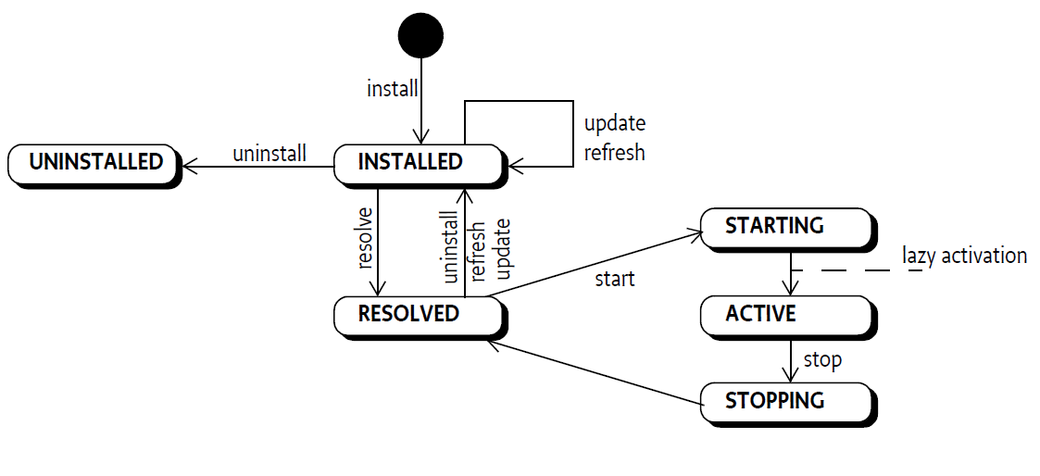
State diagram Bundle

Slide 3
Get a bundle’s state
The Bundle interface defines a getState() method for returning a bundle's state.
if ((b.getState() & (STARTING | ACTIVE| STOPPING)) != 0)
doActive()

Slide 4
Installing Bundles
The BundleContext interface defines the following methods for installing a bundle:
installBundle(String) - Installs a bundle from the specified location string (which should be a URL).
installBundle(String,InputStream) - Installs a bundle from the specified InputStream object.

Slide 5
Resolving Bundles
A bundle can enter the RESOLVED state when the Framework has successfully resolved the bundle's dependencies as described in the manifest.

Slide 6
Starting Bundles
The Bundle interface defines the start(int) method for starting a bundle and controlling the autostart setting.

Slide 7
Activation
A bundle is activated by calling its Bundle Activator object, if one exists.
The BundleActivator interface defines methods that the Framework invokes when it starts and stops the bundle.
start(BundleContext) –
stop(BundleContext)

Slide 8
Stopping Bundles
The Bundle interface defines the stop(int) method for stopping a bundle.
This calls the stop method when the bundle is in the ACTIVE state and sets the bundle's state to RESOLVED.

Slide 9
Deactivation
The BundleActivator interface defines a stop(BundleContext) method, which is invoked by the Framework to stop a bundle.
This method must release any resources allocated since activation.

Slide 10
Updating Bundles
update() - This method updates a bundle.
update(InputStream) - This method updates a bundle from the specified InputStream object.

Slide 11
Uninstalling Bundles
The Bundle interface defines the uninstall() method for uninstalling a bundle from the Framework.
This method causes the Framework to notify other bundles that the bundle is being uninstalled, and sets the bundle's state to UNINSTALLED.

Slide 12
Detecting Bundle Changes
The getLastModified() method will return the last time the bundle was installed, updated, or uninstalled.

Slide 13
Retrieving Manifest Headers
The Bundle interface defines two methods to return manifest header information: getHeaders() and getHeaders(String).

Slide 14
Loading Classes
The loadClass(String) method gives access to the bundle class loader. This method can be used to:
Load plugins from another bundle
Start an application model activator
Interact with legacy code
void appStart() {
Class initializer = bundle.loadClass(activator);
if ( initializer != null ) {
App app = (App) initializer.newInstance();
app.activate();
}
}

Slide 15
Access to Resources
The Bundle interface provides a number of methods that access resources but use different strategies.
Class Space
JAR File
Bundle Space

Slide 16
Permissions of a Bundle
hasPermission(Object)
Access to a Bundle's Bundle Context
getBundleContext()
Adaptations
adapt(Class)

